Slide 1

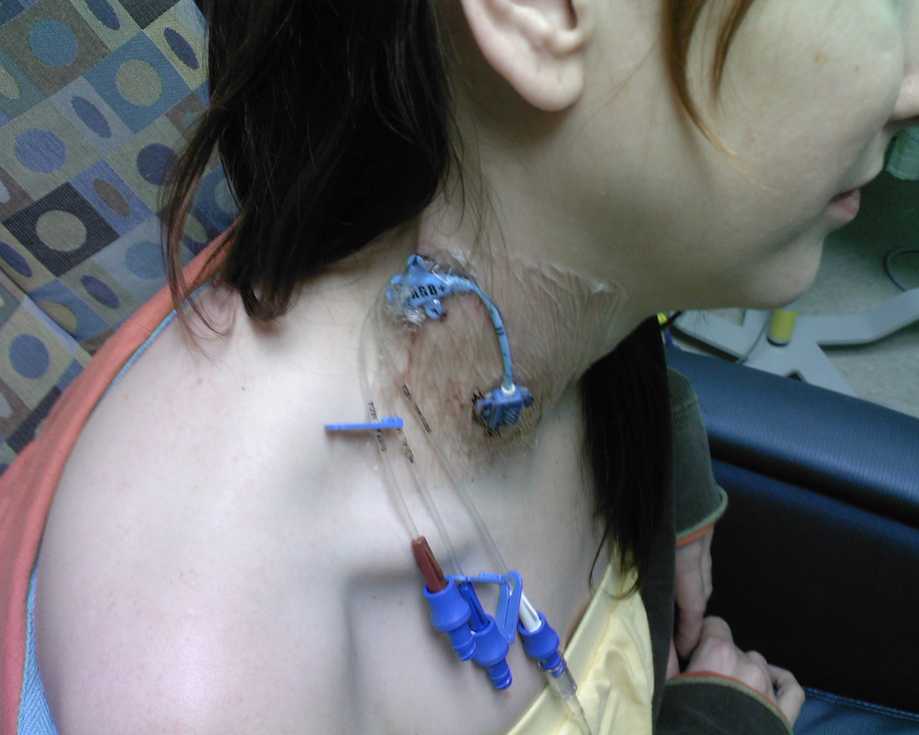

Evaluating the clinical and cost effectiveness
of educational interventions for preventing
vascular catheter bloodstream infections in critical care
Southampton
Health
Technology
Assessments
Centre
Geoff K Frampton¹, Petra Harris¹, Keith Cooper¹, Tracey Cooper², Jennifer Cleland³, Jeremy Jones¹, Jonathan Shepherd¹, Andrew Clegg¹, Nicholas Graves⁴, Karen Welch¹, Brian H Cuthbertson⁵
¹ Southampton Health Technology Assessments Centre (SHTAC); ² Department of Infection Prevention and Control, South London Healthcare NHS Trust; ³ Division of Medical and Dental Education, School of Medicine, University of Aberdeen; ⁴ Institute of Health and Biomedical Innovation, Queensland University of Technology; ⁵ Department of Critical Care Medicine, Sunnybrook Health Sciences Centre, Toronto
► BACKGROUND
Bloodstream infections (BSI) resulting from the use of intravascular catheters impose a burden on patients and health services, with annual costs to the NHS estimated at £19.1 to £36.2 million. These BSI are thought to be preventable using educational interventions to promote best practices in catheter insertion and ongoing care. However, guidance is lacking on which intervention types would be clinically effective and cost effective in NHS critical care units.
► RESULTS (2) – SYSTEMATIC REVIEW
Twenty four studies met the inclusion criteria of the systematic review. Risk of bias was difficult to assess due to poor reporting. Only one study was conducted in the UK (in Scotland), but it coincided with a national patient safety initiative, making the findings difficult to interpret.
Due to the heterogeneity of intervention types, meta-analysis was not appropriate, and a structured narrative synthesis was conducted instead. None of the controlled studies demonstrated clinical effectiveness (judged by statistical significance of their incidence density risk ratios). A number of interventions tested in single-cohort before-after studies appeared clinically effective (incidence density risk ratios for changes from baseline were significantly <1.0), but there was no clear indication that particular types of education or particular spatial or temporal scales of study were any more or less effective at reducing incidence densities of vascular catheter BSI. An exception is that single lectures in single critical care units appeared clinically ineffective. However, since data were mainly from uncontrolled studies, secular trends might have contributed to the observed results.
► OBJECTIVE
To provide a rigorous evaluation of the clinical effectiveness and cost effectiveness of educational interventions for preventing vascular catheter BSI in critical care units in England. Educational interventions were defined as interventions that included any method of information provision related to the prevention of vascular catheter BSI. They could include information provision alone or in combination with other practices (e.g. as in ‘care bundles’).
RESEARCH APPROACH
SYSTEMATIC SEARCHES in 15 databases for clinical effectiveness evidence, run in March 2011 and updated in March 2012; not limited by language
► METHODS
CLINICAL EFFECTIVENESS Characteristics of relevant primary studies were summarised in a descriptive map. Based on the map, inclusion criteria for a systematic review were developed to prioritise studies most relevant for informing current NHS practice. This process was conducted in consultation with stakeholders including critical care nurses and infection prevention staff. Clinical effectiveness outcomes from the systematic review were used to inform an economic evaluation based on a Markov model (see Research Approach, right).
ECONOMIC EVALUATION The economic model compared the costs and consequences of an educational intervention for the prevention of vascular catheter BSI against current clinical practice that did not include an educational intervention. The intervention simulated evidence-based infection prevention approaches similar to the ‘Matching Michigan’ programme which was a relevant intervention in English NHS trusts administered by the former National Patient Safety Agency during 2009-2011.
Inclusion criteria
Population – critical care patients with ≥1 intravascular catheter
Intervention – educational approaches for preventing vascular catheter BSI (education defined broadly to include any type of information provision)
Comparator – no intervention
Outcomes – incidence density of vascular catheter BSI; mortality
► RESULTS (3) – ECONOMIC EVALUATION
An estimate of clinical effectiveness for the economic model was obtained from an educational intervention similar to Matching Michigan that was identified in the clinical effectiveness systematic review (the ‘CLAB ICU’ project in Australia). The relative risk for vascular catheter BSI used in the model was 0.4 (95% confidence interval 0.22-0.67) for the change from baseline in this single-cohort study.
Model results showed that an educational intervention would prevent 0.8 vascular catheter BSI and save 0.3 lives per 100 patients admitted to critical care compared to current clinical practice, and lead to an increased survival of 3.55 years and 2.72 quality-adjusted life years. Various types of educational intervention could be more effective and less costly than current clinical practice, largely as a result of the savings from the reduced length of critical care stay.
Results of the model are robust to a range of sensitivity analyses, which explored variation in the degree of implementation of an intervention, variation in current clinical practice, and variation in the incidence density of vascular catheter BSI. At the least favourable parameter values tested an educational intervention would no longer be cost-saving, but the incremental cost effectiveness ratio would remain below the threshold conventionally considered as cost effective.
► EVIDENCE MAP (= 74 STUDIES)
Stakeholder-aided refinement of the inclusion criteria for relevance to NHS practice
Further inclusion criteria
Population – adults
Outcome – infection definition must have been reported
Design – prospective studies
► RESULTS (1) – EVIDENCE MAP
Seventy-four primary studies met the inclusion criteria for the descriptive map. Most studies were conducted in the USA (65%), Spain (10%) and Brazil (7%), with only two relevant studies conducted in the UK. Studies involved a wide range of spatial and temporal scales with diverse types of intervention, ranging from individual short lectures in single critical care units to multi-year regional-scale interventions including continuous quality improve-ment (CQI) approaches in over 100 critical care units. Nearly all studies employed uncontrolled before-after designs, with only two RCTs included (neither set in the UK). Although used as the basis of the economic model, the Matching Michigan intervention in England did not meet the inclusion criteria for the evidence map, since relevant infection incidence density outcomes were (pending publication) not available.
► SYSTEMATIC REVIEW (= 24 STUDIES)
Clinical effectiveness evidence
SYSTEMATIC SEARCHES for costs and cost-effectiveness evidence
► CONCLUSIONS & DISCUSSION
Educational interventions appear promising for preventing vascular catheter BSI in critical care units and could be potentially cost saving. However, there is a need to improve the rigour of the primary studies of clinical effectiveness so as to improve confidence in the economic evaluation. Our updated searches of the literature indicate that primary research on educational approaches for preventing vascular catheter BSI is an active area of interest (updating the evidence map after 12 months would add a further 18 studies – an increase of 24%). There is a need to ensure that this growth in the primary research evidence does not continue to depend on uncontrolled single-cohort studies.
► ECONOMIC EVALUATION (decision analytic Markov model; UK NHS perspective, followed NICE standard approach)
ACKNOWLEDGEMENTS This work was funded by the NIHR HTA Programme (project number 09/01/25). The views expressed in this poster are those of the authors and not necessarily those of the NIHR HTA Programme or the Department of Health.
FURTHER INFORMATON Corresponding author:
Dr Geoff Frampton; e-mail: gkf1@soton.ac.uk
www.southampton.ac.uk/shtac

