Slide 1


DepositMOre: Applying tools to increase full-text content in institutional repositories
Steve Hitchcock, Tim Brody, JISC DepositMOre Project
ECS, WAIS, University of Southampton
#rspevent, Increasing the full-text deposits in your institutional repository, London, 12 June 2013

Slide 2
In this talk …
What’s mine is yours, what’s yours is mine - sharing ‘full-text’ content between repositories and services?
DepositMO user tools and SWORDv2 (recap)
DepositMOre repository tools
DepositMOre repositories
Roles for repositories. Is MOre content the primary target?

Slide 3



DepositMO
Impenetrable acronym – changing the Modus Operandi of repository deposit
June 2010 – Jan 2012
DepositMOre
Self-explanatory goal – getting more stuff into your repository
Sept 2012 –
Mar June 2013
to

Slide 4

Credits and acknowledgements
PI: Les Carr
Development: Tim Brody, Dave Tarrant
MOre repositories and ‘depositors’
  University for the Creative Arts: Anne Spalding
  Goldsmiths: James Bulley
  Leeds: John Salter
  Glasgow: William Nixon
  Southampton (archaeology): Gareth Beale, Hembo Pagi, Graeme Earl
: Me

Slide 5
Why SWORD?
Simple Web service Offering Repository Deposit
SWORD (2007) single interface, deposit in multiple repositories. ‘Fire and forget’.
SWORDv2 (2012) items can be created, updated, replaced, or deleted (CRUD).
SWORDv2 endpoints built into current versions of EPrints (3.3) and DSpace (3.1)

Slide 6
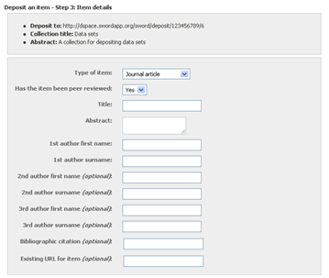
SWORD deposit interface
Facebook SWORD client
http://blog.stuartlewis.com/2009/06/02/how-does-the-facebook-sword-client-actually-work/

Slide 7
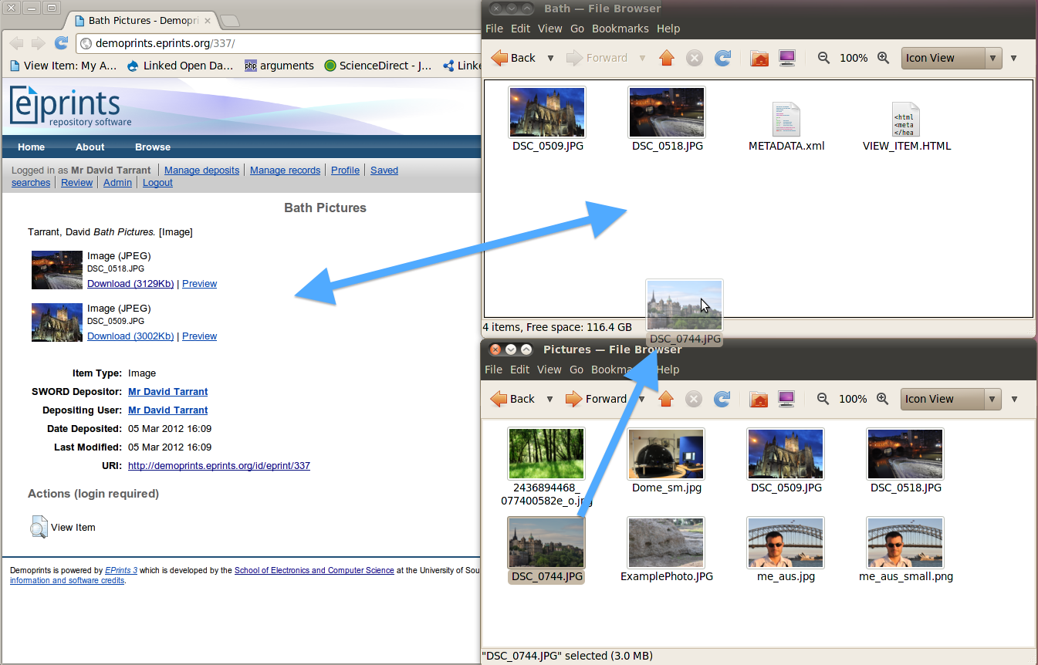
Watch Folder – a file manager-based deposit interface

Slide 8
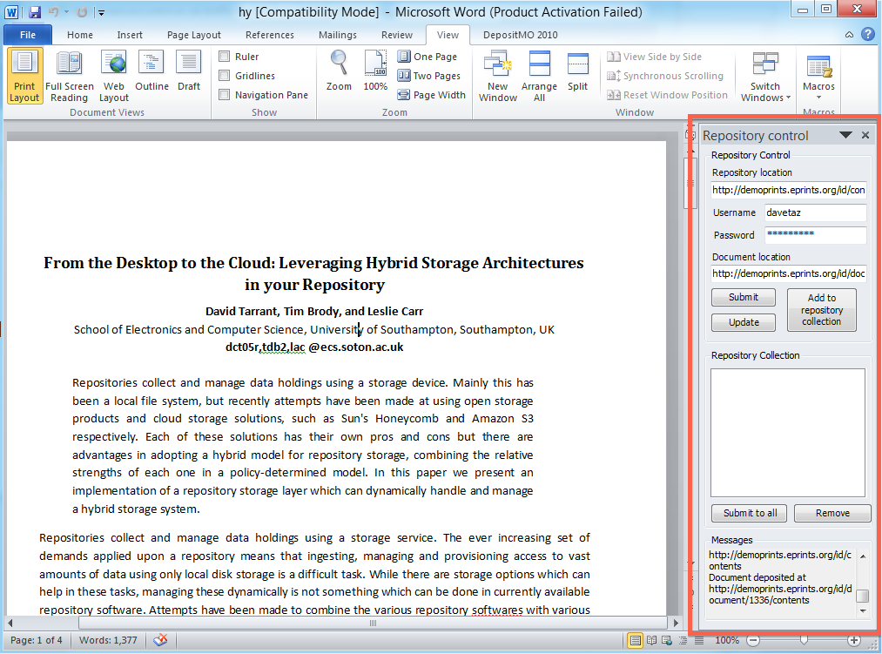

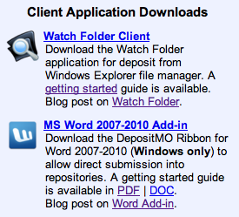
Word Add-in deposit client
http://www.eprints.org/depositmo/

Slide 9

DepositMO/re tools
MO MOre
Watch Folder: extending the user interaction model for intelligent bulk ingest to deal with 100s of documents, involving original user testers from within arts and archaeology, communities that generate large volumes of non textual digital objects.
✓
✓
Word add-in: impact of a content creation tool on deposit rates will be less immediate.
✓
X
EasyChair Deposit Tool, lists a user’s authored items in Easychair, which hosts over 15,000 conferences. The tool checks if these items are present in the user’s selected repository. Any that have not been deposited can be added with one click.
X
New
Enhancing and testing repository deposit interfaces, OR12, http://eprints.soton.ac.uk/340997/

Slide 10
Choice of content targets
EasyChair – conference papers
Microsoft Academic Search
Europe PubMed Central (RJ Broker – EDINA)
arXiv
YouTube/Vimeo – video
Archaeology image generators (PTM)

Slide 11

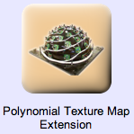
MOre repositories: chosen tools
  UCA
  Goldsmiths
  Glasgow
Leeds
Southampton (archaeology)

Slide 12

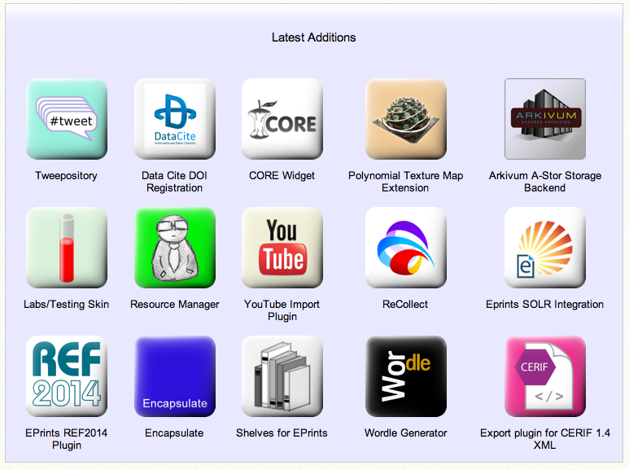
5 June 2013

Slide 13
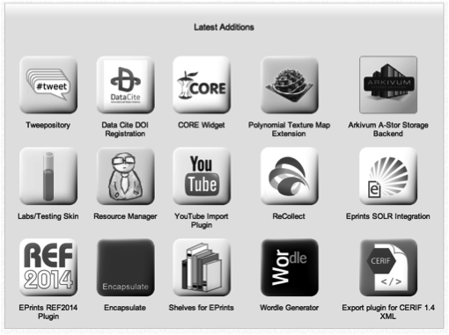
Apps by

Slide 14
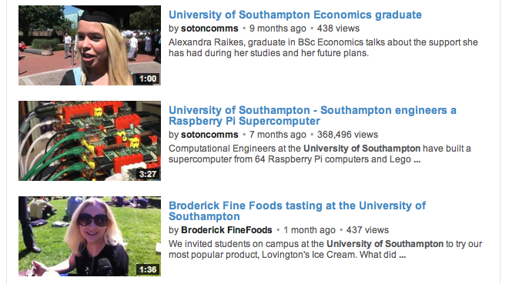
Southampton University on YouTube

Slide 15
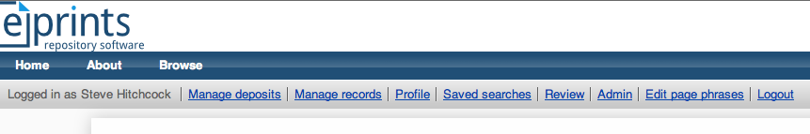
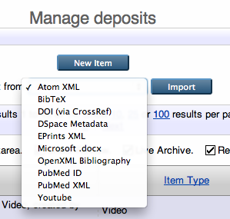
Importing YouTube video to EPrints

Slide 16
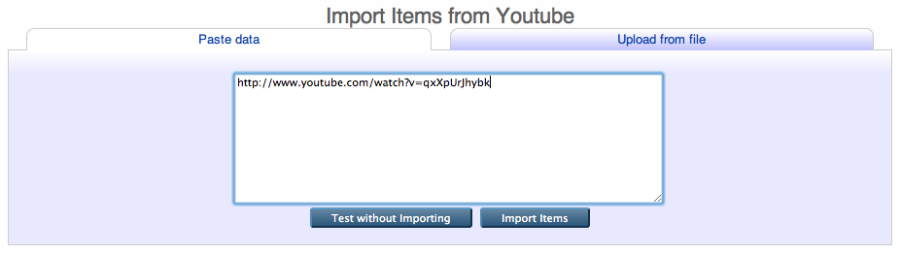
Importing YouTube video: paste URL

Slide 17
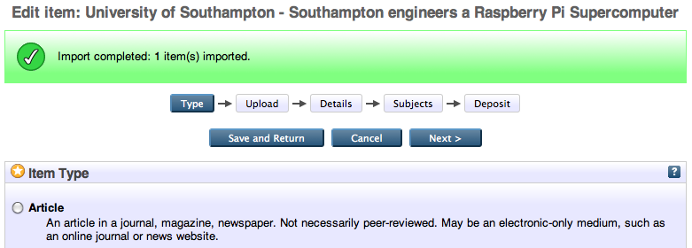
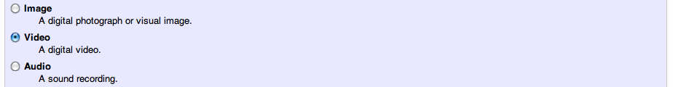
Importing YouTube video: item type auto-identified

Slide 18
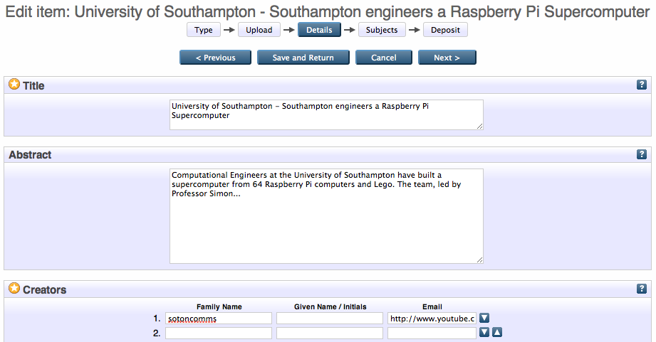
Importing YouTube video: simple metadata auto-added

Slide 19
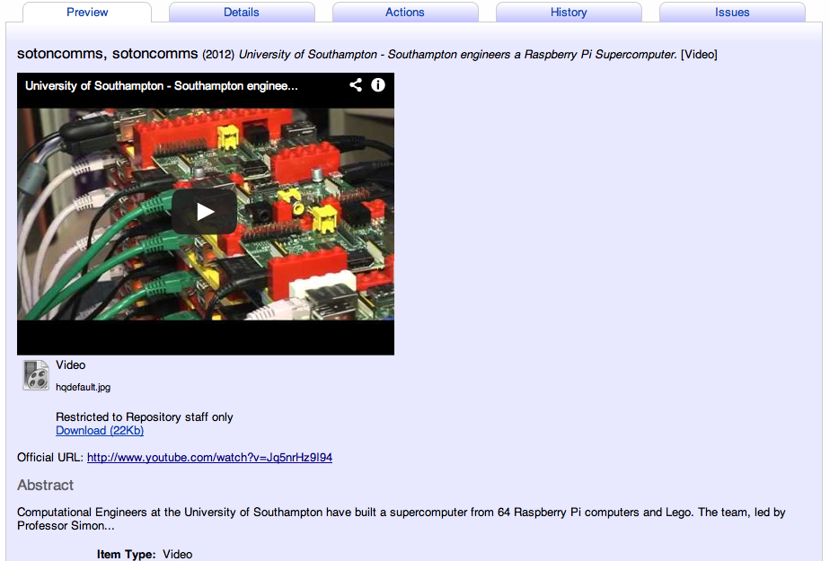
Importing YouTube video: done

Slide 20
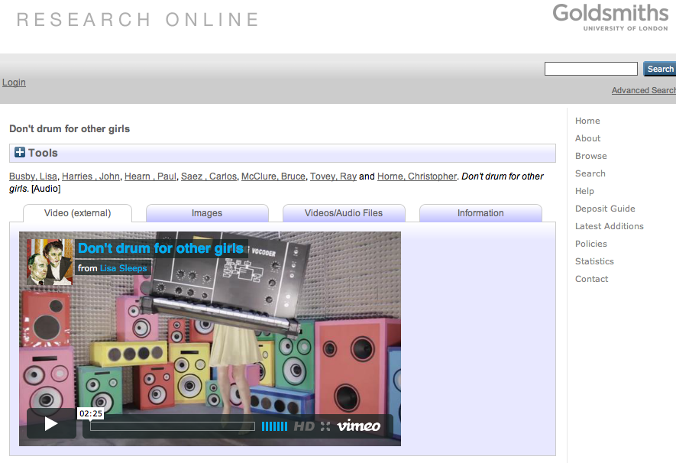
Vimeo video deposited in GRO
http://eprints.gold.ac.uk/8284/

Slide 21
Feedback from UCA on video tool
One good example Andy Joule Annimilus http://www.research.ucreative.ac.uk/1270/1/Annimilus.mov
showed our VC and two deans UCA Research Online record which included an imported video using the import tool for vimeo and they were very happy at the way in which the video played immediately from the repository.
There is however at least 15-20 further items that could be added
The benefits are likely to be ease of use of importing the films, and increased visibility and discoverability.
works in Firefox but not on IE. I understand that the issue might well be resolved on EPrints 3.3. we are on v3.2.
it would be useful to use the tool to upload additional information to existing records.
Anne Spalding, Mar-Apr 2013

Slide 22
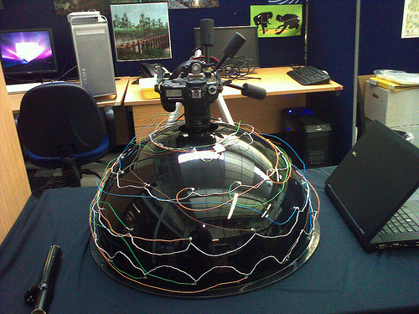
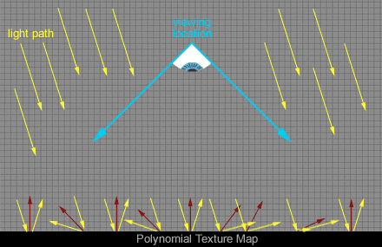
Polynomial Texture Mapping (PTM)/Reflectance Transformation Imaging (RTI)
http://www.flickr.com/photos/chough/3969335698/
Reflectance Transformation Imaging (RTI) http://culturalheritageimaging.org/Technologies/RTI/
Processing output formats
  Camera-raw -> digital negatives -> JPEG (for processing) -> RTI (using RTI Builder) -> PTM archive
Archaeological applications of polynomial texture mapping: analysis, conservation and representation http://eprints.soton.ac.uk/156253/

Slide 23
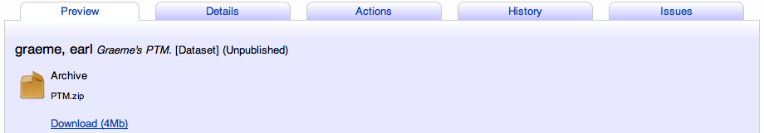
Unzipping a PTM archive: unaided
EPrints 3.3 test server – no PTM app

Slide 24
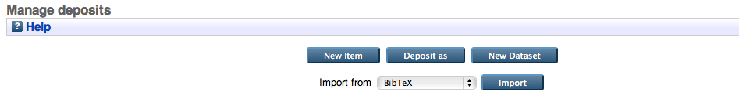
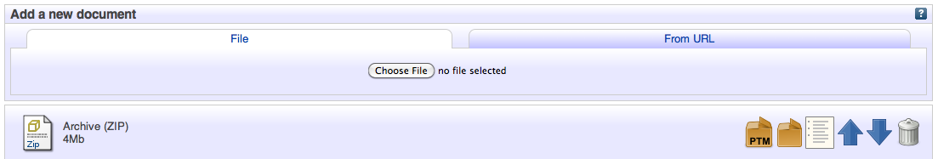
Unzipping a PTM archive: with a research data app and the PTM app
EPrints 3.3 test server – with ReCollect data deposit app and PTM app

Slide 25
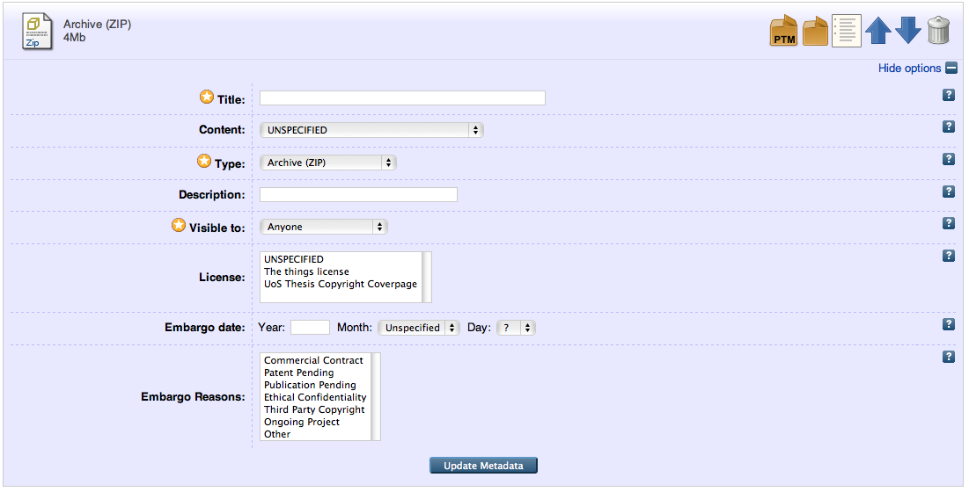
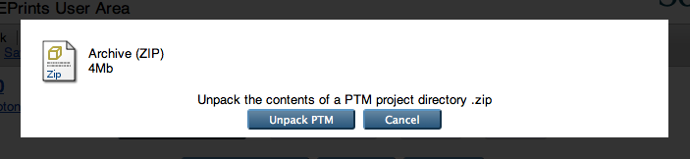
Spotting PTM unzip tool

Slide 26
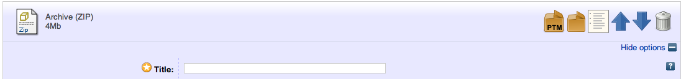
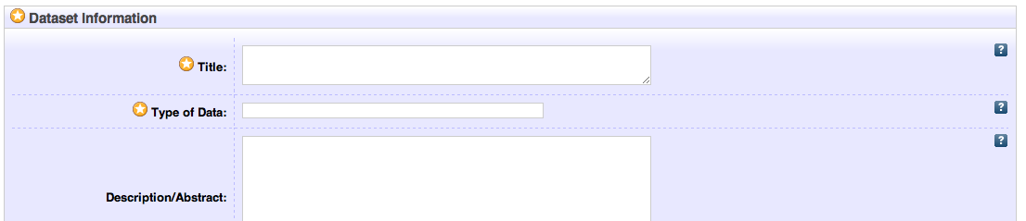
Unzipped: 3 files (it could be 80!)

Slide 27
Users’ views on EPrints PTM app
The system is almost there. There are some usability issues, but I guess most of them are related with the eprints itself, not the ptm app. The final unzipped content page needs a bit of work, as at the moment you cannot access original files one by one, only by downloading whole zip.
I think the main benefit of this system will be when actual XML file can be used to get all the metadata and have all the form fields prefilled. Sadly those XMLs do not exist yet but can be automatically generated, which we will. At the moment there are too many steps from upload to deposit.
We've started to collect data tho, and it will be a massive task (I think we have almost 1000 entries) which I think requires bulk upload functionality
Hembo Pagi, Southampton archaeologist
It would be ideal if the ingestion process stripped out the thumbnail and showed that on the archive page and then elsewhere on the page showed the snapshots, perhaps in a gallery view.
Graeme Earl, Southampton archaeologist

Slide 28
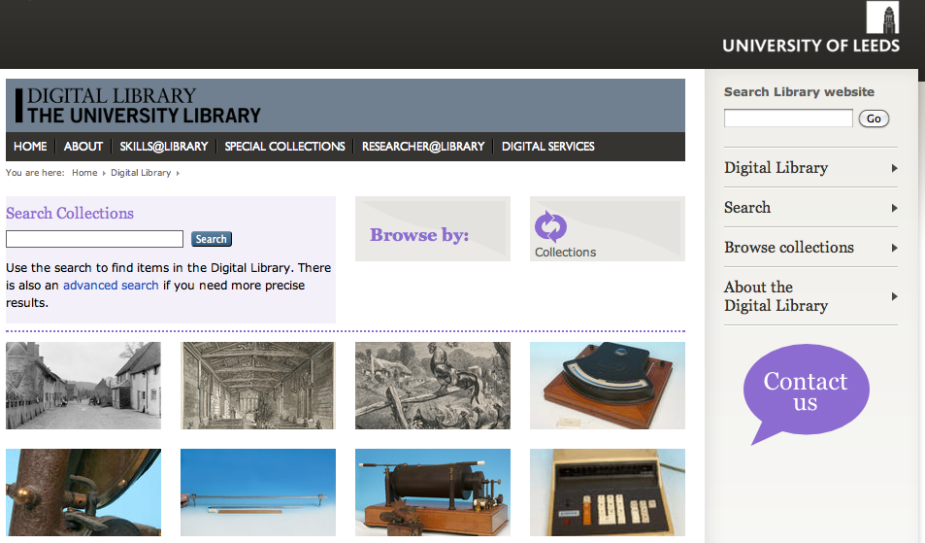
New Digital Library at Leeds
Based on the EPrints platform …
will be producing a large number of digital objects, mainly contained in folders that represent the object being digitised, e.g. several TIFFs representing individual pages of a manuscript would be held in one directory. For this 'bulk' style work, the Watch Folder script seemed like a good place to start, but...

Slide 29
Changing workflows at Leeds DL
… our process for adding the digital objects to the repository is changing from an almost linear:
Request -> Digitise -> Enhance (e.g. crop) -> Save -> Deposit -> Catalogue
to something more like:
Request -> Digitise -> Enhance -> Save ------------\
\-> Catalogue (including checking copyright) -> Deposit

Slide 30
Roles for repositories
Large content collections (MOre content)
Open access papers
Research outputs and data
Metadata aggregators and QA
Preservation and grey lit (Finch)
…

Slide 31
Roles for repositories: the new world
End of the great JISC repository era
Friend: “second-class status being given to repositories by Government and other Establishment agencies in the UK”
Finch-RCUK preference for gold open access
PLoS ONE, PeerJ preprints …
Bjork: “slowing growth” of subject repositories
Vs ResearchGate, academia.edu?

Slide 32
Roles for repositories: workflow
Workflow
  Workflow
  Workflow
Identify role and USP, then construct, review, test ________ to attract MOre deposit (at scale), and provide more user benefits, for less work

Slide 33
Useful contacts
Twitter: @depositmo
Blog http://blog.soton.ac.uk/depositmo/
Web downloads http://www.eprints.org/depositmo/
EPrints Bazaar http://bazaar.eprints.org/
Email sh94r@ecs.soton.ac.uk

