Slide 1
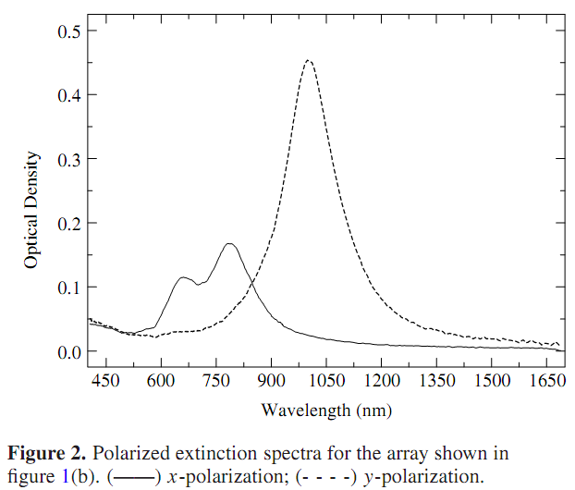
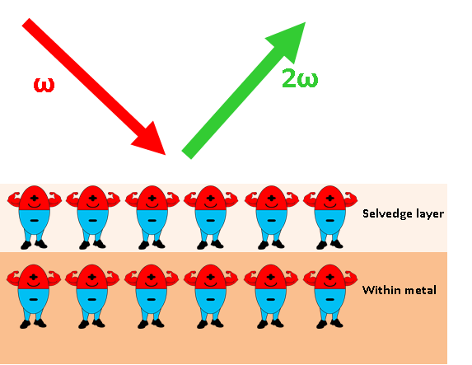
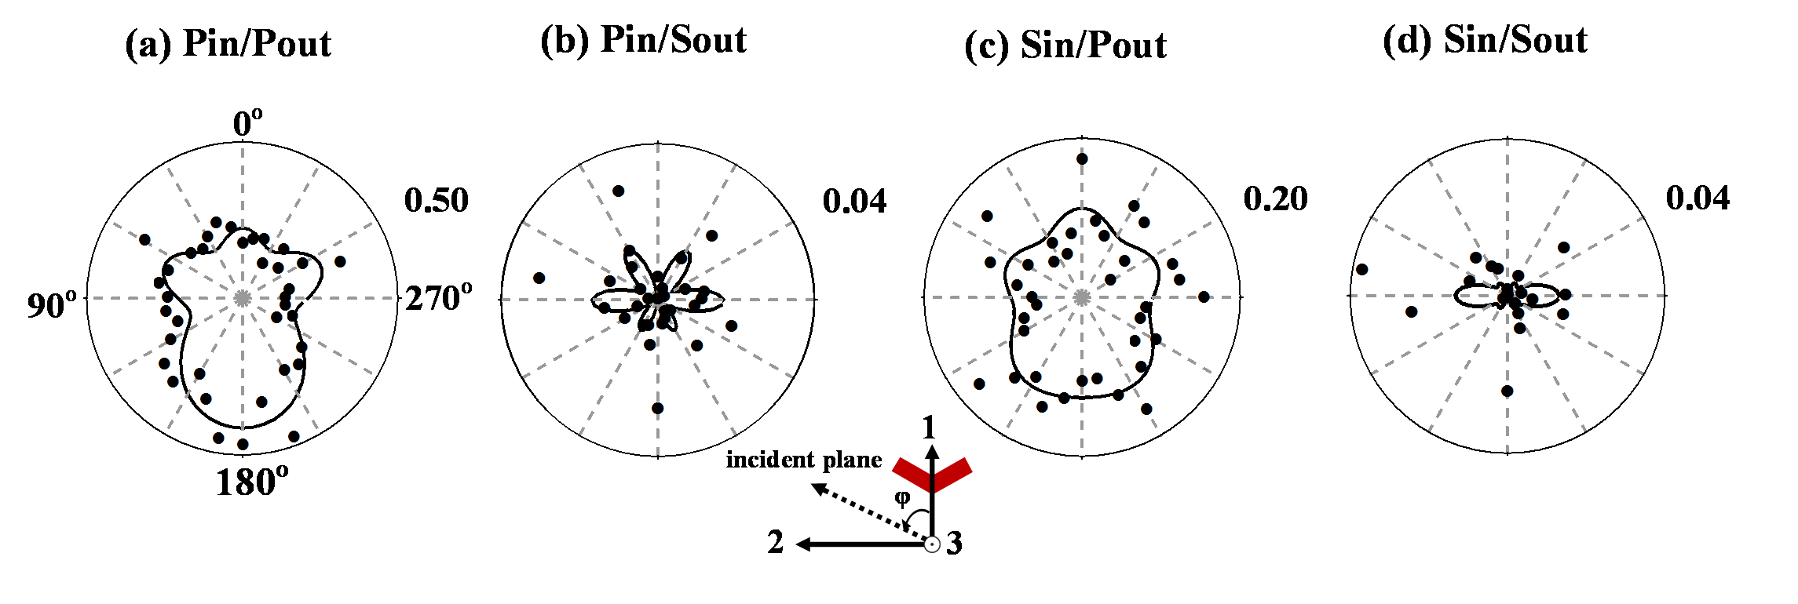
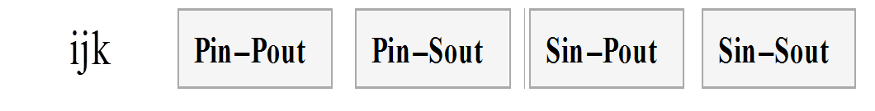
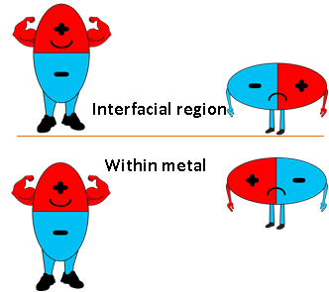
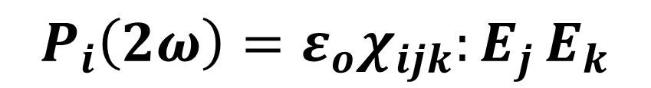
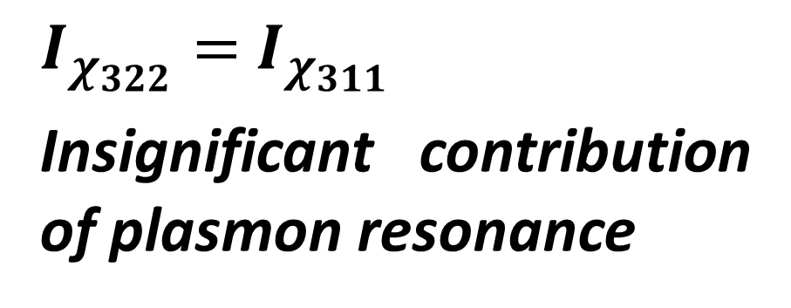

Optical second harmonic generation from V-shaped chromium nanohole arrays Ngo Khoa Quang¹, Yoshihiro Miyauchi¹, Goro Mizutani¹, Martin D.Charlton², Ruiqi Chen², Stuart Boden², and Harvey Rutt²
¹School of Materials Science, Japan Advanced Institute of Science and Technology, 1-1 Asahidai, Nomi, Ishikawa 923-1292, Japan ²School of Electronics and Computer Science, University of Southampton, SO17 1BJ, UK
Introduction
Nonlinear optics of metamaterial
Plasmon resonance
Plasmon resonance of Cr from nonlinear optical standpoint?
Enhancement of SHG signal from the disordered circular gold nanoholes compared with the periodic one.
Plasmon resonance depends on the orientation of the nanostructures.
V-shaped holes exhibits a noncentrosymmetry structure
M.Airola et al. J. Opt. A: Pure Appl. Opt. 7 118 (2005)
B. K.Canﬁeld et al., J. Opt. A: Pure Appl. Opt. 8, 278 (2006)
$$P_{i}\left(2ω\right)=ε_{o}χ_{ijk}:E_{j }E_{k}$$
Enhancement of SHG signal from the disordered circular gold nanoholes compared with the periodic one.
Sensible observability
for a surface plasmon resonance of Cr < 0.1
nm
Centrosymetry is broken at the surface
Lesufﬂeur et al., Phys. Rev. B. 75, 045423 (2007)
J. R. Sambles et al., Contemp. Phys. 32, 173 (1991)
Surface SHG is employed to probe plasmon excitation.
Objective
Survey plasmon resonance of the V-shaped chromium nanohole arrays from second order optical standpoint
e-beam lithography & AFM observation
15nm Cr
JBX-9300FS Electron Beam Lithography System
Evaporation of Cr
e-beam exposure
100 keV acceleration voltage
200 pA beam current
dose of 150 µC/cm²
V-shaped area of 100 µm²
40nm resist
e-beam resist
Dry etching
Remove remaining resist
Designed parameters
AFM observation
SHG signal from V-shaped subwavelength nanoholes
Conclusion
Correlation coefficient
r = 0.8
r = 0.3
r = 0.5
r = 0.4
The appearance of χ ₃₁₃ proves that SHG signal actually reflects V-shaped nanoholes.
We have considered several competing contributions with respect to the behavior of χ₃₁₃, which are bulk quadrupoles, lightning rod effect, plasmon exciation, and edge nonlinearity.
$I_{χ_{322}}=$ $I_{χ_{311}}$ implies an insignificant plasmon excitation.
The appearance of χ₃₁₃ proves that SHG signal actually reflects V-shaped nanoholes.
Enhancement
Cancelation
Future plan
The change of periodicity or designed parameters could hopefully support the grating coupler for plasmon resonance.
$I_{χ_{322}}=$ $I_{χ_{311}}$
Insignificant contribution of plasmon resonance
Reference
No field enhancement at the sharp apex
Image dipole effect
at the metal surface
M. Omote et al., J. Phys.: Condens. Matter. 17, 175 (2005).
Contact
Field enhancement at the sharp apex does not occur in terms of nonlinear optics as well.
-Mail address: Mizutani Laboratory, School of Materials Science, 1-1 Asahidai, Nomi, Ishikawa 923-1292 Japan
-Phone: +81-761-51-1521
-E-mail: mizutani@jaist.ac.jp
Mutual cancellation at the aperture edge surfaces

