Slide 1
Collaboration and Networking between schools
Daniel Muijs, Southampton Education School

Slide 2
School Improvement
Different types of school improvement:
Government/LA imposed (e.g. National Literacy Strategy)
Government/LA supported (e.g. EAZ)
External programme bought in by school (e.g. IQEA)
School develops own programme
Collaboration between schools

Slide 3
Networking in education
Networking and collaboration have become increasingly popular in education
Large number of programmes in the UK and internationally recently
Networking has also gained popularity in the private sector due to increased competition and need for innovation

Slide 4
Definitions
Network = at least two organisations working together for a common purpose for at least some of the time.
Collaboration = joint activities between actors from different organisations within the network.

Slide 5
Why network
Many glib statements supporting collaboration, but these are often more ideological than empirically based
This presentation:
What is the theoretical justification?
What is the empirical evidence?

Slide 6


Slide 7
Theories of networking
Theoretical groundings for networking can be classified as:
Constructivist organisational theory
Social Capital theory
New Social Movements
Durkheimian network theory

Slide 8
Goals and activities
Networking is not just about improving performance
Three main goals:
Raising achievement
Broadening opportunities and reach
Building capacity (human and material resources)

Slide 9
Goals and activities
Activities can be aimed at
Short term
Medium term
Long term

Slide 10
Goals | Activities
 | Short term | Medium term | Long term
School Improvement | Partner school shares system to target D/C borderline pupils | School leaders support each other by sharing data and openly discussing approaches to school development. Leaders are available for support when necessary | Schools develop joint accountability systems, collegial leadership approaches and sustained support networks that draw in any new leaders in the network
Broadening opportunities | Partner schools put on a joint exam preparation day | Partner schools develop some shared courses, offering specific vocational courses in each partner schools to all pupils in the partnership | Partner schools develop joint curriculum planning system, with development done collaboratively
Sharing resources | Teacher brought in from other school for cover | Teachers regularly help out in other network schools, with swapping and peer teaching common | Joint appointments made to the network, schools collaboratively plan recruitment and succession

Slide 11
Characteristics of networks
Voluntarism or coercion
Power relations
Network density
External involvement
Different time frames
Geographical spread
Vertical or horizontal
Density of schools

Slide 12
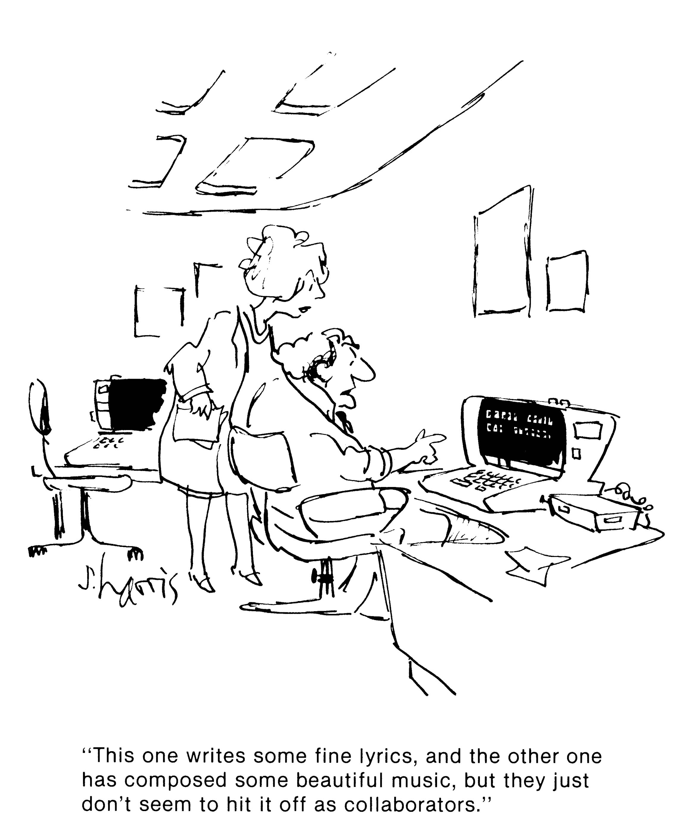
Notes:
12

Slide 13
Benefits
These theories point to benefits from networking, but what is the evidence?
We will look at three areas:
Raising achievement
Broadening opportunities and reach
Building Capacity (Human and Material resources)

Slide 14
Can networking and collaboration Raise Achievement?
Evidence from qualitative studies:
CUREE (2005): systematic review
Positive impact on pupils in 9 out of 14 studies
Positive impact on teachers in 11 out of 14
Evidence of impact from a range of programmes (e.g. Chapman & Allen, 2004; Ainscow et al, forthcoming, Muijs et al, forthcoming)

Slide 15
Can networking and collaboration Raise Achievement?
Evidence from quantitative studies
Evidence from Curee (2005) systematic review
Impact on specific groups of pupils, such as those with special needs
Overall impact not clear
Patchy impact of Networked Learning Communities (Hadfield, 2006)

Slide 16
Can networking and collaboration Raise Achievement?
Evidence from quantitative studies
Some evidence that collaboration with other agencies can narrow achievement gaps (Cummings et al, 2008; Van Veen et al, 1998)
Some evidence that specific forms of collaboration may raise achievement (Muijs, 2008)
Stronger school paired with weaker schools, but not others

Slide 17
Can networking and collaboration Raise Achievement?
Little strong causal evidence
But: evidence of specific forms of collaboration having specific impacts
Need for more quantitative studies

Slide 18
The impact of Federations
National Pupil and School Datasets from 2001 onwards
As no list exists, 50 LA’s contacted
264 schools and 122 Federations were identified
Matched sample drawn
Multilevel models

Slide 19
Typology of Federations
Cross-Phase Federations
Performance Federations
Size Federations
Faith Federations
Mainstreaming Federations
Academy Federations

Slide 20
Do Federation schools outperform comparators?
Year | 03 | 04 | 05 | 06 | 07 | 08 | 09 | 10
2004 cohort |  |  |  |  | X |  | X
2005 cohort | N |  |  |  | X | X | X | X
2006 cohort | N | N |  |  |  |  | X | X
2007 cohort | N | N | N |  |  |  | X | X
2008 cohort | N | N | N | N |  |  |  | X

Slide 21
How much difference do they make?
Cohort/Year | 2007 | 2008 | 2009 | 2010
2005 cohort | 11.4 | 17.1 | 22.6 | 34.4
2006 cohort |  |  | 26.4 | 29.5
2007 cohort |  |  | 30.9 | 35.7
2008 cohort |  |  |  | 27.5

Slide 22
What kind of collaboration?
Performance Federations – strong school works with one of more weaker ones
Academy Federations

Slide 23
Co-construct improvement around individual school needs
Networking can foster knowledge creation (Katz & Earl, 2007)
Can generate new knowledge (Ainscow & West, 2006)
Reinventing the wheel?
Can networking and collaboration Help Build School Capacity?

Slide 24
Evidence that collaboration can help break isolation of schools (Harris, 2005; Datnow et al, 2003)
Pooled resources lead to greater CPD opportunities and allow external support to be bought in (Muijs, 2008)
Sharing of good practice, though actual extent of this varies (Imitation!)
Can networking and collaboration Help Build School Capacity?

Slide 25
Overall, there is qualitative evidence of potential for capacity building, though it is not always realised
Can networking and collaboration Help Build School Capacity?

Slide 26
Can networking and collaboration Help Broaden Opportunities and Reach?
Pooled resources allow broader curriculum provision (Muijs, 2008)
Collaboration with other agencies allows greater resources to address community and social needs (Cummings et al, 2008)
Does this reduce focus on core goals?

Slide 27
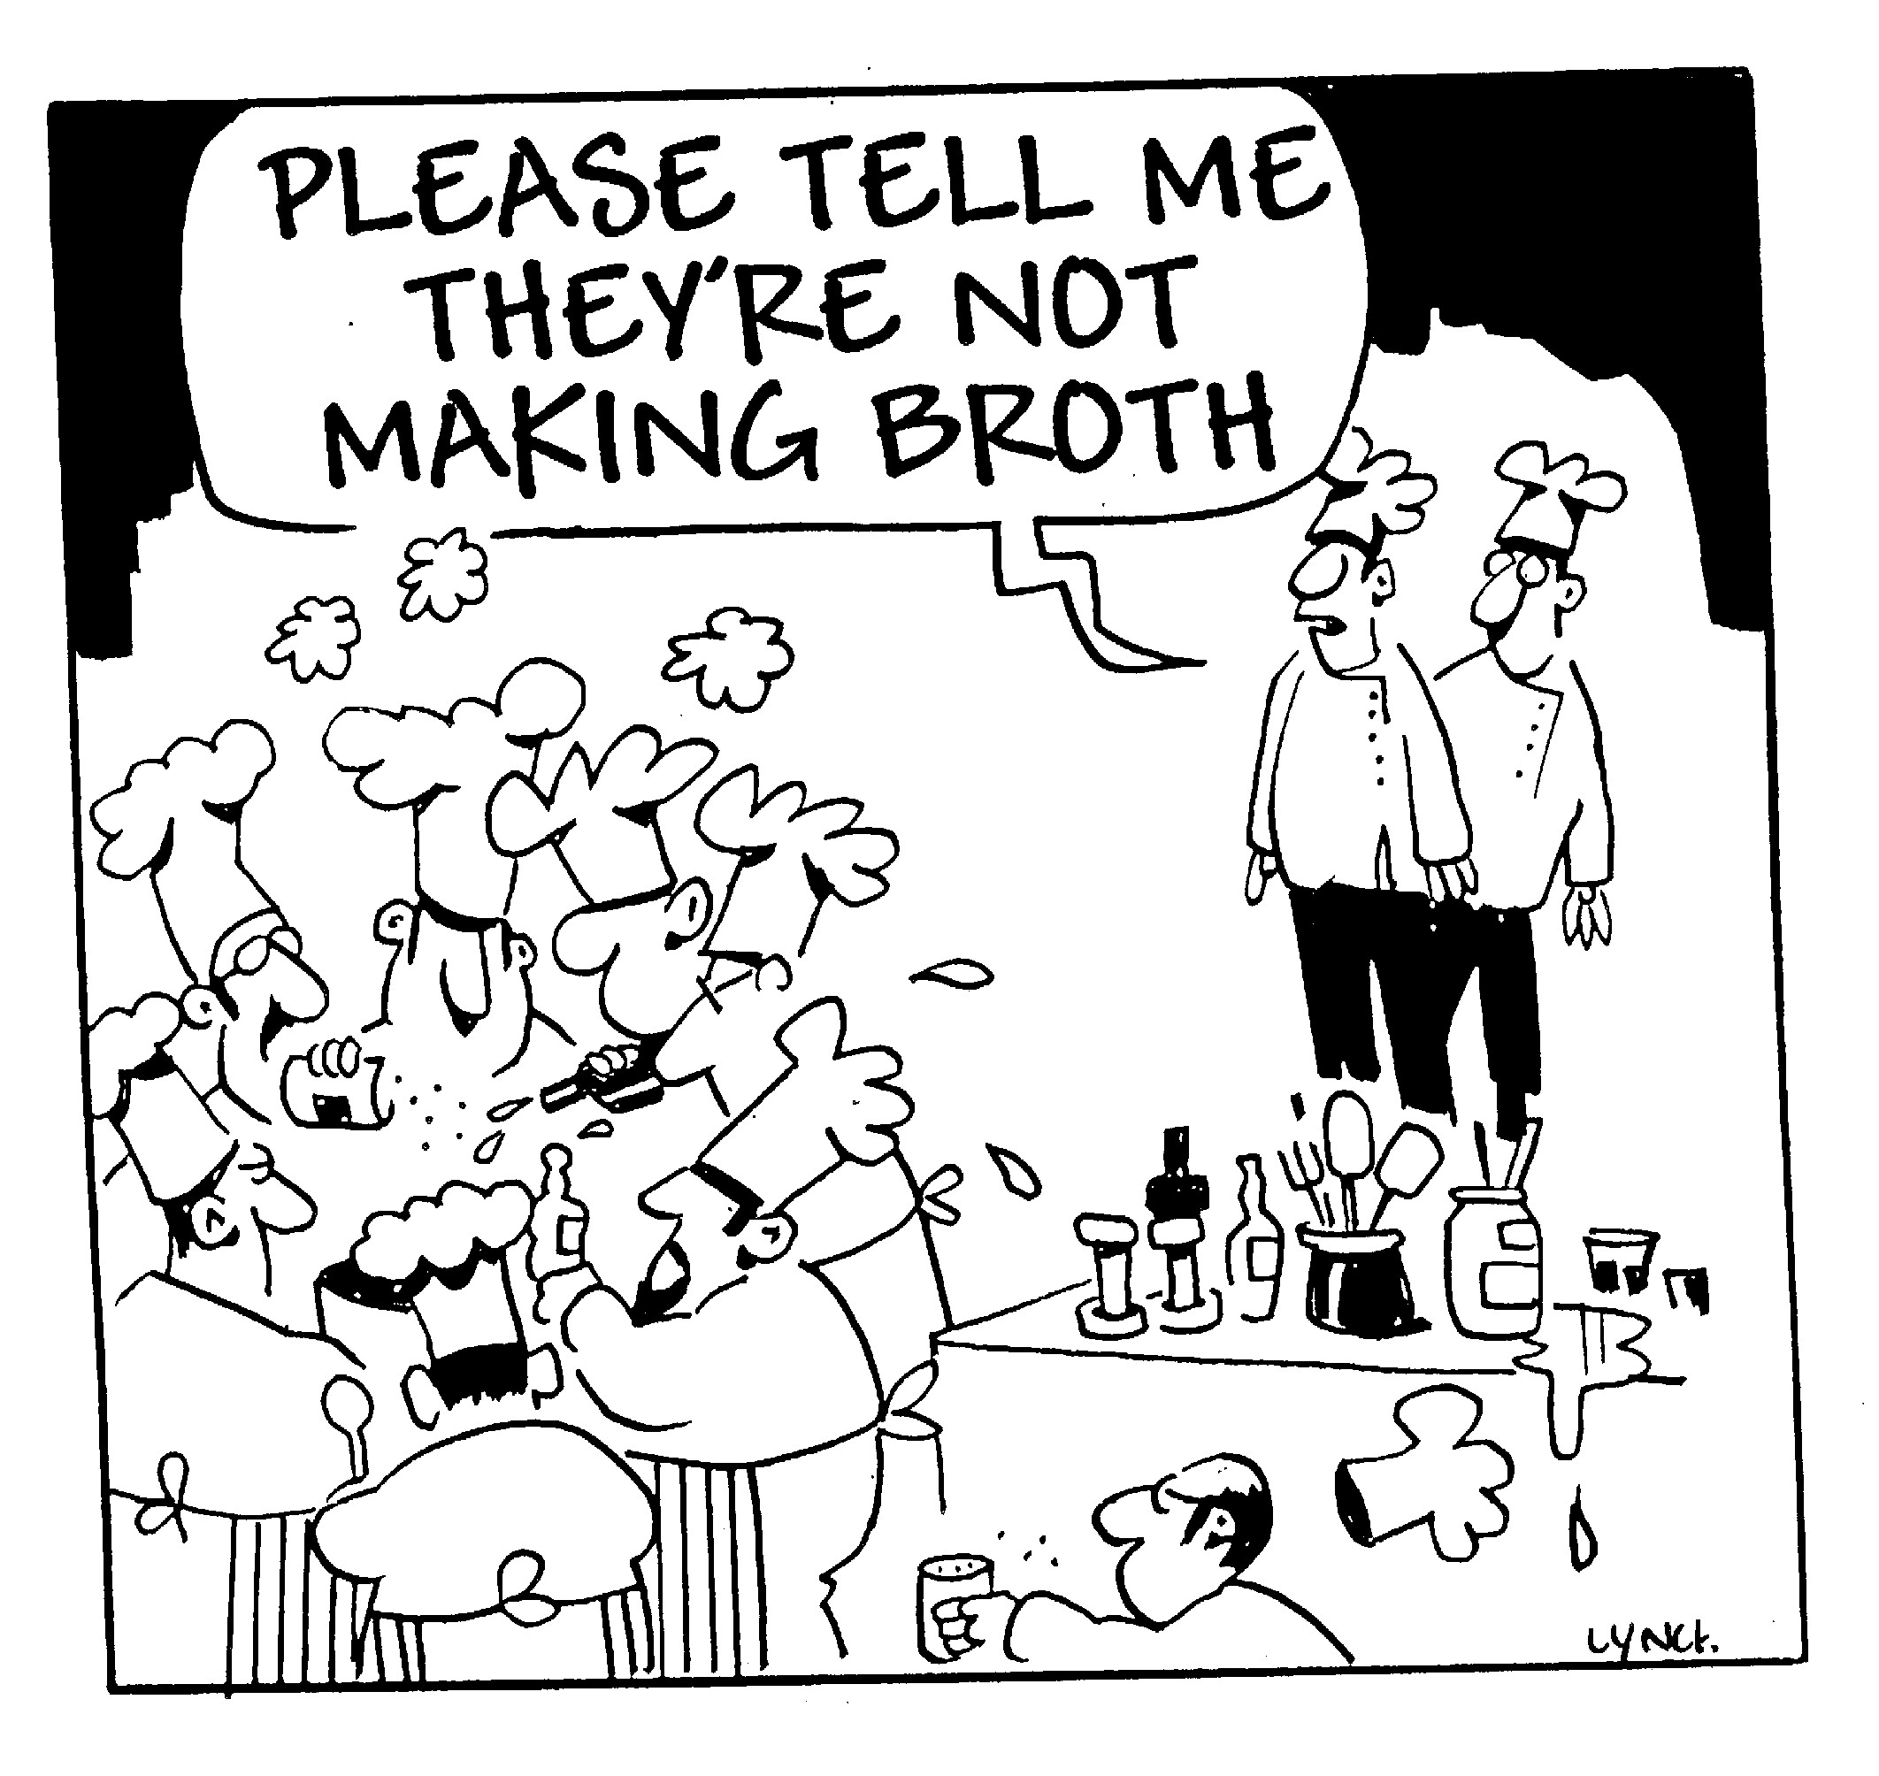

Slide 28
The impact of networking
Evidence that networking
Can broaden provision
Can lead to better use of resources
Can lead to better provision for specific groups
Can lead to improved pupil achievement

Slide 29
Collaboration and competition
Many education systems have set up a competitive environment
Does this preclude competition?

Slide 30
The ‘educational orthodoxy’
Stevenson (2007): successful collaboration ‘probably wouldn’t have worked in more competitive environment’
Hargreaves, L. (1996): collaboration is ‘a strong force to combat competition’
The two seen as oppositional

Slide 31
Evidence
There is evidence for the effectiveness of collaboration (Muijs et al, 2011)
There is also some evidence for positive effects of competition (Muijs, 2011)
There is evidence that in practise both co-exist

Slide 32
Coopetition
A relationship between two companies involving competition in some segments and cooperation in others
Happens frequently in business
Can increase
knowledge creation
innovation
resilience

Slide 33
Characteristics of coopetition
Grow the market, then compete for the spoils
Importance of complementors
Importance of proximity to market

Slide 34
Coopetition
Conditions apply:
Reciprocity (benefit for benefit)
‘Altruistic punishment’ (Fehr & Gachter, 2002)
Trust
Careful development of a relationship
Clear goals
Brokerage
Leadership skilled at managing tensions (schools?)

Slide 35
Coopetition
Evidence of effectiveness in a variety of setting, e.g.:
Bio-industry (Garcia & Velasco, 2002)
Health (Gee, 2000)
ICT (Sundali et al, 2006)
Also in education:
Lomax & Darley (1995): primary schools develop cooperation in competitive environment following LA collapse
Muijs (2008): schools competing for pupils form Federation

Slide 36
An example
Case study of a network of 6th-form colleges in Southern England
11 colleges
Socio-demographically diverse area
Colleges form a collaborative network, but compete for students who have free provider choice

Slide 37
Results
Environment perceived as highly competitive, but network seen as effective and essential
Networking seen as beneficial for many reasons:
Shared professional development
Curriculum groups
Professional support and dialogue
Quality assurance
Political influence

Slide 38
Results
Competition more differentially perceived:
Spur to improvement
‘keeps you on your toes’
Stops complacency
Greater autonomy achieved
But: more challenged colleges less positive
One benefit of collaboration is tempering competition

Slide 39
Characteristics of coopetition are present:
Compete with other providers to grow share of 6th form colleges, then compete internally
Complementarity: filling structural gaps
Proximity: collaborate on professional development and backroom functions
Results

Slide 40
Conclusion
Coopetition exists in education, and provides useful theoretical framework
Tensions will remain between collaboration and competition, and may increase with increased stresses on the system
May provide ways of getting benefits of both

Slide 41
Should I collaborate?
Collaboration is not the only route
External initiatives have been successful (Stringfield et al, 2000)
Building on internal variation and strengths (Reynolds, 2007)
However, strong evidence that this can be effective
Approaches are not mutually exclusive

Slide 42
Implications for Practice
Collaboration has many potential benefits
But: choose when to collaborate carefully, and with whom
Prepare for collaboration
Choose network partners that can complement

Slide 43
Implications for Practice
Fully commit to collaboration
Clear, shared goals
Set up clear structure
KNOW YOURSELF!

Slide 44
Final word
We need to tap into the hidden reservoir of strengths in our education systems, looking and learning both within and between our schools if we are to generate the improvement our societies require.

Slide 45
Thank you for your attention!
@ProfDanielMuijs
d.muijs@soton.ac.uk

