Slide 1
Equity, Effectiveness and Social Outcomes in Education: Problems and Possibilities
Daniel Muijs
University of Southampton

Slide 2
Structure of this presentation
Look at the relationship between educational effectiveness research, equity and social outcomes
Definitions
Lessons from educational effectiveness
Lessons for educational effectiveness

Slide 3
Effectiveness
Webster’s: ‘the quality of being effective’
Engineering: the degree to which a system or an organisation's features and capabilities enable it to meet its goals
Input-process-output model
Usually focussed on cognitive outcomes
Seen as value-free

Slide 4
Equity
Many definitions, usually explicitly value-laden
Distinction between opportunities, resources and outcomes
Kearney (1998): an equitable education system is one:
in which all children have the opportunity to achieve to their fullest potential
that is committed through its allocation of resources to the equitable achievement of all student populations.

Slide 5
Equity
Wide range of research and action
Often little connection to effectiveness

Slide 6
Effectiveness and equity
Concern for equity motivated many early researchers in effectiveness (e.g. Edmonds)
Majority of school effectiveness studies in low SES contexts
Some significant findings

Slide 7
The role of the school
Educational effectiveness research traditionally = school effectiveness research
However, school level variance is only 10%-30%
So ‘let’s be realistic’?

Slide 8
School level variance - misconceptions
Remaining variance is not pupil background, as often supposed:
Ability
Measurement error – better measurement changes outcomes (up to 50%)
Background (correlations of .3-.5)

Slide 9
School level variance - misconceptions
School effect is differential
Greater for low SES
Greater for ethnic minority students
Greater for low achievers
Muijs & Reynolds (2003): correlations between teacher behaviours and student gains 3 times higher in low SES than in high SES schools

Slide 10
Effectiveness and equity
These findings suggest effectiveness research does have some important consequences for equity in terms of supporting the achievement of disadvantaged students:
Actual findings of note
Premises and methodology of effectiveness research

Slide 11
Premises of educational effectiveness research
Sceptical – does it actually work?
Empiricist – test hypotheses against observations of the natural world
Education often characterised by ideology and wishful thinking

Slide 12
Key findings from effectiveness research
Classroom level variance is twice as high as school level variance
Within the classroom, teaching quality is key variable
Holding all other variables constant, being taught by the teacher scoring highest as opposed to the teacher scoring lowest on effective teaching scale can increase a pupil's test scores by 28%.

Slide 13
Teacher effectiveness
Teacher effectiveness is particularly important in low SES contexts
Direct instruction (e.g. Muijs & Reynolds, 2003; Hattie, 2006)
Consistency (e.g. Creemers & Kyriakides 2009)
Cultural capital underlies this

Slide 14
Metacognitive skills
Developing metacognitive and learning to learn skills is also crucial, however (Muijs et al, 2011)
We know quite a bit on how to develop these skills (van der Werf, 2010)
So which is it?
What blend works best?

Slide 15
Differential effectiveness
Key question: to what extent are teachers differentially effective in different areas?
Limited evidence to date, and somewhat contradictory:
Differences across contexts
Differences across phase
Differences across subjects
Differences across topic

Slide 16
School level factors
Instructional leadership
Involvement of staff in leadership
School climate
Limited number of goals
Clear vision

Slide 17
Effectiveness and Equity
Therefore, effectiveness research has some clear messages in terms of educational equity, some of which go against the grain
However, there are some severe limitations

Slide 18
Limitations of effectiveness research
Short term, cross sectional studies, or short-longitudinal
Focus on the school as an organisation
Methodological constraints
Innovation?

Slide 19
Short term studies
Need for studies of life course and life chances
Regression to the mean effect – gains for low SES students are often short term

Slide 20
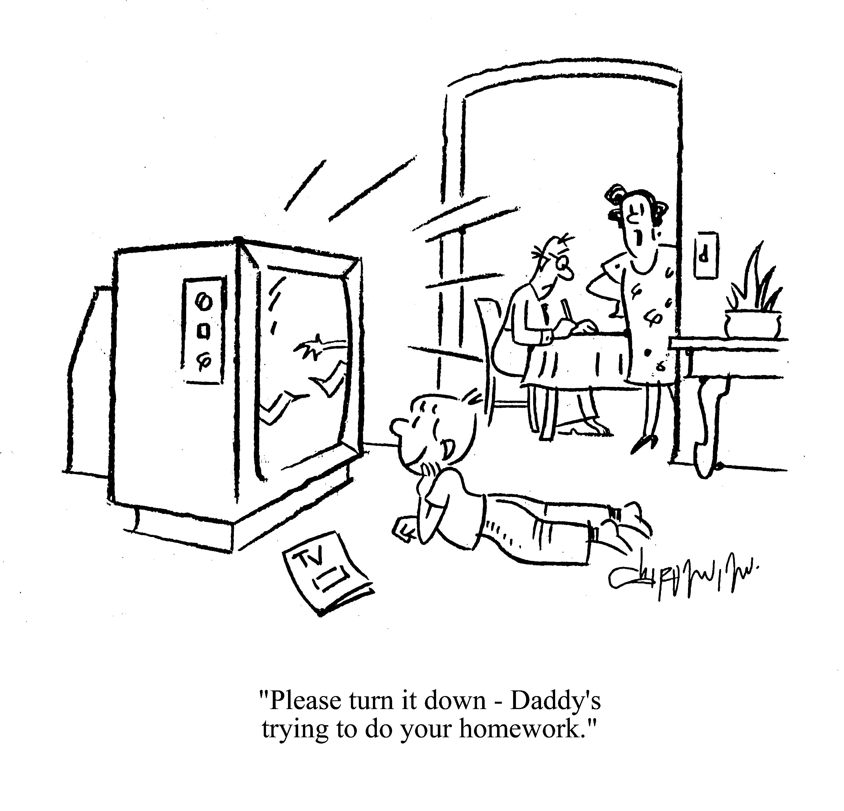
Cultural and social capital mean underachievement of middle class students can be overcome more easily

Slide 21
Methodological limitations
Correlational studies and case studies
Limited menu of methods that limits understanding and inference
Multilevel regression modelling
Leads to focus on separation of school and environment

Slide 22
Myopic focus on the school
Variance at school level limited
Community work essential, though results of extended schooling so far limited
Collaboration between schools is necessary
More attention to bottom up initiatives
Initiatives need careful mixed methods evaluation

Slide 23
Effectiveness and Innovation
Tendency to find what is already there
Inbuilt conservatism
But: too much innovation in education ill researched and based on fads
Large scale wastage

Slide 24
Small scale experiments
Small scale experiments
Cognitive and non-cognitive outcomes
Easier than often supposed
Allows small scale contextualised dissemination rather than ‘national roll outs’

Slide 25
The social outcomes of learning
Increased attention in recent years
Holistic view of education
Range of outcomes studied
Self-concept (e.g. van de Gaer et al, 2009)
Well-being (Opdenakker et al, 2007)
Resilience

Slide 26
Social outcomes
Some evidence of school effects, but weaker than cognitive
Problems of definition and measurement
Need for a systematic programme of research

Slide 27
Conclusion
Need to move beyond pattern of intervention, followed by self-report suggesting enthusiasm and impact, followed, several years later, by the confirmation that in fact nothing has really changed and the educational outcomes and life chances of the majority of disadvantaged youngsters in the area remain unaffected
Rigorous study of effectiveness is therefore essential

Slide 28
Conclusion
School effectiveness research must become educational effectiveness research in the broadest sense, including a range of educational sites
Educational effectiveness research requires attention to the range of desired outcomes of education

Slide 29
Thanks for listening!
d.muijs@soton.ac.uk

