Slide 1

A Framework for Proactive Risk Management of Online Communities
Vegard Engen, Bassem Nasser, Paul Walland
IT Innovation Centre
University of Southampton
Southampton, United Kingdom
{ve, bmn, pww}@it-innovation.soton.ac.uk

Slide 2
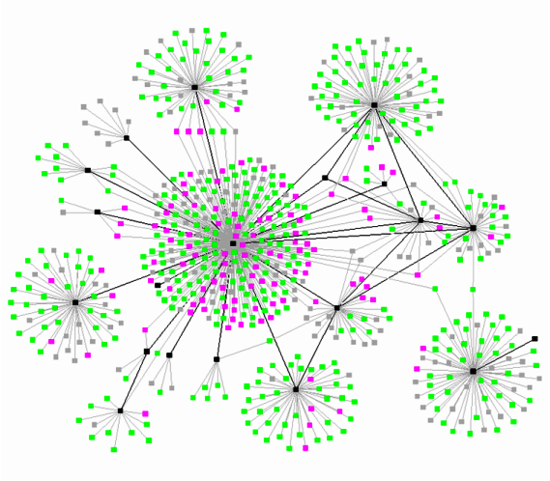


Online communities
Users interacting with other users
Users creating and interacting with content
Users interacting with community services
Complex network
Millions of users and content
We will focus on business communities
Notes:
Public Internet communities
Extranet business communities
Intranet employee communities

Slide 3
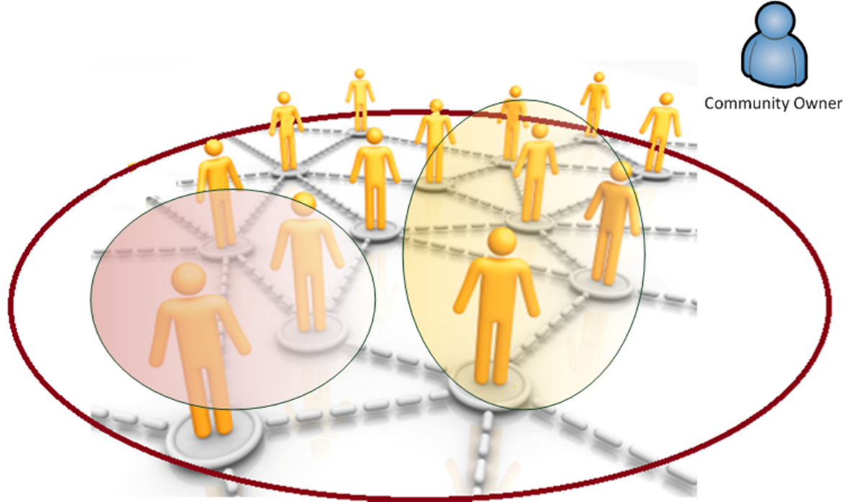
Motivation for online business communities
Can generate major economic value
Form pivotal parts of corporate expertise management, CRM, marketing...
Facilitate knowledge dissemination and communication
Boost performance and innovation
Intelligence
Preserve value

Slide 4

Current online management solutions
Dashboard for monitoring a set of Key Performance Indicators, e.g.:
page views, number of posts, average time for responding/closing users’ queries
topics & sentiment
Current state of the community
Insight onto the future state of the community

Slide 5
Objectives, risks and opportunities
Communities are driven by objectives, e.g.:
Provide customer support
Facilitate & improve employee communication
Fostering collaborations
Increase quality of experience
A risk is an event that affects the objectives negatively
An opportunity is an event that affects the objectives positively
Notes:
Our use of the word ‘risk’ is also referred to as ‘threat’

Slide 6
Risk model

Slide 7
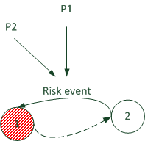
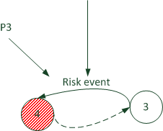
Example risks & opportunities
Risks
Community becoming inactive
Key contributors / experts leaving
Undesirable role compositions
Poor content quality
Poor response times
Opportunities
Gaining experts
Policy change
Notes:
P1, P2, P3 = explanatory parameters

Slide 8
Aims of proactive risk management
Aim: proactive risk management
Predict if risks are likely to occur
We can address the risk to:
Reduce the likelihood of occurrence
Reduce the impact on the objectives if it is inevitable to occur

Slide 9
Risk management
There are many risk management standards and methodologies:
Management of Risk (M_o_R),
FERMA Risk Management standard,
ISO 31000 Risk Management Principles and Guidelines
“Risk Management: Coordinated activities to direct and control an organisation with regards to risk” [ISO 31000]

Slide 10
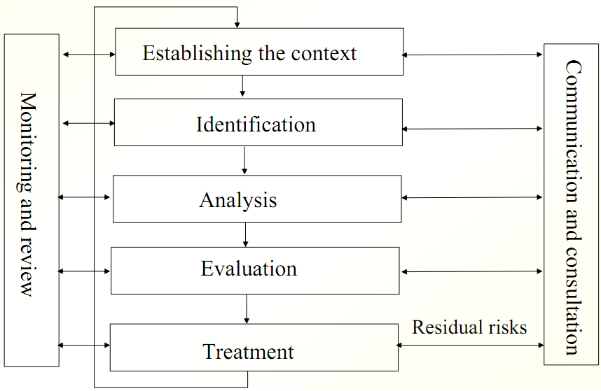
Methodology
Detailed understanding of the risks → likelihood and consequences.
Objectives and scope of the analysed system (community).
Identifying and specifying risks and their attributes – events, causes and potential consequences.
Reduce/enhance likelihood.
Reduce/enhance impact.
Classifying risks according to risk criteria → priority for treatment.
Notes:
Similar methodology adopted by all standards

Slide 11
Events categories
“… characterized by reference to potential events and consequences, or a combination of these”.
e.g. launch competitor product
e.g. change policy, block user
e.g. regulations change
e.g. change in num of users, response time exceeding threshold
e.g. role change

Slide 12
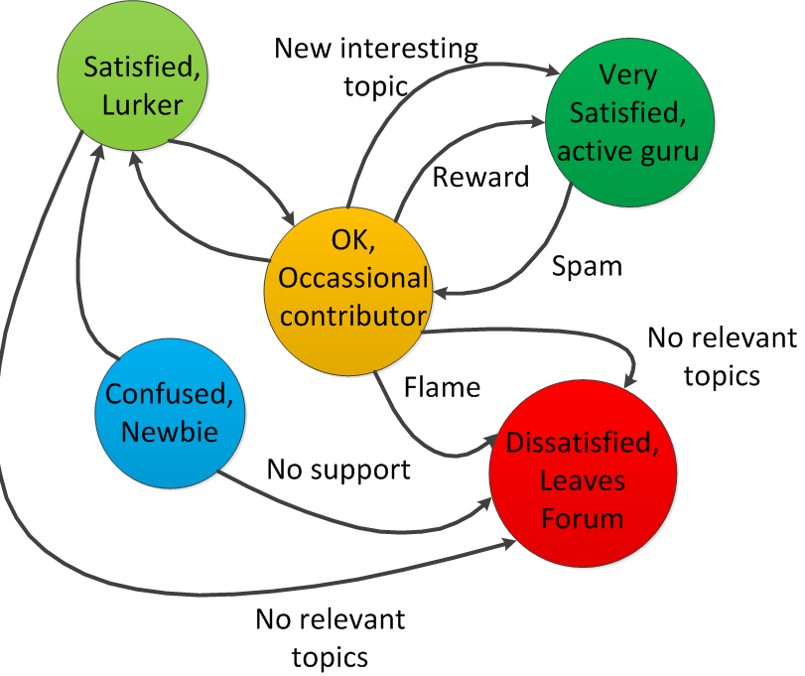
Change in user attributes: role

Slide 13
Example events – user level
State-based
User X changing from role active to lurker
Pre-condition: user x has role ‘active’
Post-condition: user x has role ‘lurker’
Threshold-based
User X activity drop ≥ 20%

Slide 14
Predictor services
Services that embed tools capable of calculating probability of events, such as:
Compartment Model
Gibbs Sampler
Processes community data, whether batches of historical data or real-time stream of community data

Slide 15
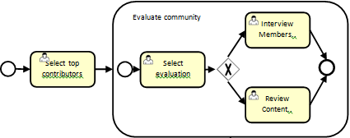
Treatment
BPMN workflows to specify treatment plans
Simulation Services
Simulating what-if scenarios, indicating impact of events
Interactive tools possible with visualisations
Can be used in the identification, analysis and treatment phases

Slide 16
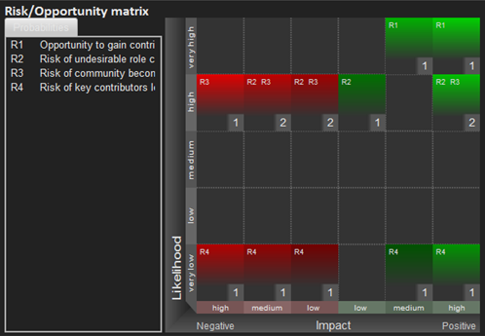
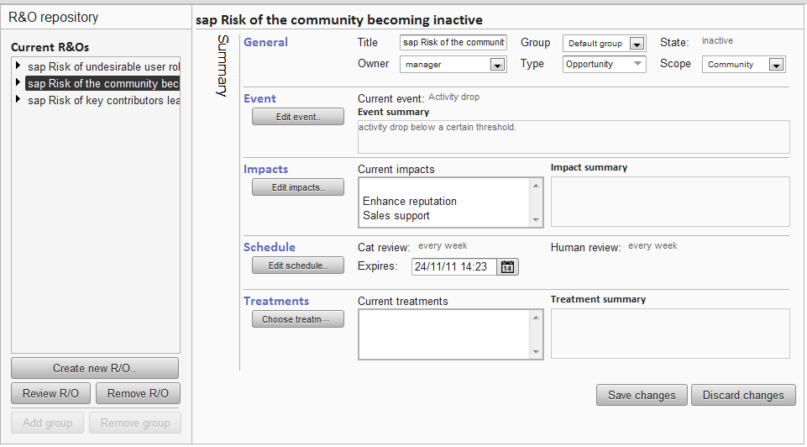

Framework Components
Actions
None
Reduce impact
Reduce likelihood
Notes:
Risk: experts becoming inactive
P(user x becoming inactive) = high → treatment → simulate impact of user x becoming inactive → action

Slide 17


Online demo of ROBUST tools
http://robust-demo.softwaremind.pl/demo/

Slide 18
Conclusion
Risk management framework for online community management
Integrated with IBM Connections
Beyond the current state to the future state
End user evaluation with IBM and SAP community managers
Robust website http://www.robust-project.eu
SIOC extension and support
Events hierarchies
Exploitation opportunities: Banking, Healthcare, Pharmaceutical, Gaming…

Slide 19
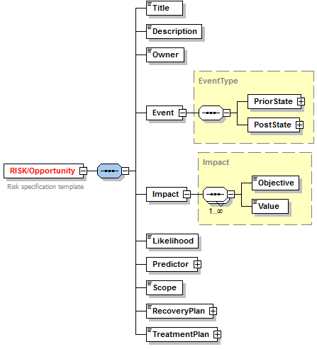

Risk representation
Notes:
Answer questions of:
How much is a user/group of users are in risk of something?
Which users are in risk?
Scope of risk.
Decomposition proportion of community
Feature attaining value

Slide 20
Responses

Slide 21
T1.1 Survey results
Community health indicators
The number of users or unique visitors
The number of active users
The number of forum contributions
Hits per page
The number of answered questions
The number of answered questions vs the number of unanswered questions
Response times
Contribution points
Quality of interactions
Zero downtime (of services)
Risk/Opportunity categories
Community/user activity (e.g. drop of expert activity below a certain threshold, churn)
Community evolution (e.g. diversity of topics)
Community usage (e.g. opportunity to add new features)
Community/user role dynamics (e.g. high proportion of lurkers to contributors)
Community structure
User experience/behaviour (e.g. negative sentiments about topic, response time)
Community content
Community maintenance
QoS and Security
Notes:
Risks and opportunities may have complex relationships and may not be clear-cut that a risk belongs to a single
mention those risk dependencies, with a note of it being discussed later

Slide 22
T1.1 Risk dependencies
P1
P2
Pn
Y1
P(Y1=S1| P1,P2,Pn)
Y2
Y3

Slide 23
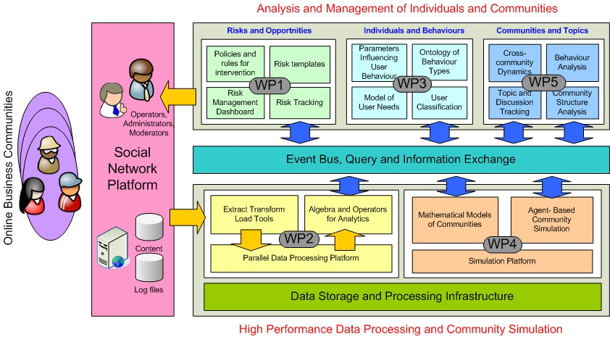
Overview of ROBUST
Notes:
O1.1 Apply formalised risk management processes to large-scale online communities
O1.2 Develop a high-performance framework for automated and policy-based risk management driven by event streams from online communities.
O1.3 Provide a community health decision support dashboard for visualising the status of online communities and their participants.

Slide 24
Event modelling
Neutral
Negative
Neutral
Negative
Positive
Notes:
An event could be one, several occurrences or non-occurrence of change in user/community attributes/circumstances.
Attention management as exploitation of the positivity event
Activities drop: test certain features, system maintenance opportunity
Sentiment +/-
Membership in out

