Slide 1

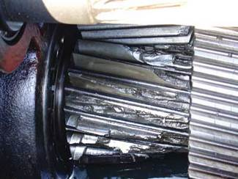
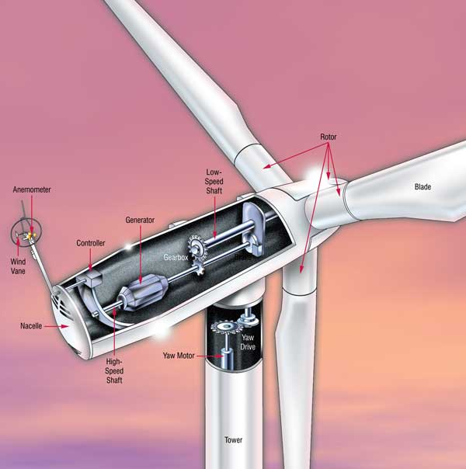
MARINE WIND TURBINE LUBRICATION
Overview
Dr. Monica Ratoi
Lecturer in Lubrication Science, nCATS
TRENDS IN MARINE ENERGY:
-market growth for wind energy is now occurring in North America, Europe and Asia, following a 30% growth in installations through the 1980s and 1990s [1]
-increased demand for higher energy output and bigger turbines [3]
-increased loading on gears create higher operating temperatures
-longer service intervals for off-shore turbines
LUBRICANT CHALLENGES:
- protect against micro-pitting and scuffing
- prevent bearing failure
- eliminate sludging, inhibit foam, clean dirt
- reduce corrosion in off-shore turbines
- extend lubricant life, drains and service intervals
Figure 2. Wind turbine gears damaged by unusual stresses [2]
TRENDS IN LUBRICATION:
-turbine gear oil specifications are beginning to reflect demand for higher lubricant performance through testing for enhanced oxidation and corrosion resistance, and improved bearing and long-term operational performance (drain interval of up to three years)
-for offshore applications, synthetic and biodegradable fluids are being increasingly developed; although synthetics cost more, they generally last longer, provide better oxidative stability and perform better in temperature extremes offering longer life
-to prevent the corrosive pitting and staining of the bearings there is a need to develop novel EP additives (nanoadditives?)
WINDS OF CHANGE:
-wind power is a high-growth, rapidly evolving industry
-wind turbine lubrication exists at the very extremes of industrial gear applications in terms of temperature, load, bearing wear, maintenance, accessibility and basic lubricant performance
-developments in lubrication and maintenance strategies for this ‘extreme’ application are paving the way for a new standard in gear and bearing lubrication
Figure 1. A typical propeller-type wind turbine [1]
RELIABILITY:
-is well above that of most conventional generating technologies; the best turbine manufacturers consistently achieve availability (a commonly used operational measure of reliability) of more than 98%
CAUSES OF FAILURE:
Many field-operating failures are a consequence of gearbox bearing failure, believed to be directly related to:
-poor lubrication due to unusual stresses and
-poor maintenance due to limited accessibility to major components
-the bearings in the wind turbine gearbox are subjected to extremely high loads, and throughout the gearbox, the bearing performance criteria will be different
-high-load/low-speed conditions arise when winds are light and can possibly lead to the breakdown of the lubricating film that is normally required for a long bearing life
References
[1] D. Barr, Machinery Lubrication, Sept. 2002, [2] S. Lawate, M. Graf, Power-Engineering 111,8, 2007, [3] M. Greaves, The UEIL Annual Congress, Oct. 2008

