Slide 1
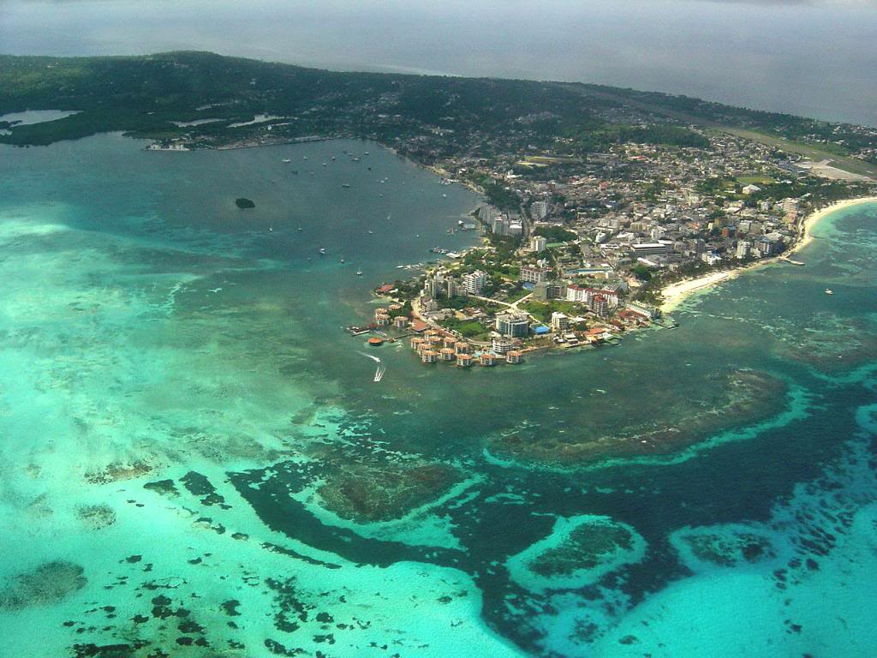
Coastal City and Ocean Renewable Energy: Pathway to an Eco San Andres
Presented by Green Team
Picture source: http://www.scafo.com.br/sp/san-andres/

Slide 2
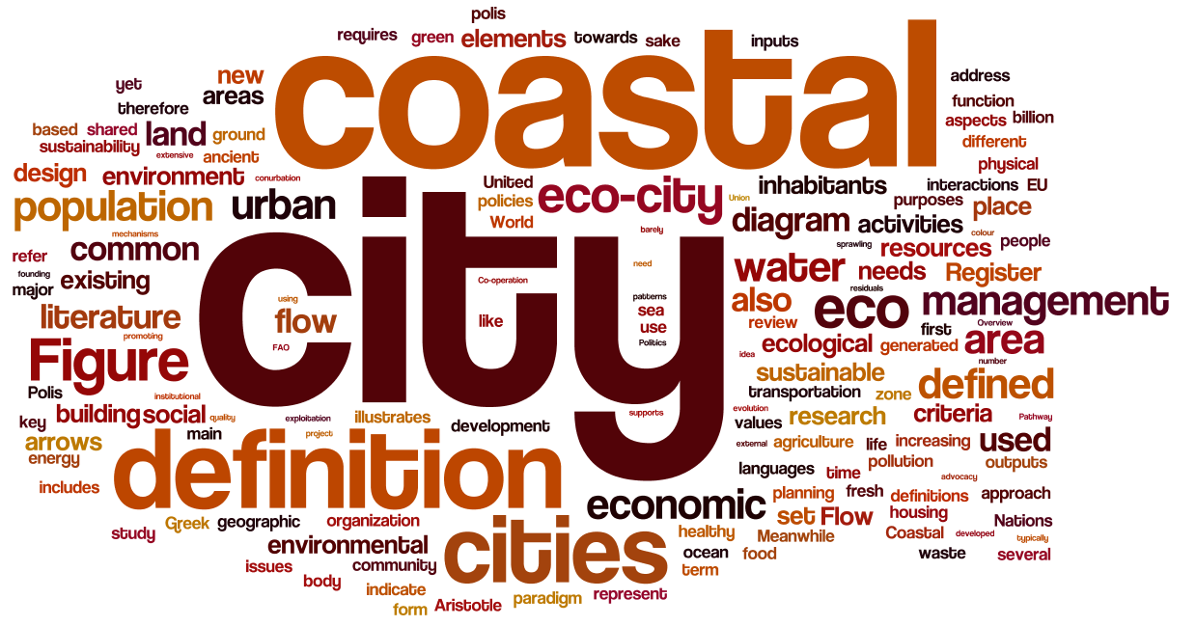
A Tale of Coastal Eco Cities

Slide 3
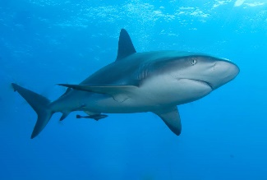


A Tale of Coastal Eco Cities
Our Definition:
Energy
Food
Water
Land-sea interface
Urban Environment
Coastal Environment
Economic Activity
Industry
Waste/Pollution
Biotic environment:
Financial Service
Infrastructure
Recreation & Leisure
Housing
Fishing
Species
Health
Transportation
Education
Innovations
Aquaculture
Abiotic environment:
Energy, Food, Water
Minerals
Currents, tides, waves, wind, seafloor, water quality, mineral resources…
Non-renewable
energy
Renewable energy
Waste/Pollution
Other Externalities

Slide 4
A Tale of Coastal Eco Cities
Our Definition:
Energy
Food
Water
Land-sea interface
Urban Environment
Coastal Environment
Economic Activity
Industry
Waste/Pollution
Biotic environment:
Financial Service
Infrastructure
Recreation & Leisure
Housing
Fishing
Species
Health
Transportation
Education
Innovations
Aquaculture
Abiotic environment:
Energy, Food, Water
Minerals
Currents, tides, waves, wind, seafloor, water quality, mineral resources…
Non-renewable
energy
Renewable energy
Waste/Pollution
Other Externalities

Slide 5

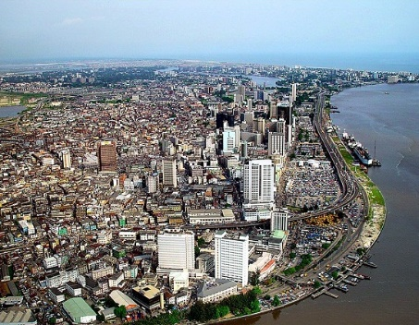


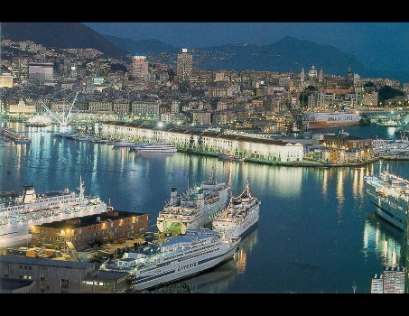
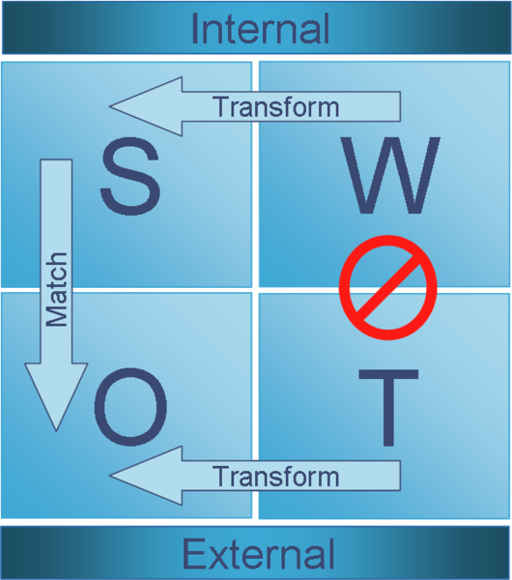
A Tale of Coastal Eco Cities
Hong Kong, China
Lagos, Nigeria
New York, US
Genoa, Italy
San Andres, Colombia
Ocean Renewable Energy

Slide 6
A Tale of Coastal Eco Cities
System Scope:
Legal Requirements
Ocean Renewable Energy
Government-Centred Scenario
Eco San Andres
Financial Plan &Marketing Scheme
Community-oriented Scenario
Transferability

Slide 7
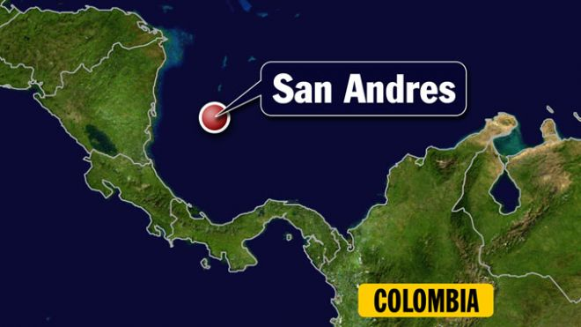
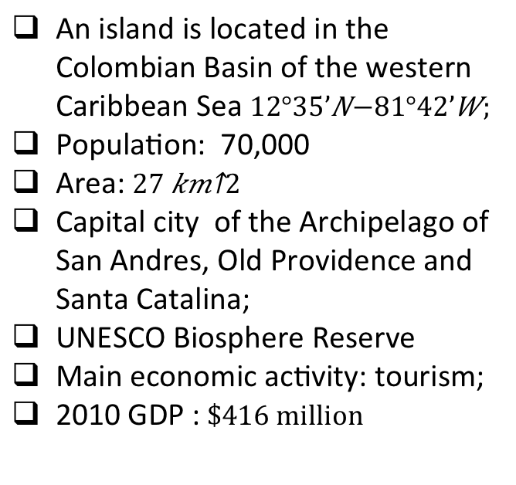
San Andres (Isla de San Andrés)
Basics
An island is located in the Colombian Basin of the western Caribbean Sea $12°35’N−81°42’W;$
Population: 70,000
Area: $27 {km}^{2}$
Capital city of the Archipelago of San Andres, Old Providence and Santa Catalina;
UNESCO Biosphere Reserve
Main economic activity: tourism;
2010 GDP :$\$416 million$
Caribbean Sea

Slide 8
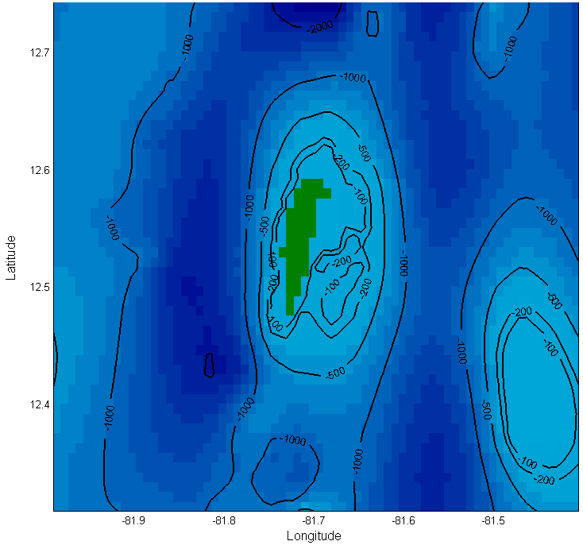
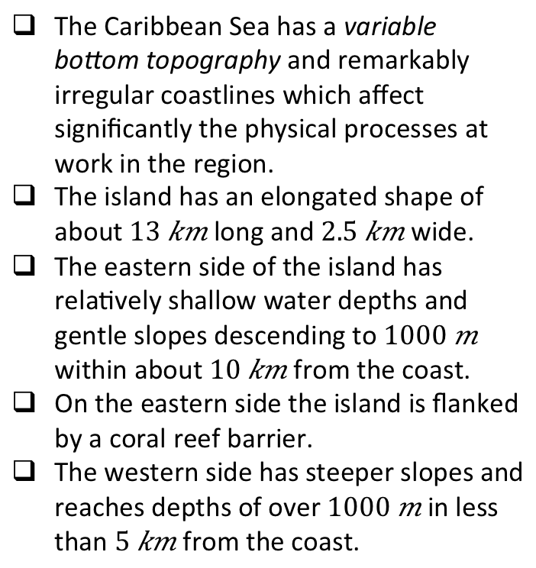
San Andres (Isla de San Andrés)
Natural Environment
The Caribbean Sea has a variable bottom topography and remarkably irregular coastlines which affect significantly the physical processes at work in the region.
The island has an elongated shape of about $13 km$ long and $2.5 km$ wide.
The eastern side of the island has relatively shallow water depths and gentle slopes descending to $1000 m$ within about $10 km$ from the coast.
On the eastern side the island is flanked by a coral reef barrier.
The western side has steeper slopes and reaches depths of over $1000 m$ in less than $5 km$ from the coast.
Bathymetric features near San Andres (British Oceanographic Data Centre, 2010)

Slide 9
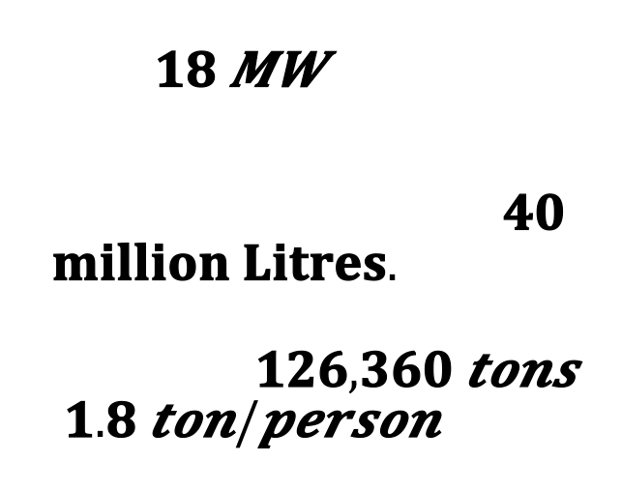
San Andres (Isla de San Andrés)
Challenges
Energy Profile
    Mono Economy;
    Dependency on external supplies (food and oil) shipped from the mainland;
    Scarcity of drinkable water resources;
    Land and water pollution.
Energy demand of the island is about which is generated from a power station that runs on diesel oil.
Annual diesel consumption:
Annual emissions of CO₂ to the atmosphere: ().

Slide 10
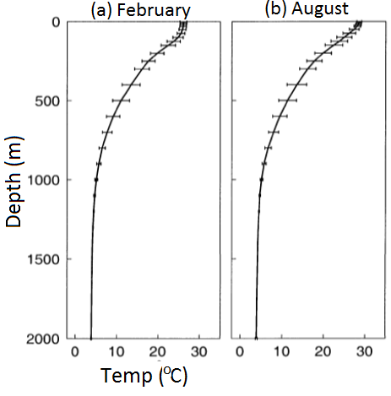
Government-Centred Scenario(OTEC)
A sustainable energy supply system for San Andres:
Ocean Thermal Energy Conversion (OTEC)
OTEC is used to extract energy from the ocean by using the temperature difference between warm surface waters and cold deep waters (ΔT ≥ 20°C).
Unlimited resource in inter-tropical regions.
Steady supply (24/7) all year round.
1000 m
1000 m
ΔT~20°C
ΔT~23°C
Climatological monthly mean temperature averaged over the western Caribbean Sea. Adapted from Sheng and Tang (2003).
Technology at early stage of commercialization
High capital cost Need for strong involvement of the central government.

Slide 11
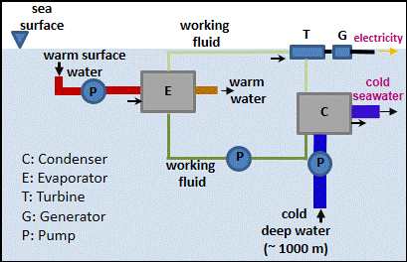
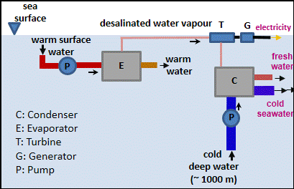
Closed Cycle (CC) vs Open Cycle (OC) OTEC technologies
CC(Closed Cycle)
OC(Open Cycle)
Working fluid: Ammonia
Products: Electricity
cold seawater
Working fluid: Sea water
Products: Electricity
cold seawater
desalinated water
technology recommended for San Andres: OTEC Open Cycle

Slide 12
A 10 MW OTEC system for San Andres
Levelized cost of electricity (capital cost, O&M,R&R): 0.36 $/kWh
Assuming a 20 years loan, interest of 4%, and inflation of 3%.
Can only be viable if both ELECTRICITY and FRESH WATER are priced
Fresh water produced by OTEC | 13 million m³/year
Potable water demand in San Andres | 10 million m³/year
Current potable water supply | 5 million m³/year
Part of excess potable water will be commercialized as bottled water.

Slide 13
Breakdown of the levelized cost of electricity (LCOE)
OTEC Levelized Cost of Electricity
(LCOE)
Price of domestic Water
(PDW)
Price of electricity
(POE)
Profit of Bottled Water
(PBW)
Price of water
(POW)
0.36 $/kWh

Slide 14
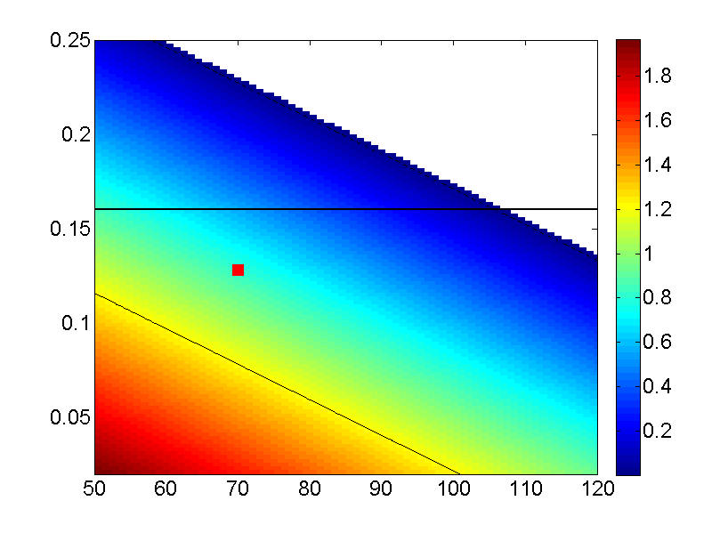

Breakdown of the levelized cost of electricity (LCOE)
PDW ($/m³)
Profit zone
(negative PDW)
Current cost of electricity
POE ($/Kwh)
current cost of domestic water
PBW ($/m³)
POE: Price of Electricity
PDW: Price of Domestic Water
PBW: Price of Bottled Water
Q_{E}: 0.16 m³/kWh
Q: 12 million m³/year
q_{d}: 10 million m³/year
q_{b}: 0.15 million m³/year
$$\frac{LCOE − POE}{Q_{E}}=\frac{q_{d}×PDW +{ q}_{b}×PBW}{Q}$$

Slide 15
Government-Centred Scenario(OTEC)
Results of cost analysis of OTEC system for San Andres
 | Current Cost | OTEC scenario | Relative change
Price of Electricity (POE) | 0.16 $/kWh | 0.13 $/kWh | cheaper
Price of domestic water (PDW) | 1.2 $/m³ | 0.8 $/m³ | cheaper
Breakdown of Levelized Cost of Electricity
 | Contribution to LCOE
Price of Electricity (POE) | 0.13 $/kWh
Price of domestic water (PDW) | 0.10 $/kWh
Price of bottled water (PBW) | 0.13 $/kWh
Levelized Cost of Electricity (LCOE) : 0.36 $/kWh

Slide 16
Alternative?
Community-Oriented Scenario
Government-centered (OTEC)
??
A renewable San Andres
Community-oriented approach
Community oriented approach
Public engagement
Relative low investment
Proven technology

Slide 17
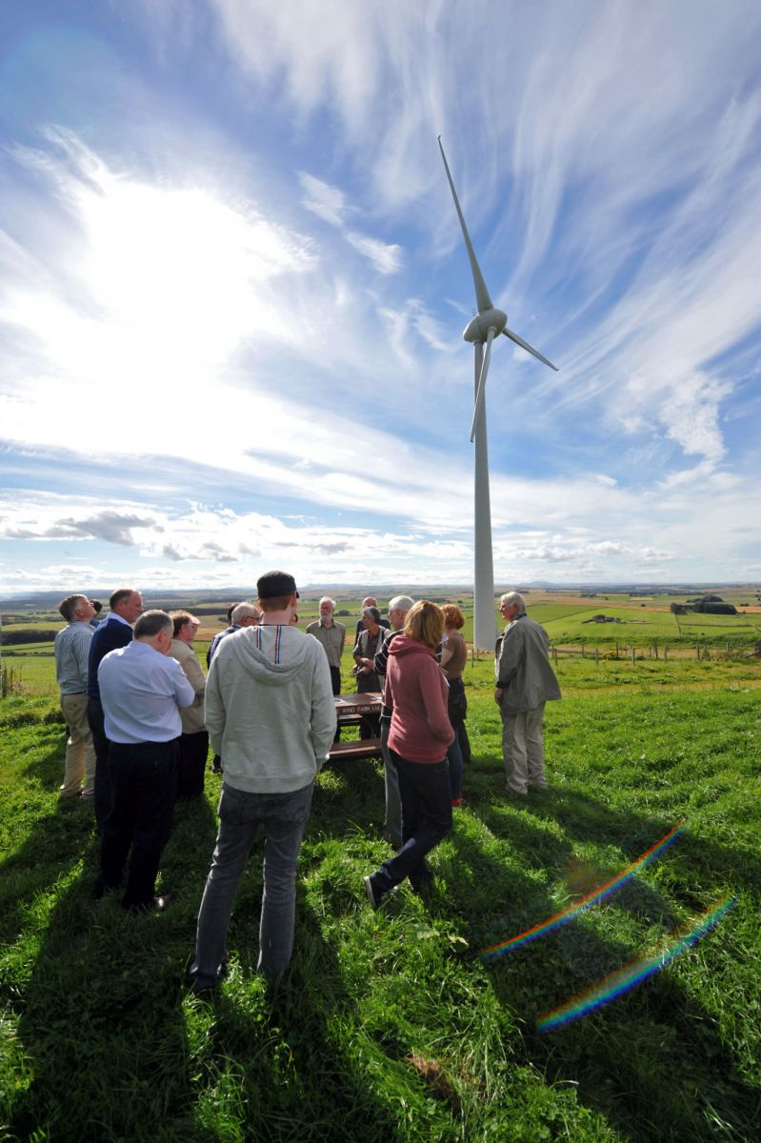
Community-Oriented Scenario
Samsø case since 1997 - 100% renewable energy Island in 10 years
Community involvement
Economic activities
Environmental
awareness
Source : PRO AKIS, http://www.proakis.eu/

Slide 18
Community-Oriented Scenario
Offshore wind – development trend
Source: EWEA. (2009). Oceans of Opportunity - Harnessing Europe’s largest domestic energy resource

Slide 19
Community-Oriented Scenario
Offshore wind – cost
Source: EWEA. (2009). The Economics of Wind Energy. “Costs of generated power comparing conventional plants to wind power, year 2010”
Source: IEA. (2008). World Energy Outlook. “Electricity generating costs in selected regions”

Slide 20
Community-Oriented Scenario
System configuration
Total power output | 10MW wind farm with fixed foundation
Location | North or North East of San Andres
Integration | To be connected to transmission grid with the existing diesels plant to balance daily consumption
Financial planning
20% of the investment cost to be funded by local citizens | Million $2.7
Individual shares (investment cost) for each local citizen | $2,700
Levelized Cost of Energy | 0.13 kWh

Slide 21
Legal Review for San Andres
International Legislation
Colombian Rules
National Policy of Ocean and Coastal Areas with operative branches at national, regional and local level:
Goal: carry out an integrated strategy in energy sector that includes renewables
Different tributary oriented rules to incentivize investment in renewables
The ocean boundaries (UN, 1982)
Exclusive economic zone (EEZ)
- the UNCLOS (Part V)
A zone beyond and adjacent to the territorial sea in which a coastal state has sovereign rights;
Outer limit of the EEZ shall not exceed 200 nautical miles from the baselines
Layout of submarine cables and pipelines (article 79

Slide 22
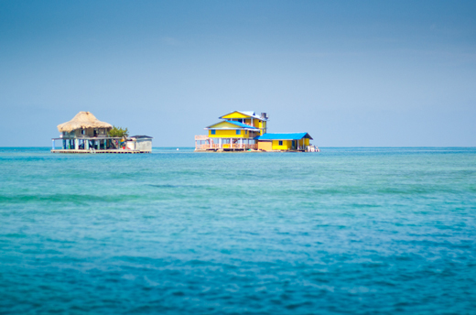
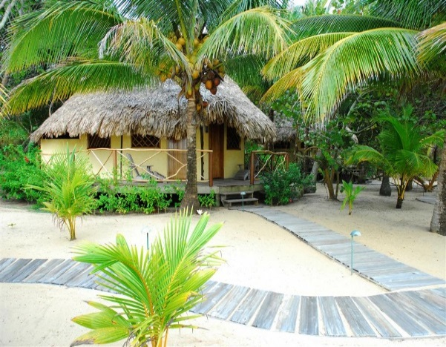
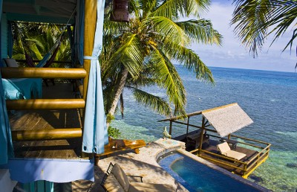
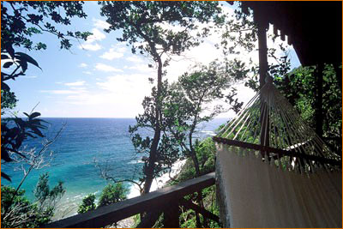
Marketing Scheme
Eco San Andres needs an adequate tourism marketing campaign that introduces the island to new target market: the eco tourists.
Optimal use of environmental resources
Respect the socio-cultural authenticity of host communities
Long term sustainability.
Goal: achieving satisfaction of local inhabitants and respecting the environment while maintaining a high level of tourist satisfaction
Possible accommodations for eco-tourism (Source: Costa Rica Star, Colombia travel, homeaway.com, sumtravel.com)

Slide 23
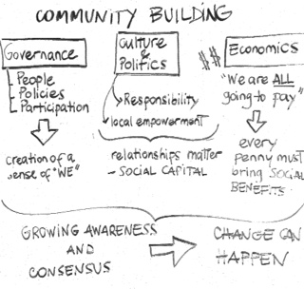
Transferability
  Transferability of the OTEC proposal
OTEC plant must be located in a tropical zone;
OTEC solution is feasible for coastal cities or islands;
Appropriate depth to reach cold deep water should be reached within short distance from the coast;
OTEC solution can be a solution for cities with a need of water supply;
Availability of funding options and/or political to support the substantial cost of the project.
  Transferability of the community oriented approach
Involvement of local stakeholders at all levels (residents, shop owners, hotel managers, politicians, etc.) throughout entire life cycle;
The identification of the right community to carry out the pilot project is vital;
Building awareness of the importance of changing energy

Slide 24
Conclusions
A portfolio of solutions (different scale, cost, production level) is a suitable approach for energy production in coastal cities.
Under both scenarios the cost of energy (water) for final users will be lower than the current one.
Consistent investments are required and should be driven by a strong political commitment.
Both scenarios will reduce the level of emissions and GHG while generating positive effects on energy consumption patterns, water supply, possible hydrogen production for clean transportation and create consensus and awareness.
Positive spill overs to other sectors towards greener solutions can be generated.

Slide 25


