Slide 1


Biomimicry for Coastal Eco-Cities:
Towards a Carbon Neutral Dover (UK)
Group D: E- Coastal Consultancy
Anjali Deshpande – Aik Ling Goh
Adriaan Goossens – Saeed Javdani

Slide 2
Overview
Coastal Eco-Cities
Dover
Biomimicry
Renewable Energy
Carbon management
Conclusions

Slide 3
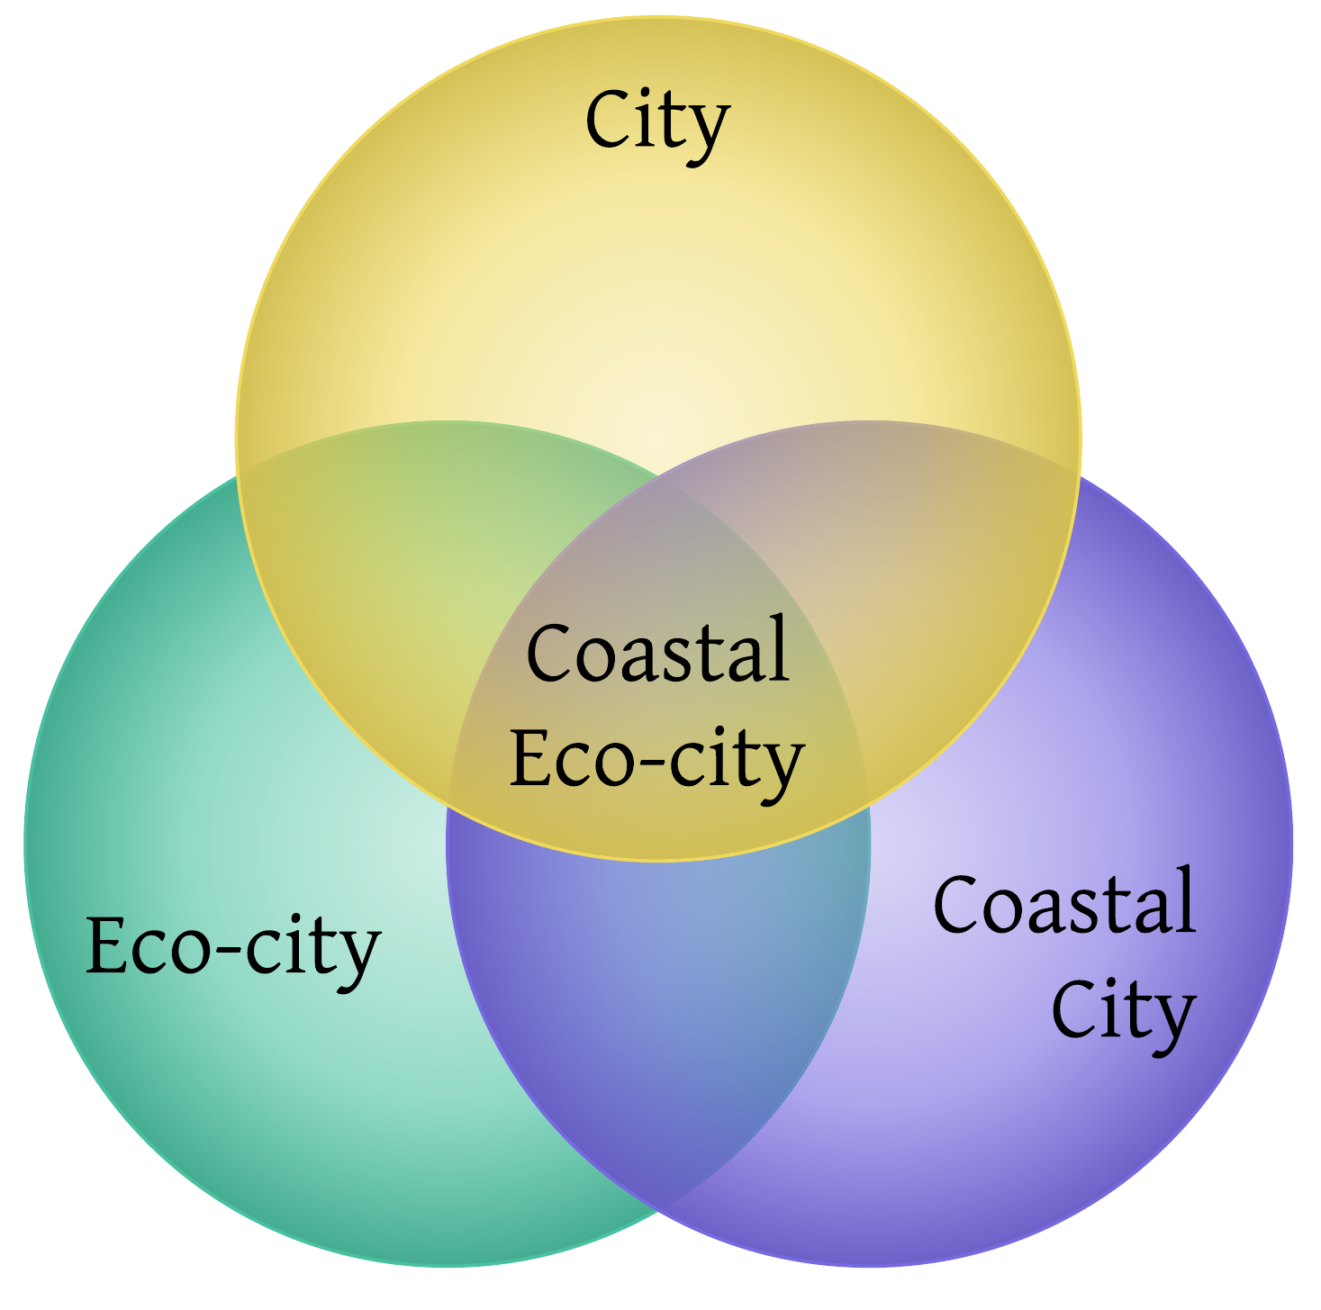
Coastal Eco-Cities

Slide 4
Coastal Eco-City
Socially and economically significant urban area near the sea
  reduce environmental impacts
  improve human well-being and life
  stimulate growth
through a harmonious relation between the land and the sea

Slide 5
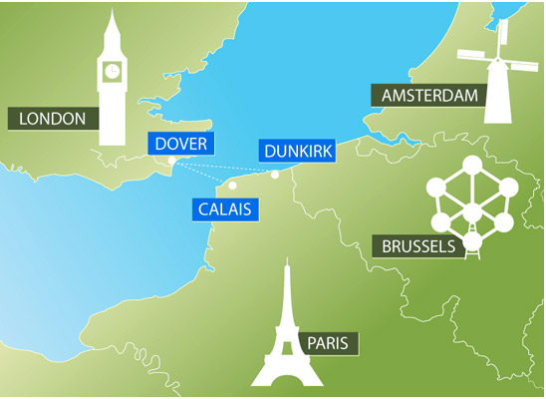
Dover
At the narrowest part of the Strait of Dover
Connection to Continental Europe
40,000 population
Important
  Port
  White Cliffs
Source: http://www.doverport.co.uk/?page=DoverFerryRoutes

Slide 6
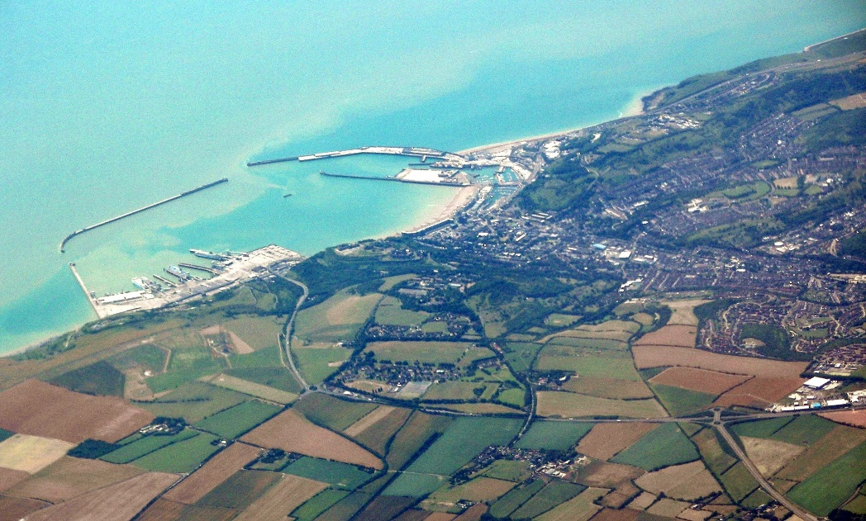
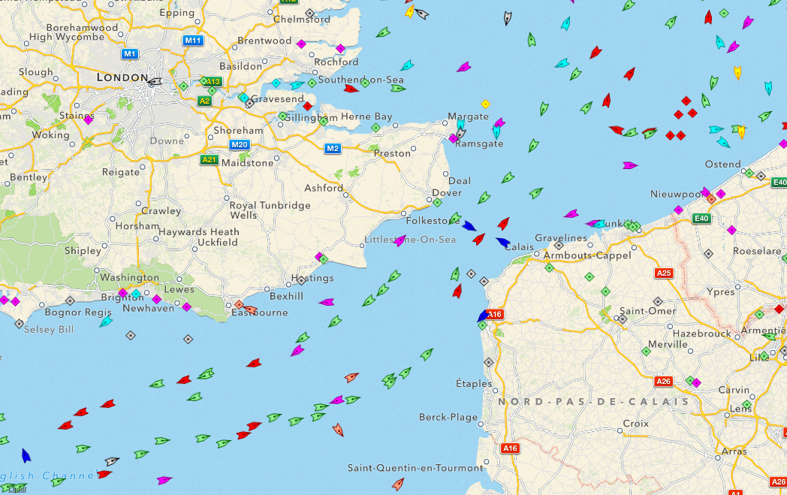
Port of Dover
Since 1606 AD
World’s busiest passenger port
  22,000 jobs
Annually:
  16 million passengers
  5 million vehicles
  £60 million turnover
  £80 billion of goods
http://en.wikipedia.org/wiki/Dover
Sources: http://www.marinetraffic.com/ais/

Slide 7
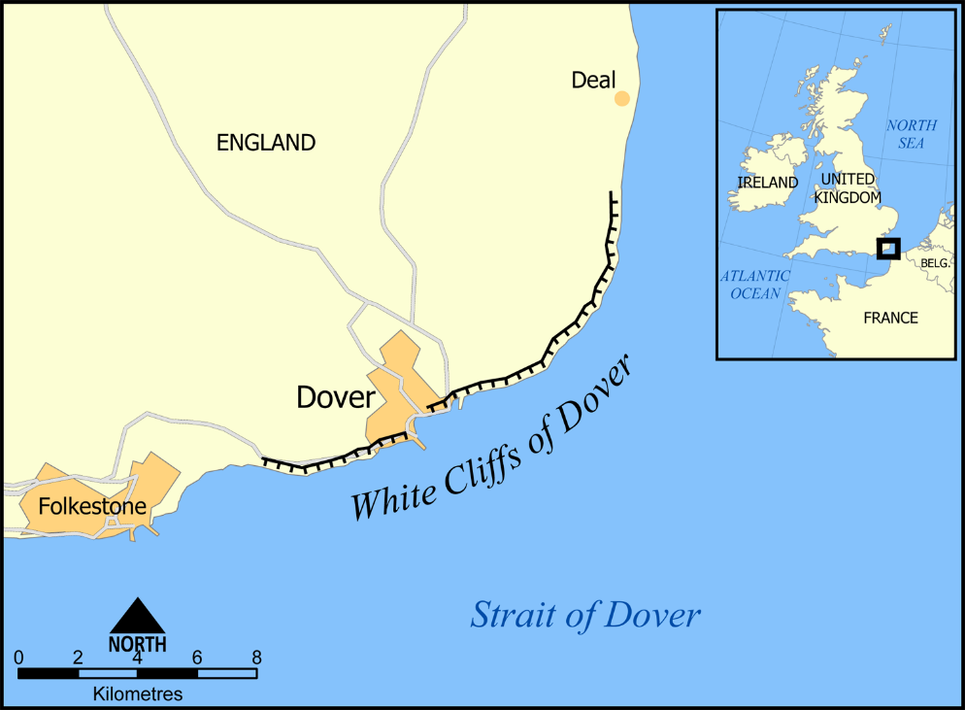

White Cliffs
Soft white chalk
Up to 110 m (350 ft)
Highly valuable
  Symbolic
  National Trust
  Area of Outstanding Beauty
Tourism in Dover:
  £ 186 million in 2003
Sources: http://en.wikipedia.org/wiki/White_cliffs_of_Dover
http://img.dailymail.co.uk/i/pix/2007/10_02/RugbyWhiteCliffs_800x600.jpg

Slide 8

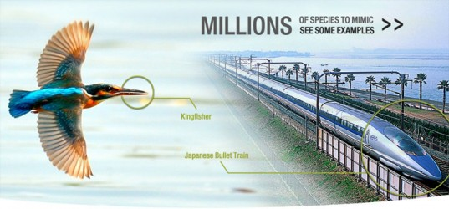
Bios + mimesis = BIOMIMICRY
Image Sources: http://inhabitat.com/giveaway-get-a-competitive-design-edge-with-this-free-intro-to-biomimicry-online-course-99-value/,

Slide 9
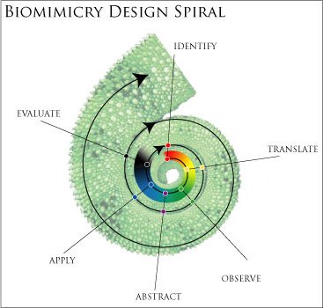
The Biomimicry Methodology
http://bradnehring.wordpress.com/2011/04/27/biomimicry-using-the-natural-world-to-benefit-and-greatly-convenience-humanity/

Slide 10
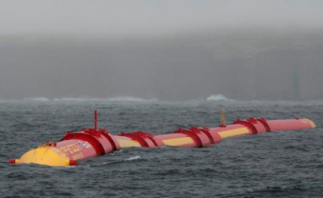
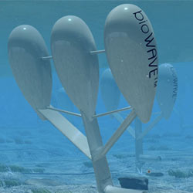
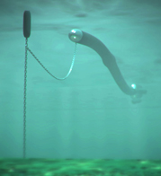
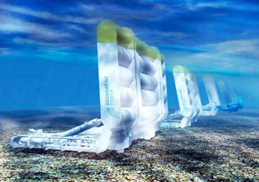
Wave Energy Converters
Pelamis – Mimics the movement of the sea snake
BioWave –Mimics the movement of the kelp
Anaconda – mimics the giant snake by riding the waves
Oyster – mimics the opening and shutting movement of the Oyster shell
Image Sources:http://coastalenergyandenvironment.web.unc.edu/files/2013/07/anaconda-wave-energy-590x240.jpg,, http://www.hydratelife.org/?p=414, http://www.hydratelife.org/?p=414, , http://wordlesstech.com/2011/06/28/oyster-wave-power-technology/ , Pelamis Wave Power

Slide 11
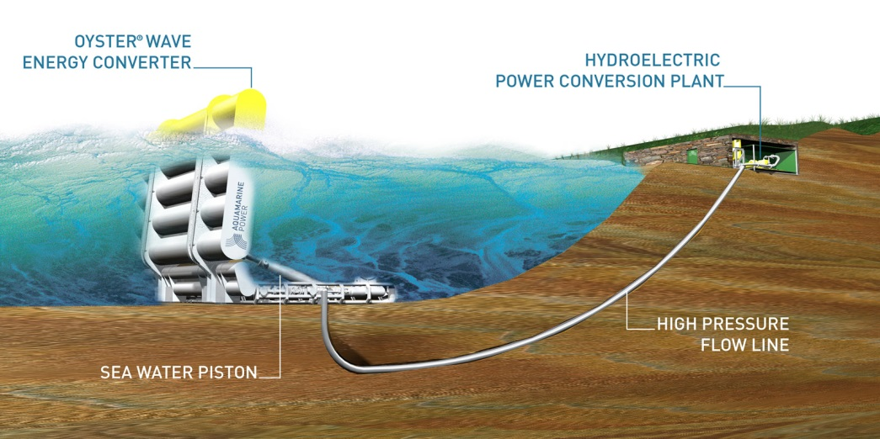
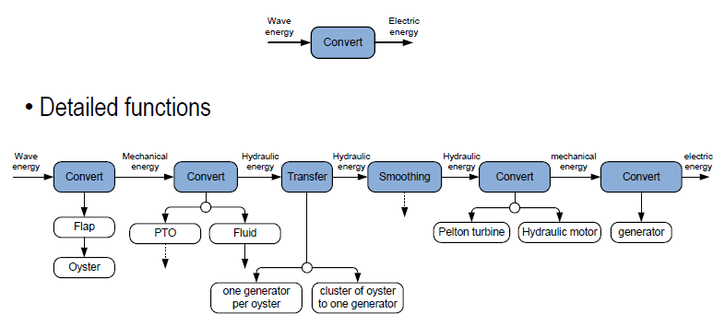
The Oyster WEC System
Image Source: http://www.maritimejournal.com/news101/marine-renewable-energy/guidelines_agreed_for_marine_energy_development

Slide 12
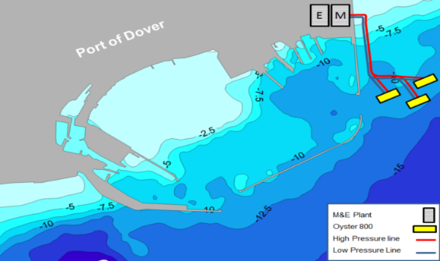
Oyster Technology for Port of Dover
Scenario 1 : 3 Oyster 800
CO2 reduction is 3200 tonnes per year
GHG reduction is 3600 tonnes per year
Project | Fabrication | Installation | Operation & Maintenance | Decommissioning | Total
2.4MW | 2.448 | 4.752 | 1.296 | 3.576 | 11.892

Slide 13
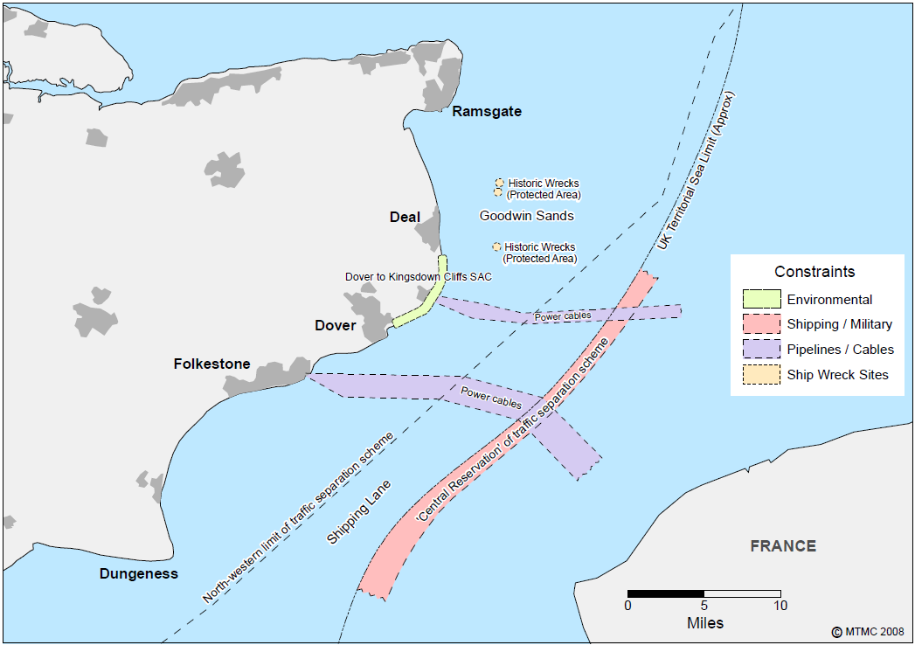
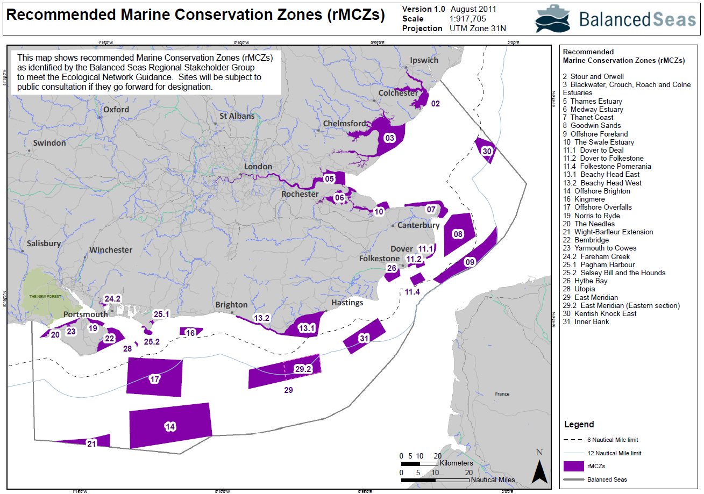
Project Constraints

Slide 14
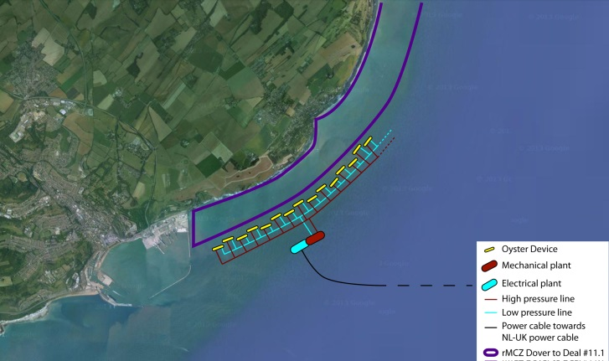
Oyster Technology for Dover
Scenario 2 : 50 Oyster 800
Protect White Cliffs from coastal erosion
Project | Fabrication | Installation | Operation & Maintenance | Decommissioning | Total
40MW | 40.8 | 129.2 | 21.6 | 59.6 | 251.2

Slide 15
Project for Dover
Location: The Coordinates for Oyster 800 are longitude 1.347º latitude 51.122º
Device to be installed in the vicinity of Dover harbour eastern walls outside the rMCZ 11.1 (at a distance of 0.6 nautical mile from the coastline)

Slide 16
OREIs Legislative Framework
Terrestrial Planning
Marine Planning
Decomissioning
Onshore Construction Permission:
Town and Country Planning Act 1990 (Section 57)
Mairne Protected Areas (MPAs)
Conservations:
AONBs
(CROW Act 2000)
SPAs
SACs
Ramsar Sites
SSSIs
Energy Act 2004
Departmetn of Environment and Climate Change (DECC)
Maritime and Coastguard Agency
Marine Guidance Note
MGN 371 (M+F)
UK Marine and Coastal Access Act 2009
(MCZs)
Licences for offshore renewable energy installations
Consents and Licensing
Electricity Act
1989
Maritime Management Organisation
(MMO) Licence
Over 1 mW devices
Seabed Lease

Slide 17
Risk Assessment of Oyster 800
Environmental Impact Assessment (Underwater Noise Impact on Marine Wildlife)
Seabed Interactions Impact Assessment
Navigational Risk Assessment (Offshore Renewable Energy Installations: impact on shipping)
Accidental Discharge

Slide 18
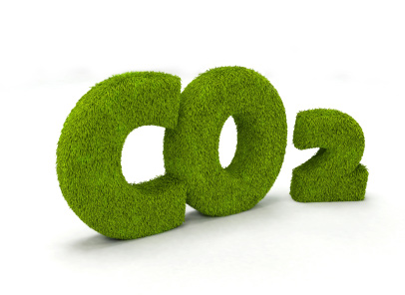
Carbon Management in Dover
Carbon Cycle
Biomimicry for carbon sequestration
Application in Dover

Slide 19
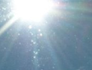
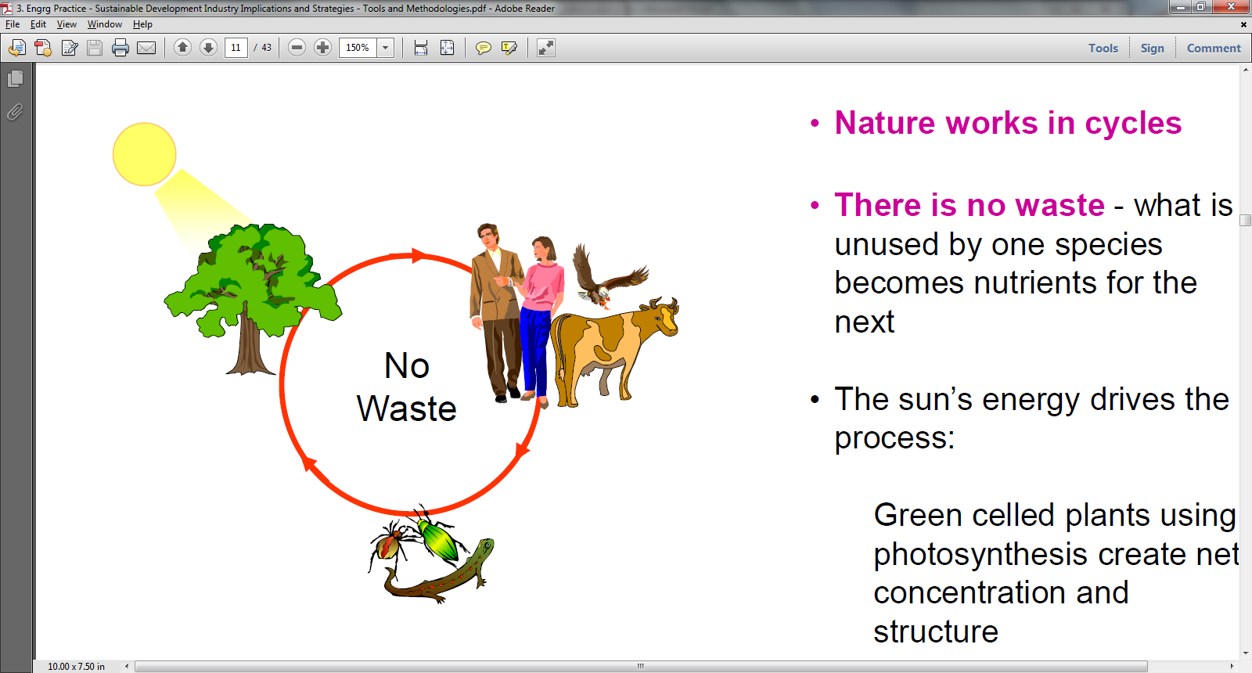
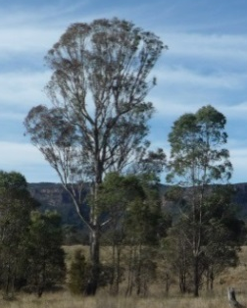
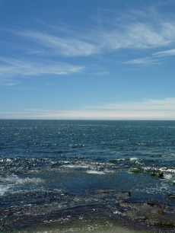


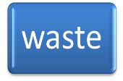
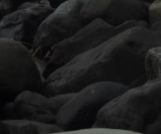
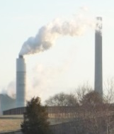
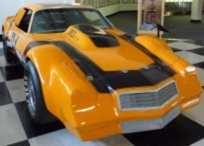

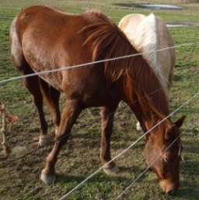
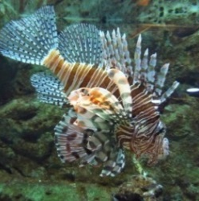
Carbon Cycle
?
© A L Goh, 2013

Slide 20
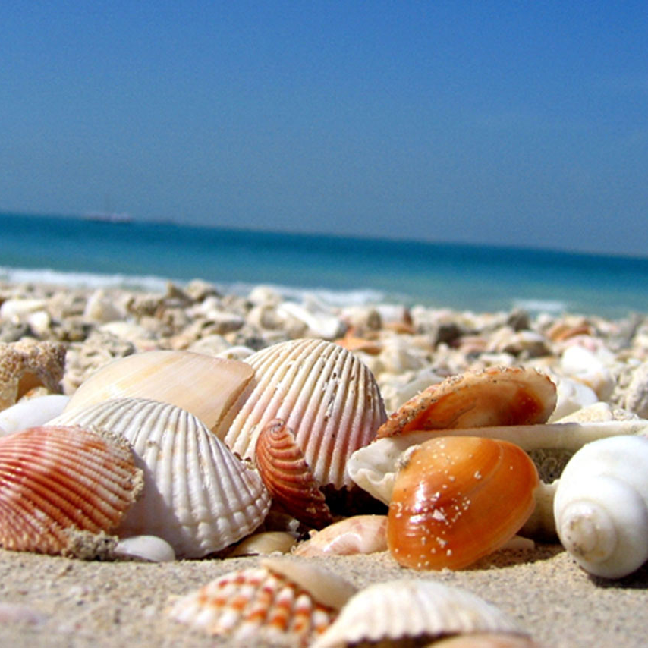
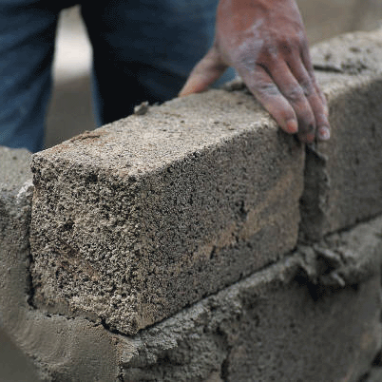
Biomimicry for carbon sequestration:
Eco-cement
Source: www.free-hdwallpapers.com
Source: Dickinson Ready Mix
Ca²⁺ + 2OH⁻ + CO₂ → CaCO₃ + H₂O

Slide 21
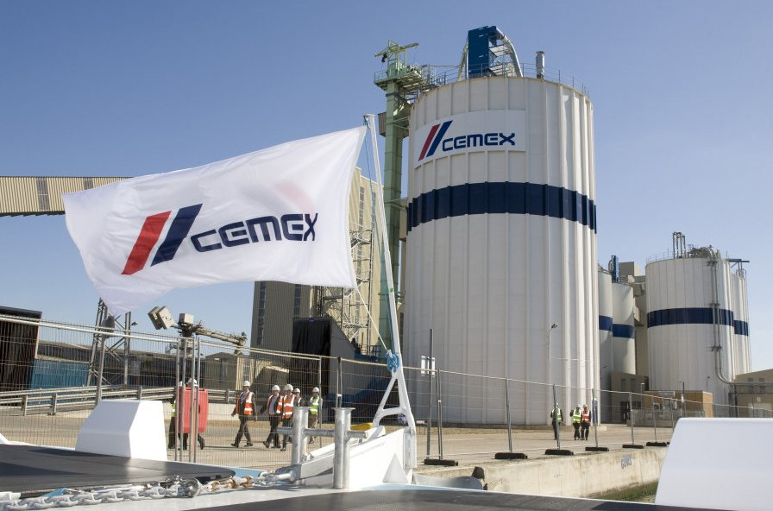
Conventional cement production
Source: Port of London Authority
CaCO₃ + heat → CaO + CO₂
50%
40%
OPC
(Ordinary Portland Cement)

Slide 22
Eco-cement proposal
1. Conventional cement production emits CO2
4. Scaling down of conventional cement production
2. Calera technology captures and stores CO2 in SCM
3. SCM replaces a portion of OPC ingredients in blended cement

Slide 23
Calera Corporation
Based in California since 2007
Vision: produce green cement from power plant CO₂ using seawater and industrial waste sources of alkalinity
Pilot plant next to a 1000 MW power plant at nearby Moss Landing
Produce an average of five ton of SCM per day.

Slide 24
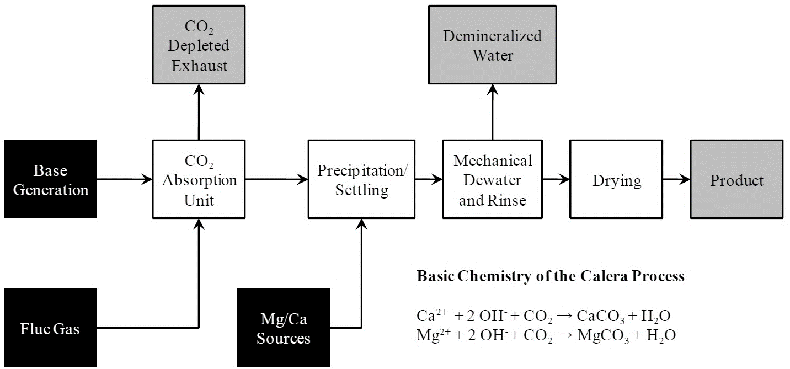
Calera Technology
(Andersen et al., 2011)

Slide 25
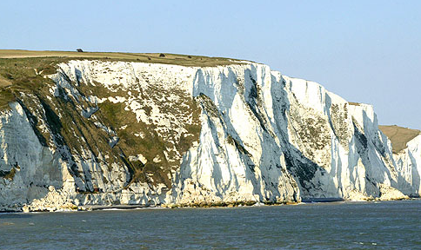
Application in Dover
Source: Port of Dover
Ca²⁺ + 2OH⁻ + CO₂ → CaCO₃ + H₂O

Slide 26
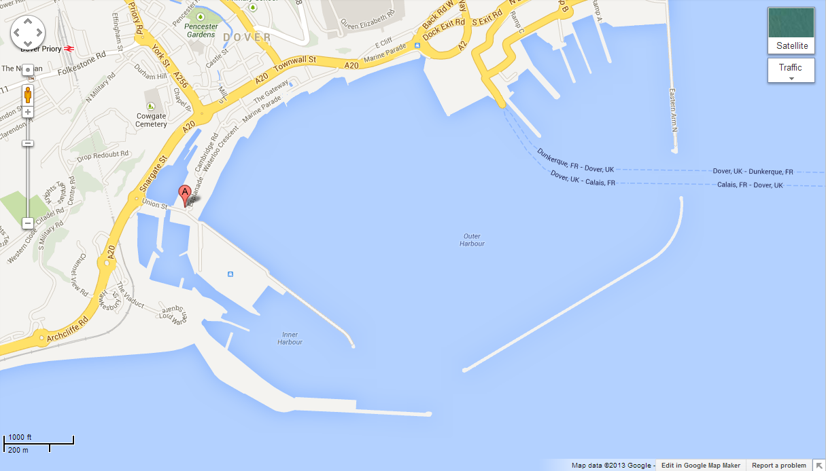

CEMEX Dover Plant
CEMEX Concrete Plant
Dunkirk Jetty, Western Docks
CT17 9TF

Slide 27

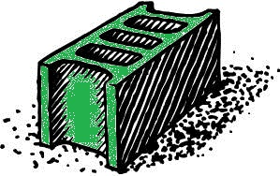
Carbon Impact
(Section 6.5.1, pages 87-91)
produces
1 tonne of conventional cement
0.6 tonne of CO₂
sequestered in
0.5 tonne of CO₂
1 tonne of eco-cement

Slide 28
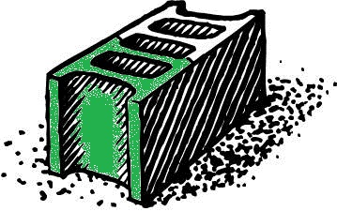
Net CO₂ emission
produces
1 tonne of blended cement:
80% conventional cement
20% eco-cement
Net CO₂ emission is 0.38 tonne CO₂
(0.8 x 0.6 – 0.2 x 0.5 tonne)

Slide 29
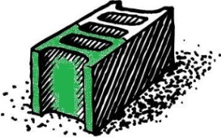
Completed Carbon Cycle
?
© A L Goh, 2013

Slide 30
Conclusion
Renewable Energy
  Oyster farm proposal
  2.4 MW near-shore Oyster farm
  Estimated savings: 3200 tonnes of CO₂ p/a
Carbon Management
  Eco-cement proposal
  Estimated savings: 0.2 tonne CO₂ per tonne of blended cement

Slide 31
Future Work
Discussion with relevant organizations
  Dover City Council
  Companies
  Investors
Biomimicry to address other issues
  Flood management
  Waste management
  Transportation

Slide 32
Thank you
for your attention!

Slide 33
Q & A

Slide 34

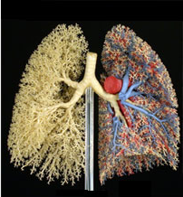
Biomimicry for Carbon Capture
(Section 6.4.1, pages 78-82)
Artificial trees
  Absorb CO₂ from atmosphere
Industrial Lungs
  Absorb CO₂ from power plant emissions
Source: Biomimicry Institute

Slide 35
Artificial Trees
(Section 6.4.1, pages 78-79)
Lenfest Center for Sustainable Energy at Columbia University
Absorbs CO₂ from the air using plastic leaves
“1,000 times more efficient than the real thing”
Do not require direct exposure to sunlight
Each synthetic tree is expected to collect about 90,000 tonnes of carbon per year

Slide 36
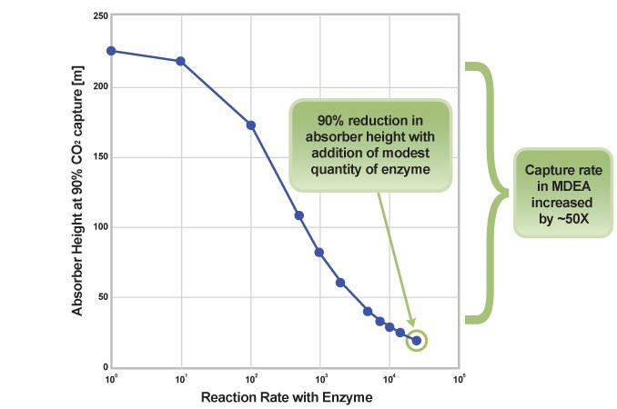
Industrial Lungs
(Section 6.4.1, pages 80-82)
Carbonic anhydrase enzyme remove CO₂ 1,000 times faster
Low-energy solvent: MDEA
Estimated cost savings of 32-45 million GBP per year
Source: CO₂ Solutions

Slide 37
Technical Performance
Calera SCM as a 20% replacement in blended cement satisfies performance standards for
  setting behaviour (ASTM C191),
  flow characteristics (ASTM C1437),
  compressive strength (ASTM C109).

Slide 38
Magnesium cement
Magnesium cements can have
  greater compressive and tensile strength,
  greater capacity to bond to woody materials.
They can be used to build
  lighter structures with
  better insulating properties.

Slide 39
Carbon Impact
If Calera SCM replaced 20% of OPC in China,
  cement production would decrease from 1.4 to 1.12 Gt p/a
  associated CO₂ emissions would be reduced by approximately 246 Mt p/a CO₂
If Calera SCM replaced 20% of OPC in the US,
  cement production would decrease from 75 to 60 Mt p/a
  associated CO₂ emissions would be reduced by approximately 13 Mt p/a CO₂
  * Assuming an emissions factor of 0.88 tCO₂ /t cement

Slide 40
Is there a market for cement?
(Last paragraph of Section 6.5.1, page 91)
US Census Bureau:
  Global population predicted to grow from today’s 6.9 billion to over 9 billion by 2050
CEMEX:
  By 2050, global annual concrete consumption will double from the estimated 10.5 billion tonnes in 2006
Entreprises pour L´Environnent:
  Strict constraints on carbon emissions might increase demand for concrete in the order of 10% to 15% by 2050

Slide 41
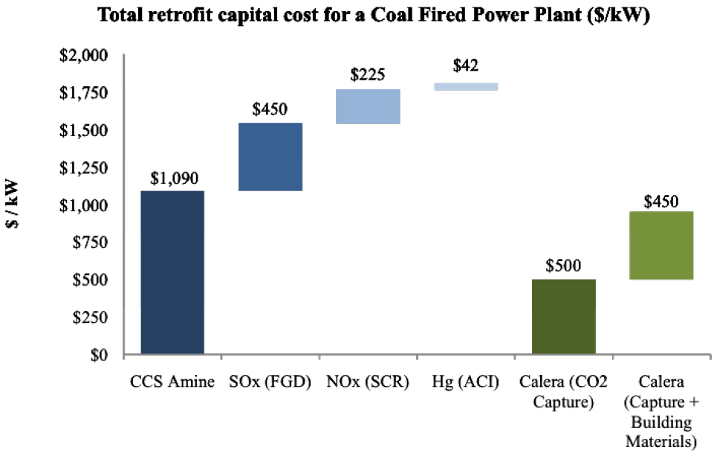
Cost Analysis
(Section 6.4.2, page 84-85)

Slide 42
Cost Analysis
(Section 6.4.2, page 84-85)
total cost of capturing carbon dioxide, sulphur oxides (SOx), nitrogen oxides (NOx), and mercury (Hg) using traditional single pollutant technologies is 1800 USD (approximately 1160 GBP) per kilowatt.
able to capture these pollutants at competitive rates and simultaneously create marketable building materials for about 950 USD per kilowatt

Slide 43
Economic Feasibility
Financial viability depends on
  availability of suitable brines and alternative alkalinity sources
  economic incentives for carbon sequestration,
  ability to satisfy technical performance criteria of local cement markets
  ability to overcome normal market resistance to new technology
Most economic when
  suitable brines and other alkaline feedstocks, and markets for SCM are available near power plants

Slide 44
Economic Feasibility
Calera has potential revenue streams from:
  Sequestration of carbon,
  Removal of SO_{X} and acid,
  Capture and non‐leachable mineralization of mercury and other heavy metals in Calera carbonaceous material
  Fly ash remediation, and
  Product sales
Calera has potential cost savings from:
  Use of waste industrial materials
  Patented electrochemistry to produce sodium hydroxide
  Off‐grid solar and wind generation at remote locations to manufacture alkaline feedstocks
Profitability depends on carbon markets

Slide 45
System Analysis
New power sector equilibrium
  lower carbon emissions,
  lower electricity demand,
  higher prices for electricity from fossil fuel,
  higher market share for renewable and low-carbon generation (because coal plants take on the cost of CCS),
  higher investment in end-use energy efficiency.
New cement sector equilibrium
  lower cement and concrete prices,
  higher demand for these lower cost products,
  lower demand for mined products replaced with Calera materials.

Slide 46
System Analysis
Calera market penetration will encourage other CO₂ mitigation options like:
  Cost-effective energy saving in households and companies,
  Renewable energy sources of power generation,
  Substitution of competing building materials for cement and concrete,
  Relatively low-carbon power generation like natural gas and combined heat and power.

Slide 47
Legislative Issues
(Section 6.4.2, page 85)
The Calera process eliminates the need to
  transport gaseous CO₂,
  locate feasible storage sites, and
  address the ownership and liability issues associated with injection operations and long-term storage.
Due to the stability and usefulness of the carbonate mineral in the built environment
  “ownership is clear and liability is limited to the normal liability for any building material”

Slide 48
Environmental Impact
(Section 6.5.2, page 91)
Ions may not be as abundant as expected
Extraction may change seawater composition, causing imbalance to oceanic eco-system
On top of using natural brines such as seawater, industrial waste products like kiln dust, cement dust or fly ash from smokestacks could provide a source of ions and alkalinity

Slide 49
Environmental risks
(Section 6.4.2, page 85)
Calera process eliminates the risk of CO₂ leaking from pipeline or geologic storage sites.
There used to be environmental issues associated with building pipelines to transport CO₂ to geologic storage sites.
Now this is irrelevant.

Slide 50
Scalability
Modular retrofit to existing power plants, making it scalable
Post-combustion capture process does not require large changes to current infrastructure.
Calera process can operate with flue gasses ranging from less than 2% CO₂ concentration to essentially pure CO₂.

Slide 51
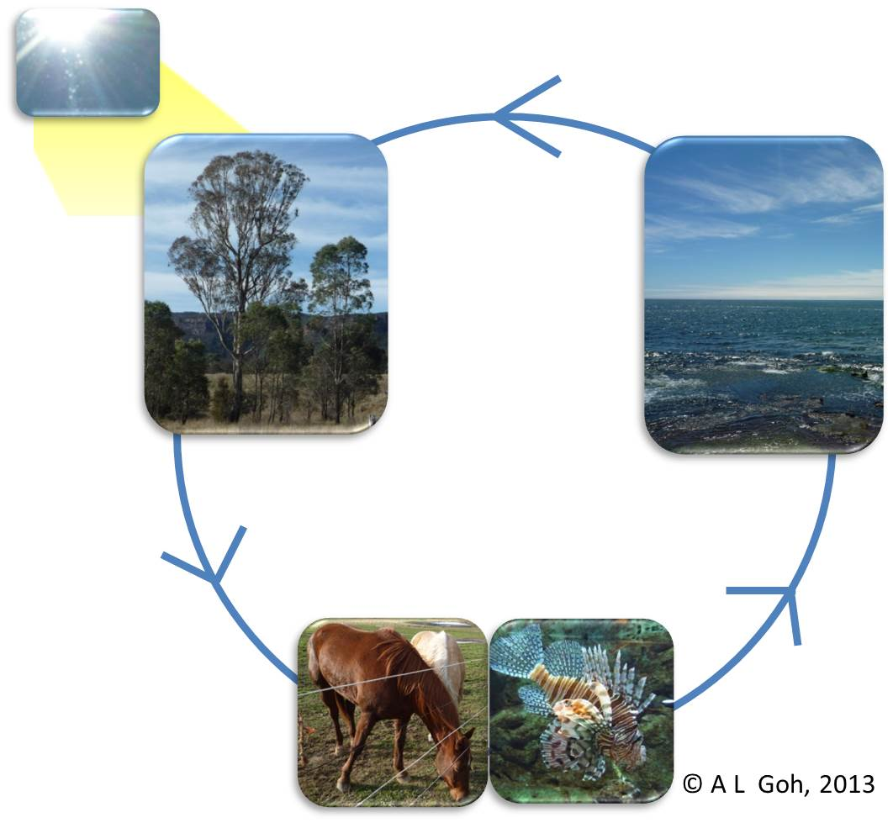
Carbon Cycle

Slide 52
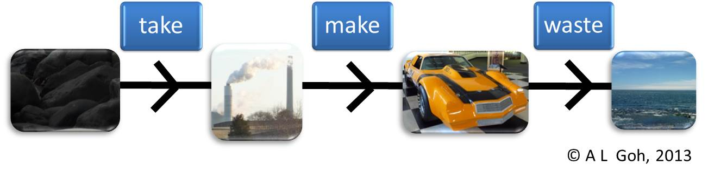
Carbon Cycle

Slide 53
Carbon Cycle
?
© A L Goh, 2013

Slide 54
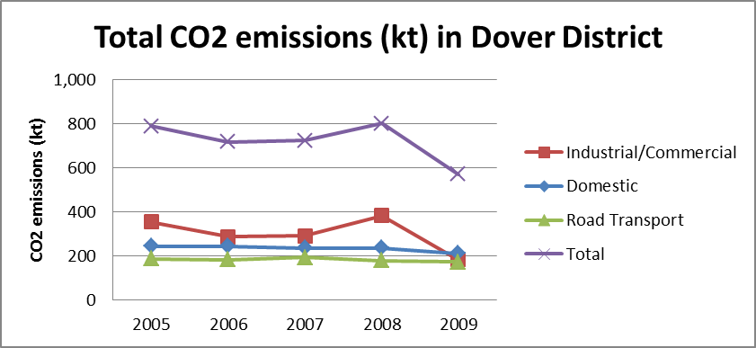
Carbon Emissions in Dover
(Kent County Council, 2011)

