Slide 1
Improving physics teaching through action research: the impact of a nationwide professional development programme
Willeke Rietdijk
Caro Garrett
Marcus Grace
ESERA 2013 5 September 2013
Nicosia, Cyprus

Slide 2
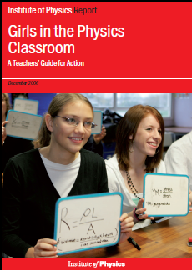
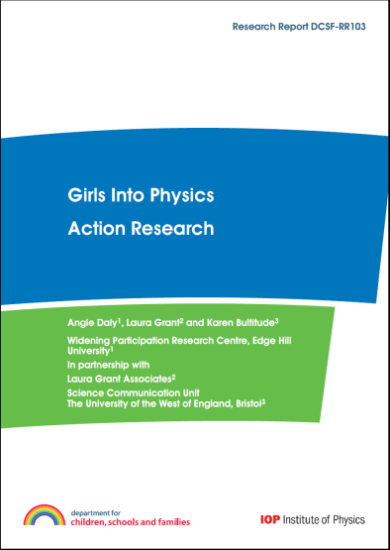
The Action Research for Physics (ARP) programme
Programme set up as professional development programme for teachers
Evaluation research commissioned by the National Network of Science Learning Centres and Department for Children, Schools and Families; focus on impact on pupil attainment and future uptake of physics
Organised and managed by the nine Regional Science Learning Centres between September 2009 and February 2011.
Built on findings from Girls in the Physics Classroom (Hollins et al., 2006) and Girls into Physics (Daly et al., 2009) projects.

Slide 3
The course
A model of professional development incorporating action research, with, as its aims:
  to try out new approaches to teaching physics...
  ...which lead to an increase in young people’s engagement with the subject...
  ...and pursuit of physics beyond GCSE level.
Notes:
Today focusing on impact of programme on teachers! Reported on student outcomes at previous conference. Evaluation paper published in 2011, teacher Case Studies (part 2) published in 2012

Slide 4
Research into teacher professional development
More successful when:
  implemented over long time scale;
  incorporating opportunities for reflection on changes teachers make.
Support from senior management essential in:
  embedding long time scale CPD in school
  developing inquiring learning communities (Joyce & Showers, 2002)
  developing a school culture which encourages the uptake of physics (IoP, 2012)

Slide 5
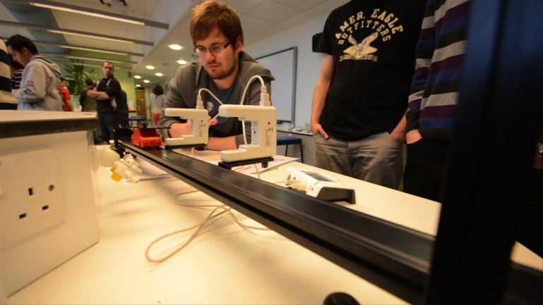
Structure and content of the programme
  3 separate CPD sessions of one day, focusing on:
    action research theory and explanation;
    physics teaching strategies;
    feedback from individual
    teacher’s action research findings
  2 rounds of action research in between the 3 sessions
    Intervention in one of the 6 strands from the Girls into Physics project: Careers, Teaching & Learning; School Culture; Progression; Classroom Management; Workforce
    Intervention to be developed over 2 rounds of action research to incorporate feedback from first round in second round
  +1 day away from school for reading and planning
Notes:
Emphasis on cyclical nature of the process, involving iterative stages of reflection, planning, action and observation which lead on to further reflection and planning (McNiff et al., 1996; 2002)
Taking a broad view of action research as a form of self-reflective inquiry, to understand and improve one’s own practice (Carr and Kemmis, 1986)

Slide 6
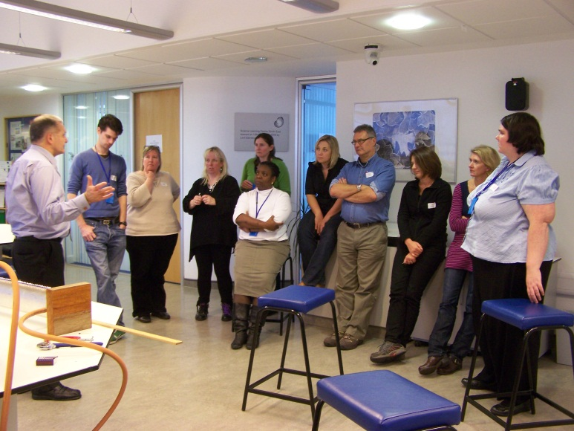
3 professional days
Notes:
First PD day:
Introduction to outcomes of Girls into Physics project
Exploring definitions, examples, pros and cons of action research
Training in collecting, analysing, interpreting data
Consider own research question + discussion with peers and tutor
Think about collecting useful baseline data, considering indicators for measurement
Second PD day:
All teachers present first findings of their classroom action research
Receive feedback from tutors and peers
Reflect on learning and progress so far
Refine action research plans for second round of implementation in classroom
Collaborate with peers in refining research designs and implementations
Share ideas and practice
Third PD day:
Report on classroom action research findings
Collaboratively evaluate these final findings
Receive support with writing up reflective reports on intervention
Comparing experiences and views with those at the start of the course

Slide 7
Research questions
What were teachers’ views about the ARP programme and the impact of action research on their classroom practice?
What were the teachers’ senior managers’ and programme tutors’ views about the programme?

Slide 8
Research methods, data collection & analysis
Research methods + Data collection:
  Quantitative: questionnaires for
    participating teachers (n=110/64)
    senior managers (n=38) from secondary schools across the UK
  Qualitative:
    9 focus groups with teachers (n=54)
    1:1 interviews with course tutors (n=9)
    (at all 9 regional UK Science Learning Centres)
SPSS + Nvivo for data analysis
Notes:
Research methods
Quantitative:
2 Teacher questionnaires (pre- and post training): concerns, teaching strategies, feelings about the programme, impact of the programme
Teachers’ Senior Managers Questionnaires:
Qualitative:
Teacher focus group meetings at 9 regional Science Learning Centres at the end of the programme to assess impact of taking part in course
1:1 Course tutor interviews about their views on the success of the programme and any recommendations for future running of the course
Statistical analysis of the questionnaire data (ChiSq; t-tests; Pearson correlations ; no direct cause and effect associations necessarily implied)
Qualitative analysis (thematic coding) using NVivo of the interviews and focus group meetings

Slide 9
Questionnaires and interview items
Teacher questionnaire: concerns; teaching strategies; impact of programme on various aspects & at various levels
Teacher focus meetings: impact of programme, teaching strategies particularly successful in engaging students
Senior manager survey questions: impact of programme on teachers, students, science department and wider school + satisfaction with programme
Programme tutor interviews: usefulness of programme for teachers & their students; teachers’ learning from action research in the classroom
Notes:
Teacher questionnaires (pre + post)
i) Teaching strategies teachers used to engage students in their classes (pre- and post- programme for comparison)
ii) Concerns about teaching physics (pre- and post);
iii) What teachers felt needed changing in their own physics classes to increase student engagement (pre-programme);
iv) Perceived impact of the ARP programme on:
own physics teaching;
confidence and enthusiasm to teach physics;
whether the programme had addressed concerns about physics teaching.
Changes in practice, changes to SOW, remaining concerns
Impact on colleagues/Department and wider school level
Teacher focus group meetings
30-minutes at the end of the final PD day
face-to-face or video-conferenced
volunteer teacher participants
assessing teachers’ views of
impact of the training
which teaching strategies had been particularly
successful in engaging students with physics.
Senior managers questionnaires
(Senior managers approved teachers' involvement in the programme.)
The questionnaire asked about impact of the programme on:
the teachers’ confidence, enthusiasm and capability to teach physics;
the students’ performance and attitudes towards physics; and
the science department and at a wider school level;
send other teachers on the programme in the future?
recommend the programme to other schools?
Programme tutor interviews:
30 minutes
mostly phone interviews; occasionally face-to-face
Questions about:
usefulness of programme for teachers
impact of programme on:
participants' teaching
participants' students
participants' learning from doing action research in classroom

Slide 10
Teachers’ physics action research projects
67 action research interventions (8 in girls’ schools; 1 in a boys’ school; rest in mixed gender schools)
Projects included action research on:
  questioning techniques;
  introducing the context and applications at the beginning rather than at the end of a topic (this was reported by teachers as especially successful);
  bringing more real-life context into the lesson (for example using short anecdotes);
  introducing relevant mathematics at the start of a topic to boost confidence;
  video peer assessment;
  more discussion;
  cross-curricular activities;
  incorporating outside speakers in class;
  students researching careers;
  students’ presenting about what physicists do.

Slide 11
Findings at start of programme
Teachers' backgrounds (n=110)
55% female and 45% male teachers
from a very wide range of schools.
55% subject background in physics, 13% in biology, and 9% in chemistry.
36% had taught science for more than 10 years, 22% for 6-10 years, 40% for 1-5 years
36% had done some previous action research.

Slide 12
Findings at start of programme (cont)
Concerns about teaching physics (only 55% were physics ‘specialists’), including a lack of confidence
Limited range of strategies used to address
  Differentiation for gender/ability
  Links to careers and global/social issues
Notes:
Teachers’ concerns related to:
Engaging and enthusing students
Making physics relevant
Challenging students’ perceptions of physics as a hard subject
Progression to post-compulsory physics
Confidence in their own teaching of physics
Gender imbalances (particularly girls’ enjoyment and progression in physics)
Teaching strategies used:
90% of the teachers ‘rarely’ differentiated for boys and girls
68% reported that they differentiated for more able students at least ‘sometimes’.
25% ‘rarely’ linked physics with careers in their physics lessons
16% ‘rarely’ made links with global and social issues in their physics lessons.

Slide 13
Post-programme teacher questionnaires
Action research:
100% found the action research useful for improving classroom practice
91% had learnt 'a lot' or 'quite a lot' about action research since programme start
86% said their intervention had been 'very’ or ‘quite’ effective in increasing student engagement with physics
50% had changed their schemes of work as result of the programme
Increase in motivation/enthusiasm to teach physics
Increase of discussion and reflection time
Notes:
64% felt increased motivation/enthusiasm to teach physics
50% said their own interest in teaching physics had increased (50% said it had stayed the same)
Changes in teaching physics strategies
72% increased discussion time in class
85% increased student reflection/thinking time
Changes in motivation/enthusiasm
64% felt increased motivation/enthusiasm to teach physics
50% said their own interest in teaching physics had increased (50% said it had stayed the same)
Changes in teaching physics strategies
Discussion had become a more natural part of teachers' physics lessons
Quality of the discussion had improved
Thinking time had sometimes increased
I have increased discussion – with practicals for example, I stand back for 10 minutes to see what happens and I was very impressed by the discussions taking place. The pupils are so responsive I don’t have to control the class as much. (Male teacher 1, Focus group 1)
[students are] used to being given a little bit of time to discuss it, and they are actually starting to do that now, so I think that’s perhaps a confidence thing as well with me, that I feel more comfortable now with them. (Female teacher 7, Focus group 1)

Slide 14
Figure 1. Confidence changes in teachers between the beginning and end of ARPP
Notes:
At the end of the Programme teachers reported increased confidence in:
Getting pupils engaged in physics (78% feel more confident)
Getting girls engaged in physics (56% feel more confident)
Making physics relevant (78%)
Boosting pupils’ confidence in physics (63%)
Boosting girls’ confidence in physics (59%)
Increasing pupils’ awareness of careers/futures in physics (70%)
Making abstract physics more ‘visible’ for pupils (70%)
Making the most of resources (62%)

Slide 15
Table 1. Physics teaching strategies used by teachers before and after the intervention
(a higher score indicates more use of the strategy)
In your physics lessons, how often do you… | Mean (SD) |  | T-value
 | Before | After
Encourage dialogue between teacher and student? | 1.41 (.53) | 2.97 (.18) | 19.78***
Encourage dialogue between student and student? | 1.16 (.37) | 2.74 (.44) | 21.09***
Differentiate between boys and girls? | 1.89 (.51) | 1.36 (.56) | -4.97***
Differentiate for gifted & talented students? | 2.86 (.40) | 2.22 (.62) | -6.35***
Use gender-neutral examples and illustrations? | 1.69 (.71) | 2.55 (.63) | 6.06***
Link physics with careers? | 1.53 (.54) | 2.29 (.59) | 6.84***
Link physics with everyday life? | 1.60 (.62) | 2.79 (.41) | 11.76***
Link physics with global and social issues? | 1.33 (.51) | 2.41 (.56) | 11.30***
Link physics with other subjects? | 1.77 (.63) | 2.35 (.55) | 4.46***
Make links between topics? | 1.81 (.61) | 2.66 (.55) | 7.19***
Use non-technical language? | 2.12 (.62) | 2.74 (.48) | 5.98***
*p<.05; **p<.01; ***p<.001

Slide 16
Teacher focus group meeting findings
9 held at end of CPD day 3 at all Science Learning Centres (live or VC) (n=54)
Confirmed the questionnaire findings
Teachers very positive about the benefits for their practice of discussing classroom strategies and ideas with other teachers on the course
Many teachers feel formal engagement with action research has had many benefits
  realise they do it all the time,
  but the course ensured greater focus,
  and the cyclical nature of action research impacted more on their practice
  some say they will try to do this more often
Many teachers feel pupils are more engaged now
Discussion in class is found to be extremely useful
Many teachers not sure of impact on post-16 take-up (hard to tell – and even if increased take-up, what are the reasons?)

Slide 17
Comments about the usefulness of action research
I think the course has reminded me how important it is, even if you’ve had a go at doing something different, that’s not necessarily the end of it; you can go back and have a look at it again. It is nice to get something that you think’s going to work and is going to be useful. And it’s not a wrong thing to go back and change it. (Female teacher 6, Focus group 2)
Often if you have a look at an idea you’ll implement it all the way across the board and you’ll never actually know if it’s that idea that made a change in the results. Whereas doing it this way, having it controlled, looking at the year before, you do get that feedback that it was actually because you did that. (Male teacher 5, Focus group 3)
It’s led me to reflect more on my teaching, and therefore, I think, I’ve been more inspired in my lessons to feel that I now know what makes students tick a little bit more. I’m aware much more of what they enjoy and what they don’t enjoy, and I’m more aware of different ways of working, which I’ve learnt from other professionals here. (Male teacher 5, Focus group 5)

Slide 18
Senior managers questionnaire
  There have been huge benefits in terms of motivation and enjoyment of physics, and benefits for teachers, having the creative freedom to work together on a common project. (Senior manager 2)
Course tutor interviews
  One teacher told me that there’s a little bit of a buzz about what’s going on, which has really heightened the profile of the department within the school and therefore is changing the senior managers’ attitudes (Programme tutor 9)
Notes:
Senior manager questionnaire findings:
38 senior managers responsible for PD across their schools responded to the questionnaires
91% felt that the action research programme had been ‘very useful’ or ‘quite useful’ for classroom improvement
37% said they planned to use their teachers’ findings in future staff development
61% said they would send other teachers on this PD course in the future
87% would recommend the course to other senior managers
Many senior managers had a clear understanding of their teacher’s intervention and the impact it had: (Quotes)
Course tutor interview findings:
9 programme tutors
generally felt the course had been very useful for participants in terms of:
having a period of time out of school to reflect on their practice
implementing something new in their classes
discovering and considering things they had never known or considered before
sharing their practice with teachers from other schools.
Action research as useful in terms of improving classroom practice
The process of action research was perceived as inspiring for teachers
Almost all teachers were felt to recognise the value of action research for improving classroom practice
Significant impact in the classroom and beyond: (quotes)

Slide 19

Case studies
Rietdijk, Willeke, Grace, Marcus and Garrett, Caro (eds.) (2012) Action Research for Physics Case Studies, Southampton Education School, 106pp. (accessible at http://eprints.soton.ac.uk/342679/ )
Notes:
18 teachers
School context, overview of intervention, changes to lessons, new resources required, timing issues, impact on self, impact on colleagues, recommendations, appendices with resources used

Slide 20
Conclusions
ARP programme was considered a resounding success by all stakeholders
Intention to continue action research approach to physics teaching as a means of improving classroom practice
Increased teacher self-efficacy and confidence in engaging students in physics and making physics relevant
Adopting new teaching strategies
Increased motivation and enthusiasm towards teaching physics
Sometimes unfocussed project aims due to inexperience with action research; some teachers would require further assistance with action research planning and scoping techniques.
Senior managers' overwhelming endorsement of the ARP programme in delivering classroom improvement is an important measure of its success.

Slide 21
Recommendations/implications
Engagement with course and action research has been a driver of change in the classroom
Science Learning Centres delivering Action Research courses modelled on ARPP and its predecessors
Continue to do so in the new era of CPD in England
  the National College for School Leadership (NCSL) has designated the first cohort of teaching school alliances. These will lead the school system in training and developing outstanding teachers. (DfE 2011:12)
Continuing issues around release time for teachers

Slide 22
References
Research publications:
Rietdijk, Willeke, Grace, Marcus and Garrett, Caro (2011) Action Research for Physics Programme Final Report, National Science Learning Centre (accessible at https://www.sciencelearningcentres.org.uk/impact-and-research/ARPPexecutivesummary.pdf)
Rietdijk, Willeke, Grace, Marcus and Garrett, Caro (eds.) (2012) Action Research for Physics Case Studies, Southampton Education School, 106pp.(accessible at http://eprints.soton.ac.uk/342679/
Accessible from the IoP website:
Daly, A., Grant, L. and Bultitude, K. (2009) Girls into Physics: Action Research: Evaluation Report, London: Department of Children, Schools and Families, UK
Hollins, M., Murphy, P., Ponchaud, B. and Whitelegg, E. (2006) Girls in the Physics Classroom: A Teachers’ Guide for Action. London, Institute of Physics
Murphy, P. and Whitelegg, E. (2006). Institute of Physics Report: Girls in the Physics Classroom: A Review of the Research on the Participation of Girls in Physics. London: Institute of Physics

Slide 23
Thank you
Our email addresses:
W.Rietdijk@soton.ac.uk
C.Garrett@soton.ac.uk
M.M.Grace@soton.ac.uk

