Slide 1
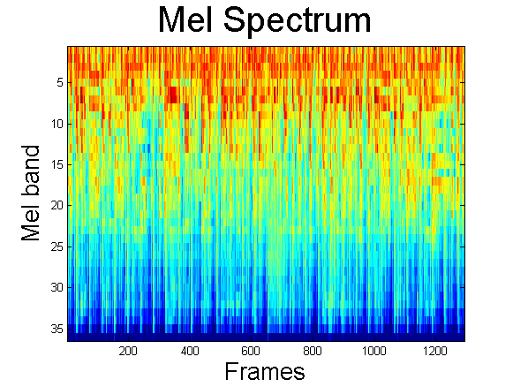

WAIS @ MIREX 2011
AMS and Genre Classification Tasks
Franz de Leon, Kirk Martinez
Web and Internet Science Group • School of Electronics and Computer Science • University of Southampton
{fadl1d09, km}@ecs.soton.ac.uk
Summary
Audio Music Similarity
Audio features that approximate timbre, rhythm and tempo are used for genre classification and music similarity estimation. In our system, audio data are modelled as long-term accumulative distribution of frame-based spectral features. This is also known as the “bag-of-frames” (BOF) approach wherein audio data are treated as a global distribution of frame occurrences.
The timbre, rhythm, and tempo distances are calculated separately. Before they are combined, each distance component is normalized by removing the mean and dividing by the standard deviation of all the distances. The results are then weighted before being summed. Symmetry is obtained by summing up the distances in both directions for each pair of tracks [4].
Distances between timbres are computed by comparing the GMM models. We use symmetric Kullback-Leibler (KL) distance between two models [5]. The Euclidean distance is used to compute distance between rhythms. For tempo distances, a simple absolute distance is computed.
Feature Extraction
Audio Pre-processing
The first step before calculating any features is to normalize the audio signal. The process scales and shifts the sound vectors so they have maximum amplitude of one and have average value of zero. The signal is then cut into frames with a window size 512 samples (~23 msec. @ F_{Sampling}=22 kHz) and hop size 512 samples.
Timbre Component
The timbre component is represented by the Mel-Frequency Cepstral Coefficients (coefficients 2:20) [1]. We use a single Gaussian represented by its mean µ and covariance matrix Σ. Other features derive derived from the spectral representation are spectral flux, spectral flux from delta spectrum, spectral flux from Mel-frequency spectrum, and spectral flux from Mel-frequency delta spectrum.
Rhythm Component
The rhythm component is based on the Fluctuation Patterns [2] (FPs) of the audio signal. Fluctuation patterns describe the amplitude modulation of the loudness per frequency band. For each frame, the fluctuation pattern is represented by a 12x30 matrix. The rows correspond to reduced Mel- frequency bin while the columns correspond to modulating frequency bands. To summarize the FPs, the median of the matrices is computed. Additional features derived are FP mean and FP standard deviation.
Tempo Component
The tempo component is derived from a technique using onset autocorrelation [3]. The tempo is computed by taking the first-order difference along time of a Mel-frequency spectrogram then summing across frequency. A high-pass filter is used to remove slowly-varying offsets. The global tempo is estimated by autocorrelating the onset strength and choosing the period with the highest windowed peak.
Spectral Distances
Normalize
W₁
Distance
Matrix
Rhythm
Distances
Normalize
W₂
Σ
Tempo Distances
Normalize
W₃
Genre Classification
Genre classification involves training a classifier. The timbre, rhythm and tempo features are combined as a single vector to represent each training file. For the classifier, the Directed Acyclic Graph-Support Vector Machine [6] is used to handle the multi-class problem. For the DAG-SVM classifier, the radial basis function kernel is used.
Audio Files
Log,
DCT
MFCC
Spectral Features
Spectral Features
Combine
Features
Scale Features
Flux
Spectral
Flux
Rhythm
Features
DAGSVM
Genre
Tempo Features
Training
Test Song
Results
Fluctuation
Patterns
Rhythm
Features
Acknowledgements
Franz de Leon is supported by the Engineering Research and Development for Technology Faculty Development Program, DOST Philippines.
References
[1] B. Logan and A. Salomon, “A Music Similarity Function Based on Signal Analysis,” in IEEE International Conference on Multimedia and Expo, pp. 745-748, 2001.
[2] E. Pampalk, “Computational Models of Music Similarity and their Application in Music Information Retrieval,” Vienna University of Technology, 2006.
[3] D. P. W. Ellis and G. E. Poliner, “Identifying `Cover Songs’ with Chroma Features and Dynamic Programming Beat Tracking,” in 2007 IEEE International Conference on Acoustics, Speech and Signal Processing - ICASSP ’07, 2007, p. IV-1429-IV-1432.
[4] E. Pampalk, “Audio-Based Music Similarity and Retrieval : Combining a Spectral Similarity Model with Information Extracted from Fluctuation Patterns,” in Submission to MIREX 2006, 2006.
[5] M. I. Mandel and D. P. W. Ellis, “Song-level Features and Support Vector Machines for Music Classification,” in Submission to MIREX 2005, 2005, pp. 594-599.
[6] J. C. Platt, N. Cristianini, and J. Shawe-taylor, “Large Margin DAGs for Multiclass Classification,” Advances in Neural Information Processing Systems 12, pp. 547-553, 2000.
Tempo
Tempo Features
http://www.soton.ac.uk
http://www.wais.ecs.soton.ac.uk

