Slide 1
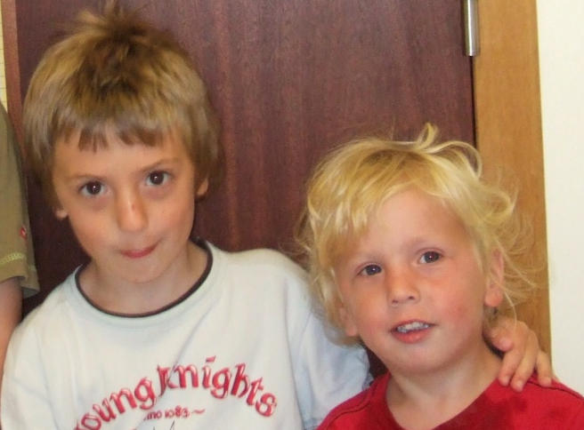
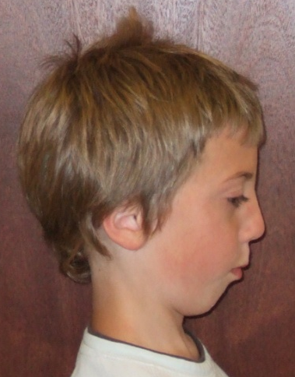
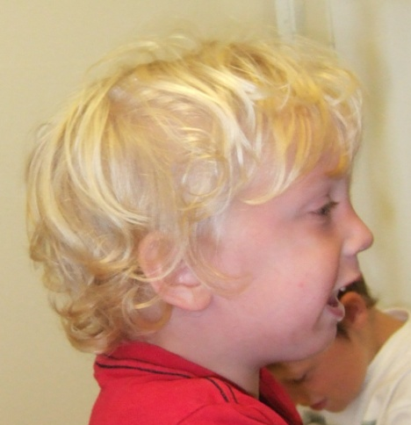
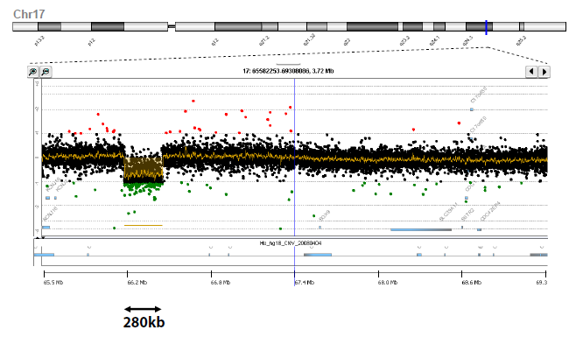
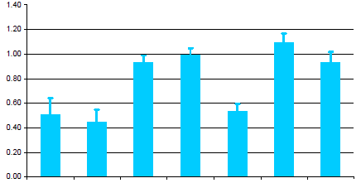
Fig1
Ai
Aii
Aiii
B
PRS183
I
1 2
KCNJ2
del/+ +/+
1 2 3 4
II
del/+ del/+ +/+ +/+
1.156
Mb
SOX9
II1 II2 II3 II4 I1 I2 control
= PRS, flat midface, pectus excavatum
= cleft of soft palate, flat midface

Slide 2
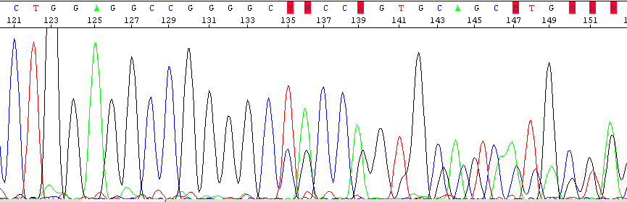
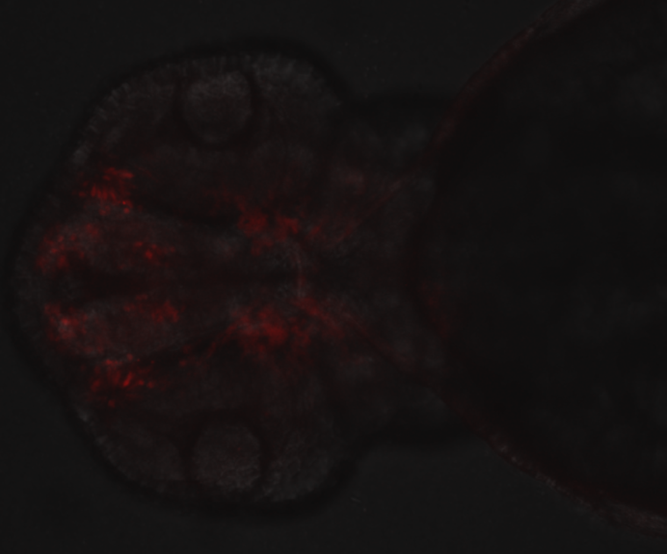
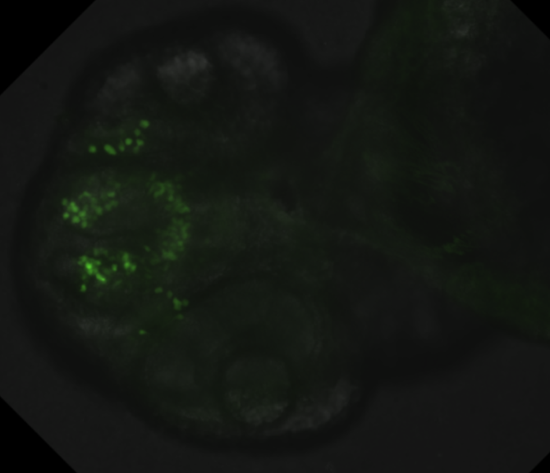
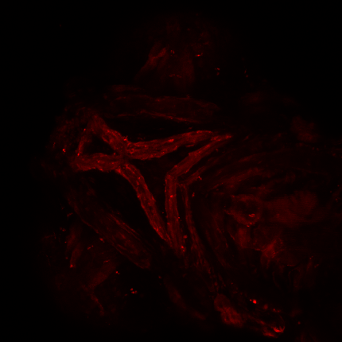
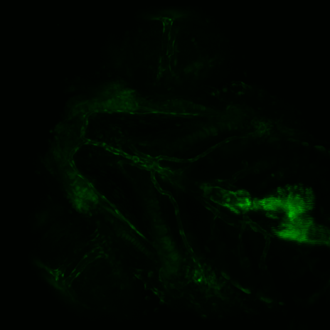
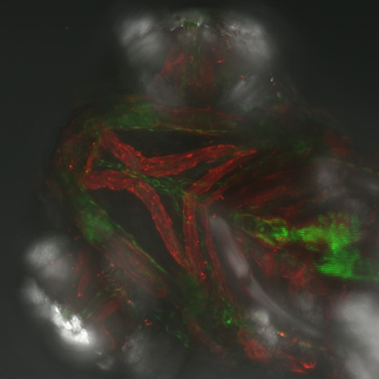
Fig2
A
I
1 2
FOXC2 del
rs78542003
II
1 2
rs78542003, FOXC2 del
III
1 2
FOXC2; c.975-984delCGCCGGGGGC, p.Ala326ThrfsX8
rs78542003, FOXC2 del
rs78542003, FOXC2 del
lymphoedema
distichiasis
PRS
Bi Bii
op
pas
op
pas
fb
fb
HCNE-F2(wt)-mCherry 48hpf
HCNE-F2(var)-GFP 48hpf
Biii Biv Bv
ep
ch
ep
ch
HCNE-F2(wt)-mCherry 5dpf
HCNE-F2(var)-GFP 5dpf merge Biii+Biv+brightfield 5dpf

Slide 3
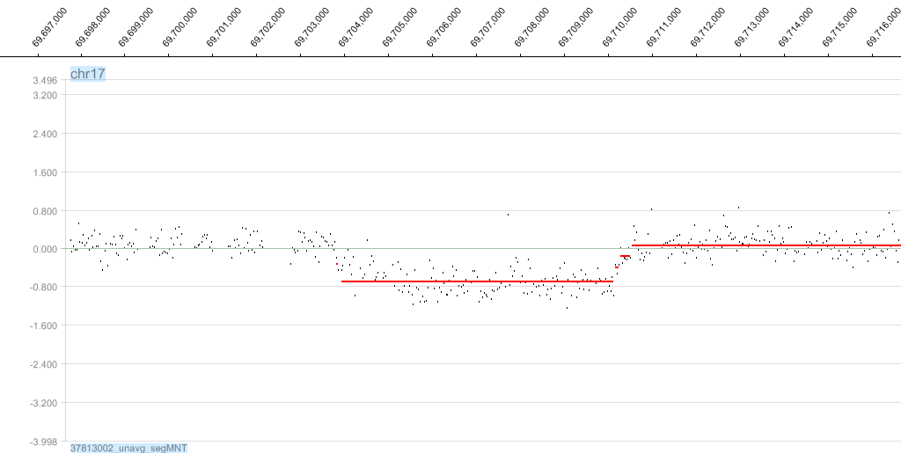
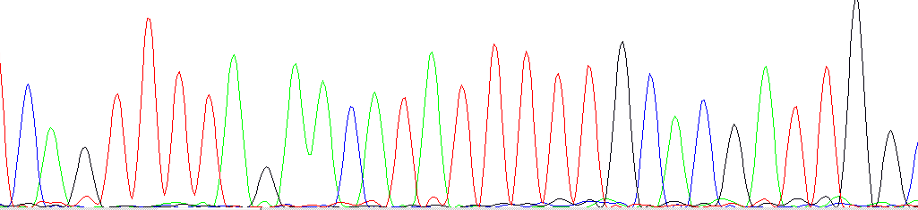
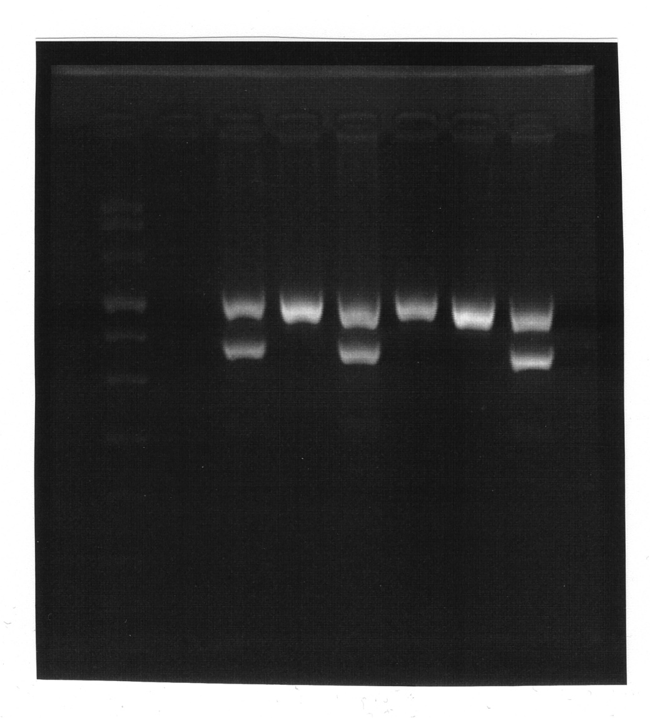
407 kb upstream of SOX9
C A G T T T T A G A A C A T A T T T T T G C A C G A T T G G
C A G T T T T A G A A C A T A t t t a t c a t c c c a a a g
t g t c a a a a t g c a c a g T T T T T G C A C G A T T G G
del/+
del/+
+/+
del/+
+/+
+/+
Fig3
A
deletion = 6031 bp
del-spanning:
5’ reference:
3’ reference:
B
neg
III3
III1
II3
III2
1
PRS116
M
II2
I1
I
II
1 2 3
= PRS
= deafness
III
1 2 3
= feeding difficulties at birth
= Dupuytren’s contracture

Slide 4
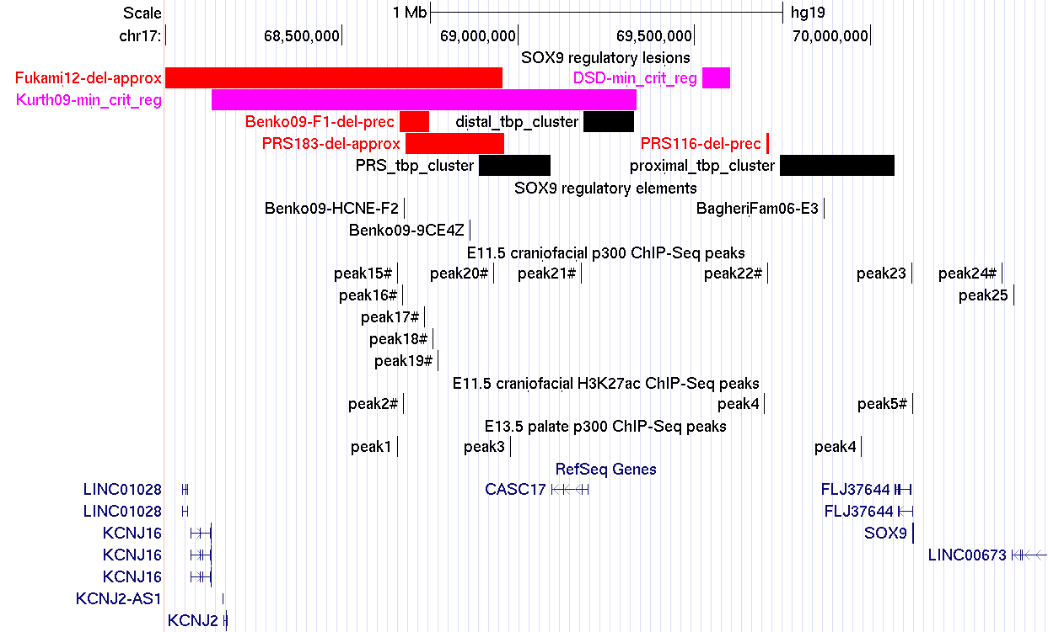
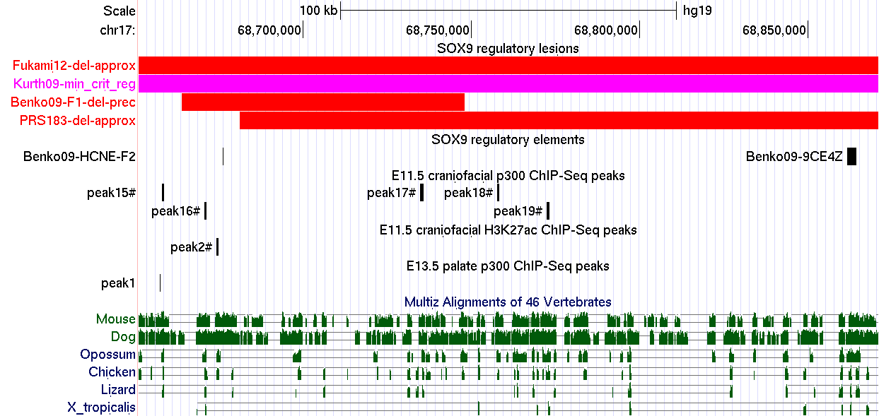
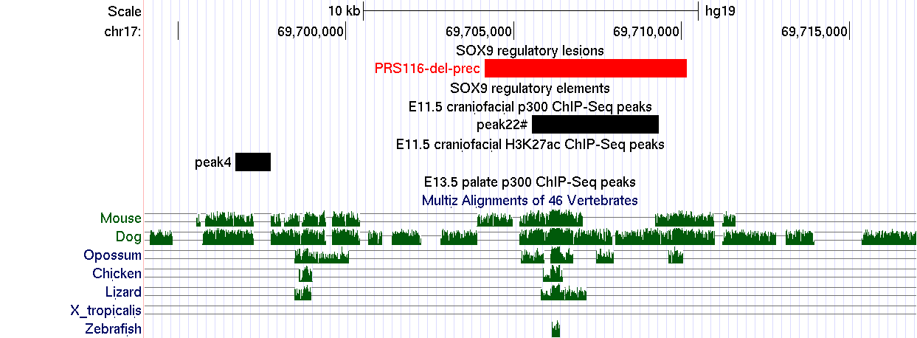
Fig4
A
CEN
TEL
B
C
B
A
B
C
D
C

Slide 5
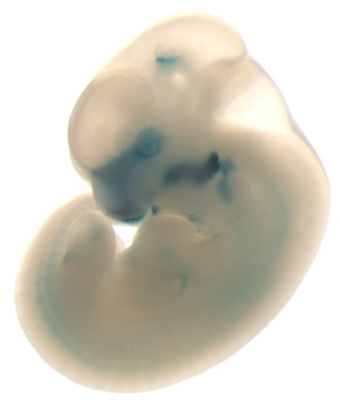
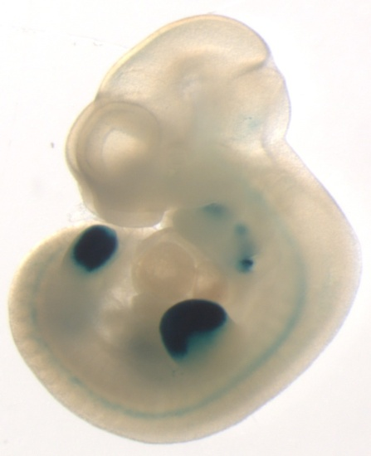
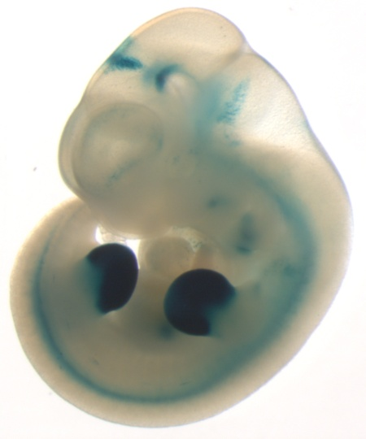
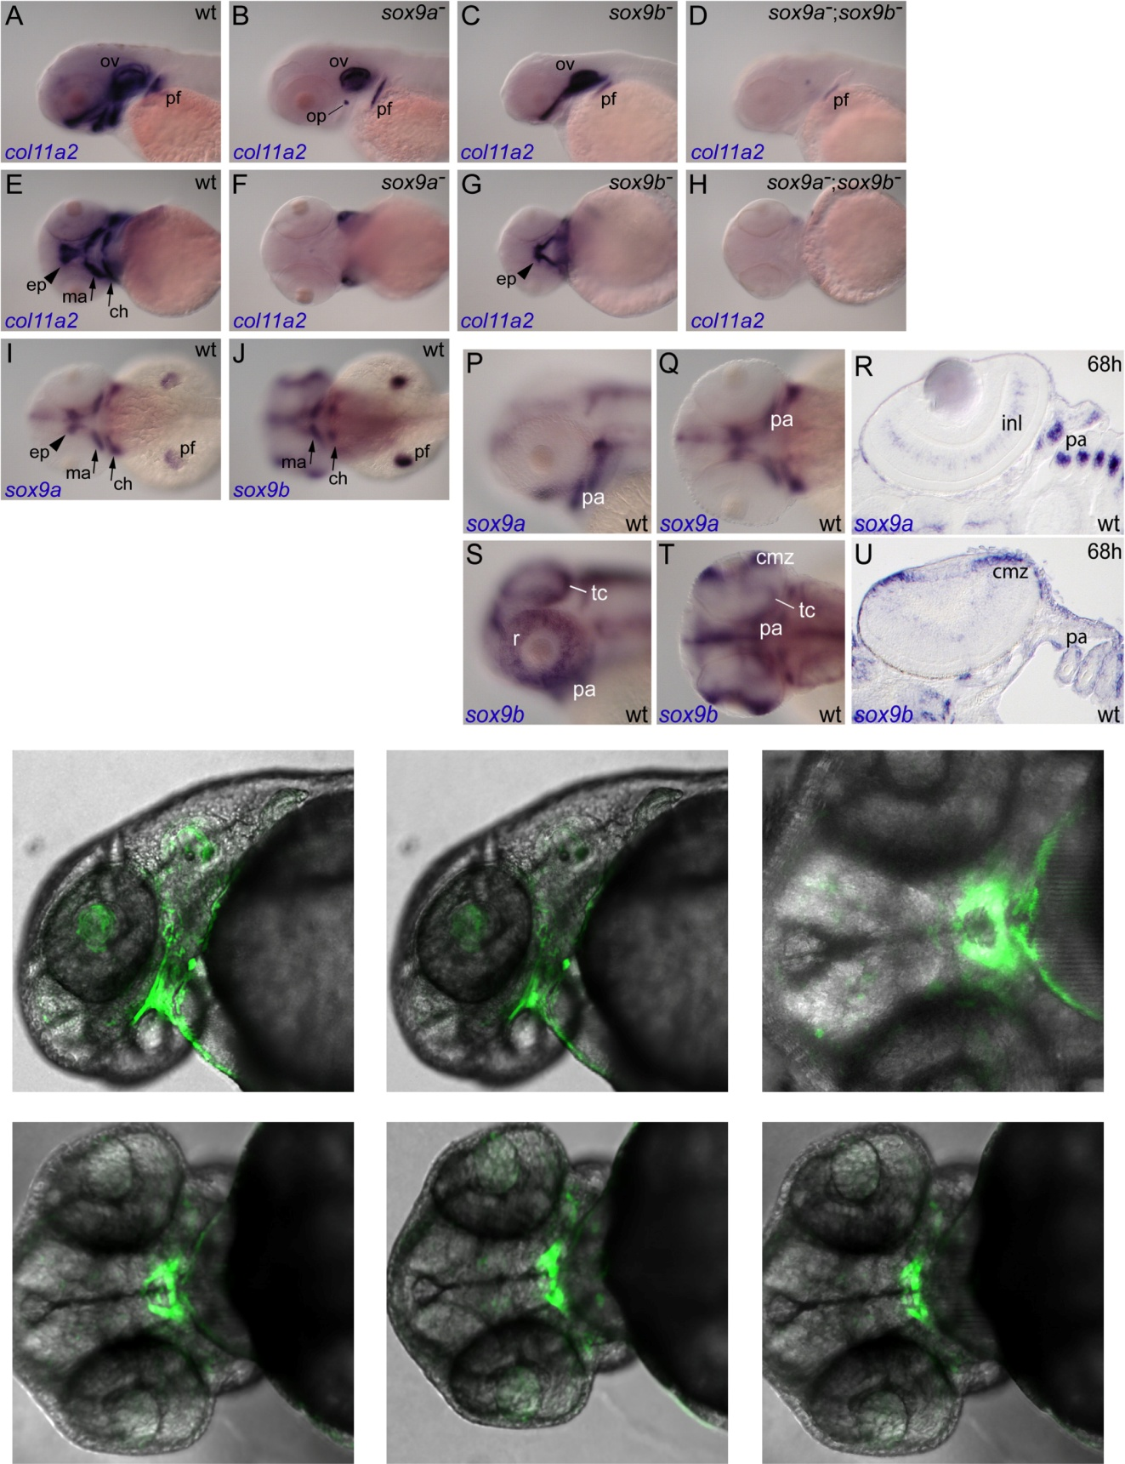
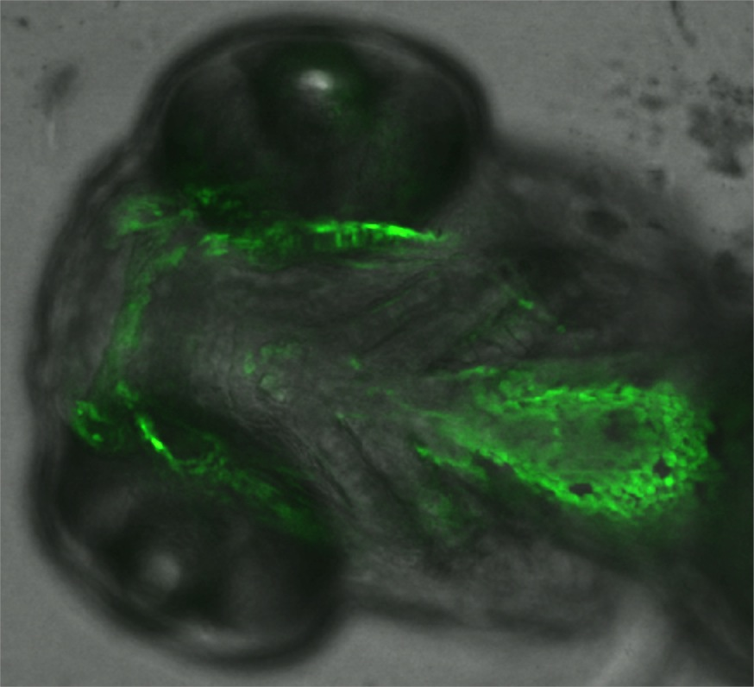
Fig5
A
peak 16-lacZ
peak 22- lacZ
B
peak 17-GFP
48 hpf
48 hpf
96 hpf
Mc
pq
oc
pa
lat
ven
ven

Slide 6
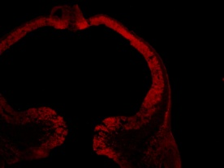
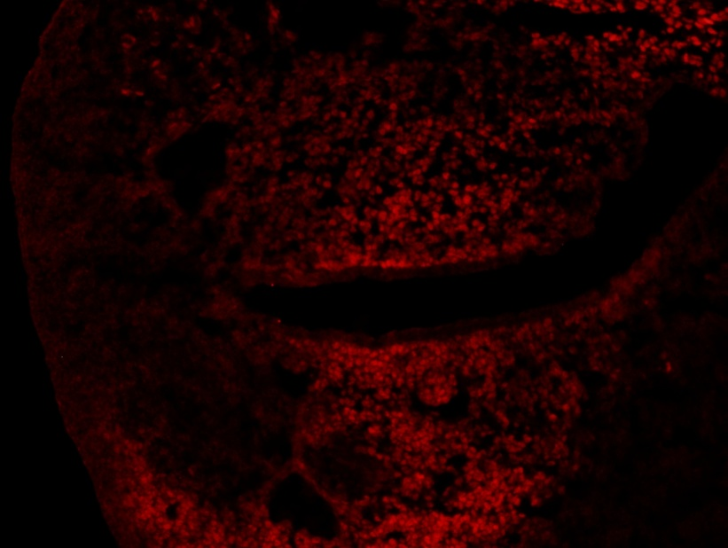
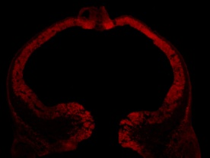
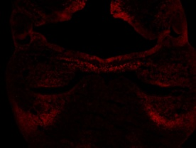
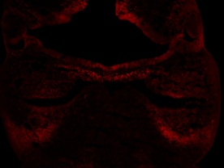
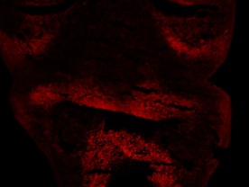
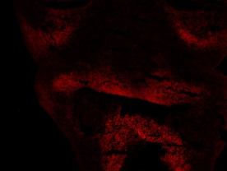
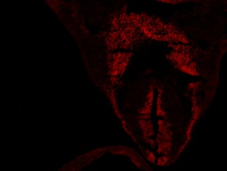
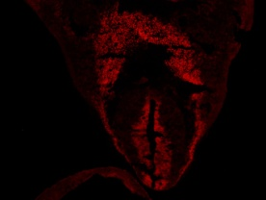
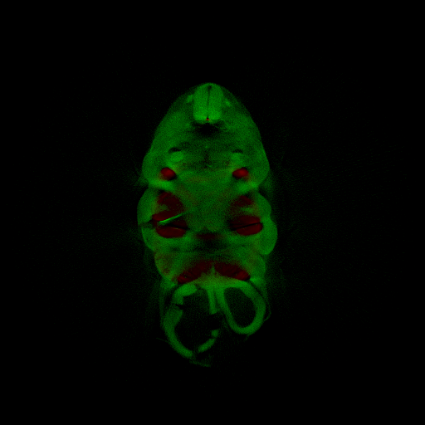
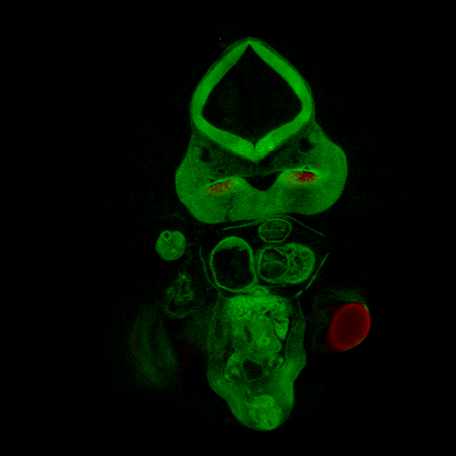
Fig6
A
B
oc
B
mp
Sox9
Sox9
C
D
D
oc
mp
peak 16-lacZ
peak 16-lacZ
E
F
F
oc
mp
lb
peak 22-lacZ
peak 22-lacZ

