Slide 1
Highlights of EULAR 2014 from a Health Professional View
Dr Jo Adams
Professional Lead for Occupational Therapy University of Southampton UK
National Public and Patient Involvement Lead for Arthritis Research UK Centre of Excellence for Sport, Exercise and Osteoarthritis
EULAR Health Professional Scientific Committee
ja@soton.ac.uk

Slide 2
DISCLOSURES
Research grant funding from EULAR; Arthritis Research UK; Ascension Orthopedics USA; Bristol Myers Squib; Cancer Collaborative Network; Wessex Medical Trust; College of Occupational Therapists; Constance Owens Trust; Worldwide University Network; National Institute for Health Research (Health Technology Assessment).
No personal payment or paid consultancy

Slide 3
Health Professional Sessions
US Imaging
Food as Therapy
Promoting healthy lifestyle
Evaluating practice
Targets and mechanisms of treatment in chronic pain
Patients perspectives in rheumatologic outcomes
eHealth Literacy
Tracking the Journey
Patient self reported disease activity measures in RA
Annual reviews
Sceleroderma patient centred intervention network
Easy travelling facilitating a normal life
Patient education

Slide 4


Slide 5
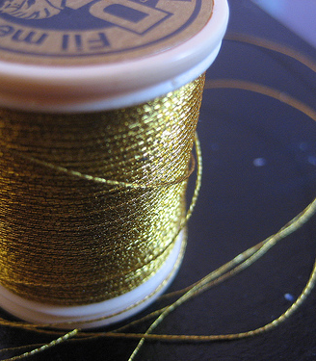

How to Connect ?
“Golden Thread”
“Red Thread”

Slide 6
Supporting patient engagement in self management strategies
Timely as self management for long term conditions is now a priority (Naylor 2013; WHO 2013)
Engaging people with RMD conditions in effective self management has better outcomes for all (Lorig et al 1999)
Health professionals can have the skills and insights to do this well (Lillie et al 2013)

Slide 7
1 Background to patient engagement in self management
2 Practical examples of how to facilitate patient engagement in self management
3 Evidence for successful strategies for patient engagement in self management

Slide 8
Background to patient engagement in self management

Slide 9

Putting knowledge into practice:
Psychological Barriers
Dr Vasiliki Christodoulou
CYPRIOT ANTIRHEUMATIC ASSOCIATION
Thought
Bodily Sensation
Emotion
Action
Cyprus Institute of Psychotherapy
Notes:
Psychological barriers come in many forms.
They may be thought barriers, sensations or emotions.
We will consider each one.

Slide 10
A vicious entrapment
I worry about my health
I neglect healthy behaviours
Anxiety
Stress
Sadness
AVOID
BLOCK
COMFORT EAT
I tense up Symptoms may flare up
Pain
Notes:
a vicious cycle maybe developed. Worrying about health results in anxiety and stress. Besides these emotions may be related with tension and a symptom flare up which in turn encourages one to avoid, block and comfort eat. Naturally whilst ignoring the illness one is also less careful with nutrition and other health behaviours.
Sooner or later this is again realised and worrying remerges.

Slide 11
Values-based Choice and Mindfulness
We can freely CHOOSE our health behaviour!
How would I like to behave with regards to my health?
What role would I choose to play in my family, friends’ life?
What would I have liked to have seen myself doing if I could look back from old age?
Value
I would like to be a mother who plays with her children
Caring for my body is important so that I can be playful more often
Barrier
Often my symptoms flare up and its difficult to run around
Choice
I choose to eat healthy foods
I exercise twice a week
Notes:
If we could justify what is really important to us we could freely choose without feeling compelled to justify.
Also a choice of a healthy food may take on lost more personal meaning than a simple daily choice.
It is an action representative of my greater stance in life.
For example being a mother who values being active with her children. She may choose a certain food as means of pursuing this type of relationship with her children and not because
“media tells her so” “she has to” or “because she should”

Slide 12
In a nutshell!
Changing nutritional habits is difficult whatever your personal circumstances.
It presents with added challenges in chronic conditions as people often seek comfort in periods of distress.
Healthy behaviours can be connected to life values rather than be based on ‘should’ or ‘must’.
Making healthier choices requires an ability to accept difficult thoughts and feelings.
Practicing mindfulness acceptance can be a useful technique.
Notes:
In conclusion,
A change in nutritional habits is difficult for everyone but especially in chronic conditions.
It is best to move away from rules of behaving to activating personal values that support our choices.
This may require an acceptance of difficult private content. Mindfulness approaches may be helpful in this regard.

Slide 13



Motivation Contributes to the Physical and Psychological Health of Rheumatoid Arthritis Patients: Above and Beyond Physical Activity
Dr Peter C Rouse . Duda,. Veldhuijzen van Zanten, Metsios,Ntoumanis, Yu,. Kitas
Study Aim: To test whether patients’ motivation to be physically active predicted physical function and well-being

Slide 14

Participants (N = 106)
Confirmed diagnosis of Rheumatoid Arthritis
  Without co-morbidities prohibiting exercise
  No recent joint operations (6 months)
  About to enter an exercise intervention

Slide 15
Hierarchical Regression Analyses
Predictors
Disease Activity
  C-reactive Protein
Moderate & Vigorous Physical Activity Behaviour
  International Physical Activity Recall¹
Relative Autonomy Index (Motivation)
  Behavioural Regulations in Exercise Questionnaire- 2²
Outcomes
Indicators of Well-being
  Subjective Vitality Scale³
  Hospital Anxiety & Depression Scales⁴
  Stanford Health Assessment Questionnaire⁵
¹ Craig et al. (2003), ²Markland & Tobin, (2004), ³Ryan & Frederick, (1997),⁴Zigmond et al. (1983), ⁵Kirwan, (1986)
Notes:
A series of hierarchical regression analyses were conducted to test whether rheumatoid arthritis patients’ motivation to be physically active predicted indicators of well-being above and beyond that of self-reported moderate to vigorous physical activity (MVPA). CRP was included in all analyses to control for the effect of disease activity. Moderate to vigorous PA was measured using the IPAQ, and the Relative Autonomy Index created from the BREQ-2 as a measure of motivation. Higher RAI scores represent more autonomous motivation to exercise.
Four indicators of wellbeing were employed as outcome measures. Subjective vitality as an indicator of positive wellbeing, the HADS measured symptoms of anxiety & depression and the Multi-dimensional assessment of fatigue was an indicator of physical wellbeing.
Analyses were conducted on 4 indicators of wellbeing.

Slide 16


Subjective Vitality
*
*
R²= .05
R²= .06
R²= .08
Regression Model F (3,98) 5.57, p = .001
Notes:
I have presented the results of the analyses in graphical form to aid visual interpretation with the bars representing the standardised betas when all variables are included in the model. Here it can be seen that both self-reported physical activity and motivation were significant contributors to the prediction of a positive indicator of psychological wellbeing. Effect sizes indicate the motivation explained the most amount of variance in percpetions of subjective vitality.
Note: The b-values tells to what degree each predictor affects the outcome if the effects of all other predictors are held constant. Standardised B-values are easier to interpret as not dependent on the units of measurement. They provide the number of SD’s that the outcome will change as a results of one SD change in the predictor. Allow direct comparison so provide a better insight into the ‘importance’ of each model. Therefore, we are able to compare the contribution made by Disease Activity, PA and Motivation.

Slide 17
Subjective Vitality
*
*
R²= .05
R²= .06
R²= .08
Regression Model F (3,98) 5.57, p = .001
Notes:
I have presented the results of the analyses in graphical form to aid visual interpretation with the bars representing the standardised betas when all variables are included in the model. Here it can be seen that both self-reported physical activity and motivation were significant contributors to the prediction of a positive indicator of psychological wellbeing. Effect sizes indicate the motivation explained the most amount of variance in percpetions of subjective vitality.
Note: The b-values tells to what degree each predictor affects the outcome if the effects of all other predictors are held constant. Standardised B-values are easier to interpret as not dependent on the units of measurement. They provide the number of SD’s that the outcome will change as a results of one SD change in the predictor. Allow direct comparison so provide a better insight into the ‘importance’ of each model. Therefore, we are able to compare the contribution made by Disease Activity, PA and Motivation.

Slide 18


Depressive Symptoms
*
R²= .04
R²= .03
R²= .15
Regression Model F (3,98) 5.5, p = .001
Notes:
As a an indicator a of psychological illbeing, results revealed that only motivation significantly contributed to the prediction of depressive symptoms and this relationship was negative explaining 15% of the variance.

Slide 19
Depressive Symptoms
*
R²= .04
R²= .03
R²= .15
Regression Model F (3,98) 5.5, p = .001
Notes:
As a an indicator a of psychological illbeing, results revealed that only motivation significantly contributed to the prediction of depressive symptoms and this relationship was negative explaining 15% of the variance.

Slide 20
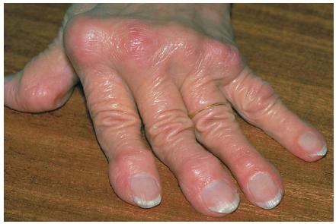
Physical Function
*
R²= .03
R²= .01
R²= .07
Regression Model F (3, 97) 3.52, p = .018
Notes:
Finally, for participant's physical function, the model was significant with motivation predicting 7% of variance.

Slide 21
Physical Function
*
R²= .03
R²= .01
R²= .07
Regression Model F (3, 97) 3.52, p = .018
Notes:
Finally, for participant's physical function, the model was significant with motivation predicting 7% of variance.

Slide 22

Conclusions
Motivation contributes to well-being above and beyond self-reported physical activity
Physical activity may not be sufficient to enhance physical and psychological well-being.
Physical activity interventions could target motivation and behaviour to gain well-being benefits
Notes:
In conclusion, the results provide support for the premise that the reasons why RA patients participate in physical activity contribute to indicators of physical and psychological wellbeing. Therefore, it is possible that the act of physical activity itself may not be sufficient to enhance psychological well-being if the reasons for participating are more controlled. Further, motivation also contributed to physical well-being highlighting the important link between psychological processes and perception of physical wellbeing.

Slide 23
Practical Examples for patient engagement in self management

Slide 24

HEALTH LITERACY: THE UPRISING AND UTILITY
OF INTERNET TOOLS TO EMPOWER THE COMMUNITY
Luis Loureiro luisloureiro@esenfc.pt
Health Sciences Research Unit: Nursing (UICISA: E) of Nursing School of Coimbra, Portugal
Learn about your users and their goals
Write actionable content
3. - Display content clearly on the page.
4. - Organize content and simplify navigation.
5. - Engage users with interactive content
6. - Evaluate and revise the site.

Slide 25
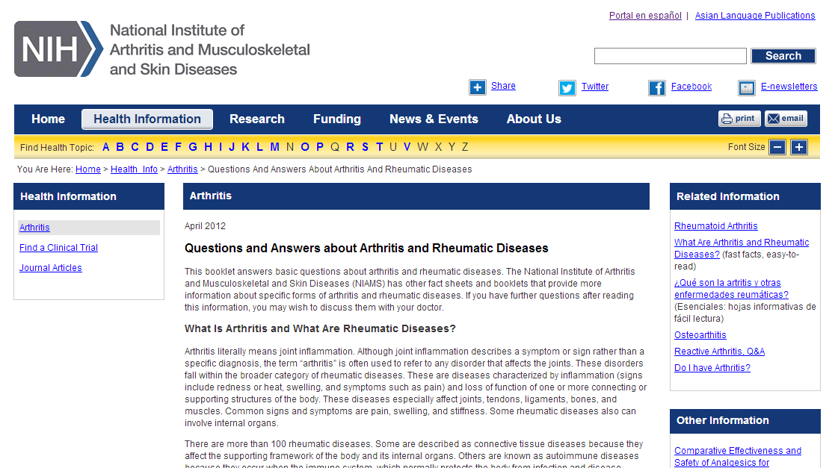

Slide 26



Building an online self management training for adults with rheumatism: Expert patients in the lead
Judy Ammerlaan, RN, MSc
What are the needs of people with arthritis, regarding an online self management program?
Aim
Integrating Self-determination theory (Ryan & Deci)
Integrating individual experiences and needs
Involvement of the end-user in every step
Department Rheumatology and Clinical Immunology

Slide 27


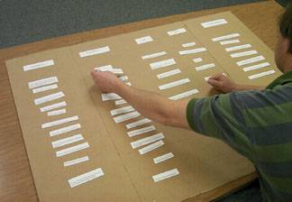
Step 1: Needs assessment
Private group (n=35) on facebook ;Recruitment on @ReumaUitgedaagd, websites
Step 2: Needs assessment: Concept mapping
Card sorting task (n=27)
Content similarity
Rate Importance
Round table conversation

Slide 28
If I had the opportunity, I need…
… a customised online course
……different themes
(treatment, dealing with psycho-social consequences, family, work, communication, stress, pregnancy, pain, medication, fatigue)
… educate and train self management skills
….get support and share experiences with a group
… an expert patient as coach
… include discussion board & chat

Slide 29
3 Evidence for successful strategies for patient engagement in self management

Slide 30

Rheumatoid Arthritis Disease Activity Self-Assessment
Evaluating the effects of a self-assessment program in Rheumatoid Arthritis Maxime DOUGADOS
    The COMEDRA experience
To evaluate the impact of a nurse-led program on RA patient self-assessment of disease activity on the management of the disease by the treating rheumatologist.

Slide 31

Rheumatoid Arthritis Disease Activity Self-Assessment
Rationale
  Difficulty for the treating rheumatologist to monitor frequently the disease because of time contraints^{[1]}
  Reluctance of the treating rheumatologist to change therapy in case of moderate disease activity^{[2]}
  Increased importance of the role of the nurses in the management of rheumatic patients^{[3]}
  Increased importance of the role of the patients in the participation of the treatment decision^{[4]} and also in his/her capacity of evaluating his/her RA disease activity ^{[5]}
[1] Haraoui B et al J. Rheum 2012, 39; 949-53
[2] Dougados M. et al Rheumatology 2013; 52; 391-9
[3] van Eijk-Hustings Y. et al Ann Rheum Dis 2012; 71; 13-19
[4] Iversen M.D. et al Ann Rheum Dis 2010; 69; 955-63
[5] Cheung P. et al clin Exp rheumatoid 2013; Marsh 13; Epub

Slide 32
Rheumatoid Arthritis Disease Activity Self-Assessment
Methods: trial design
Self-assessment
RA
Control(co-morbidities)
M0
M6

Slide 33
Rheumatoid Arthritis Disease Activity Self-Assessment
Methods: participants
Patients:
➢ RA
➢ Stable disease
➢ Written informed consent
Nurses:
➢ Trained (1,5 day session)

Slide 34
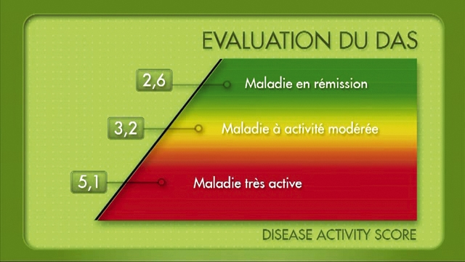
Rheumatoid Arthritis Disease Activity Self-Assessment
Methods: Interventions
Video

Slide 35
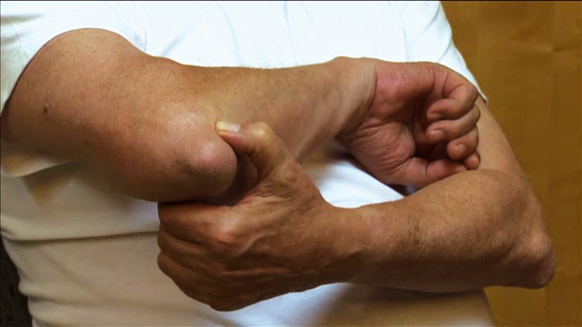
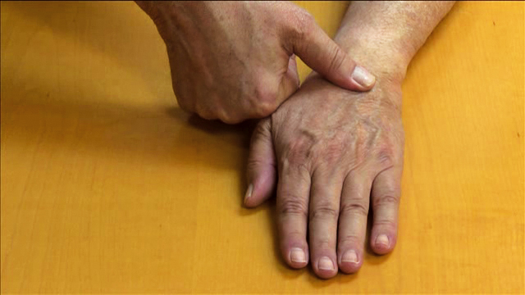
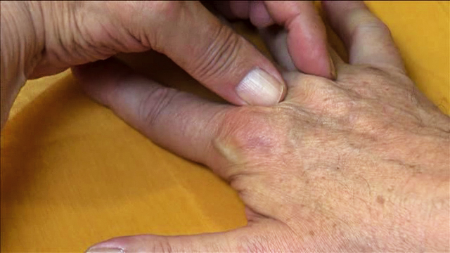
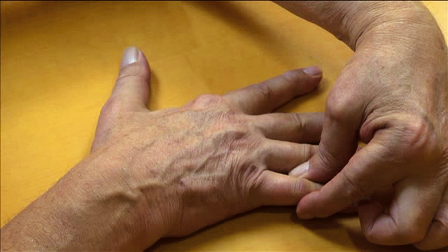
Rheumatoid Arthritis Disease Activity Self-Assessment
Methods: Interventions
Training session for joint self-assessment

Slide 36
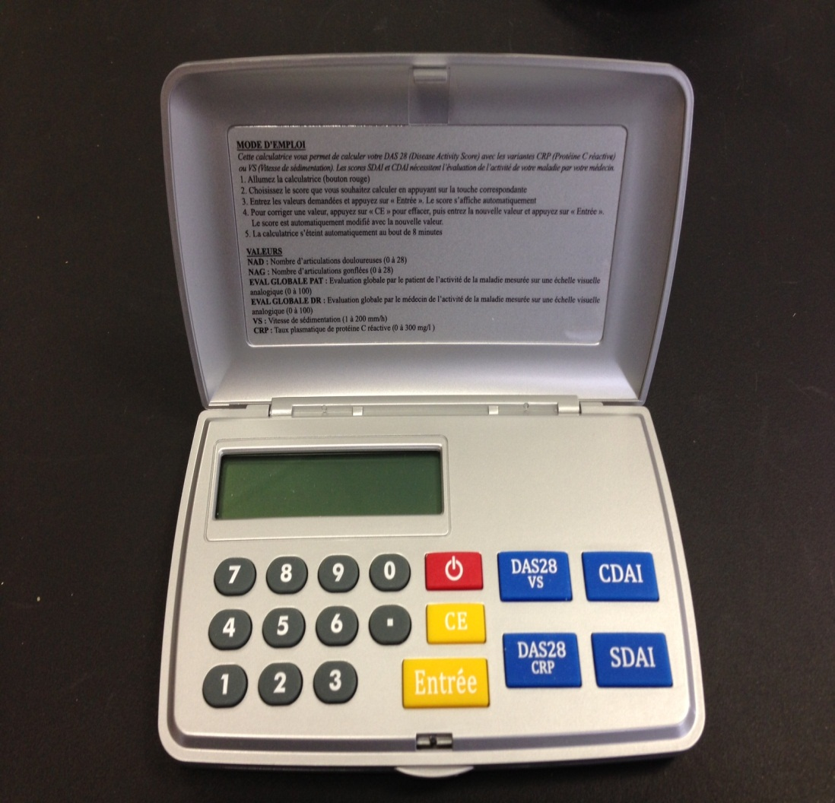
Rheumatoid Arthritis Disease Activity Self-Assessment
Methods: Interventions
Tools
DAS calculator
Booklet

Slide 37
Rheumatoid Arthritis Disease Activity Self-Assessment
Methods: Outcome measures
Primary: intensification of DMARD therapy between M0 and M6

Slide 38
Rheumatoid Arthritis Disease Activity Self-Assessment
Results: Primary outcome DMARD
intensification between M0 and M6
DMARDs intensification
(% patients)

Slide 39


A self-monitoring and patient-initiated follow-up service for patients with rheumatoid or psoriatic arthritis: a randomized controlled trial Hayley McBain, Mike Shipley
Intervention
Self-monitoring & patient initiated service
Control
Usual care
6 weekly appointments with nurse specialist to monitor blood tests symptoms and side effects
One-off training session
Self-monitoring of 6 blood test and associated symptoms & side-effects
Use this information to initiate telephone consultation with nurse specialist
No scheduled appointments with nurse specialist
Qualitative interviews
Notes:
100 participants were randomised to one of two groups and followed for 6 blood tests in order to assess their ability monitor and initiate care safely along with comparisons between the intervention and control group healthcare utilisation, clinical and psychosocial outcomes.

Slide 40
RCT results
~75% of all decisions made by participants in the intervention group led to correct initiation of care from the rheumatology nurse
55% fewer appointments with their rheumatology nurse (p<0.0001)
39% fewer arthritis‐related GP appointments (p=0.07)
Between 10.88%-13.88% reduction in healthcare resources compared with usual care¹ ²
¹ National Schedule of Reference Costs 2010-11 for PCTs; ³ Unit Costs of Health & Social Care 2012
Notes:
This model of care may therefore be a viable alternative for established RA and PsA patients on DMARD therapy.

Slide 41
Qualitative results
Theme 1 – Burden of care Sub-theme: Efficiency Sub-theme: Impact on work life Sub-theme: Normality
Theme 2 – The self-management process Sub-theme: Knowledge Sub-theme: Control Sub-theme: Behavioural regulation
Theme 3 – Conflict Sub-theme: Between laboratory tests and symptoms Sub-theme: Between study guidelines and practice
Theme 4 – Anxiety
Theme 5 – A tailored service Sub-theme: Right time Sub-theme: Right method
Notes:
Semi-structured interviews (n=12)
Thematic analysis

Slide 42
Theme 1 – Burden of care
Sub-theme: Efficiency
  “when I came to see the rheumatologist you know I waited for like two hours sometimes and got seen for two minutes, …..it seemed a bit tedious to wait all that time to be told everything was fine come back in a couple of month.” – JD
Sub-theme: Impact on work
  “I’ve spend 45 minutes in the waiting room and you know, it comes at a time cost, particularly when your paid by the hour it can come at a much larger cost” AS

Slide 43
Theme 2 – The self-management process
“…it’s just more control of my own time…..it allows me to control the monitoring to suit my requirements rather than the hospital schedule” – NP
“…seeing my results has enabled me to understand my body and its reactions to the disease and to methotrexate.” – RG
Notes:
Knowledge, control, behavioural regulation

Slide 44
Summary
Patients want to be more involved
RA patients can judge when blood tests are out of range and when an outpatients appointment is required
Significant reductions in healthcare utilisation
More convenient and responsive service than usual care

Slide 45
Summary
1 Background to patient engagement in self management
2 Practical examples of how to facilitate patient engagement in self management
3 Evidence for successful strategies for patient engagement in self management

Slide 46

Health Professionals strength is that we bring different professional perspectives and approaches to our work with people with RMD

Slide 47

Thank you
ja@soton.ac.uk

