Slide 1



SARAH: Strengthening and Stretching for Rheumatoid Arthritis Affecting the Hand: A randomised controlled trial
Adams J, Williams MA, Heine PJ, McConkey C, Lord J, Dosanjh S, Williamson EW, Rahman A, Underwood M, Lamb SE on behalf of the SARAH trial team
Dr Jo Adams Associate Professor. Professional Lead for Occupational Therapy. Faculty of Health Sciences University of Southampton
ja@soton.ac.uk
http://www.southampton.ac.uk/healthsciences/about/staff/jo_adams.page

Slide 2
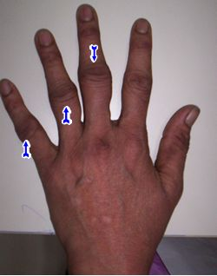
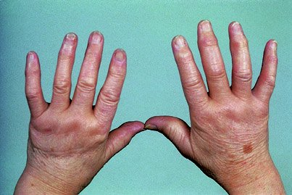
Background
Wrist and hand joints are affected early in RA (Adams et al 2004; Horsten et al 2010)
Early RA = hand and wrist pain, weakness, ↓mobility, stiffness for majority of patients even with medical advances (Weinblatt 2013; Boers et al 2012; Toyama et al 2013;Seto et al 2013)

Slide 3




Background
Functional limitations that impact on work, leisure and quality of life (NICE 2009; Seto et al 2013)

Slide 4
Background
UK Clinical guidelines state that individuals with RA should have access to specialist hand therapy for ex’s to ↑ strength, movement and function (Deighton et al 2009 and Luqmani et al 2009)
Evidence base for specialist hand therapy is weak (Wessel, 2004 and Ottawa Panel, 2004)
National Institute of Health Research HTA funded call into the effectiveness of hand therapy for people with early RA(£1million)

Slide 5
Research Questions
What is the clinical effectiveness of adding a therapy programme for hands and upper limbs in addition to, usual care in the reduction of hand dysfunction and pain for patients with RA.
What is the cost-effectiveness of adding this programme to usual care.

Slide 6
Study Design
RA patients referred to PT/OT from RA clinic
Checked for eligibility
Research Clinic appointment
Blinded Baseline Ax
Individually randomised
Joint protection, mobility exercises and functional splinting
Control intervention then 5 additional sessions of optimised exercise programme (12 weeks)
Usual care Intervention (n=240) Exercise Intervention (n=240)
Blinded Follow-up assessments at 4 and 12 months

Slide 7
Inclusion Criteria
INCLUDED
People with RA meeting the ACR clinical and immunological criteria.
Pain and dysfunction of the hands and/or wrist joints.
Either not on a disease modifying medication (DMARD), or have been on a stable DMARD regimen for 3 months or more.
EXCLUDED
Patients recovering from upper limb joint surgery, or fracture, in the previous 6 months.
Patients on a waiting list for upper limb orthopaedic surgery.
Patients who are pregnant.
Aged less than 18 years.

Slide 8
Materials and Methods
Usual care intervention
  1-3 sessions, joint protection education, general exercise advice, ± functional splint
Enhanced tailored functional exercise programme intervention
  Usual care plus 5 additional sessions of supervised functional exercises
  7 stretching
  4 strengthening
  Adherence-promoting strategies for daily home exercise programme
  All delivered by an experienced hand therapist trained in SARAH protocols (n=48)

Slide 9
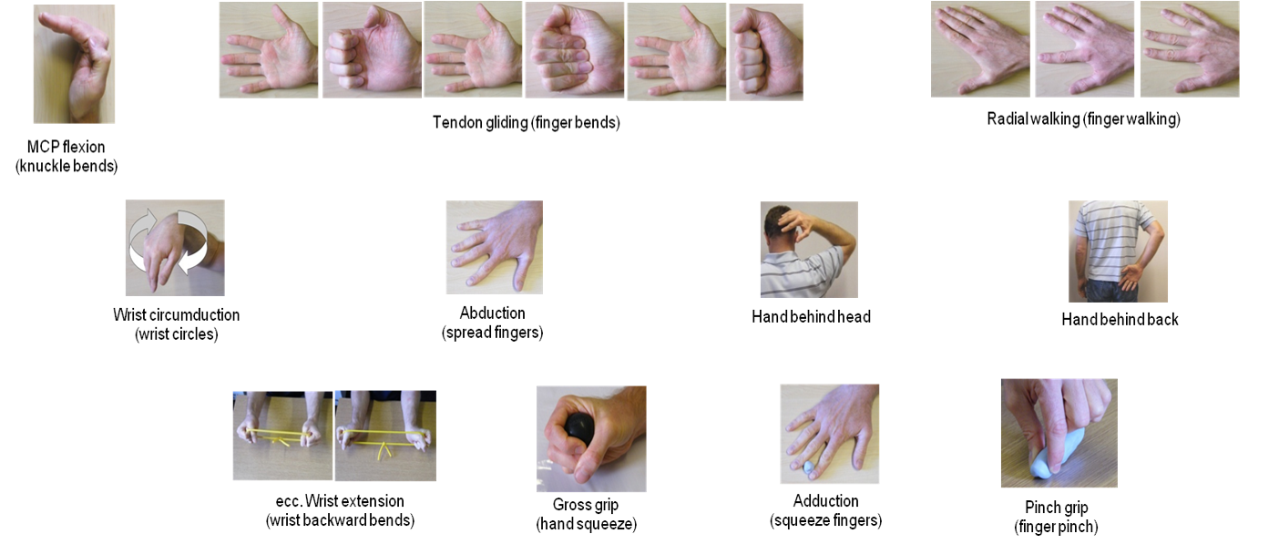
Materials and Methods

Slide 10
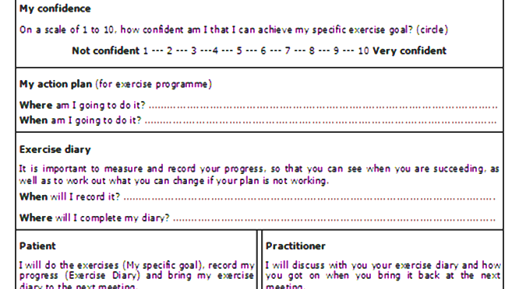
Materials and Methods
Implementation Strategies

Slide 11
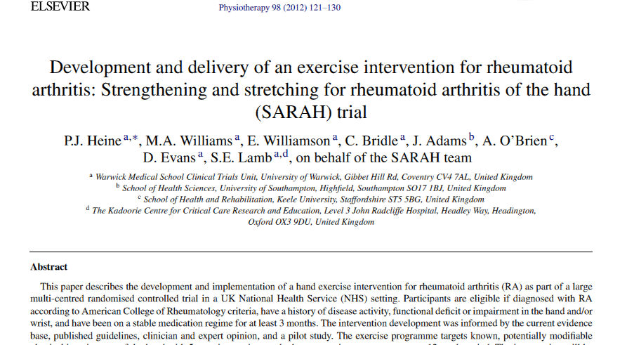
Materials and Methods

Slide 12

Materials and Methods
1° outcome – Michigan Hand Outcomes (MHQ) Questionnaire hand function subscale
2 ° outcomes – MHQ, pain, QoL, physical impairments, self-efficacy, Quality Adjusted Life Years (QALY)
Intention to treat analysis
Health Economics – intervention costs, resource use, EQ-5D
Target fully powered sample to detect a clinically meaningful difference n = 480

Slide 13
Results
490 randomised (244 Usual Care, 246 Extended Functional Exercise programme)
Groups well matched at baseline
75% compliant with treatment
438 (89%) followed up at 12 months

Slide 14
Baseline Characteristics
 | Usual Care (n=242) | Enhanced Functional Exercise (n=246)
Age Mean(SD) | 63.5(11) | 61.3 (12)
Sex (% Female) | 186(76%) | 188 (76%)
Employment status (n%) | Full time 22(9) Part time 30(12) Self employed 10(4) | 29(12) 26(11) 11(5)
Right/Left Dominance (n%) | Right 215(90) Left 23(9) | 226(92) 18(7)
Years since RA diagnosis (median IQR) | 10 (4,22) | 10(4,21)
Baseline biologic DMARD (n%) | 52(22) | 51(21)
MHQ overall and ADL Mean(SD) | 52.1(16.4) 54.1(25.0) | 52.1(15.2) 54.5(24.5)
SF-12 Mean(SD) | 34.5(9.5) | 33.8(9.8)
Grip Ns Mean(SD) | 130.3(73.1) | 134.2(83.3)

Slide 15
Results
SARAH Consort Trial Flow Chart

Slide 16
Results
Outcome | Mean Change from baseline Usual / Enhanced (95%CI) | Mean Treatment difference | P value
MHQ Function 4 months 12 months | 4.04(2.17to 5.91)/ 8.73(6.83 to 10.64) 3.56(1.45 to 5.68) / 7.93(5.98 to 9.88) | 4.60(2.22 to 6.97) 4.35(1.60 to 7.10) | 0.0002 0.0020
MHQ ADL 4 months 12 months | 2.57(-0.40 to 4.74)/ 7.86(5.44 to 10.28) 2.27(-0.04 to 4.59)/ 5.89(3.66 to 8.13) | 5.46(2.41 to 8.51) 3.78(0.64 to 6.93) | 0.0005 0.0187
MHQ sum 4 months 12 months | 4.34(2.67 to 6.00)/7.28 (5.65 to 8.91) 4.22(2.23 to 6.21(/ 7.59(5.75 to 9.43) | 2.98(0.73 to 5.24) 3.48(0.82 to 6.15) | 0.0098 0.0108
SF12 4 months 12 months | 0.91(0.03 to 1.803)/2.04(1.01 to 3.08) 0.03(-0.96 to 1.03)/ 1.19(0.23 to 2.14) | 1.08(-0.22 to 2.37) 1.14(-0.19 to 2.46) | 0.1043 0.0931
Hand grip 4 months 12months | 7.35(2.43 to 12.28)/15.55(10.17 to 20.93) 9.57(3.66 to 15.48/15.77(10.11 to 21.42) | 8.59(1.39 to 15.80) 6.55 (-1.60 to 14.69) | 0.0198 0.1160

Slide 17
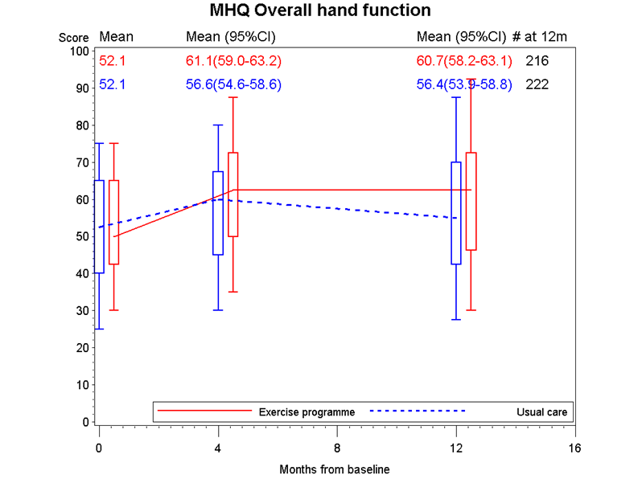
Results

Slide 18
Results: Health Economics
Usual care cost ~£85 and Ex prog. ~£185
Estimated difference in mean QALY accrued over 12 months was 0.01 greater in the ex. programme group

Slide 19
Conclusion
Addition of an optimised hand functional exercise programme for RA is effective (Effect size =0.3)
There was no difference in pain or adverse events between enhanced and usual care.
The estimated mean healthcare cost of the enhanced programme was approximately £100 higher than usual care.
Cost per QALY gained is well below NICE’s thresholds of £20,000 to £30,000

Slide 20
Conclusion:
Contribution to the practice/evidence base of occupational therapy
Occupational therapists can successfully include clinically and cost effective enhanced hand exercise programmes in out patient practice to improve the functional and self-reported outcomes for people with RA of the wrist and hands

Slide 21
Acknowledgements
Thanks go to:
All our patient participants
All our collaborating clinicians
The SARAH team of multidisciplinary academics

