Slide 1



Skim Reading: An Adaptive Strategy for Reading on the Web
Gemma Fitzsimmons, Mark J Weal and Denis Drieghe

Slide 2

Why is it important to study reading on the Web?
Users of the Web engage in a wide variety of different activities (Trend Data, 2012):
searching for information
reading the news/reading for comprehension
sending and receiving email
social networking
Within all of these activities, the primary task that users engage in is reading text
But we can read for comprehension, skim read or conduct a visual search for information

Slide 3
Present Experiment
In the present experiment I am focusing on reading for comprehension vs skim reading on the Web
With the large amount of information available to us on the Web we need a strategy to sort through all of the text presented to us

Slide 4
Speed-comprehension trade off
Skim reading has been shown to negatively affect comprehension (Carver, 1984; Just & Carpenter, 1987 ; Dyson & Haselgrove, 2000)
Others have shown that there is a difference between important and unimportant information. The important information does not receive the same loss of comprehension that the unimportant information receives (Masson, 1982; Reader & Payne, 2007; Duggan & Payne, 2009)
To explain these findings, it was suggested that an adaptive satisficing strategy was being used to gain as much information from the text in reduced time

Slide 5
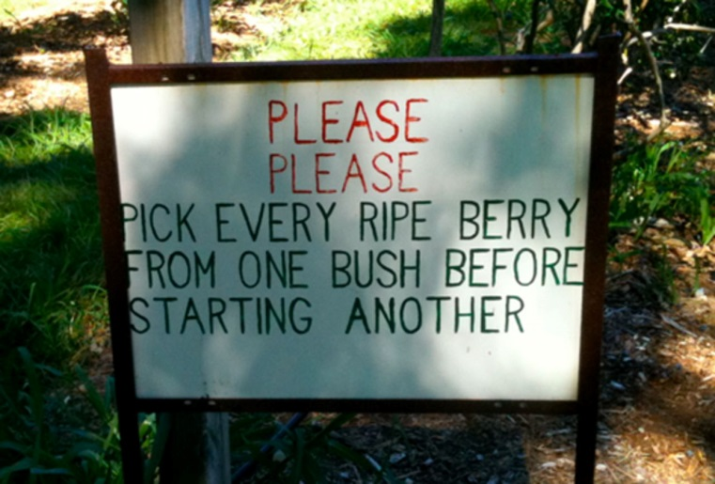
Information Foraging
Pirolli and Card (1999) used a metaphor of a bird foraging for berries in patches of bushes as an example of information foraging.
The bird must decide how long to spend on one patch before expending time moving onto a new patch to forage for berries. The problem is at what point does the bird decide to move from one patch to a new one?
Notes:
Please Please pick every ripe berry image from – Wolfe (2013) When is it time to move to the next raspberry bush? Foraging rules in human visual search
- http://www.journalofvision.org/content/13/3/10/F1.medium.gif

Slide 6

Foraging – A Satisficing Strategy
A satisficing strategy is where an individual is sensitive to their ‘information gain’ and uses this as a threshold
In reading the reader searches for where information gain is high and when it drops below an acceptable threshold, they move on to a new patch of text
In this experiment we explore whether a satisficing skim reading strategy is used when reading on the Web and whether hyperlinks have an impact on the strategy

Slide 7
Overview
Eye movement methodology
Research questions:
How does skim reading affect the way we read hypertext?
How does skim reading affect comprehension?

Slide 8
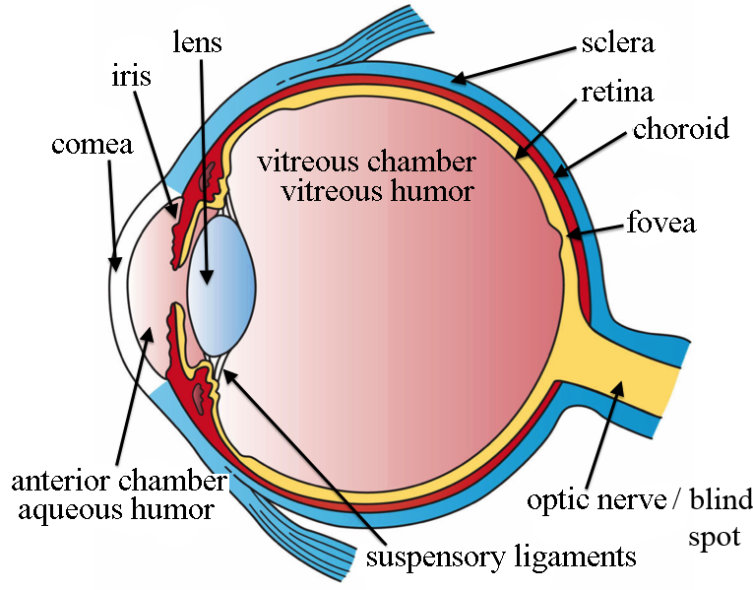
Anatomy of the Eye
Notes:
Anatomy of the eye image from - http://en.wikipedia.org/wiki/File:Three_Main_Layers_of_the_Eye.png

Slide 9
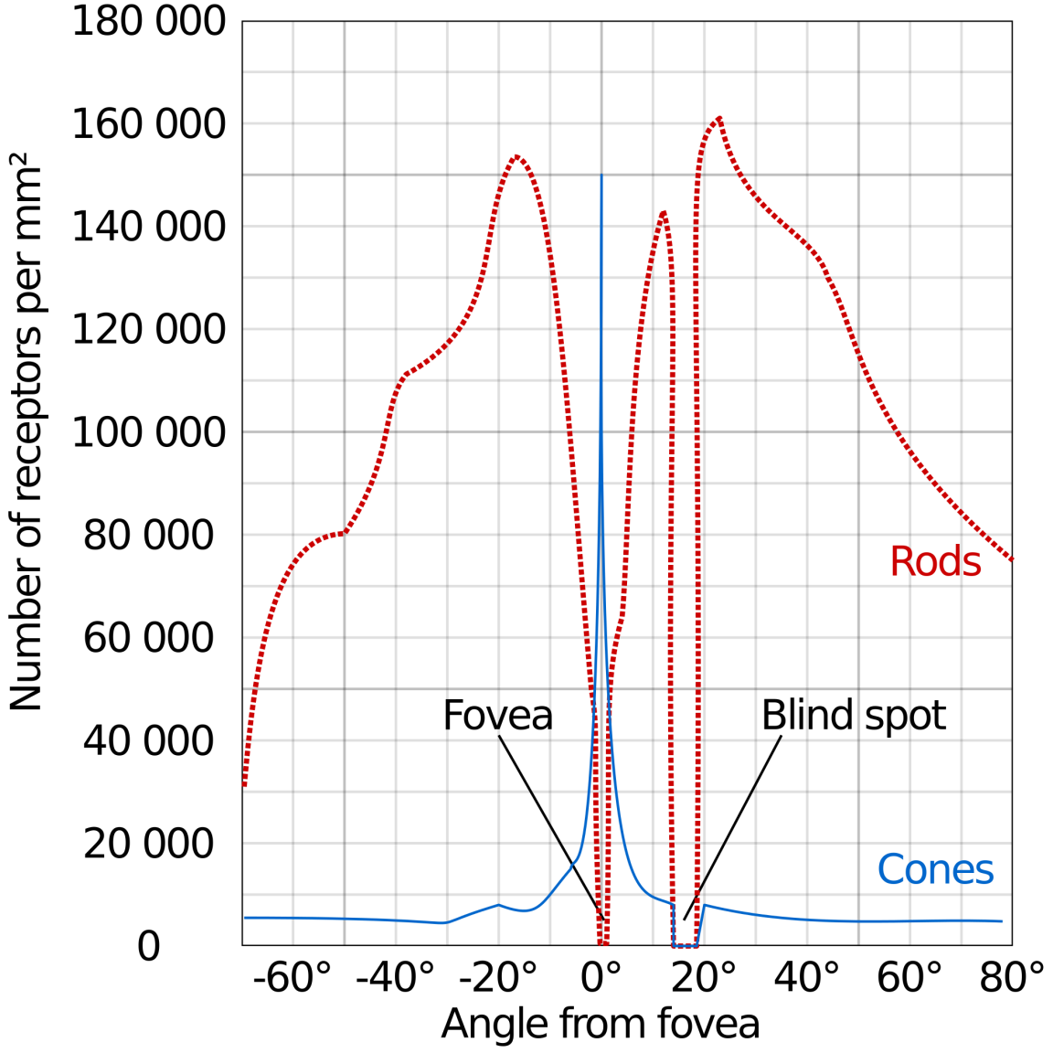
Retina
Retina contains photoreceptor cells:
Rods – peripheral vision/low light levels/detecting motion
Cones – fine detail in the centre of vision/colour vision

Slide 10

Eye Movement Methodology
Due to the anatomy of the eye it is necessary that we make eye movements
Fixations – where the eye is steady and we can take in information
Saccades – where the eye is in motion and we are functionally blind
Due to low acuity outside of the fovea we need to directly fixate anything, such as a word, in order to process the information

Slide 11
Eye movement example
Not every word is fixated
The length of each saccade varies
The duration of each fixation varies

Slide 12
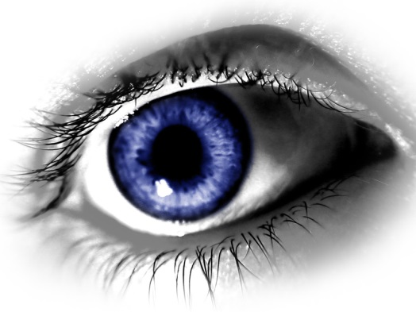
Reading Research
Eye movement and reading research started in the 1970s and has substantial literature exploring how we read
Rayner and Pollatsek (1989) found that the more difficult the text the longer the fixations and the shorter the saccades and more backward-directed eye movements (regressions) are made to re-read information
Eye movements are a measure of online cognitive processing (Liversedge & Findlay, 2000) i.e. what is going on in our brains in reflected in our eye movements

Slide 13
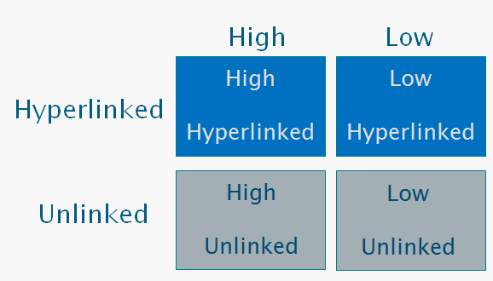
The Present Experiment
How does skim reading affect the way we read hypertext?
32 participants - 8 conditions (within)
2 (Task Type) x 2 (Word Type) x 2 (Word Frequency
Word Frequency
Task Type
Read normally
Word
Type
Skim read
Notes:
Why did we use a frequency manipulation? To see if high level information of hyperlinks interacts from lexical processing
High Log HAL frequency – 9.91
Low Log HAL frequency – 5.75

Slide 14
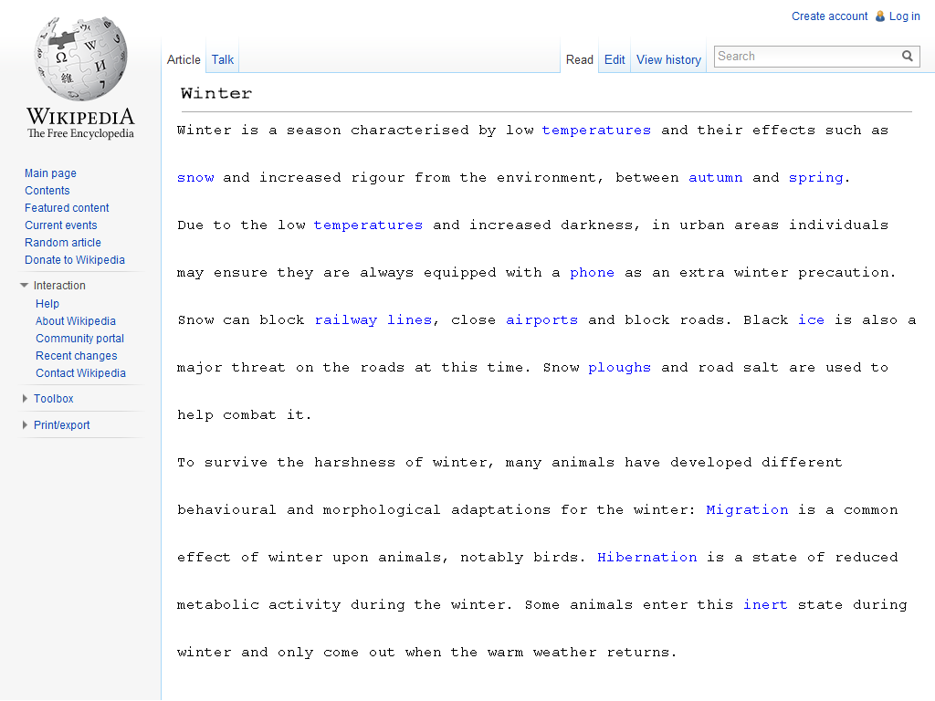
Experimental Stimuli
Notes:
Demand/rigour
Phone/scarf
Salt/grit
Sleep/inert

Slide 15
Rating Pre-Experiment
How does skim reading affect comprehension?
Participants who did not take part in the main experiment were asked to rate each sentence on its importance
From these ratings we created comprehension questions based on the two most important and two least important sentences
After each trial participants were asked to respond to these comprehension questions
Notes:
Ordinary reading study – non web. Always shown first

Slide 16
Example Trial
Comprehension Q 1
0
Comprehension Q 2
Comprehension Q 3
Comprehension Q 4

Slide 17
Results - How does skim reading affect the way we read hypertext?
Participants read significantly faster when they were skim reading (Normal=39 seconds, Skimming=20 seconds)
We focused on the target word regions for the rest of the analysis to explore how our manipulations affected reading behaviour
Linear mixed-effects models (LME) were used for the eye movement analysis (suited for missing data due to word skipping)

Slide 18
Eye Movement Measures
Skipping Probability – Percentage the target word was skipped in first-pass reading
Single Fixation Duration – Time spent on the target word to process it
Go-past Times – Time spent on the target word, including re-reading before moving past the target word
Bill kicked the football and scored a goal.
Notes:
Target words fixated only once 93.91% of the time

Slide 19
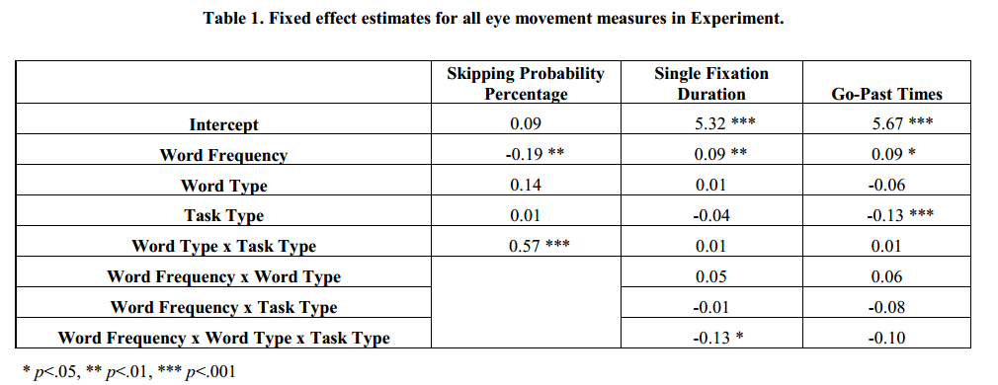
Results – Main Effects
Significant effect of Word Frequency across all measures, low frequency words skipped less and fixated for longer
No effect of Word Type, suggesting that linked word are not more difficult to process, replicating Fitzsimmons, Weal & Drieghe (2013)
Effect of Task Type in Go-Past Times only, indicating that there was less re-reading in the skimming task

Slide 20
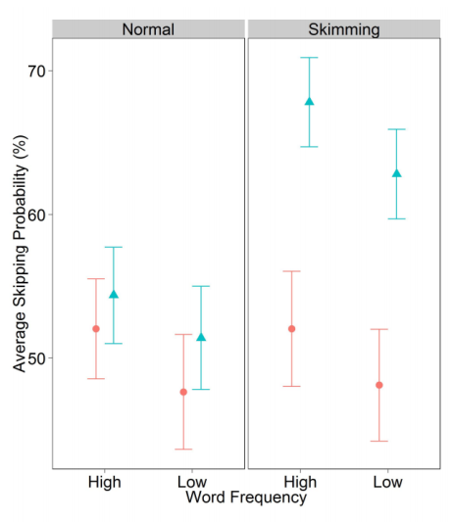

Results – Skipping Probability Interaction: Word Type x Task Type
No difference between Word Type in Normal reading
Unlinked word are skipped significantly more often than linked words in the Skimming condition

Slide 21
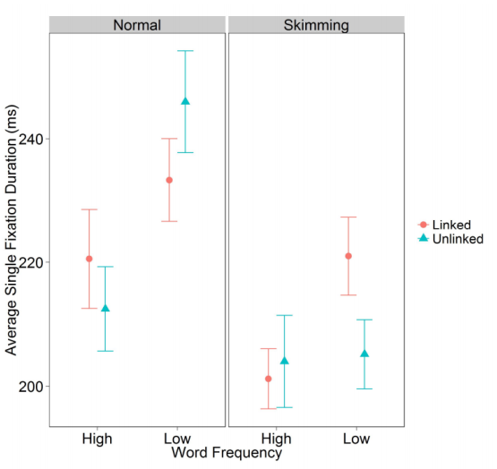
Results – Single Fixation Duration Interaction: Word Frequency x Word Type x Task Type
Fixation times shorter when skimming
When reading normally there is a Word Frequency effect in both Linked and Unlinked words
However, when skim reading a Word Frequency effect is only observed in Linked words

Slide 22
Discussion - How does skim reading affect the way we read hypertext?
Participants read faster when skim reading
Links had an effect on skim reading
Links less likely to be skipped and more likely to be fully processed compared to unlinked words when skim reading
Are links important?

Slide 23
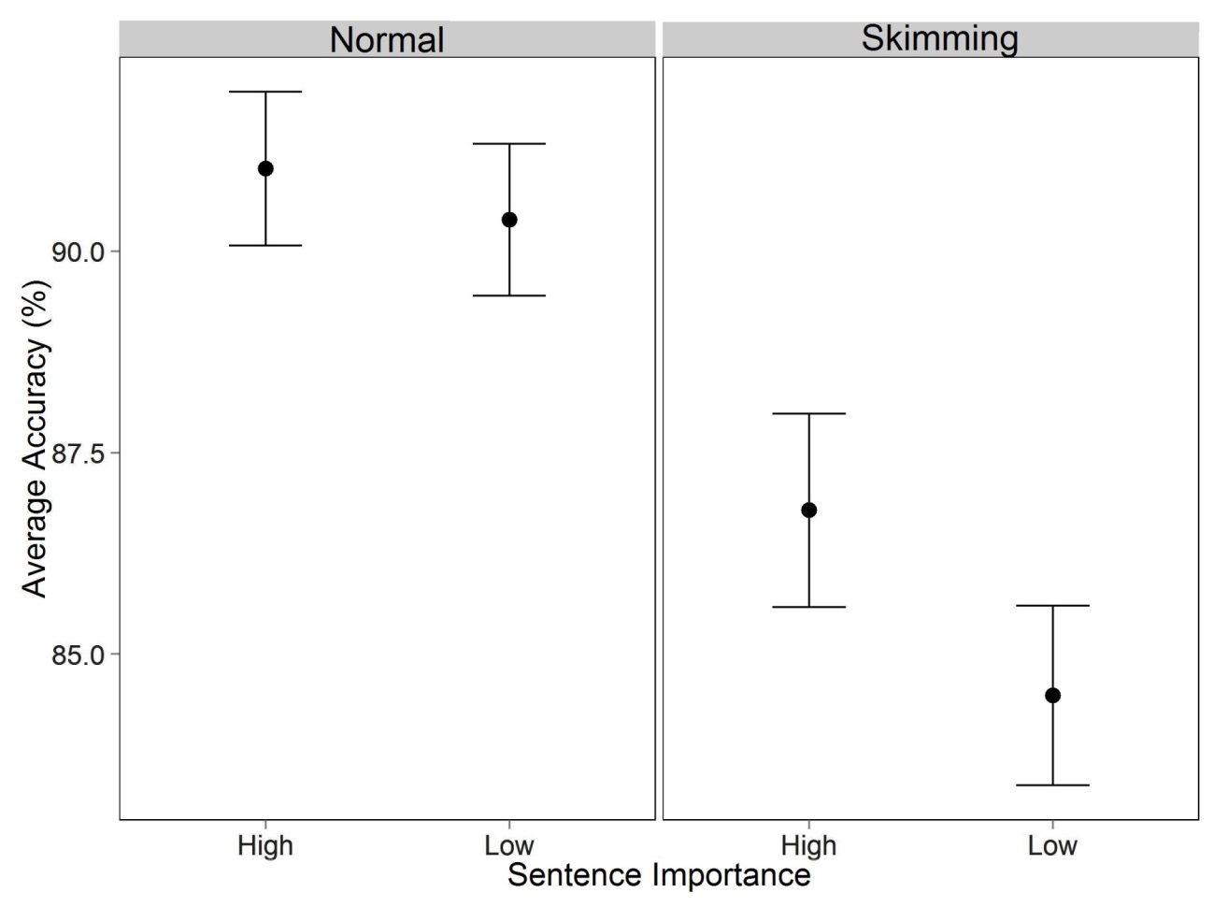
Results - How does skim reading affect comprehension?
Significant main effect of Task Type - Comprehension significantly decreased when skim reading
Marginal effect of importance – Accuracy was improved slightly for important sentences

Slide 24
Discussion - How does skim reading affect comprehension?
Comprehension decreases when skim reading
Comprehension is marginally improved for important sentences
Important sentences contain more links
Participants may have been prioritising important sentences and using links as markers to which sentences were important

Slide 25
General Discussion
Eye movement results suggest that the reader is focusing on the linked words while skim reading
Together, the eye movement results and comprehension results suggest that the reader may be using an adaptive strategy to read quickly while attempting to maintain comprehension

Slide 26
General Discussion
There were more links in the important sentences
The reader could be using links as markers to find the important information in the text in order to engage in an optimal strategy for gaining information
This means we need to consider what words we use as links

Slide 27
Future Research
Clicking and navigating through Webpages
Other Webpages that are not Wikipedia – not all Webpages contain so many hyperlinks in the text where you can assume the destination is another similar Wikipedia page
Task effects – reading for comprehension vs skim reading vs searching for information

Slide 28
Thank you for your attention!
Any questions?

Slide 29
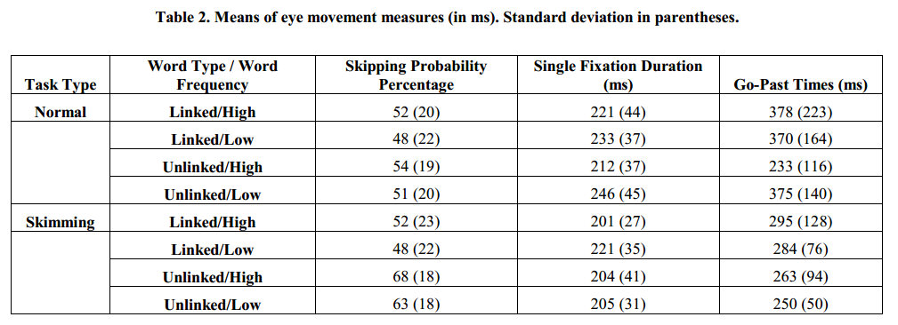
Appendix – Eye movement means

Slide 30
Appendix – Skipping Probability
Main effect qualified by a significant interaction between Word Type x Task Type

Slide 31
Appendix – Single Fixation Duration
Main effect qualified by a significant interaction between Word Frequency x Word Type x Task Type

