Slide 1
“I don’t think we’re in Kansas anymore…?”

Slide 2

Developing “Good character”
A Values Based curriculum model
Chris McLean, Adult Field Lead
Cathy Sullivan, Head of Practice Learning
University of Southampton

Slide 3
Context
Educational drivers
  NMC Standards:
  “Compassionate” … “integrity” … “graduate”
  NMC requirement for Good Character
Practice drivers
  Care and compassion
    (E.g. 2011 Health Service Ombudsman report)

Slide 4
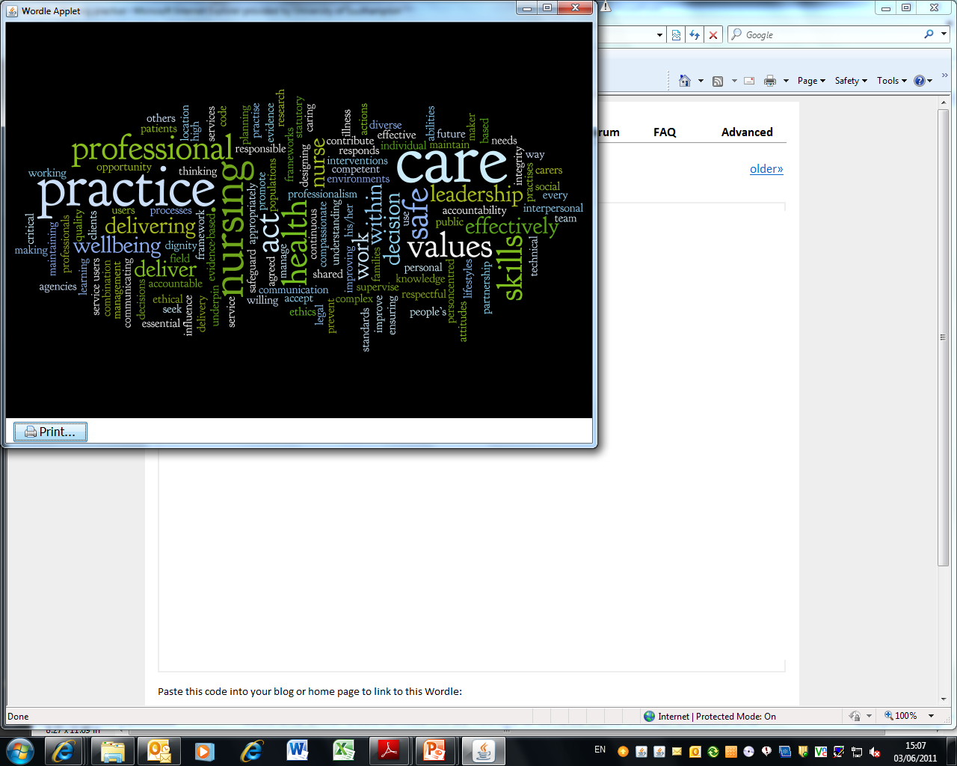
Notes:
The topics to grade were initially chosen after close scrutiny of new NMC standards for education and review of the code of conduct and their underpinning values. Certain words/ key areas stood out and from noticing these grading themes were developed

Slide 5
Theoretical Perspectives
Values Based Practice
  Clinical and ethical challenges reflect different value perspectives of parties involved (Fulford, 2004)
  Nursing is a science of the ‘unique’ which is able to deal with this nursing situation, this hospital, that patient or this service user group. (Rolfe & Gardner 2005)
Virtue Ethics
  Character
  Virtues (intellectual virtues; courage; “caring virtues”)

Slide 6
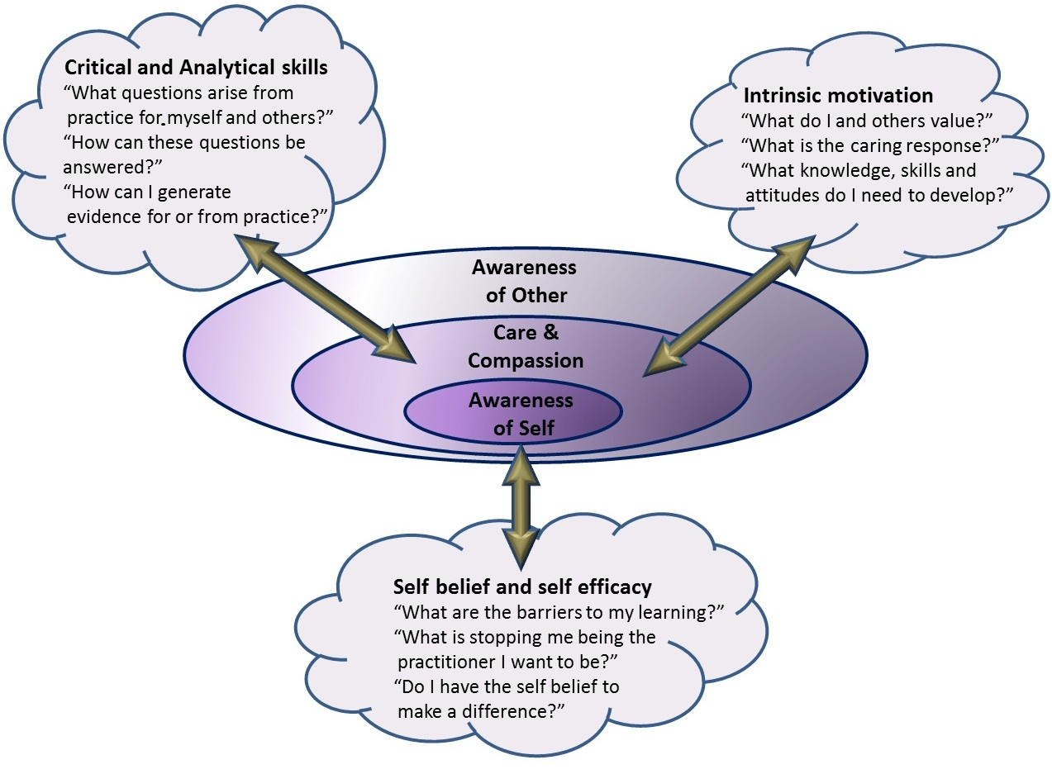

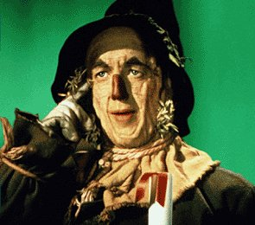
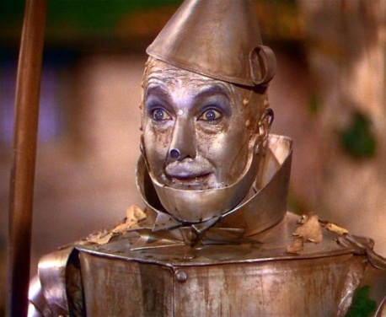
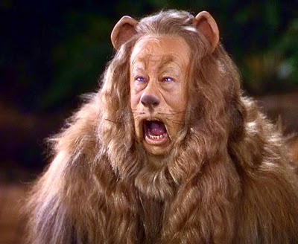
The Brain
The Heart
The Heart
Self
Discovery
The Nerve

Slide 7
Values Based Enquiry
Guided by principles rather than process.
Example Semester 1 activities:
“Why are you here?”
“What are you most proud of achieving this term?”
“Examining emotional responses to practice”
“Role models and concepts of a Good Nurse”

Slide 8
Embedding the model
Shared ethos /philosophy
Values Based Enquiry groups
Assessments – “What makes a good nurse”
Graded assessment of practice based upon values
Managing student programmes

Slide 9


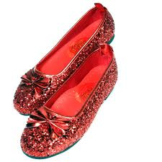
The Yellow Brick Road Curriculum
A personal journey which we can only guide.
Individuals who are responsive to values of self and others
Practice grounded in care and compassion
Practitioners with ‘the heart’, ‘the nerve’ and ‘the brain’

Slide 10
References
Fulford, K.W.M. (2004) Ten principles of Values Based Medicine IN Radden, J. (2004) The Philosophy of Psychiatry: A Companion. Oxford University Press: New York pp206-234
Rolfe, G., Gardner, L. (2005) Towards a nursing science of the unique: Evidence, reflexivity and the study of persons Journal of Research in Nursing 10: 297-310

