Slide 1
Carbon Nanotube Composite Surfaces for Electrical Contacts of MEMS Switches
Dr Adam P. Lewis
Project members:
University of Southampton:
Dr Liudi Jiang
Prof Mark Spearing
Mr Michael P. Down
Dr Chamaporn Chianrabutra
USMC:
Prof John W. McBride
Dr Suan H. Pu
Dr Hong Liu
Micro | Nano | MEMS 2014

Slide 2
Outline
Introduction
Motivation and Aims
Electromechanical Switching Behaviour
Carbon Nanotube Composites
Mechanical and Electro-mechanical Characterisation
Experimental Overview
Initial Experiments
Setup
Results
MEMS Experiments
Fabrication of MEMS Devices
Results
Summary

Slide 3
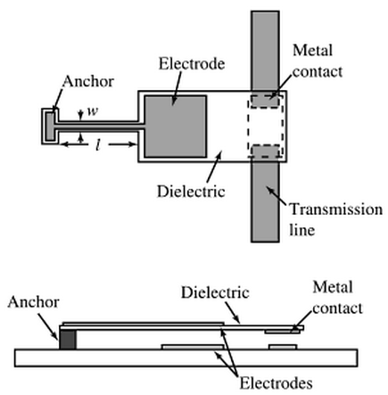
Introduction: Motivation
MEMS relays have numerous advantages:
Excellent frequency response
Off-state: zero-low current leakage/high isolation
On-state: low resistance/low insertion loss
Small size
Alternative technologies:
PIN diodes, FETs
Electromechanical relays
Reed relays
Source: G. M. Rebeiz – “RF MEMS – Theory, Design, and Technology” (2003)

Slide 4
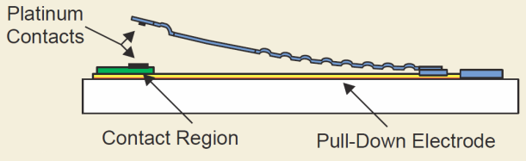
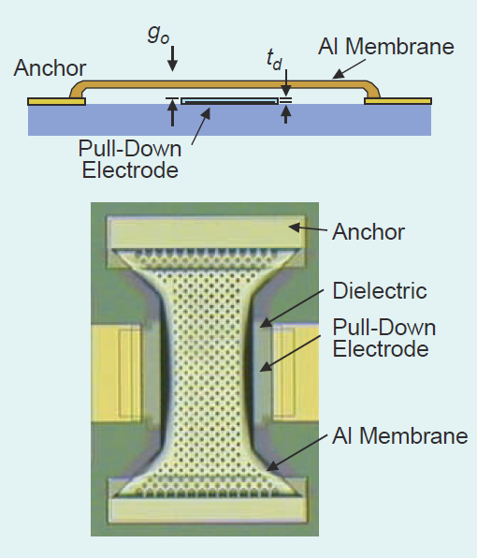
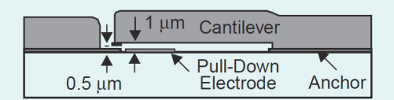
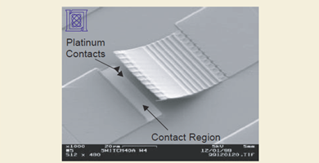

Introduction: Motivation
Two types of MEMS switch:
Capacitive (AC signals only)
Metal-contacting (DC – AC signals)
Problem:
Electromechanical interaction between metal contacts
→ degradation of contact → limits device lifetime
Analog Devices
Lincoln Laboratories
Raytheon
Source: G. M. Rebeiz & J. B. Muldavin – “RF MEMS Switches and Switch Circuits” – IEEE Microwave Magazine (2001)

Slide 5
Introduction: Aims
Investigate benefit of Au/MWCNT composites for MEMS switches
Characterise electro-mechanical performance of Au/MWCNT composites
Demonstration of Au/MWCNT as electrical contact for MEMS switch
Further understanding of failure process of Au/MWCNT composites

Slide 6
Introduction: Electromechanical Switching Behaviour
Every switching cycle:
Mechanical damage
Impact (contact) force caused because the contacts physically separate and come into contact – resulting in wear
Electrical damage
Hot-switching
Cold-switching
Dry-switching

Slide 7
Introduction: Electromechanical Switching Behaviour
For hot-switching case: molten metal bridge (MMB)
Contact 1
Every cycle:
Surface melts
Molten metal bridge
Breaks unevenly
Material transfer
Contact 2

Slide 8
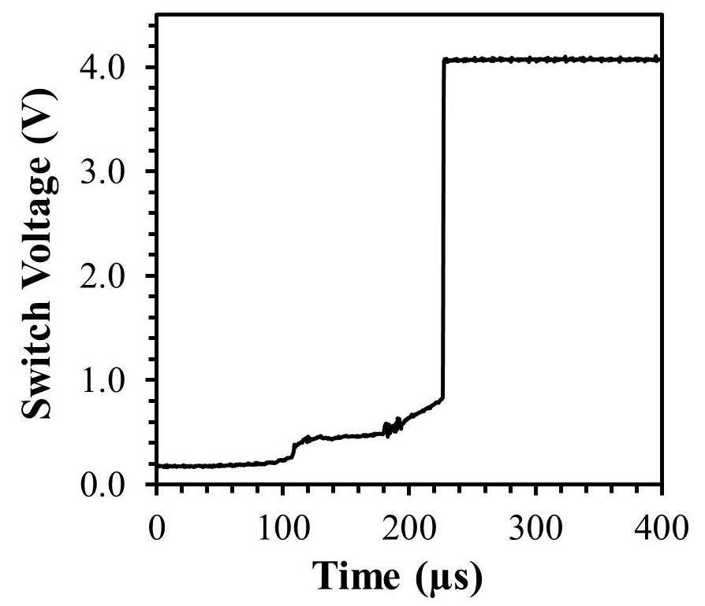
Introduction: Electromechanical Switching Behaviour
Graph showing typical MMB
For gold:
Melting voltage: 0.43 V
Boiling voltage: 0.88 V

Slide 9
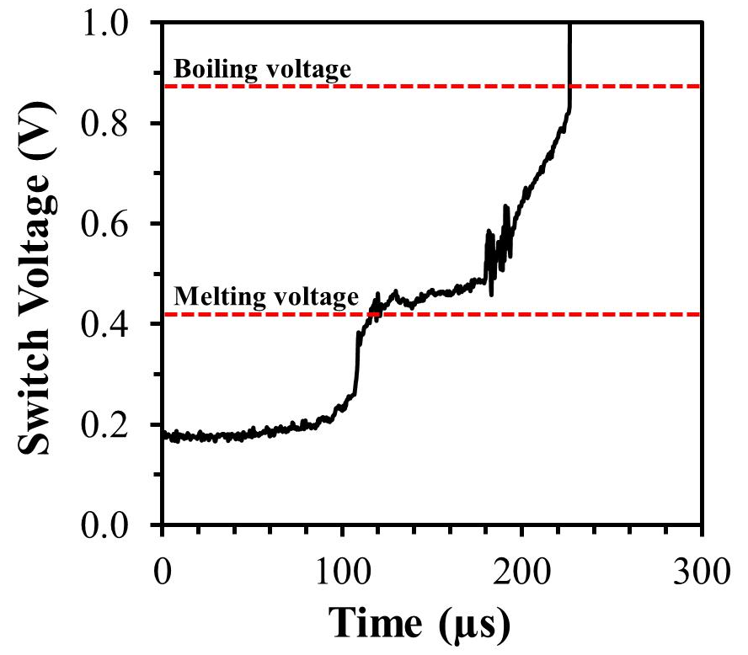
Introduction: Electromechanical Switching Behaviour
Graph showing typical MMB
For gold:
Melting voltage: 0.43 V
Boiling voltage: 0.88 V

Slide 10
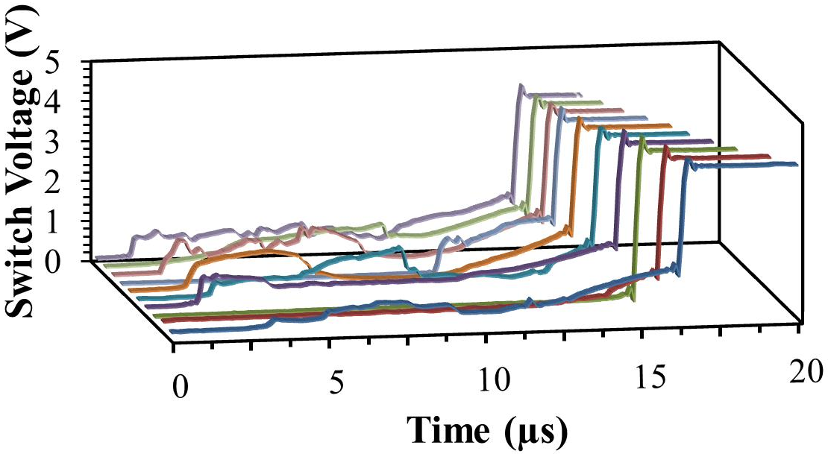
Introduction: Electromechanical Switching Behaviour
Illustration showing variation of MMB phenomenon
10 cycles – same switching conditions

Slide 11
Carbon Nanotube Composites
Mechanical Characterisation
Electro-mechanical Characterisation

Slide 12
Carbon Nanotube Composites
Mechanical properties of Multi-Walled Carbon Nanotube (MWCNT) forest reduces wear and improves lifetime

Slide 13
Carbon Nanotube Composites
Sputter
Buffer layer = Al₂O₃
Sputter
Sputter
Catalyst layer = Fe
Au layer: 500 nm
CVD
Heat to growth temperature - anneal
Gas = Ar + H₂
CVD
Grow MWCNTs
Gas = Ar + C₂H₄

Slide 14
Carbon Nanotube Composites: Mechanical Properties
Controllable by varying thickness of components
Increasing gold thickness provides stiffer and harder surface
Increasing MWCNT thickness increases indentation depth, and contact area

Slide 15
Carbon Nanotube Composites: Mechanical Properties
Material properties can be defined by composition
Varying the components allows a control of the samples properties, and design for best results

Slide 16
Carbon Nanotube Composites: Mechanical Properties
Characterising the samples in terms of the thickness ratio
Allows predictive models of various untested compositions
Sample of specific mechanical properties can then be developed

Slide 17
Carbon Nanotube Composites: Mechanical Properties
Au thickness affects only the energy absorption of the composite and dynamic hardness
More Au provides a less absorbing surface, with more bounces

Slide 18
Carbon Nanotube Composites: Mechanical Properties
The MWCNT layer affects the residual depth of the indents more than absorption
The long CNTs provide more compliance, increasing depth and contact area

Slide 19
Carbon Nanotube Composites: Electro-mechanical Properties
Notes:
Discuss: electro mechanical characterisation based on composition (thicker MWCNTs slightly increase resistance, thicker Au dramatically reduces the resistance); the evidence of a good electrical contact surface (low resistivity at low loads (below 1 Ohm at 1mN);

Slide 20
Switching Experiments

Slide 21
Experimental Overview
Number of experiments performed on range of rigs and devices
Initial Experiments:
PZT-based rig
Limited frequency
Long testing durations
MEMS based rig
Higher frequency
Closer to MEMS device
dimensions/actuation method/contact force/etc.
Two stage development process:
2.1 Device 1 – design, fabrication and results
2.2 Device 2 – design and fabrication

Slide 22
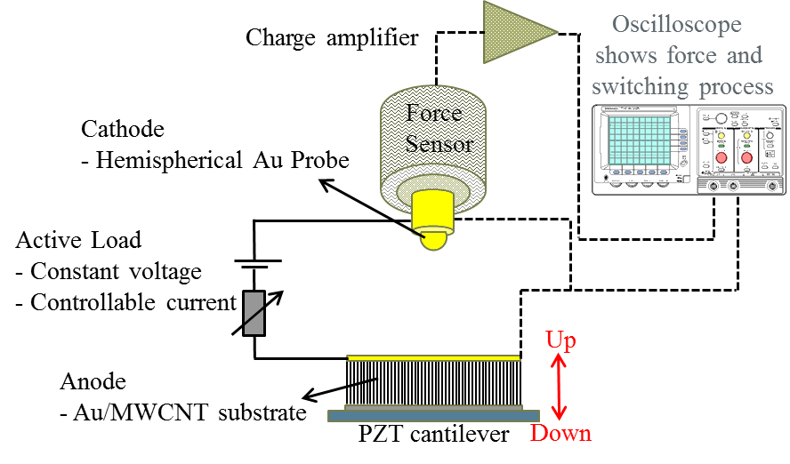
Initial Experiments: Setup
Charge amplifier
Au-coated ball
PZT cantilever moves sample up and down
- simulating contact
Au-MWCNT composite

Slide 23
Initial Experiments: Setup
Constants:
Load voltage: 4 V
Contact force: 1 mN
Contact pair: Cr/Au ball to Au/MWCNT forest [30 µm high forest with 500 nm Au]
Varied:
Load current: 20, 30, 40, 50 and 200 mA

Slide 24
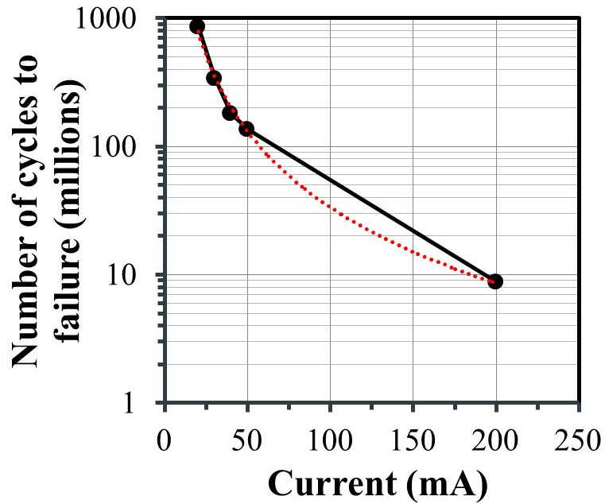
Initial Experiments: Results
Fine transfer model
The number of cycle to failure for a given load current:
Δvolume = k x I²
N_{fail} = 3x10¹¹ x I⁻²
Au/MWCNT
Model

Slide 25
Initial Experiments: Results
SEM images of failed Au/MWCNT composites tested with different load currents
20 mA
30 mA
40 mA
50 mA
200 mA

Slide 26
MEMS Devices
Device 1

Slide 27
MEMS Experiments: Fabrication of MEMS Device 1
From the fundamental equations and modelling with Coventor the following dimensions were chosen:
Length: 10 mm
Thickness: 20 µm
Width: 2 mm
Predicted resonant frequency: 240 Hz
70 mins for 10⁶ cycles
4.8 days for 10⁸ cycles
Predicted pull-in voltage (for gap <25 µm): < 30 V

Slide 28
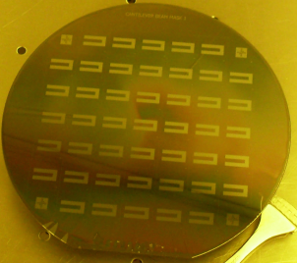
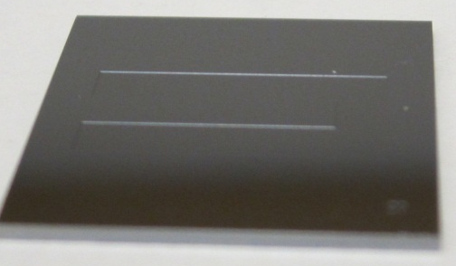
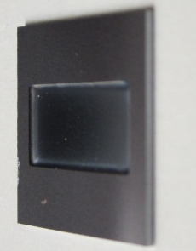
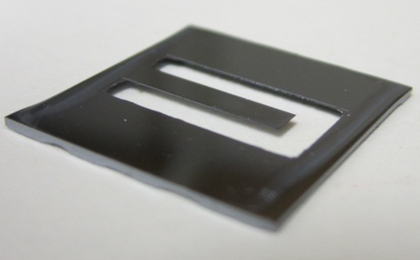
MEMS Experiments: Fabrication of MEMS Device 1
Silicon wafer
Photolithography on top side
Etch top (~20 µm)
Wafer dicing
Photolithography on under side
Etch large part of underside
(~400 µm)
Finish underside etch

Slide 29
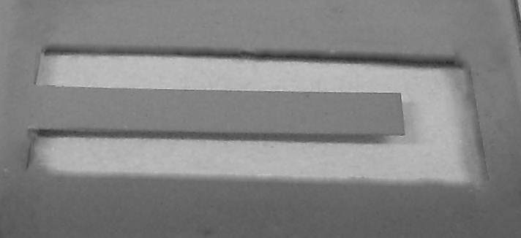
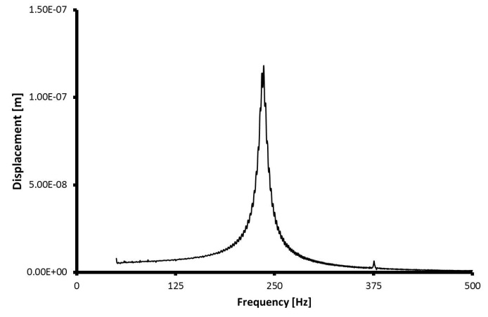
MEMS Experiments: Fabrication of the MEMS Device 1
Sputter-coat cantilever beam with 10 nm and 500 nm of Cr and Au respectively
Measured 1st modal resonant frequency:
235 Hz
2 mm
10 mm

Slide 30
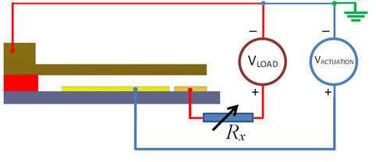
MEMS Experiments: Setup
Constants:
Load voltage: 4 V
Electrostatic actuation
Contact force: ~5 – 10 µN
Varied:
Load current: 10 and 50 mA

Slide 31
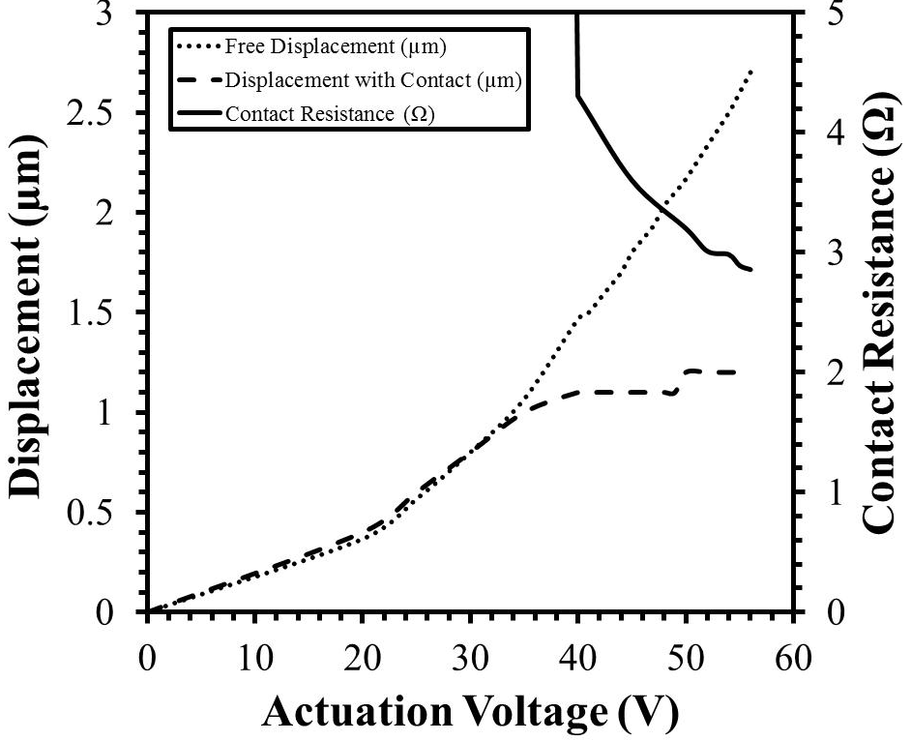
MEMS Experiments: Device 1 Results

Slide 32
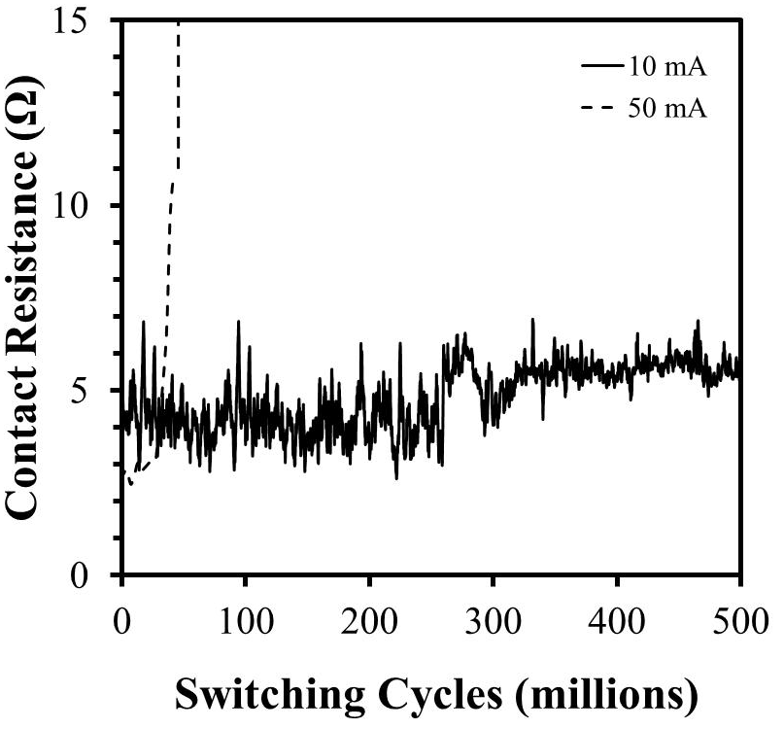
MEMS Experiments: Device 1 Results
At 10 mA composite survived for >500 million hot-switched (4 V) cycles
At 50 mA composite failed after 44.4 million hot-switched (4 V) cycles

Slide 33
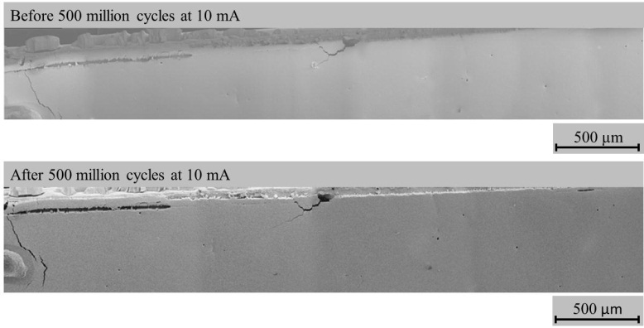
MEMS Experiments: Device 1 Results
Au/MWCNT
Au/MWCNT
Outline illustrating cantilever beam overlap

Slide 34
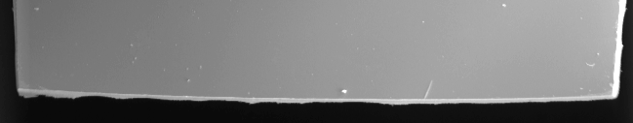
MEMS Experiments: Device 1 Results
Before experiment
Cantilever Beam Tip
After experiment
Cantilever Beam Tip

Slide 35
MEMS Devices
Device 2

Slide 36
MEMS Experiments: Fabrication of MEMS Device 2
From the fundamental equations and modelling with Coventor the following dimensions were chosen:
Length: 1.7 mm
Thickness: 10 µm
Width: 100 µm
Predicted resonant frequency: 4.3 kHz
At 4 kHz it would take 1.5 days to reach 500 million cycles
Predicted pull-in voltage (for gap <5 µm): < 12 V

Slide 37
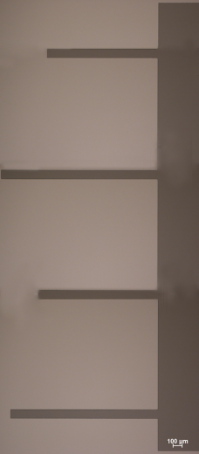
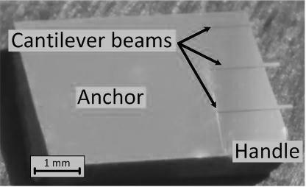
MEMS Experiments: Fabrication of MEMS Device 2
SOI wafer
Photolithography to define cantilevers
Wet etch large part of oxide layer
HF vapour etch to release beams
Etch device layer (10 µm)
Wafer dicing
Sputter with Cr/Au
500 µm

Slide 38
MEMS Experiments: Planned Experiments
Investigate lifetime for range of load currents
10 mA – 100 mA
Investigate failure mechanisms at low force and compare with initial results (1 mN)
Investigate effect of MWCNT forest parameters:
forest height
gold-thickness
contact material

Slide 39
Summary

Slide 40
Summary
Understanding electrical and mechanical aspects of switching contacts
Molten metal bridge phenomenon
Electrical and mechanical failure mechanisms
Described Au/MWCNT composites
Fabrication
Mechanical
Electro-mechanical performance
Function as a electrical contact material

Slide 41
Summary
Investigate failure mechanisms of Au/MWCNT composites when used as electrical contacts
Au/MWCNTs composites give large switching lifetimes even when tested under hot-switching conditions:
44.4 million cycles at 50 mA (4 V)
Over 500 million cycles at 10 mA (4V)
Discussed new experimental setup for testing Au/MWCNT contacts
Enables acquisition of data for further analysis and investigation of failure mechanisms for Au/MWCNT composite contacts
New setup more closely resembles end device
Size, contact force, actuation method

Slide 42
Questions?
This work was supported by the Innovative Electronics Manufacturing Research Centre (IeMRC), UK and Engineering and Physical Sciences Research Council (EPSRC), UK under grant number: EP/H03014X/1.

