Slide 1
Changing the social relations of research – innovation and orthodoxy
Melanie Nind
Inequality in Education - Innovation in Methods
12 November 2014, Warwick University
M.A.Nind@soton.ac.uk

Slide 2
1. The nature of innovation in methods and reasons for innovating 2. Innovation beyond methods: challenging inequality 3. Democratising research

Slide 3
The nature of innovation in methods and reasons for innovating

Slide 4
NCRM and innovation
National Centre for Research Methods is tasked by ESRC to increase the quality and range of methodological approaches used by UK social scientists through a programme of training and capacity building, and with driving forward methodological development and innovation through its own research programme.

Slide 5
Defining features of innovation
Innovation should be rooted in genuine attempt to improve some aspect of the research process (not just gimmickry or innovation for innovation sake)
Driven by complex social relations
Can comprise developments to established methods as well as new methods
Should (arguably) be some level of dissemination, acceptance and take-up in the social science community
(Travers, 2009; Coffey and Taylor, 2008; Xenitidou and Gilbert, 2012:
see Wiles et al 2013)

Slide 6
Differences in definition
Applying only to new methods or methodologies or advances or developments of established methods (see Taylor & Coffey, 2008)
Taken up by the wider social science community (Taylor & Coffey, 2008; Wiles et al) or not yet filtered through to the mainstream (Xenitidou & Gilbert, 2009, 2012).

Slide 7
Drivers of innovation
Value placed on innovation by research councils, funders, journal editors & reviewers, REF etc
Emergence of complex new social situations, developments in disciplines, and resulting research questions
Affordances of new technologies
Filling methods gaps and responding to ethical concerns

Slide 8
Some cases of innovation
Online/Virtual ethnography … Netnography - Robert Kozinets
Child-led research … Children as Researchers - Mary Kellett
Creative methods … Lego Serious Play - David Gauntlett

Slide 9
Studying innovation cases
interviews with developer of the method/approach
interviews with users, reviewers, commentators, appliers
review of academic response to innovations

Slide 10
Thematic analysis
Timeliness – why this, why now
Distinctiveness
Contribution to the substantive area, discipline or methods
Process of breakthrough, acceptance and uptake
Potential future

Slide 11
Findings
Innovators motivated by perceived needs, shortcomings & ethical concerns
Process involves publication, publicity, championing, fit with the time and mood
Innovators take & manage risks
There are dangers as well as virtues
Reflexivity is essential

Slide 12
Conclusions
Importance of the long view
Need for us to innovate with caution and reflexivity and in response to genuine social or methodological need or opportunity
So what about innovation in the social relations of research and in relation to Inequality in Education?

Slide 13
Innovation beyond methods: challenging inequality

Slide 14
Epistemological shifts re who leads
Kellett (2005) describes her approach as ‘a new paradigm’
Innovation = training and supporting children & young people to design and conduct research that is led by them from the initial idea through to its dissemination.
‘What drove me was empowering children … what I really wanted to do was to see if I could pioneer a way where children can be empowered to do their own research’ (Kellett)

Slide 15
Standpoint epistemology
‘Children ‘create knowledge that we [adults] couldn’t necessarily create. And they can analyse in a way that, we don’t analyse, because … sometimes they see things that we don’t.’ They need to lead research on children because of their unique ‘insider’ perspective which is critical to our understanding of children’s worlds, inaccessible via research led or managed by adults. They have ‘a better understanding of what contemporary childhoods are’ by dint of living them, this leads to a privileging of their perspectives throughout. (Kellett)

Slide 16
Inclusive researchers’ stance
For researchers with learning disabilities and their inclusive research allies who leads is important:
‘Ideas have to come from members of the group’ (Rohhss in Nind & Vinha, 2012);
‘they're [others] only there for support’ (Gareth in Nind & Vinha, 2012)
Experts by experience

Slide 17
The argument
‘If people do their own research it’s about doing things for themselves and for their groups and not being led, or rejected by others. … It is started and led by us, we are not following someone else, or being partly included, which also means partly rejected, by someone else. … it has to be done by people themselves right from the beginning by using the words people want to use, putting together reports and papers that are understandable for them and others, and using the methods that make the most out of each person’s skills. Then we have real ownership of the research.’
(Townson et al, 2004, p73)

Slide 18
The ethics driver
‘The right thing to do’ (Holland et al, 2008)
About redressing wrongs – labelling, pathologizing, colonizing
About tackling marginalisation of certain voices
About engagement & empathy & who has the right to ask questions, make decisions, tell the stories, take the credit

Slide 19
Is this methodological innovation?
Does the new political climate for research, new concerns for funders, and the drivers for a more ethical approach add up to methodological innovation?
Kellett’s methods training for children is very traditional – codification of methods

Slide 20
Core tension (1)
Need to learn and adopt research conventions to be taken seriously. This makes lay researchers more like academic researchers – in our likeness. So if this is an innovation, it has to be less innovative or different to be more successful! (And risky business for academics to be associated with…)
Academic gatekeeping keeps it in check – if too different it is deemed not to be research at all!

Slide 21
Core tension (2)
Can replace one essentialism with another …
Yet all voices are mediated; children’s perspectives [for example] are “not devoid of influence from the adult world” (Exp 3, Nind et al, 2012);.

Slide 22
Core tension (3)
Studies so grounded in experience they can fail to go beyond experience into new knowledge …
Where does theoretical innovation fit?

Slide 23
Democratising research

Slide 24
Democratisation is about
‘net movement toward broader, more equal, more protected, and more mutually binding consultation’ (Tilly 2007, p.59)
the capacity to participate in the critical decisions that affect our lives - democratic goods such as inclusiveness (Smith 2009)

Slide 25
Changing dynamics and discourse
Research that in some way changes the dynamic between research/researchers and the people who have traditionally been the subjects of that research.
Discourse changing from research on people who are the objects or subjects of research, to research with those people, and perhaps by or for them.

Slide 26
The big questions
Who owns this research problem?
Who is the initiator of the project?
In whose interests is the research?
Who has control over the processes and outcomes?
How is the power and decision-making negotiated?
Who produces the knowledge claims and owns the research?

Slide 27
Inclusive research
participatory research emancipatory research
partnership & user-led research
child-led peer community decolonizing
activist scholarship participatory action research democratic dialogue

Slide 28
Participatory research involves
democratic relationships to produce knowledge which incorporates participants’ everyday knowledge to solve problems (Cancian 1989)
research participants in the decision-making and conduct of the research (Bourke 2009)
meaningful partnership and meaningful social transformation (Byrne et al 2009)
de-privileging academic knowledge & bringing it into dialogue with the knowledge held by ‘experts by experience’

Slide 29
Emancipatory research involves
not sharing the control of the research, but control being taken over by those who are implicated in it - controlling the knowledge generated about you
activists angry at the way research has traditionally placed a professional gaze on them, with academics seen as studying them for their own benefit and adding to their oppression
less changing the rules of the game and more changing to a different game altogether (Oliver 1997)

Slide 30
Innovation in what?
Often in these turns towards the democratization of research innovation in methods is not the point, the point is innovation in what the researcher sets out to do.
The purpose is broader than adding to the body of knowledge or even that knowledge having impact.
It is to do something new for those involved and affected, if not always to do something new methodologically

Slide 31
The agenda is to:
transcend inequalities in research power dynamics
demonstrate competence of marginalised groups
create knowledge that is more valid, more authentic
enable self-development, political agency, increased confidence and skills, lead to more active participation, enhance social inclusion, give voice, build self-advocacy provide training, skills, jobs, networks, and friendships (Nind & Vinha, 2012, 2014)

Slide 32
It can be innovating with spaces
Your space, my space, new space (Barod 2014)
Closed/invited spaces or claimed/created spaces (Thomson 2007)
‘democratic spaces of radical inclusivity’ (Torre 2005)

Slide 33
Re-discovery – feeling like innovators
The move to challenge the power dynamics of research production is happening in disability studies, feminist research, race, childhood, among mental health service survivors, health service users etc etc
Each seem to be inventing it for themselves afresh
Every individual researcher seems to do this – product of the lack of a traditional literature review!

Slide 34
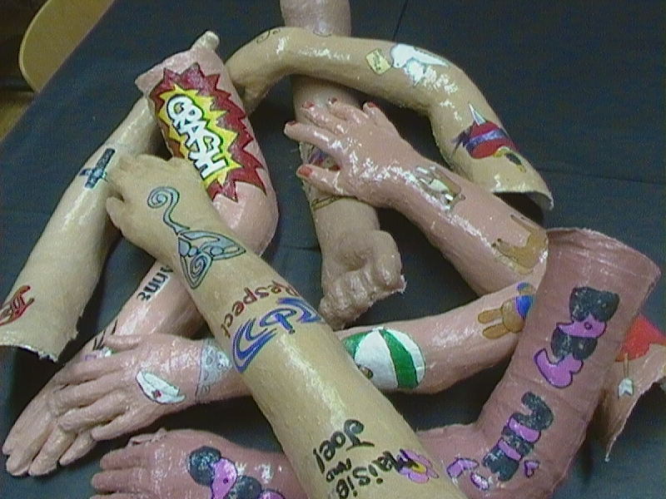
Or being innovators?

Slide 35
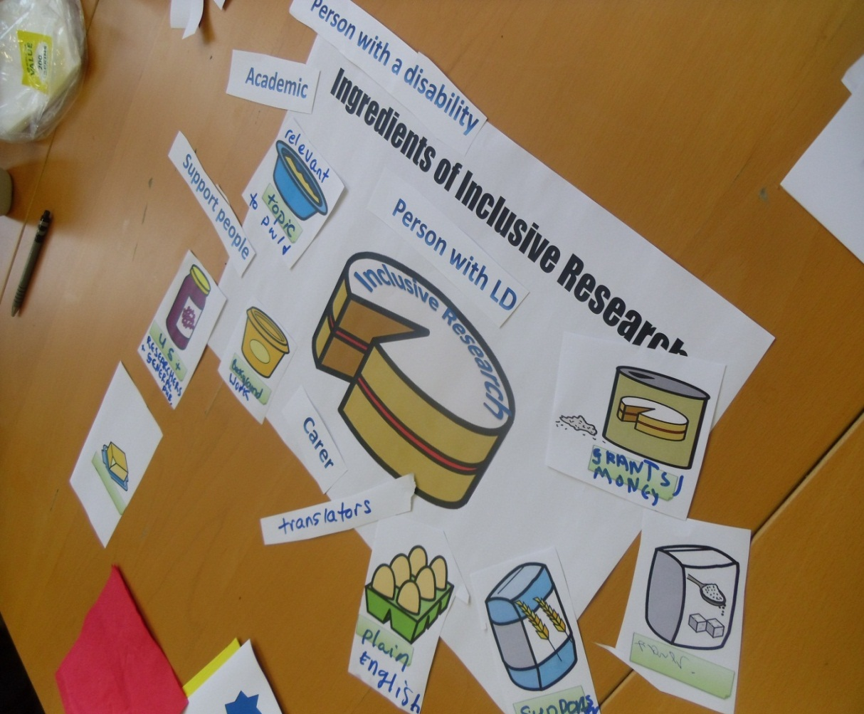

Slide 36
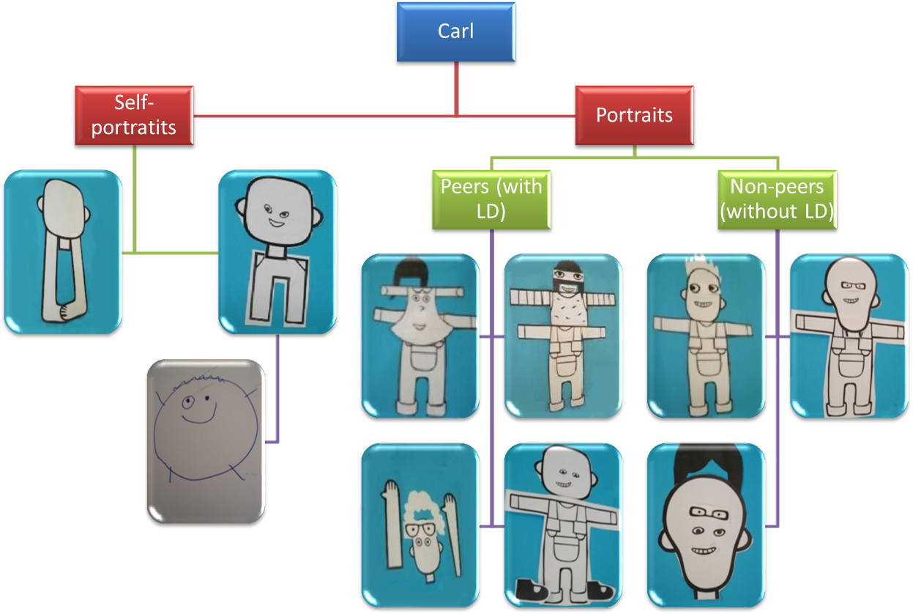

Slide 37
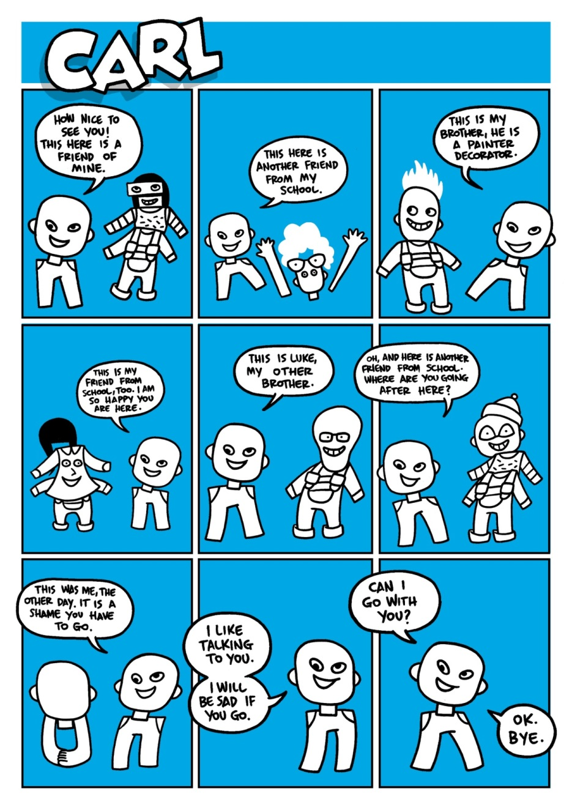
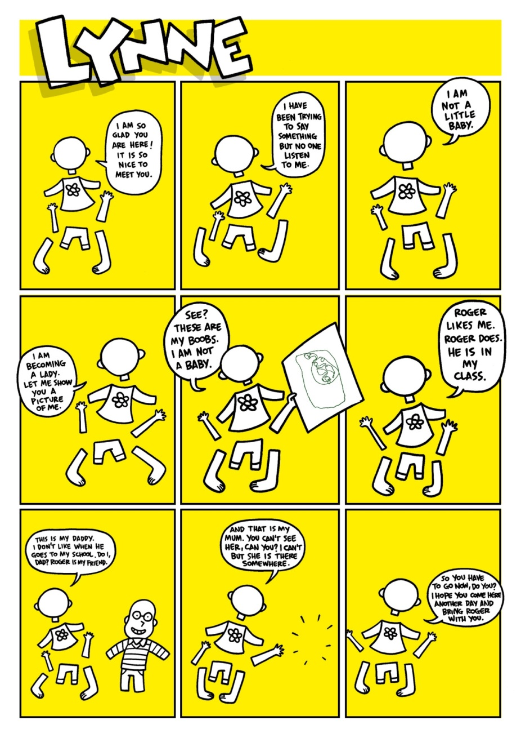

Slide 38
Nind, M., Wiles, R.A., Bengry-Howell, A. & Grow, G.P. (2013) Methodological Innovation and Research Ethics: Forces in tension or forces in harmony? Qualitative Research 13(6) 650–667.
Wiles, R.A., Bengry-Howell, A., Nind, M. & Crow, G. (2013) But is it innovation? The development of novel methodological approaches in qualitative research, Methodological Innovation Online 8(1), 18-33.
Nind, M. (2014) What is Inclusive Research? London: Bloomsbury Academic.
Nind, M. & Vinha, H. (2012) Doing research inclusively, doing research well? Report of the study: Quality and capacity in inclusive research with people with learning disabilities. University of Southampton. http://www.southampton.ac.uk/education/research/projects/quality_and_capacity_in_inclusive_research_with_learning_disabilities.page?

Slide 39
Cancian, F. (1989) Participatory Research and Working Women: Democratizing the production of knowledge, paper presented at the Annual Meeting of ASA, San Francisco.
Bourke, L. (2009) Reflections on Doing Participatory Research in Health: Participation, Method and Power, International Journal of Social Research Methodology 12 (5): 457–74.
Byrne, A., Canavan, J. & Millar, M. (2009) Participatory Research and the Voice-Centred Relational Method of Data Analysis: Is It Worth It? International Journal of Social Research Methodology 12 (1): 67–77.
Clarke, G., Boorman, G. and Nind, M. (2011) 'If They Don't Listen I Shout, and When I Shout They Listen’: Hearing the Voices of Girls With Behavioural, Emotional and Social Difficulties, British Educational Research Journal 37(5): 765–80.
Dodd, M. (2014) Making connections: Problems, progress and priorities – a practitioner’s viewpoint (unpublished doctoral thesis). University of Southampton.
Gauntlett D (2007) Creative Explorations: New approaches to identities and audiences. London: Routlege.
Kellett, M. (2005) How to Develop Children as Researchers. London: Sage.
Kozinets RV (2010) Netnography: Doing ethnographic research online. London: Sage.

Slide 40
Oliver (1997) Emancipatory Research: Realistic Goal or Impossible Dream? In C. Barnes and G. Mercer (eds), Doing Disability Research, Leeds: Disability Press.
Smith, G. (2014) Lessons for social research from participatory decision making, ESRC 6th Research Methods Festival, University of Oxford. http://www.ncrm.ac.uk/resources/video/RMF2014/filmed.php?id=ab53003
Smith, G. (2009) Democratic Innovations: Designing institutions for citizen participation. Cambridge: Cambridge University Press.
Thomson, F. (2007) Are Methodologies for Children Keeping them in their Place?, Children's Geographies 5(3): 207–18.
Torre, M.E. (2005) The Alchemy of Integrated Spaces: Youth Participation in Research Collectives of Difference. In L. Weis and M. Fine (eds), Beyond Silenced Voices, 2nd edn, Albany, NY: State University of New York Press.
Townson, L., Macauley, S., Harkness, E., Chapman, R., Docherty, A., Dias,J., Eardley, M. and McNulty, N. (2004). We are all in the same boat: doing ‘people-led research’, British Journal of Learning Disabilities 32, 72–6.
Vinha MHGL (2011) Learners’ perspectives of identity and difference: a narrative study on visual and verbal representation of self and other, PhD thesis, University of Southampton.

