Slide 1


Student Mental Health: A Prospective Cohort Study
of the Impact of Increased Tuition Fees
Thomas Richardson
Doctorate in Clinical Psychology, University of Southampton
Supervisors:
- Peter Elliott, Doctorate in Clinical Psychology, Southampton
- Ron Roberts, Department of Psychology, Kingston University
- Completed for D.Clin.Psychol thesis
- Submitted to the
British Journal of Psychiatry
Notes:
Completed for thesis
Submitted part of results to BJP: Aiming high, will then be more realisitic
Lit review- accepted with revisions, but wont bore you with that today

Slide 2
Introduction
- Increasing demand for student mental health services (RCP, 2011)
- Mental health during university worsens over time (Bewic et al., 2010; Cooke et al., 2006)
- Mental health related to financial problems, debt concerns, considering dropping out due to finances (Roberts et al., 1999; 2000 Andrews & Wilding, 2004; Cooke et al., 2004)
- English students poorer mental health than Finnish students (Jessop et al., 2005)
- Studies in wider UK general population have shown a relationship (Clark et al., 2012; Jenkins et al., 2008; Meltzer et al., 2013)
Notes:
Demand for services: more students with mild-moderate MH problems, increase in suicide rates.
Final years: worse mental health. Mental health worse than prior to uni
Cooke: 3 year longitudinal study, greater worsening over time if worried about debt
Andrews: Difficulties predict depression and anxiety mid way through degree, after controlling for symptoms prior to uni
Jessop: Finland lower levels of student debt
Wider UK: Large epidemiological studies- relationships between debt and MH especially depression, anxiety disorders, suicide and drug and alcohol problems, possibly psychosis

Slide 3
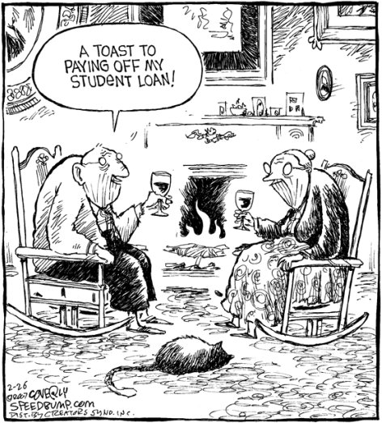
Introduction
Student Debt
- Tuition fees in England and Wales increased from £3k a year in 2011 to £6-9k a year in 2012 (average=£8,360)
- Debt upon graduation predicted to double to £59k (PUSH, 2011)
85% will never pay this back
Aim
Assess the impact increased fees on student mental health
Notes:
£59k for English students
Scottish students- most still get for free, got smug emails from Scottish students unions reminding me of that
85% never pay back: Only if earn above £30k, interest added. Picture might actually be the minority.
Never been such a big increase- perfect opportunity to assess impact. Also aimed to be longitudinal- most research in the area cross sectional so causality is hard to establish.

Slide 4
Method
Design
Prospective cohort study comparing students who started university in 2011 to those starting in 2012 when fees increased.
Standardised Measures
Self-report measures completed online twice in first year:
- Alcohol Use Disorder Identification Test (AUDIT): alcohol problems (α=.86)
- Clinical Outcomes Routine Evaluation General Population Version (CORE-GP): global mental health in non-clinical populations (α=.90)
- 7 Item Generalized Anxiety Disorder Questionnaire (GAD-7) : symptoms of general anxiety (α=.92)
Notes:
Prospective cohort study: compare groups which differ on some variable (in this case tuition fees) and follow them up over time
Measures: had to be free. SF-36: £12k with 90% discount, RAND-36: Free (same questions but different subscales)

Slide 5
Method
- Centre for Epidemiological Studies Depression Scale (CES-D): depression in the general population (α=.95)
- Eating Attitudes Test- 26 Item Version (EAT): attitudes towards food and eating/eating disorder symptoms (α=.93)
- Perceived Stress Scale (PSS): global perceived stress(α=.91)
- Family Affluence Scale (FAS): socioeconomic status
- Index of Financial Stress (IFS): recent financial stress/poverty, e.g. ‘I went without meals’ (α=.70)
- Prodromal Questionnaire- Brief Version (PQB): psychosis risk/prodromal psychotic symptoms (α=.82)

Slide 6
Method
- Author constructed questions on demographics & finances.
Procedure
- Every university students union in the UK contacted
- Survey advertised via email, websites or social media (46/114 advertised)
Participants
- First year British undergraduate students
- 681 participants included at time 1, 411 at time 2
- 76% (n=516) female
- 71.6% (n=486) from England
- 10.5% (n=71) mature students
Notes:
Every students union contact. NUS despite campaigning against fees decided not to take part- not make enemies in high places.
40% of unis advertised- range from Oxford to bottom of league, all over UK. Scotland as well- different fees- less impact?

Slide 7
Method
Statistics
- Multiple linear or logistic regression used: impact of financial variables after controlling for demographic differences between cohorts
- Mixed Factorial ANOVA: Assess changes over time by fees
Notes:
Linear regression: hierarchal- 23 steps

Slide 8
Results
Financial Differences between Cohorts
- 2012 cohort: higher loan, longer to pay back, more likely to see as extra tax
- No significant differences on financial stress, family affluence, difficulty paying bills, stress about debt, considering abandoning for financial reasons
Notes:
See as extra tax rather than debt might or have to pay back
No difference on being able to pay the bills, not just rich kids

Slide 9
Results
Predictors at Time 1:
- Depression and Global MH worse for those paying lower fees (β=.19, β=.20, p<.05)
- Smaller loans: More Alcohol Dependence (β=.13, p<.01)
- Larger loans: More Psychotic symptoms (β=.11, p<.01)
- Greater stress about debt: Worse depression, Global MH, Anxiety, Stress
- Higher Financial Stress: Worse depression, Alcohol Dependence, Global MH, Stress, Psychotic Symptoms, Eating Disorder
- Considered not coming to university for financial reasons: Worse Depression, Global MH, Anxiety, Psychotic Symptoms
Notes:
Say: this is with all variables included, so demographics controlled for
Worse for lower fees: uncomfortable not what expecting to find, read the guardian. Worried would be seen as cameron’s whipping boy. But not that simple as we’ll see.
More alcohol dependence- might just be able to afford to drink more!
Psychotic symptoms- ccross sectional
Stress about debt: how stressed are you about your debt?
Financial stress: struggling to make ends meet

Slide 10
Results
Mediators
- Lower family affluence: more depressed due to greater debt, more stressed due to greater financial stress
- Difficulty paying bills related to mental health, stress and anxiety via stress about debt
- Alcohol use moderated relationship between stress about debt and anxiety
- Higher levels of financial stress accounted for poorer mental health and greater anxiety in those from Wales
- Higher levels of financial stress explained greater alcohol dependence in those of mixed ethnicity
Notes:
Difficulty paying bills: Subjective (stress- how much it bothers you) more important than actual ability to get by. Not difficulty per se, but how much you worry about it. Subjective more important than objective (role for psychological intervention)
Those from Wales: harder to make ends meet- poorer MH
Those stressed about debt drink to cope with anxiety

Slide 11
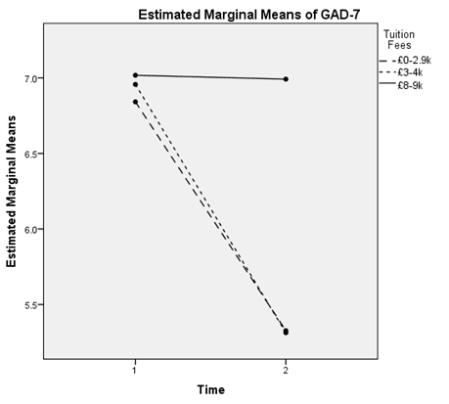
Results
Changes over time: Anxiety (GAD-7)
Significant Time*Fees Interaction: F(2, 336)=4.83, p<.01
Notes:
Changes over time: Mixed Factorial ANOVA
Significant changes over time, no main effect of fees except alcohol- less fees drunk more, but significant interaction
Start off the same: but those paying less improve over first year, whilst those paying more stay the same

Slide 12
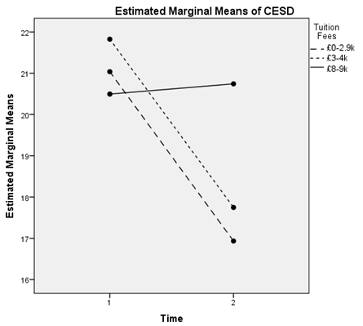
Results
Changes over time: Depression (CES-D)
Significant Time*Fees Interaction: F(2,336)=7.03, p<.001
Notes:
- Depression: Those paying less started off worse- but reversed over time

Slide 13
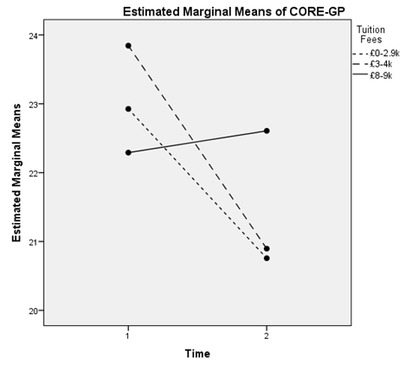
Results
Changes over time: Global Mental Health (CORE-GP)
Significant Time*Fees Interaction: F(2, 336)=4.90, p<.01
Notes:
- CORE: Those paying more actually started off worse

Slide 14
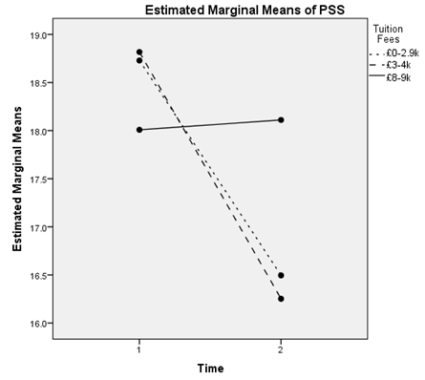
Results
Changes over time: Stress (PSS)
Significant Time*Fees Interaction: F(1,336)=5.58, p<.01
Notes:
- No effect for psychotic symptoms

Slide 15
Results
Predictors at Time 2
After controlling for time 1 scores and demographics:
- Greater Financial Stress time 1: Worse Depression and Anxiety time 2
- Predict take 16-20 years to pay back worse than 6-10 years on Global MH, Anxiety and Stress
- See Loan as extra tax worse Global MH than debt have to pay back
Notes:
Predictors at time 2: longitudinal relationships. Same regressions, but also controlled for time 1 score.
Time to pay back: Those who thought would never pay back no difference. See differently- accept never pay back- not stressed?
Say about shows causality- financial problems worsen MH, rather than MH increasing risk via poor financial management.
Some relationships disappeared- so those with poorer mental health worse finances, more likely to worry about debt, but this also independently worsens mental health of students

Slide 16
Conclusions
- No immediate impact of fees increase on student mental health
- Those paying more appear less likely to recover over time
- If this trends continues: serious public health problem
- Financial problems strongly related to mental health problems
- Causality appears to work both ways
Limitations
- Sample relatively small, not representative (self-selection bias)
- Large drop out at time 2
- Stats not ideal
Notes:
No immediate impact: might be in first time more worried about starting lectures, making friends, getting drunk- not worry about finances. Only in second term does it hit them.
Public health problem: nearly half a million new students a year
Causality: those with poor mental health prone to poor finances and stress about debt, but these factors also worsen mental health independently
Limitations
Limitations: not representative- heavily female, self-selection: 50% depressed ‘student mental health survey’- attracted those with MH problems
Large drop out: 65% completed. Normal for student survey. Psychotic symptoms and financial stress increased risk of drop out.
Stats: Time 2 not really enough participants for regression. Lots of stats.
- Follow-up is on-going: 2012 cohort 3 time points, 2011 at 5. Hope to continue until they finish uni- effects felt when cant get a job, realise repayments don’t even pay debt, buy a house etc. MH worse if end up in more debt than predicted?

Slide 17
Conclusions
Clinical Implications
- Possible stress on services
- Clinician's should ask about debt, student financial services should ask about mental health
- CBT/Mindfulness may be useful- work on thoughts about debt
Notes:
Clinical Implications
If continues- more pressure on already stretched services
Student Counselling: consider finances as a factor. Debt advisors- screen for depression.
- Subjective (stress about debt) more important than objective (amount of debt)- psychological factors important. Work on catastrophic thoughts about debt. Mindfulness- notice the thought you’ll be in debt forever and let it go!

Slide 18
Acknowledgements
- University of Southampton and NHS for Sponsoring and Funding
- My supervisors Peter Elliott and Ronald Roberts
- Students unions who helped with recruitment
Those who gave me permission to use their questionnaires:
- Teresita Narciso, Management of Substance Abuse Team, World Health Organisation, Geneva, Switzerland.
- Richards Evans, CORE System Trust, UK.
- Dr Kroenke, Regenstrief Institute, Indianapolis, USA.
National Institute of Mental Health, USA.
- Dr. David Garner, River Street Clinic, Sylvania, Ohio, USA.
- Dr. Sheldon Cohen, Department of Psychology, Carnegie Mellon University, Pittsburgh, Pennsylvania, USA.
- Dr. Candace Currie, Child and Adolescent Health Research Unit, Medical School, University of St Andrews, UK.
- Dr. Mohammad Siahbush, Department of Health Promotion, University of Nebraska Medical Centre, Omaha, USA.
- Dr. Rachel Loewy, Department of Psychiatry, University of California and San Francisco, USA.

Slide 19
References
Andrews, B., & Wilding, J. M. (2004). The relation of depression and anxiety to life-stress and achievement in students. British Journal of Psychology, 95(4), 509-521.
Clark, C., Pike, C., McManus, S., Harris, J., Bebbington, P., Brugha, T., . . . Stansfeld, S. (2012). The contribution of work and non-work stressors to common mental disorders in the 2007 Adult Psychiatric Morbidity Survey. Psychological Medicine, 42(4), 829-842.
Cooke, R., Barkham, M., Audin, K., Bradley, M., & Davy, J. (2004). Student debt and its relation to student mental health. Journal of Further and Higher Education, 28(1), 53-66.
Cooke, R., Bewick, B. M., Barkham, M., Bradley, M., & Audin, K. (2006). Measuring, monitoring and managing the psychological well-being of first year university students. British Journal of Guidance & Counselling, 34(4), 505-517. Bewick, B., Koutsopoulou, G., Miles, J., Slaa, E., & Barkham, M. (2010). Changes in undergraduate students’ psychological well‐being as they progress through university. Studies in Higher Education, 35(6), 633-645.
Andrews, B., & Wilding, J. M. (2004). The relation of depression and anxiety to life-stress and achievement in students. British Journal of Psychology, 95(4), 509-521.
Jenkins, R., Bhugra, D., Bebbington, P., Brugha, T., Farrell, M., Coid, J., . . . Meltzer, H. (2008). Debt, income and mental disorder in the general population. Psychological Medicine, 38(10), 1485-1493.
Jessop, D. C., Herberts, C., & Solomon, L. (2005). The impact of financial circumstances on student health. British journal of health psychology, 10(3), 421-439.
Meltzer, H., Bebbington, P., Brugha, T., Farrell, M., & Jenkins, R. (2013). The relationship between personal debt and specific common mental disorders. Eur J Public Health, 23(1), 108-113.
PUSH. (2011). Push Student Debt Survey 2011. London: Push.
Roberts, R., Golding, J., Towell, T., Reid, S., Woodford, S., Vetere, A., & Weinreb, I. (2000). Mental and physical health in students: The role of economic circumstances. British Journal of Health Psychology, 5, 289-297.
Roberts, R., Golding, J., Towell, T., & Weinreb, I. (1999). The effects of economic circumstances on British students' mental and physical health. Journal of American College Health, 48(3), 103-109.
Royal College of Psychiatrists. (2011). Mental health of students in higher education. London: Royal College of Psychiatrists.

