Slide 1

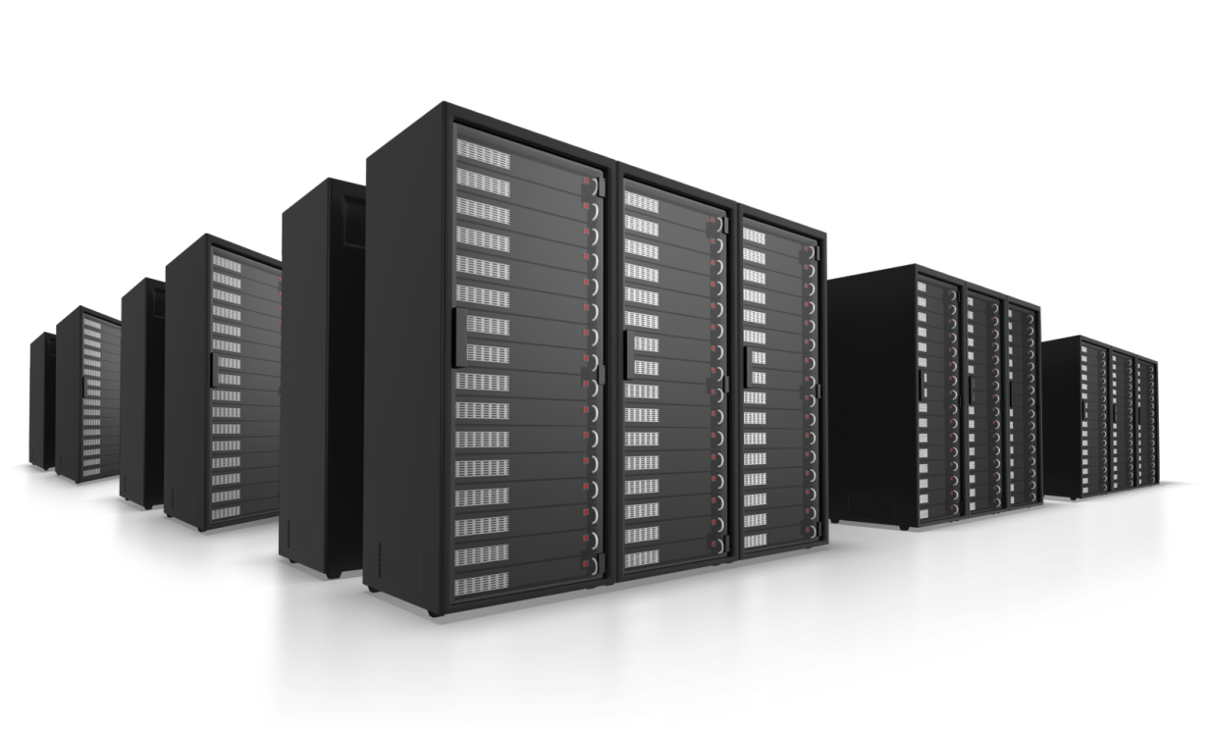

Business Process Risk Management in Digital Audio-Visual Workflows
Making an impact and creating value
http://www.it-innovation.soton.ac.uk/

Slide 2

PLAN
DO
ACT
CHECK
Making an impact and creating value
http://www.it-innovation.soton.ac.uk/

Slide 3

Planning
Receive Material
Build workflows
Capture risk information
Simulate future scenarios
Make decisions
Cleaning
Transfer Recording
File-based QC
Technical QC
Making an impact and creating value
http://www.it-innovation.soton.ac.uk/

Slide 4
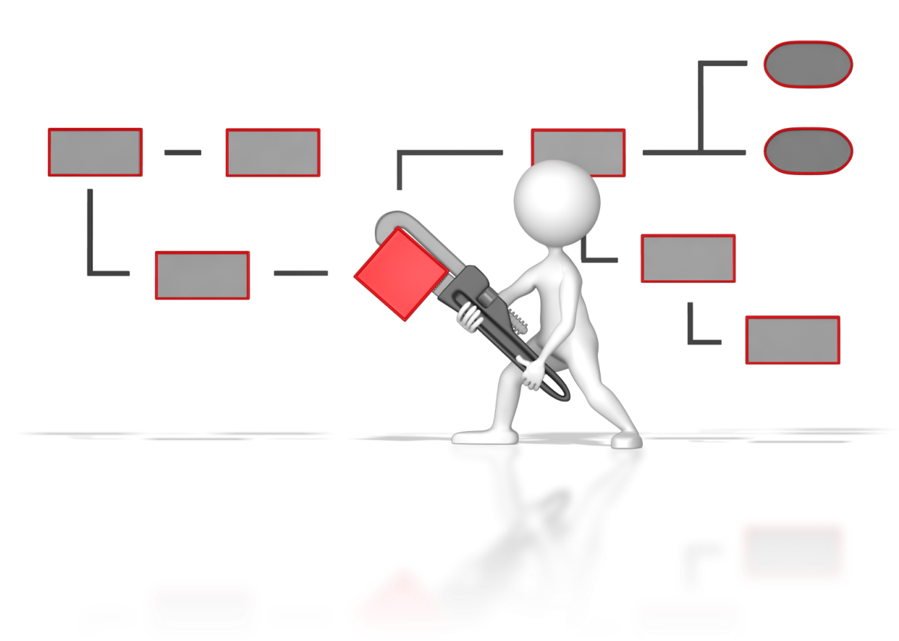
Planning
PLAN
DO
ACT
CHECK
Build workflows
Capture risk information
Simulate future scenarios
Make decisions
Making an impact and creating value
http://www.it-innovation.soton.ac.uk/

Slide 5

Planning
PLAN
DO
ACT
CHECK
Build workflows
Capture risk information
Simulate future scenarios
Make decisions
Making an impact and creating value
http://www.it-innovation.soton.ac.uk/

Slide 6

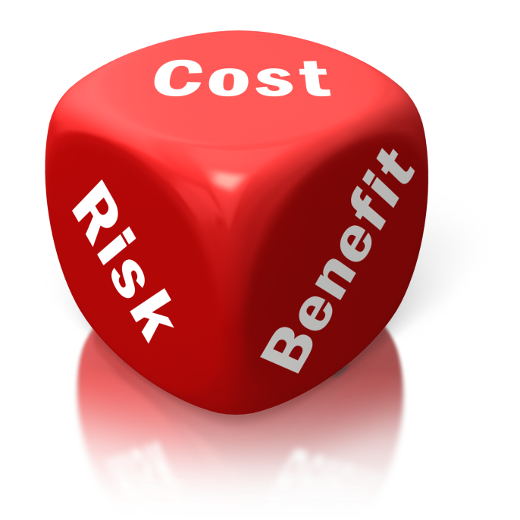
Planning
PLAN
DO
ACT
CHECK
Build workflows
Capture risk information
Simulate future scenarios
Make decisions
Making an impact and creating value
http://www.it-innovation.soton.ac.uk/

Slide 7

Planning
PLAN
DO
ACT
CHECK
Build workflows
Capture risk information
Simulate future scenarios
Make decisions
Making an impact and creating value
http://www.it-innovation.soton.ac.uk/

Slide 8
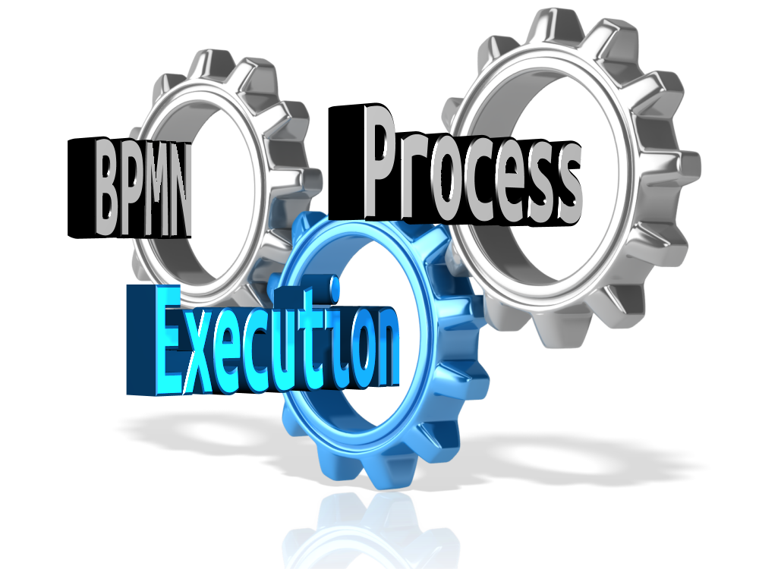
Execution
PLAN
DO
ACT
CHECK
Execute business processes
Orchestrate services
Record execution metadata
Making an impact and creating value
http://www.it-innovation.soton.ac.uk/

Slide 9

Execution
PLAN
DO
ACT
CHECK
Execute business processes
Orchestrate services
Record execution metadata
Making an impact and creating value
http://www.it-innovation.soton.ac.uk/

Slide 10
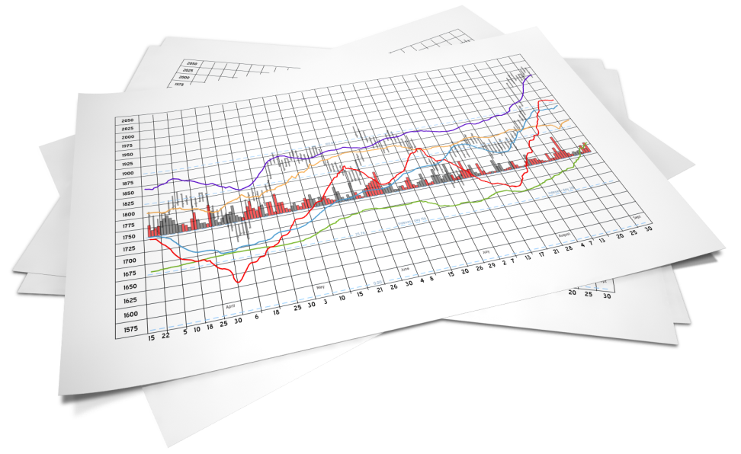
Execution
PLAN
DO
ACT
CHECK
Execute business processes
Orchestrate services
Record execution metadata
Making an impact and creating value
http://www.it-innovation.soton.ac.uk/

Slide 11

Monitoring
PLAN
DO
ACT
CHECK
Preservation metadata
Process analytics
Calibrate simulation
Trigger live alerts
Making an impact and creating value
http://www.it-innovation.soton.ac.uk/

Slide 12
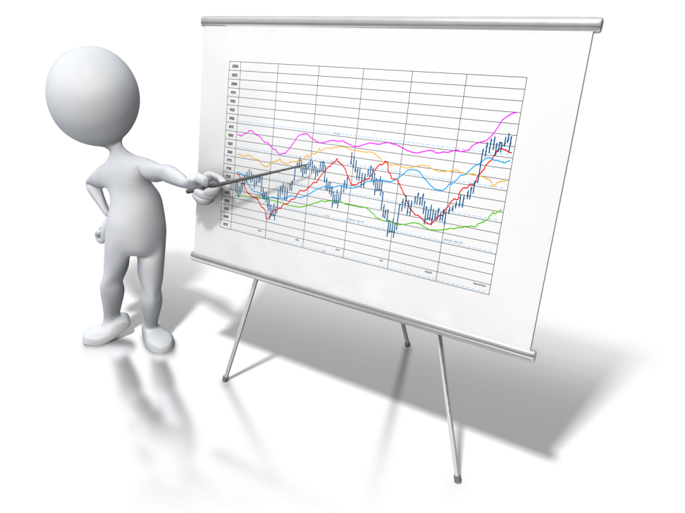
Monitoring
PLAN
DO
ACT
CHECK
Preservation metadata
Process analytics
Calibrate simulation
Trigger live alerts
Making an impact and creating value
http://www.it-innovation.soton.ac.uk/

Slide 13
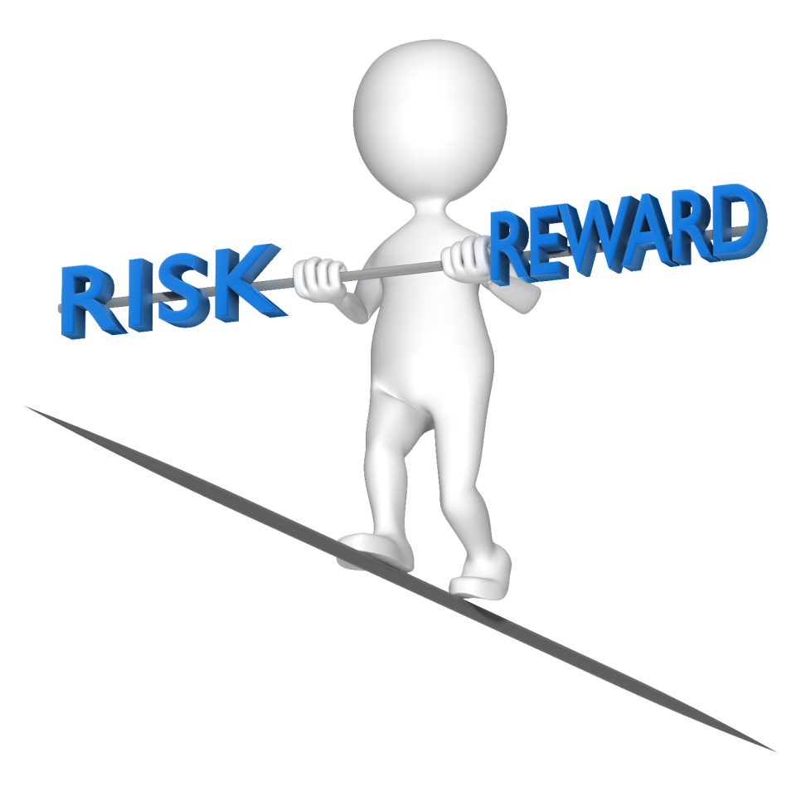
Monitoring
PLAN
DO
ACT
CHECK
Preservation metadata
Process analytics
Calibrate simulation
Trigger live alerts
Making an impact and creating value
http://www.it-innovation.soton.ac.uk/

Slide 14

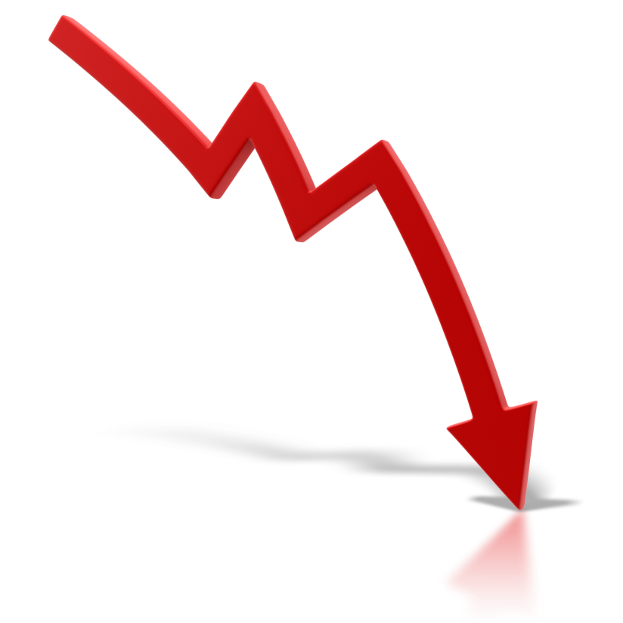
Monitoring
PLAN
DO
ACT
CHECK
Preservation metadata
Process analytics
Calibrate simulation
Trigger live alerts
Making an impact and creating value
http://www.it-innovation.soton.ac.uk/

Slide 15
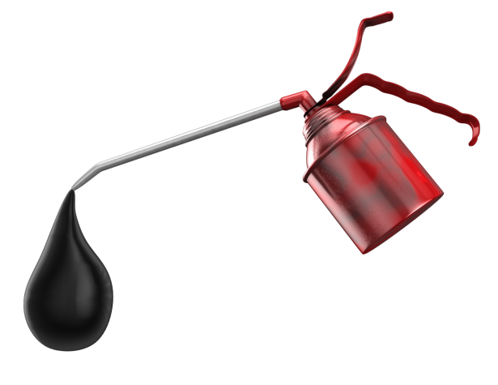
Adaptation
PLAN
DO
ACT
CHECK
Adapt workflows
Manage risks
Configure risk alerts
Making an impact and creating value
http://www.it-innovation.soton.ac.uk/

Slide 16
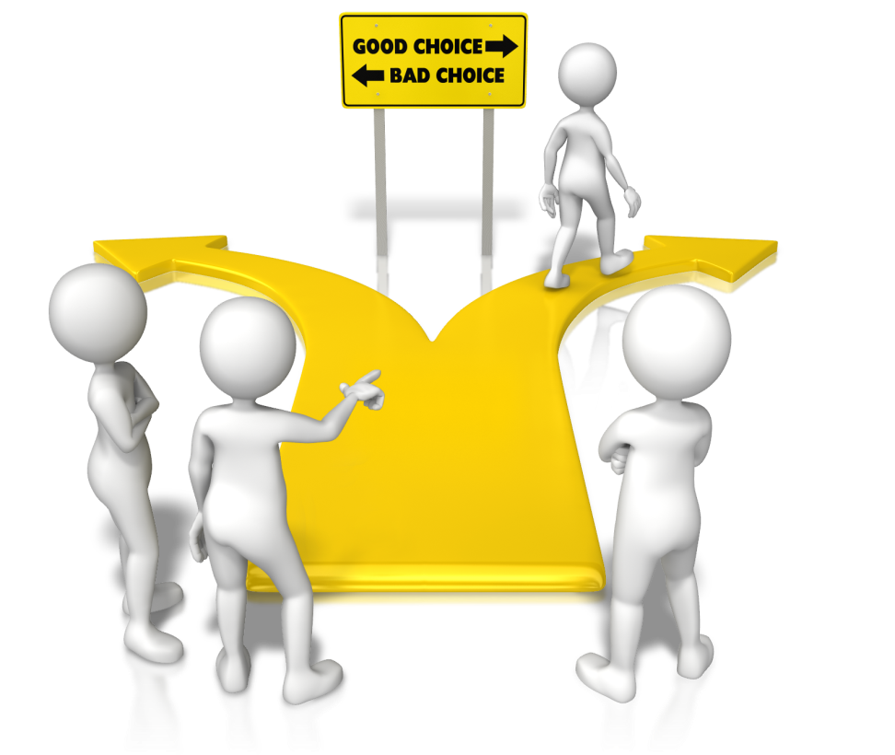
Adaptation
PLAN
DO
ACT
CHECK
Adapt workflows
Manage risks
Configure risk alerts
Making an impact and creating value
http://www.it-innovation.soton.ac.uk/

Slide 17
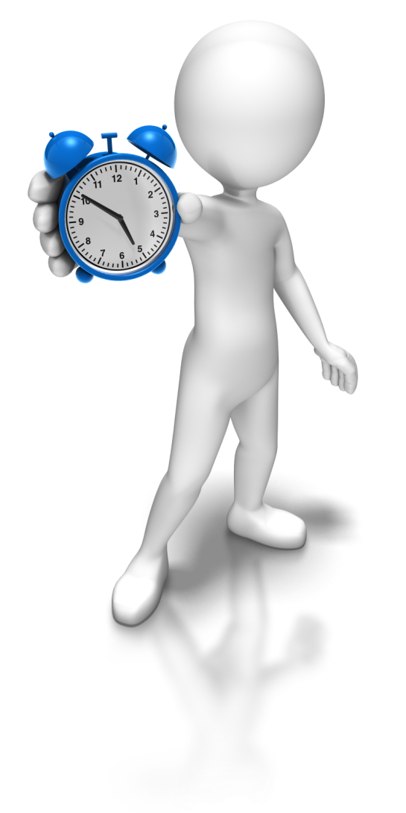
Adaptation
PLAN
DO
ACT
CHECK
Adapt workflows
Manage risks
Configure risk alerts
Making an impact and creating value
http://www.it-innovation.soton.ac.uk/

