Slide 1
Risk Management
Digital AV Media Damage
Prevention and Repair

Slide 2
Business Process Risk Management
Risk framework
Business process simulation

Slide 3
Why risk management?
Preservation workflows can be large and complex
Too many variables and options to consider simultaneously
Risk information typically in experts heads
Improve cost-benefit
Identifying and understanding key vulnerabilities
Targeting investments
Move away from “firefighting”
Organisations may spend more time dealing with issues rather than preventing the issues from occurring in the first place

Slide 4
Best practice process
PLAN
DO
ACT
CHECK

Slide 5
Planning
Build workflows
Capture risk information
Simulate scenarios
Make decisions
PLAN
DO
ACT
CHECK

Slide 6
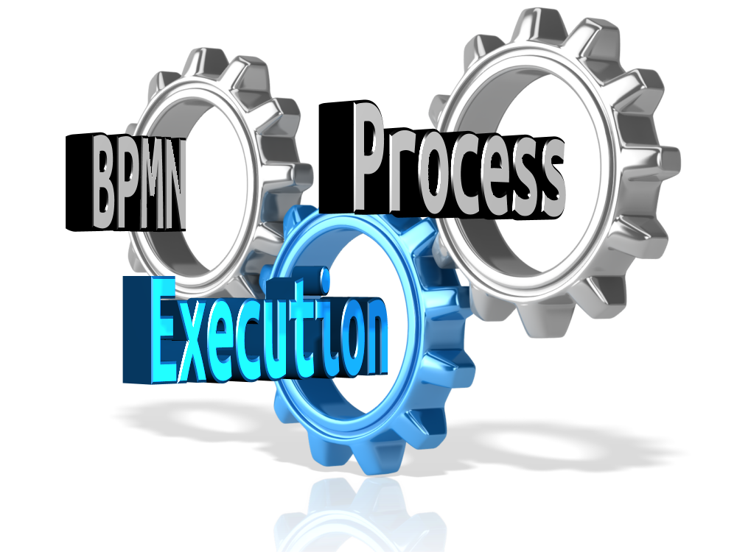
Execution
Execute business processes
Orchestrate services
Record execution metadata
PLAN
DO
ACT
CHECK

Slide 7
Monitoring
PLAN
DO
ACT
CHECK
Preservation meta-data
Process analytics
Calibrate simulation
Trigger live alerts

Slide 8
Act
PLAN
DO
ACT
CHECK
Adapt workflows
Improve processes
Manage risks
Configure risk alerts

Slide 9
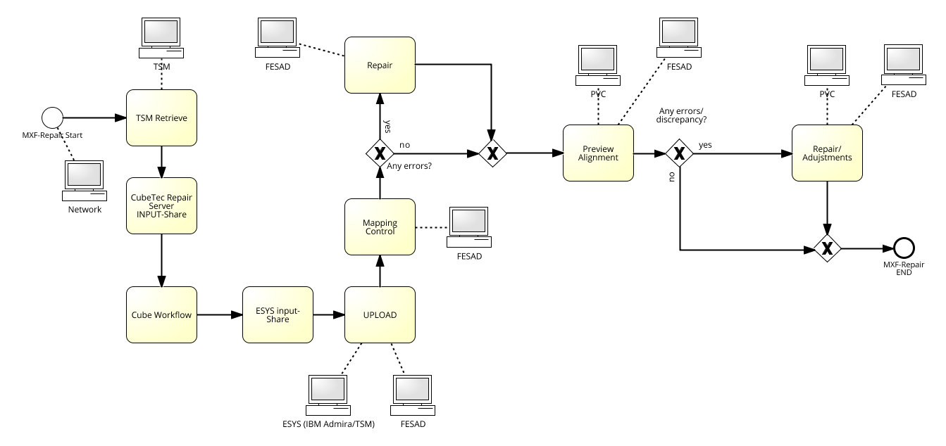
Real-life example from DAVID
ORF MXF Repair workflow

Slide 10
Planning & risk specification
Risk: Wrong file selected
Risk: Retrieve fails
Likelihood?
Impact? Cost?
Risk: Overload
Risk: Wrong assessment

Slide 11
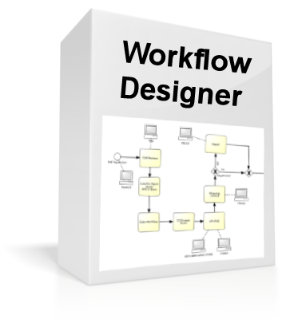
Software tools

Slide 12
Software tools
Workflow (BPMN)
Risks, probabilities, cost
Rate of files, …
Results, e.g.,
Risk occurrences
Time and cost for dealing with risk
Tasks most affected by risk

Slide 13
Simulation results

Slide 14
Why risk management?
Reduce costs
Optimise workflows
Reduce likelihood or impact of risks
Proactive management (rather than reactive firefighting)
Justification of expenses on technology and controls
Cost of risks occurring vs cost of preventing risks
Support process improvement
Simulating different “what if” scenarios
Support tools for best practices
Based on existing standards

Slide 15
Disclaimer
This presentation reflects only the author’s views and the European Union is not liable for any use that may be made of the information contained therein.

