Slide 1
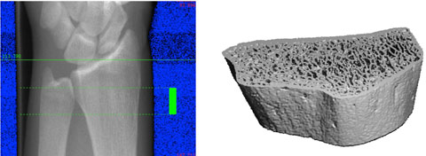
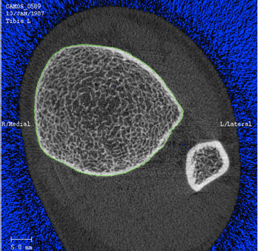
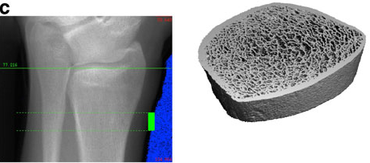
A
C
B
Fig. 2, A typical setup of HR-pQCT for patient measurements.
A and B: The procedure for HR-pQCT analysis requires a ‘scout view’
x-ray of the radius (above) or tibia (below) so that the operator can select the
region of interest for scanning (solid green bar). Subsequently, three dimensional
data can be obtained in the scan region (right).
C: A typical section from HR-pQCT showing the ultradistal tibia and fibula. The
green line on the periosteal surface of the tibia is used to extract the
bone of interest for subsequent three-dimensional analysis.
Adapted from [4].

