Slide 1
PBMC
Sputum
Biopsy
A .Th2 cells
ANOVA P=0.004
ANOVA P=0.03
ANOVA P=0.02
P=0.04
**
*
Health
Asthma
T_{H}2 cell frequencies
(% CD4+ or CD8- T cells)
T_{H}2 cell frequencies
(% CD4+ or CD8- T cells)
PBMC
Sputum
BAL
Biopsy
Healthy
Mild
Mod.
Severe
Healthy
Mild
Mod.
Severe
Healthy
Mild
Mod.
Severe
B. Th17 cells
Sputum
BAL
Biopsy
Health
Asthma
T cell frequencies
(% CD4+ or CD8- T cells)
T_{H}17 cell frequencies
(% CD4+ or CD8- T cells)
PBMC
Sputum
BAL
Biopsy
Healthy
Mild
Mod.
Severe
Healthy
Mild
Mod.
Severe
Healthy
Mild
Mod.
Severe
C. Treg cells
Sputum
BAL
Biopsy
P=0.03
Health
ANOVA P=0.02
Asthma
**
T cell frequencies
(% CD4+ or CD8- T cells)
Treg cell frequencies
(% CD4+ or CD8- T cells)
PBMC
Sputum
BAL
Biopsy
Healthy
Mild
Mod.
Severe
Healthy
Mild
Mod.
Severe
Healthy
Mild
Mod.
Severe
Notes:
Figure 1. Major CD4+ T cell subsets stratified by disease severity
Frequencies of (a) CD3+4+ T cells expressing IL-13 (Th2 cells) (b) CD3+4+ T cells expressing IL-17 (Th17 cells) and (c) FOXP3 (Treg) in PBMC, sputum, BAL and bronchial biopsies measured by intracellular cytokine staining and flow cytometry. Results are expressed as a percentage of live CD3+CD4+ T cells, or for bronchial biopsies, as a percentage of CD3+8- T cells. Medians are shown as horizontal lines. Left hand column of panels shows healthy controls compared with asthmatics, and P values are from Mann-Whitney U tests. Right three columns of panels show the same data stratified by disease severity (defined at enrolment) where P values are from Kruskal-Wallis tests and are given where P<0.05. Significance post hoc by Dunn’s compared with health: *P<0.05, ** P<0.01. † P<0.05 mild compared with severe asthma. healthy control; mild asthma; moderate asthma; severe asthma. Abbreviations: BAL, bronchoalveolar-lavage, PBMC, peripheral blood mononuclear cell.

Slide 2
A. MAIT cells
P=0.005
P=0.002
P=0.02
Healthy
Asthma
MAIT cell frequencies
(% CD3+ cells)
PBMC
Sputum
BAL
Biopsy
B. PBMC
C. Sputum
Test for linear trend P <0.0001
Test for linear trend P=0.006
MAIT cell frequencies
(% CD3+ cells)
Healthy
Mild
Severe
Healthy
Mild
Moderate
Moderate
Severe
D. Bronchoalveolar lavage
E. Bronchial biopsies
Healthy
Moderate
Healthy
Mild
Moderate
Severe
Mild
Severe
Notes:
Figure 2. Mucosal associated invariant T-cells are deficient in asthma
Frequencies of Vα7.2+CD161+ (MAIT)-cells as a proportion of total live CD3+ T cells in peripheral blood, sputum, bronchoalveolar-lavage (BAL) and bronchial biopsies (a) in health and asthma. Medians are shown as horizontal lines. Differences are compared by unpaired t tests on log-transformed data. The deficiency of MAIT cells correlates with severity as shown by linear trends across groups using residuals on log-transformed data and are given where P<0.05. Post hoc Dunnett’s compared with health: * P<0.05, ** P<0.01.

Slide 3
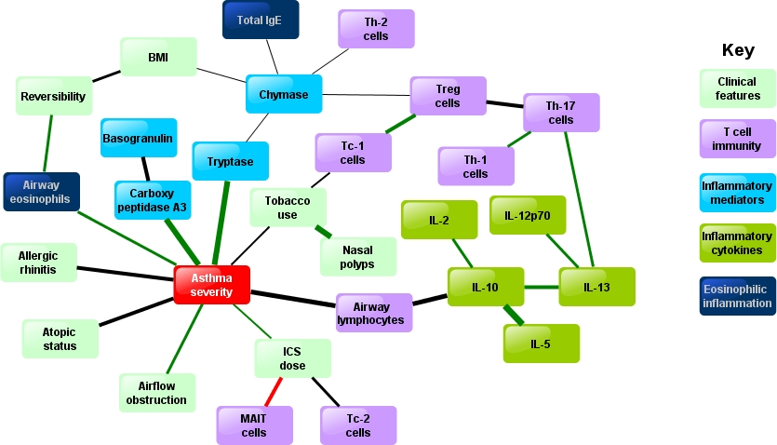
Notes:
Figure 3. Bayesian network analysis of interactions between pathobiological parameters and asthma severity.
Bayesian Belief Network showing the strongest interactions between 28 clinical and pathological parameters in 62 participants across a range of clinical severities of asthma or health. Nodes without strong interactions were excluded. Line thickness represents strength of interaction (Euclidean distance). Line colours represent: green, positive associations; red, negative associations; black, non-linear associations. Asthma severity is the overall physician assessment conducted on enrolment (see methods) and spans mild, moderate or severe asthma (see Table S1). Abbreviations: BMI, body mass index; ICS, inhaled corticosteroids; IL, interleukin; MAIT, mucosal associated invariant T-cell; Tc1, CD8+IFN-γ+ T cell; Tc2 CD8+IL-13+ T cell; Th, T helper cell; Treg, regulatory T-cell.
3

Slide 4
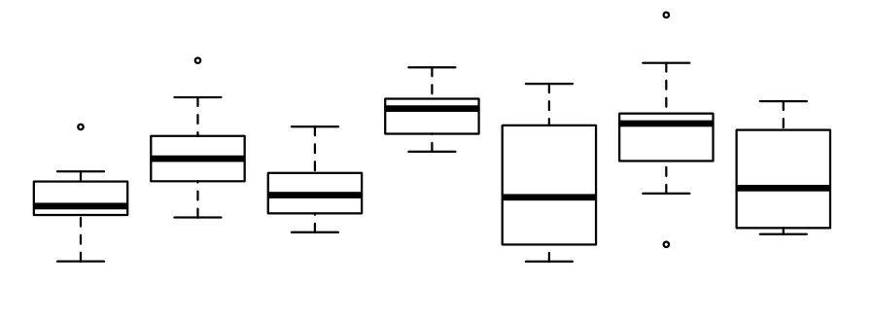
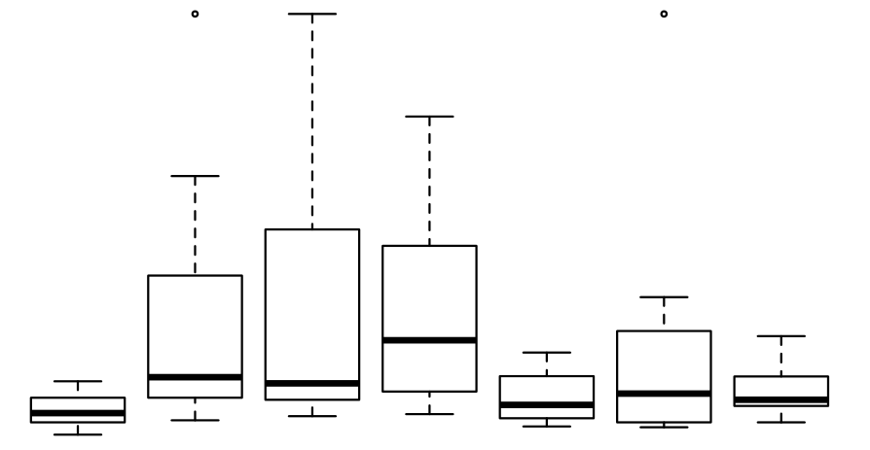
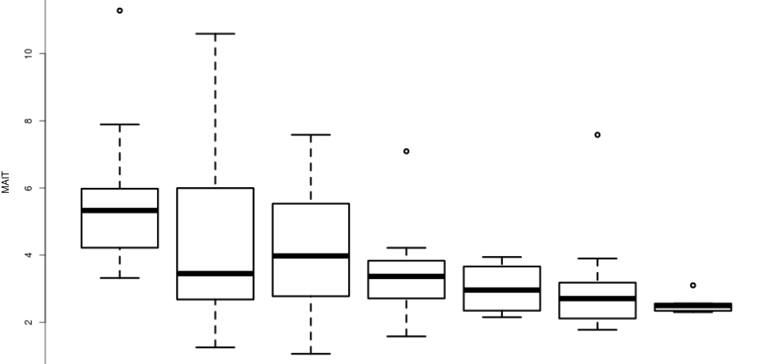
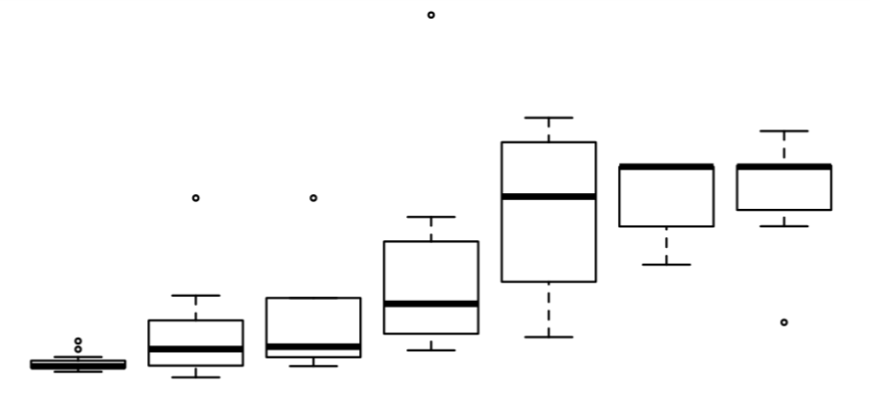
A. Interleukin-5
B. Exhaled nitric oxide
ANOVA P=0.003
ANOVA P=0.005
***
*
*
*
4
200
2
150
Log Interleukin-5
100
0
eNO (ppb)
-2
50
-4
0
Health
1
2
3
4
5
6
Health
1
2
3
4
5
6
Clinico-pathobiological cluster
Clinico-pathobiological cluster
C. Tryptase
D. MAIT-cells
ANOVA P<0.001
ANOVA P=0.02
***
***
**
*
***
*
4
10
3
8
2
MAIT cell frequency
(% of CD3+ cells, average across tissues)
Log mast cell tryptase
6
1
4
0
2
-1
Health
1
2
3
4
5
6
Health
1
2
3
4
5
6
Clinico-pathobiological cluster
Clinico-pathobiological cluster
Notes:
Figure 5. Multi-dimensional clinico-pathological clusters in asthma and health.
Panel a shows the same clinico-pathobiological topological network as Figure 2, generated using all clinical and pathological features together, overlaid with the distribution of neutrophilic (sputum neutrophils >61%, coloured green) or eosinophilic asthma (sputum eosinophils >3%, coloured red). Panel b. shows the same network coloured according to average concentrations of the type-2 cytokines IL-4, -5, -13 in serum, sputum and BAL. Panel c. shows the network coloured according to concentration of mast cell tryptase in sputum and BAL and panel d. shows the frequencies of MAIT-cells (d).
The TDA used 62 subjects with most complete data; Metric: variance normalized Euclidean; Lenses: principal and secondary singular value decomposition (SVD)(Resolution 32, Gain 4.0/3.5x, Equalized); Node size: proportional to number of individuals in node. colour bars: red high values, blue: low values.
Analyses generated from clinico-pathological TDA network show the concentrations of interleukin-5 (e) averaged across serum, sputum and BAL. Exhaled nitric oxide concentrations are elevated in milder clusters (f). Mast cell tryptase in BAL and sputum are markedly elevated in C-PE-E and C-PE-F (severe, steroid-refractory disease) (g). Frequencies of CD3+Vα7.2+CD161+ (MAIT)-cells in blood, sputum, BAL and bronchial biopsy are reduced in the more severe C-PEs 4-6. Box and whisker plots show medians, interquartile ranges and ranges. Statistical tests: one way ANOVA, with post hoc t tests compared with health, using Bonferroni correction (*P<0.05, ** P<0.01, *** P<0.001).

Slide 5
107 Consented and assessed for eligibility
9 Excluded:-
8 Did not meet inclusion criteria
5 Negative methacholine challenge test (presumed asthmatics)
3 Positive skin prick testing (healthy controls)
1 Investigator judgement: on ciclosporin therapy
98 Included
2 Discontinued: participant choice
96 Completed study
96 Clinical phenotyping
84 Sputum induction
75 Bronchoscopy
24 Healthy control
15 Mild asthma
23 Moderate asthma
22 Severe asthma
Notes:
Figure E1. Flow Diagram Showing Study Design and Recruitment

Slide 6
Sputum
BAL
Biopsy
A . Th2 to Th1 Ratio
P=0.006
ANOVA P=0.049
ANOVA P=0.01
ANOVA P=0.009
Health
*
**
**
Asthma
*
Ratio of T_{H}2 to T_{H}1 cells
Ratio of T_{H}2 to T_{H}1 cells
PBMC
Sputum
BAL
Biopsy
Healthy
Mild
Mod.
Severe
Healthy
Mild
Mod.
Severe
Healthy
Mild
Mod.
Severe
B. Th1 cells
Sputum
Sputum
BAL
BAL
Biopsy
Biopsy
Health
Asthma
T_{H}1 cell frequencies
(% CD4+ or CD8- T cells)
T_{H}1 cell frequencies
(% CD4+ or CD8- T cells)
PBMC
Sputum
BAL
Biopsy
Healthy
Mild
Mod.
Severe
Healthy
Mild
Mod.
Severe
Healthy
Mild
Mod.
Severe
Notes:
Figure E2. Major CD4+ T cell subsets stratified by disease severity
(a) Ratios of CD3+4+ T cells expressing IL-13 (Th2 cells), to those expressing IFN-γ (Th1 cells) and (b) frequencies of CD3+4+ T cells expressing IFN-γ (Th1 cells) in PBMC, sputum, BAL and bronchial biopsies measured by intracellular cytokine staining and flow cytometry. Results are expressed as a percentage of live CD3+CD4+ T cells, or for bronchial biopsies, as a percentage of CD3+8- T cells. Medians are shown as horizontal lines. Left hand column of panels shows healthy controls compared with asthmatics, and P values are from Mann-Whitney U tests. Right three columns of panels show the same data stratified by disease severity (defined at enrolment) where P values are from Kruskal-Wallis tests and are given where P<0.05. Significance post hoc by Dunn’s compared with health: *P<0.05, ** P<0.01. † P<0.05 mild compared with severe asthma. healthy control; mild asthma; moderate asthma; severe asthma. Abbreviations: BAL, bronchoalveolar-lavage, PBMC, peripheral blood mononuclear cell.

Slide 7
A. BAL cytokines
IL-5
ANOVA P<0.0001
IL-13
ANOVA P=0.02
IL-17
ANOVA P=0.04
***
*
*
*
Concentration (pg/ml)
LOD
Healthy
Mild
Mod.
Severe
Healthy
Mild
Mod.
Severe
Healthy
Mild
Mod.
Severe
B. Sputum Supernatant
IL-5
P=0.005
IL-13
IL-17
**
Concentration (pg/ml)
LOD
Healthy
Mild
Mod.
Severe
Healthy
Mild
Mod.
Severe
Healthy
Mild
Mod.
Severe
C. Clinical Correlates of BAL IL-17
Allergic rhinitis
Airway eosinophilia
Serum IgE
Epithelial shedding
P=0.02
r_{s}=0.34
P=0.04
r_{s}=0.42
P=0.007
P<0.001
BAL IL-17 (pg/ml)
Absent
Present
Normal
Elevated
Allergic rhinitis
BAL eosinophil count (%)
Serum IgE (iu/ml)
BAL epithelial cell counts
Notes:
Figure E3. T-cell cytokines in bronchoalveolar lavage fluid and sputum supernatant.
Cytokines were measured in duplicate in bronchoalveolar lavage (BAL) (a) and sputum (b) from 60 individuals (18 healthy controls, 12 mild, 16 moderate and 14 severe asthmatics). BAL IL-17 was associated with allergic rhinitis, airways eosinophilia, serum IgE and the extent of epithelial shedding (see results in supplementary appendix for the method used to asssess shedding). Cytokines were measured by multiplex enzyme-linked electrochemiluminescent assay using the Meso Scale Discovery platform. BAL samples were first concentrated 45-fold by centrifugal dialysis. Log-transformed data were compared by ANOVA (where significant, the p value is given at the top of each figure). Significance post -hoc by Dunn’s compared with health: *P<0.05, ** P<0.01, *** P<0.001. LOD (---): limit of detection.

Slide 8
A. PBMC MAIT cells v ICS dose
B. Sputum MAIT cells v ICS dose
C. FEV1 v PBMC MAIT cells
r_{s}= -0.59
P<0.0001
r_{s}= -0.42
P=0.004
r_{s}= 0.38
P=0.005
MAIT cell frequencies
(% CD3+ cells)
MAIT cell frequencies
(% CD3+ cells)
FEV1 (% predicted)
Daily dose of inhaled corticosteroids
(mcg BDP equivalent)
Daily dose of inhaled corticosteroids
(mcg BDP equivalent)
MAIT cell frequencies
(% CD3+ cells)
Asthma control questionnaire
v PBMC MAIT cells
E. GINA level of control
v PBMC MAIT cells
F. Step on GINA treatment algorithm
v PBMC MAIT cells
r_{s}= -0.47
P=0.0003
r_{s}= -0.55
P<0.0001
r_{s}= -0.59
P<0.0001
Uncontrolled
Partly
controlled
Level of GINA treatment
(step)
Asthma control questionnaire
(score out of 7)
GINA level of control
Controlled
MAIT cell frequencies
(% CD3+ cells)
MAIT cell frequencies
(% CD3+ cells)
MAIT cell frequencies
(% CD3+ cells)
Notes:
Figure E4. Clinical correlates of mucosal associated invariant T-cells frequencies
Frequencies of Vα7.2+CD161+ (MAIT)-cells in peripheral blood (A,C-F) and sputum (B) are negatively correlated with (A,B) dose of inhaled corticosteroids, (D) asthma control questionnaire score, (E) GINA level of control, (F) step on GINA treatment algorithm and positively correlated with FEV1 (as a percentage of predicted). r_{s,} Spearman’s correlation coefficient.

Slide 9
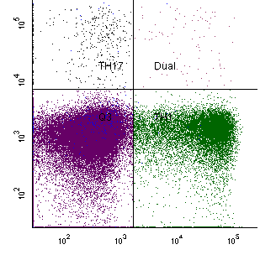
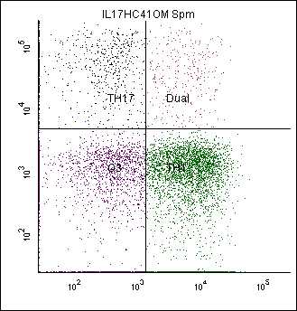
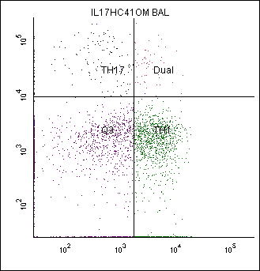
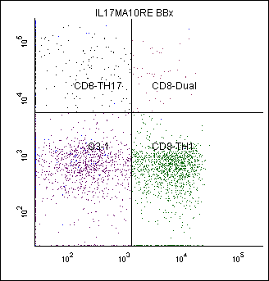
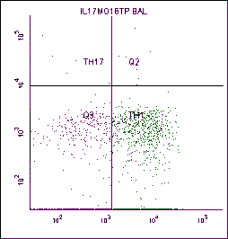
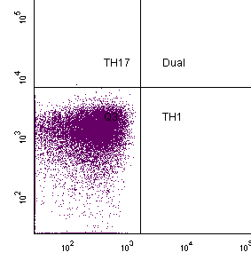
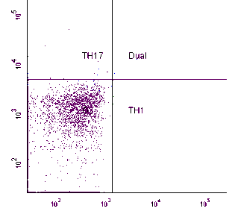
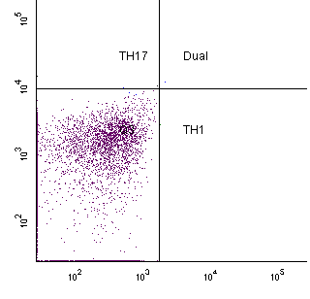
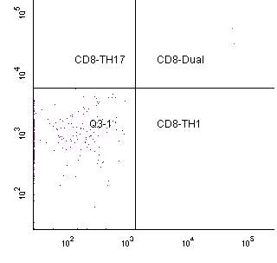
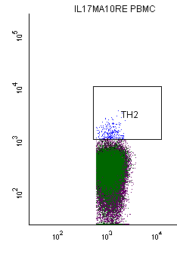
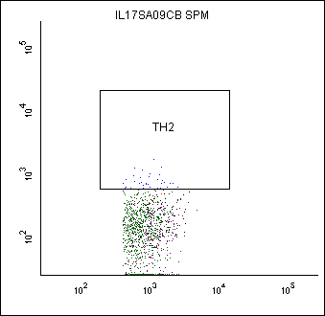
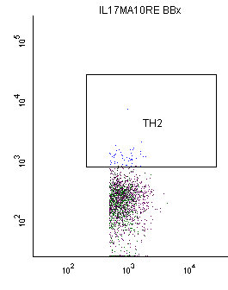
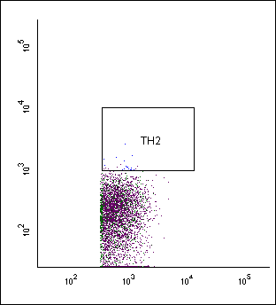
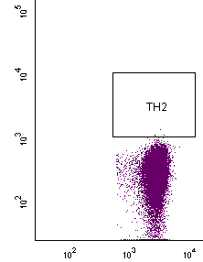
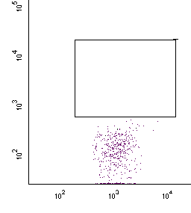
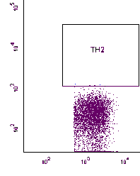
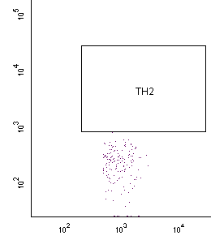
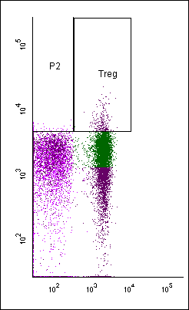
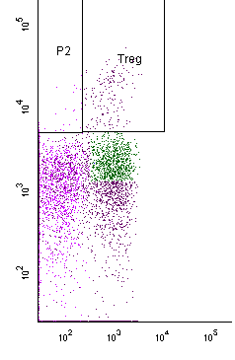
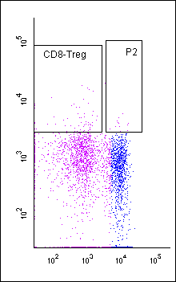
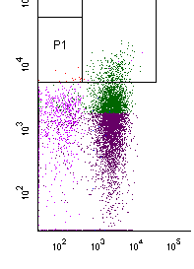
PBMC
T_{H}17
0.63%
Sputum
T_{H}17
10%
BAL
Biopsy
T_{H}17
6.9%
T_{H}17
7.6%
T_{H}1
20%
T_{H}1
55%
T_{H}1
45%
T_{H}1
34%
IL17
IFNγ
Controls
T_{H}2
0.35%
Ctrl
T_{H}2
3.3%
Ctrl
T_{H}2
0.3%
Ctrl
T_{H}2
2.6%
Ctrl
IL-13
CD4
T reg
5.7%
T reg
3.8%
T reg
4.5%
T reg
8.2%
FoxP3
FoxP3
CD4
CD8
Notes:
Figure E5

Slide 10
A .γδ-17 T cells
PBMC
BAL
P>0.05
P>0.05
ANOVA P>0.05
ANOVA P>0.05
Health
Asthma
IL-17-secreting γδ T cell
Frequencies (% γδ T cells)
IL-17-secreting γδ T cell
Frequencies (% γδ T cells)
PBMC
BAL
Healthy
Mild
Mod.
Severe
Healthy
Mild
Mod.
Severe
Notes:
Figure E6. IL-17 secreting γδ T cells in health and asthma
(A) Frequencies of γδ T cells secreting IL-17 as a proportion of total γδ T cells in peripheral blood and in bronchoalveolar lavage measured by intracellular cytokine staining and flow cytometry. Groups are compared by Mann-Whitney (two groups) or Kruskal-Wallis tests (multiple groups). Abbreviations: BAL, bronchoalveolar-lavage, PBMC, peripheral blood mononuclear cell.

Slide 11
A. PBMC
B. Sputum
C. Cryopreserved PBMC
Th17
P=0.034
0.8
0.4
0.0
Th1
8
4
0
Th2
0.3
0.2
0.1
0.0
T cell frequency
(% of total CD4+ T cells)
Treg
6
4
T cell frequency
(% of total CD4+ T cells)
2
0
1
0
10
20
30
Days since first symptoms
Days since first symptoms
Notes:
Figure E7 T cell frequencies in peripheral blood and sputum during acute viral infections.
Frequencies of CD4+ T cells in (a) peripheral blood and (b) induced sputum during acute upper respiratory tract infections measured by intracellular cytokine staining and flow cytometry on samples processed directly ex vivo. Day 0, baseline screening visit (n=14); day 4, symptom day 4 (n=13); day 7, symptom day 7 (n=14). Plots show means ± 95% confidence intervals. In general data are not paired. Mean frequencies of sputum Th17 cells increased 1.8-fold from 6.2% at baseline to 11% at symptom day 7 (ANOVA P=0.087, post-hoc t test P=0.034). (c) T cell frequencies in paired samples of cryopreserved peripheral blood taken from 26 individuals at day 0, baseline screening visit, at day 1 and days 4, 7, 10, 13, 17 (each ±1 day) and day 30-35, showing the dynamics of the T cell response with greater temporal resolution.

Slide 12
A. Dynamics of peripheral Th17 cell frequencies
B. Areas under curves for Th17 response
Exacerbated
No exacerbation
P=0.2
Th17 cell frequency
(% of total CD4+ T cells)
AUC of Th17 response
Days since first symptoms
No
exacerbation
Exacerbated
Notes:
Figure E8 Peripheral blood Th17 response according to whether experienced an exacerbation.
(a) Peripheral blood Th17 cell frequencies measured by flow cytometry on cryopreserved samples plotted over time and stratified by whether subjects experienced an exacerbation of their asthma defined as a 0.5 point fall in asthma control questionnaire between screening and symptom day 7 (n=16 exacerbated, n=10 did not). Plots show mean ±95% confidence interval.
(b) Plot of areas under the curve for peripheral Th17 response over time, stratified by whether subjects experienced an exacerbation. P=0.2 for unpaired t test.

Slide 13
A. MAIT cells
B. Non-MAIT T cells
P=0.03
(P>0.05)
MAIT cell frequency
PBMC 3C10+CD161-
cell frequency
Before oral
steroids
After oral
steroids
Before oral
steroids
After oral
steroids
C. Peripheral MAIT cells by date of sample acquisition (quarter).
D. Serum Vitamin D3 by date of sample acquisition (quarter).
**
*
***
***
***
2
5
1
4
0
Ln(MAIT cell frequency)
Ln(Vitamin D3)
3
-1
2
-2
-3
1
Jan-Mar
Apr-Jun
Jul-Sep
Oct-Dec
Jan-Mar
Apr-Jun
Jul-Sep
Oct-Dec
Notes:
Figure E9. Peripheral blood MAIT-cell frequencies over the course of the year and after oral corticosteroids
a and b. Frequencies of peripheral blood MAIT (Vα7.2+CD161+) cells and a non-MAIT T cell population (Vα7.2+CD161- cells) in 12 moderate asthmatic subjects, usually controlled on inhaled corticosteroids, before and after 7 days of treatment with 20 milligrams of oral prednisolone given once daily. Frequencies are shown as a percentage of live CD3+ T-cells. P values are for paired t tests: * P<0.05, ** P<0.01.
c. Peripheral blood MAIT-cell frequencies vary over the course of the year and are highest in the summer months.
Log-transformed Vα7.2+CD161+ cell frequencies from healthy and asthmatic subjects according to the quarter in which phlebotomy was performed, with a sinusoidal regression line. R²=0.16. ANOVA P<0.0001 with post-hoc Dunnett’s * P<0.05 and **P<0.01 when compared with January-March.
d) Serum vitamin D3 concentrations vary over the course of the year and are highest in the summer months.
Log-transformed vitamin D3 concentrations from healthy and asthmatic subjects according to the quarter in which phlebotomy was performed, with a sinusoidal regression line. R²=0.30. ANOVA P<0.0001 with post hoc Dunnett’s ***P<0.010 compared with Jan-Mar.

Slide 14
Inflammatory mediators in BAL (a, b, d, e) and sputum (c, f) in health and asthma
A
B
C. Sputum
Healthy
Asthma
Healthy
Asthma
Healthy
Asthma
D
E
F. Sputum
**
**
**
*
*
Healthy
Mild
Mod.
Severe
Healthy
Mild
Mod.
Severe
Healthy
Mild
Mod.
Severe
Notes:
Figure E10. Inflammatory mediators in bronchoalveolar lavage (a,b,d,e) and sputum (c,f) in health and asthma
Concentrations of tryptase (a and d), (b) carboxypeptidase A3 (b and e) in BAL, and sputum of chymase (c and f). Differences are compared by Mann Whitney tests (two groups). P values are for Kruskal-Wallis tests (multiple groups) with post hoc Dunn’s compared with health: * P<0·05, ** P<0·01.

Slide 15
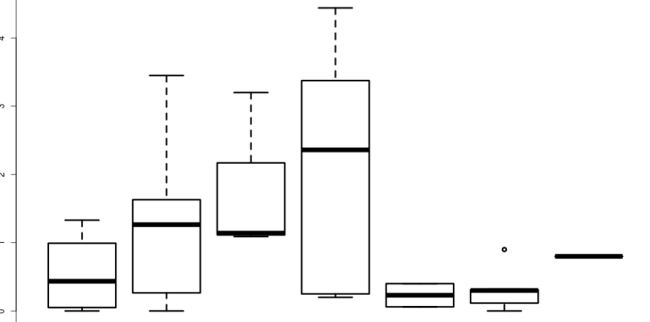
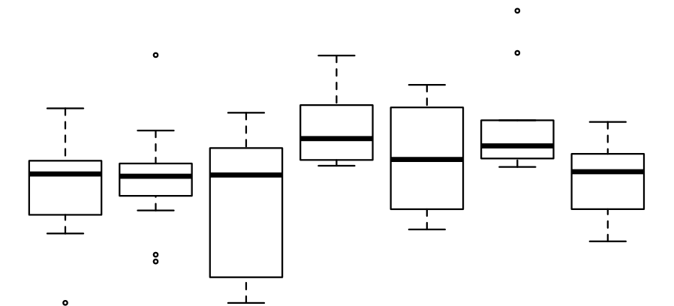
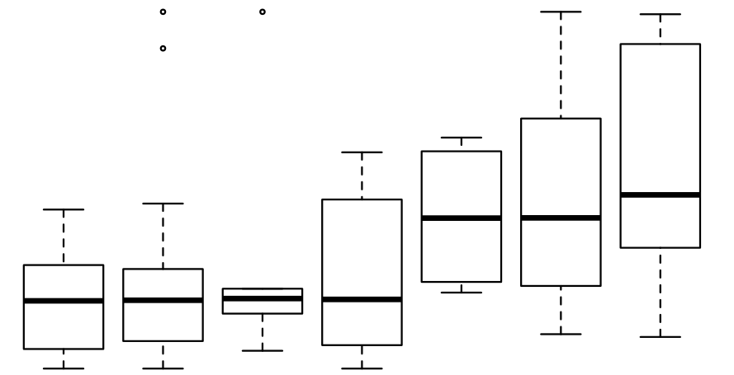
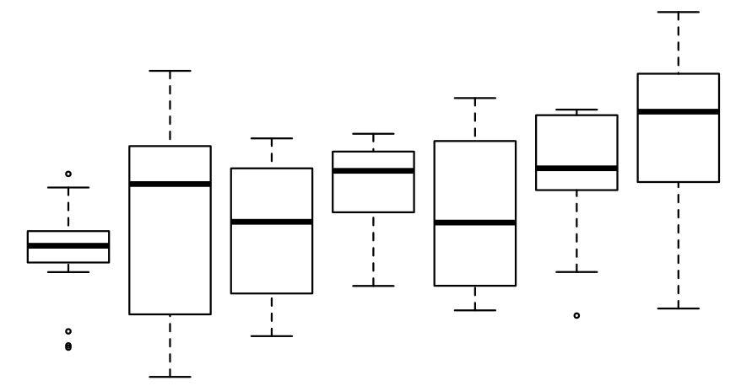
A. Th2 cell frequencies in bronchial biopsies
B. Interleukin-13
ANOVA P=0.02
ANOVA P=0.02
*
*
*
4
4
3
Th2 cell frequency
(% of CD8⁻ cells)
2
2
Log interleukin-13
0
1
-2
0
Health
1
2
3
4
5
6
Health
1
2
3
4
5
6
Clinico-pathobiological cluster
Clinico-pathobiological cluster
C. Mast cell chymase
D. Carboxypeptidase A3
ANOVA P=0.02
*
ANOVA P=0.02
*
*
*
5
4
4
2
3
0
Mast cell chymase (arbitrary units)
Log carboxypeptidase A3
2
-2
1
-4
-6
0
Health
1
2
3
4
5
6
Health
1
2
3
4
5
6
Clinico-pathobiological cluster
Clinico-pathobiological cluster
Notes:
Figure E11 Additional pathobiological features of clinico-pathobiological clusters
Analyses generated from clinico-pathobiological TDA network shown in Figure 3. (a) Frequencies of CD3+4+ IL-13+ (Th2) cells measured by flow cytometry in bronchial biopsies are elevated specifically in the mild-moderate clusters A to C. (b) Concentrations of interleukin-13 averaged across serum, sputum and bronchoalveolar lavage. C and D) Average concentrations of mast cell (c) chymase and (d) carboxypeptidase A3 in BAL and sputum are markedly elevated in clusters E and F (severe, steroid-refractory disease). Box and whisker plots show medians, interquartile ranges and ranges. Statistical tests: one way ANOVA, with post-hoc t-tests when compared with health, using Bonferroni correction (*P<0.05, ** P<0.01, *** P<0.001).

Slide 16
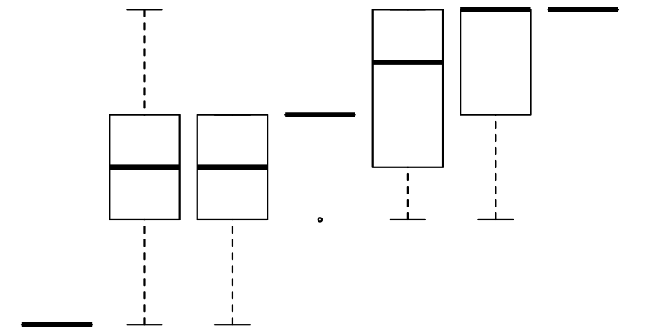
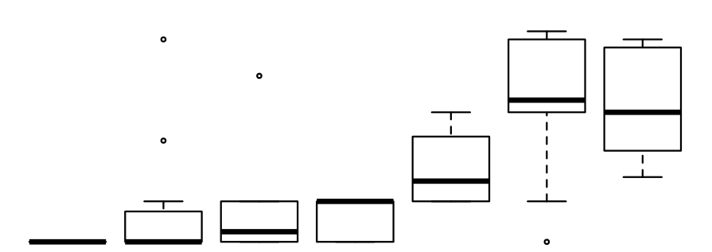
A. Asthma severity
ANOVA P<0.001
Uncontrolled asthma 3
***
*
***
*
***
***
2.5
2
1.5
Asthma severity (GINA)
1
0.5
Health 0
Health
1
2
3
4
5
6
Clinico-pathobiological cluster
B. Inhaled corticosteroid dose
ANOVA P<0.001
*
**
2000
1500
1000
ICS dose (mcg bdp equivalent)
500
0
Health
1
2
3
4
5
6
Clinico-patholobiological cluster
Notes:
Figure E12. Analyses generated from clinico-pathological TDA network shown in Figure 4.
(a) Asthma severity differs widely between different clinico-pathological subgroups: named from 1 to 6 in increasing severity using GINA classification of health (0), controlled asthma (1), partially controlled asthma (2) and uncontrolled asthma (3). (b) Dose of inhaled corticosteroids (ICS) in micrograms beclomethasone equivalent (mcg bdp) per day. Boxes and whiskers show medians, interquartile ranges and ranges. Statistical tests: one way ANOVA, with post hoc t tests compared with health, using Bonferroni correction (*P<0.05, ** P<0.01, *** P<0.001).

Slide 17
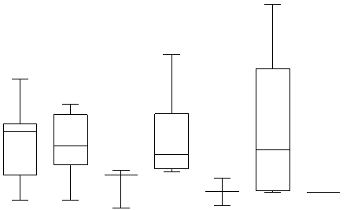
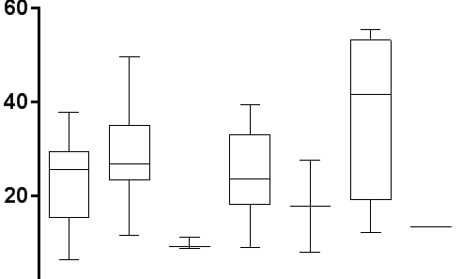
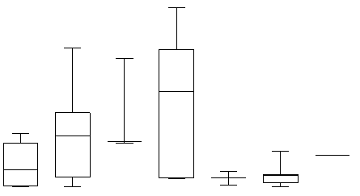
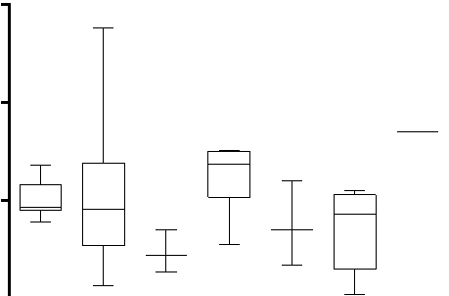
A. Th17 cell frequencies in biopsies
B. Th1 cell frequencies in biopsies
ANOVA P=0.3
ANOVA P=0.02
15
60
10
40
Th17 cell frequency
(% of CD4⁺ or CD8⁻ cells)
Th1 cell frequency
(% of CD4⁺ or CD8⁻ cells)
5
20
0
0
Health
1
2
3
4
5
6
Health
1
2
3
4
5
6
Clinico-pathobiological cluster
Clinico-pathobiological cluster
C. Th2 cell frequencies in biopsies
D. Treg frequencies in biopsies
ANOVA P=0.02
ANOVA P=0.1
*
4
15
3
10
Th2 cell frequency
(% of CD4⁺ or CD8⁻ cells)
Treg cell frequency
(% of CD4⁺ or CD8⁻ cells)
2
5
1
0
0
Health
1
2
3
4
5
6
Health
1
2
3
4
5
6
Clinico-pathobiological cluster
Clinico-pathobiological cluster
Notes:
Figure E13. CD4+ T cell subsets in bronchial biopsies according to clinico-pathobiologic clusters
Analyses were generated from the clinico-pathobiologic TDA network shown in Figure 4 from the main text. Frequencies of (A) CD3+8- IL-17+ (Th17) cells, (B) CD3+8-IFN-γ (Th1) cells, (C) CD3+8-IL-13+ (Th2) cells and (D) CD3+8-FoxP3+ (Treg) measured by flow cytometry in bronchial biopsies. Box and whisker plots show medians, interquartile ranges and ranges. Statistical tests: one way ANOVA, with post-hoc t tests when compared with health, using Bonferroni correction (*P<0.05, ** P<0.01, *** P<0.001).

Slide 18
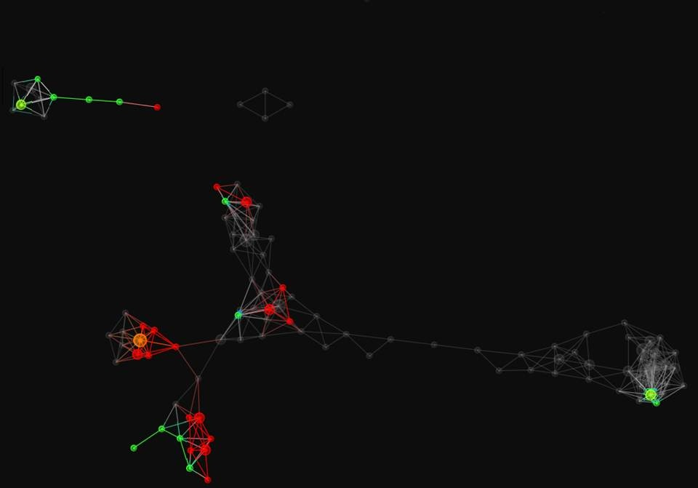
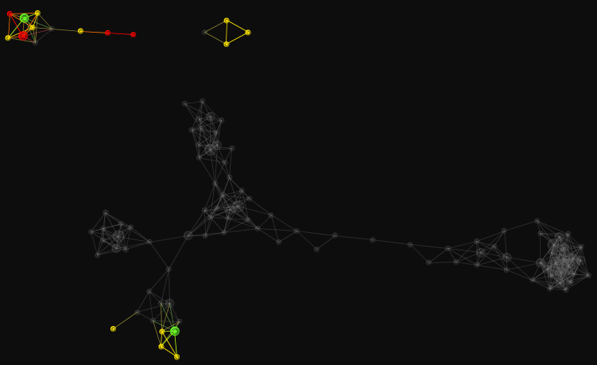
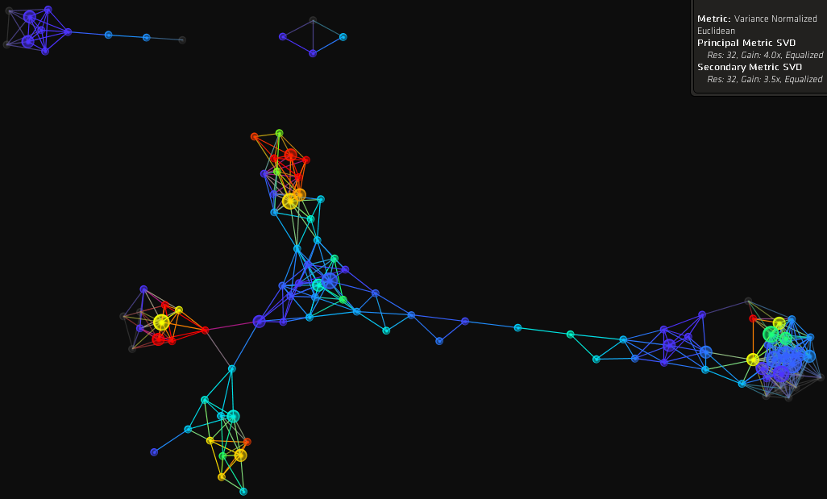
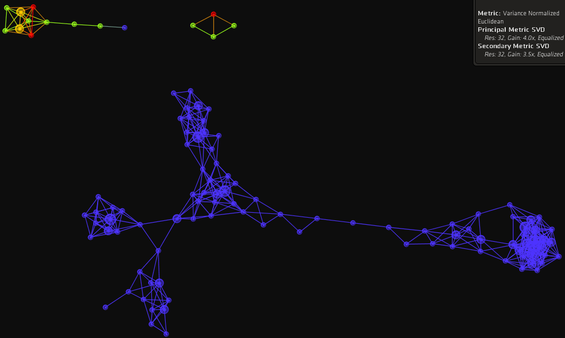
A. Sputum eosinophilia and neutrophilia
B. SARP: ‘cluster 5’
6
4
3
Eosinophilic
Neutrophilic
2
1
Health
5
No
Mixed node
Yes
C. Salicylate sensitivity
D. IL-13 secreting CD8+ (Tc2) cells in biopsies
Absent
Present
Low
High
Notes:
Figure E14. Eosinophilic inflammation amongst clinic-pathobiological clusters
(a) Distribution within the clinico-pathobiological network of neutrophilic (sputum neutrophils >61%, coloured green) or eosinophilic asthma (sputum eosinophils >3%, coloured red). (b) Distribution of asthmatics fulfilling the criteria of ‘cohort 5’ defined by the Severe Asthma Research Program¹⁰. (c) Aspirin-sensitive asthma (red: present, blue: absent, green / yellow: mixed nodes – what does mixed mean?). (d) Frequencies of IL-13 secreting CD8+ (Tc2) cells in bronchial biopsies; note the close correlation with i.e. co-localization sputum eosinophilia.
The TDA used 62 subjects with most complete data; Metric: variance normalized Euclidean; Lenses: principal and secondary singular value decomposition (SVD)(Resolution 32, Gain 4.0/3.5x, Equalized); Node size: proportional to number of individuals in node. colour bars: red high values, blue: low values.

