Slide 1
Student Success on Face-to-Face Instruction and MOOCs
Web And Internet Science Group
What can Learning Analytics uncover?
@AdrianaGWilde / Ed Zaluska / Dave Millard (@hoosfoos)
29 June 2015 – Web Science Education 2015 #wseducation
Notes:
Thanks to the chair for the introduction and for the privilege of being here in the Workshop. I am Adriana Wilde, a PhD researcher at the University of Southampton, working with Ed Zaluska and Dave Millard in the WAIS group. I’d like to talk to you about “Student Success on Face-to-Face Instruction and MOOCs”: In this talk we’ll look at Student Success on Face-to-Face Instruction and MOOCs with a learning analytics perspective

Slide 2
Why is it important to study student success in Higher Education?
How is the model of face-to-face instruction different/similar to that in MOOCs?
How can learning analytics uncover further differences/similarities?
@AdrianaGWilde #websci2015
Notes:
I only have a few minutes of your attention, so I’d like to focus on three main things, three things I’d like you to take after this talk. These are: 1, 2, 3.
My ongoing research is about seeking answers to the last question – and, in a manner not foreign to web scientists: with interdisciplinarity.

Slide 3
@AdrianaGWilde #websci2015
Notes:
But first the first – defining success! This is a rather “cheesy” quote from a motivational author. However, this is has a ring of truth (even if oversimplified). If we want to predict and encourage student success, we need to identify what makes a student successful, but how ?

Slide 4
Student success in Higher Education
Progression
Completion
Student success
Achievement
Student Satisfaction
Retention
Stakeholders interest:
Personal dimension
Institutional
Society as a whole!
@AdrianaGWilde #websci2015
Notes:
Student success is not measured in a simple, unified way. There are a multitude of measures depending on which perspective you choose.
These days in HE we talk a lot about student satisfaction (mostly for the economic implication of dissatisfied learners!), but better understood metrics are completion (Proportion of annual student intake who obtain their pursued qualification), progression (within a programme of study or beyond it)
Retention (Persistence in the HEI , Not dropping out) Achievement – Performance.
Studying these can tell us a lot not just about the person or the institution, but society as a whole, and give us insights on the nature of learning.

Slide 5
F2F instruction vs MOOCs
There are some obvious differences – but are these fundamental to the way students learn?
What are the commonalities?
F2F
instruction
MOOCs
Koller, D. (2012) “What we’re learning from online education”
@AdrianaGWilde #websci2015
Notes:
We are now familiar with the traditional model of Face-to-Face instruction, where a typical class has dozens of people, where the interaction is pretty much like this now – f2f.
With MOOCs, Massive Open Online Courses, we are increasingly becoming more familiar, instead of dozens, we have thousands, and the interaction becomes via a messaging board, mainly between peers because given the volume, it can be prohibitive for instructors.
And these are the obvious differences – however we hypothesise that they are NOT fundamental to the way students learn. Long are the days where we believed that the “plasticity of the brain” and early exposure to digital media, made you a “digital native” and hence learn differently. So how do we go about uncovering the commonalities?

Slide 6
Analysis of data to extract characteristics of students and learning activity that could be used for understanding of performance, prediction of achievement, and timely interventions.
Ferguson (2012) “Learning Analytics: drivers, developments and challenges”
@AdrianaGWilde #websci2015
Notes:
To uncover these commonalities, we’re using learning analytics!

Slide 7
Predictive modelling of student outcomes
Source: www.slideshare.net/sbs/designing-systemic-learning-analytics-at-the-open-university
@AdrianaGWilde #websci2015
Notes:
The answer is YES we can – but the challenge for learning analytics in the past years has been to convince “the guardians” of the data that it has a value for diagnosing, predicting, and making timely interventions! Now, as a research community, (and with “Big Data” being a trending term) the challenge is no longer to convince them. The challentge is…

Slide 8
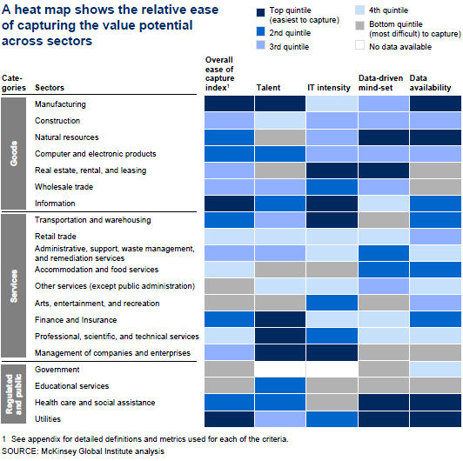
The challenge!
“While all sectors have barriers to capture value from the use of big data … [these] are higher for education, because of a lack of data-driven mind-set and available data”
McKinsey Global Institute report (2011)
@AdrianaGWilde #websci2015

Slide 9
The Data
@AdrianaGWilde #websci2015
Notes:
Let me now tell you about my methodology for this study.
First of all, the data - I have access to datasets from three different institutions, each with a different model of instruction.
The School of Computer Science at the Central University of Venezuela, follows a Face to Face instruction model.
The University of Chile, also follows a Face to Face instruction model, but this is complemented with a VLE for which

Slide 10
The MOOC dataset
Enrolments
(learner_id,enrolled_at,unenrolled_at)
580787 entries
Comments
(id,author_id,parent_id,step,text,timestamp,moderated,likes)
145,425 entries
Step Activity
(learner_id,step,first_visited_at,last_completed_at)
468,634 entries 468,518 entries
Question Response
(learner_id,quiz_question,response,submitted_at,correct)
0 entries
@AdrianaGWilde #websci2015
Notes:
No data in Question-response in this particular Dataset (learner_id,quiz_question,response,submitted_at,correct)

Slide 11
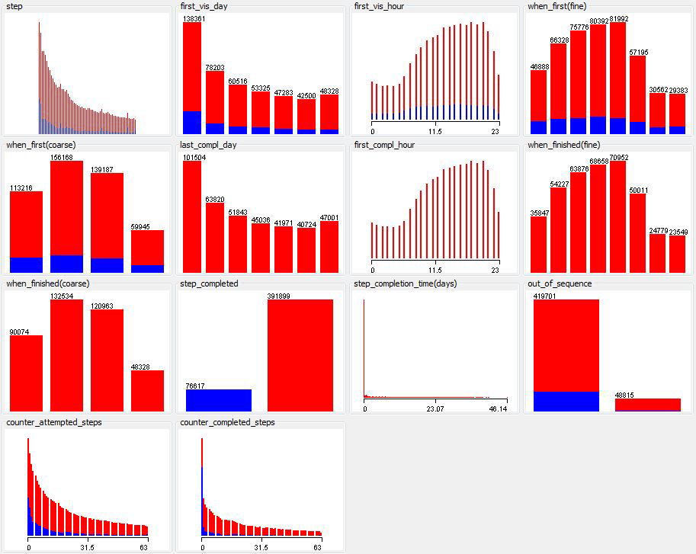
Step Activity
Augmenting data in preparation for data mining
@AdrianaGWilde #websci2015

Slide 12
Curricular mesh for Civil Engineering in Computing
Source:
http://escuela.ing.uchile.cl/docencia/Mallas_Especialidades/COMPUTACION
Description as list:
http://www.uchile.cl/carreras/4971/ingenieria-civil-en-computacion
@AdrianaGWilde #websci2015
Notes:
Here the challenge is not augmenting – but reducing the dimensionality of the data in a meaningful way!
A student taking Civil Engineering in the University of Chile, specialising in Computing, takes this many modules, leaving a data trail of his/her learning path. All the modules they took, all the mid-module assessments, all the interactions with their peers and lecturers within the VLE. This is VAST!

Slide 13
Curricular mesh (Plan común)
Source: http://escuela.ing.uchile.cl/docencia/Mallas_Especialidades/COMPUTACION
@AdrianaGWilde #websci2015
Notes:
For practicality, (and because the biggest problem of student retention and progression lie here), we focus on the first few semesters of the course, the “common plan”. The relevant information here is the codes – here we have the performance of the student in each module, and we hypothesise (also from anecdotal experience) that students difficulties in earlier modules tend to carry through over the years as the precedence system would suggest.

Slide 14
The UCh Datasets
221 attributes, including:
Socioeconomic data (e.g. parental level of instruction)
Previous education attainment (e.g PSU results)
Current performance (e.g. marks in intermediate assessments)
Students data-trail of their interactions with the mobile version of their VLE, U-Cursos
@AdrianaGWilde #websci2015
Notes:
So. What have we got?

Slide 15
UCV data
@AdrianaGWilde #websci2015
Notes:
This is the diagram of their relational database. I am in the great position of being able to request what data I want (what would answer my research questions?)

Slide 16
Research Questions
F2F
instruction
MOOCs
@AdrianaGWilde #websci2015
Notes:
Are the success factors in different learning contexts (such as in MOOCs and in F2F instruction) comparable?
They are manifested differently in each context, but are they related to the same important principle?
How can learning analytics help to bridge it?

Slide 17
Research Questions (on MOOC data)
Who elects to do this MOOC?
What are the predictors of participants completion?
Does the composition of various types of MOOC activities have a measurable effect on participants completion?
What type of activity students complete/engage on the best?
Does the perceived difficulty of activities have a measurable effect on completion?
gender
age
education
employment
videos
audios
discussions
articles
exercises
difficulty
confusion
frustration
boredom
happiness
@AdrianaGWilde #websci2015
Notes:
Modelled using time devoted to MOOC activities.
Leony (2014) “Rule-based detection of emotions in the Khan Academy Platform”.

Slide 18
Research Questions (on F2F instruction)
What are the predictors of student’s retention and completion?
What type of modules students complete/engage on the best?
Does the perceived difficulty of modules have a measurable effect on completion?
Initial demographics
education
gender
age
place of origin
parents education
employment
PSU scores
Registration type
private/state schooling
mathematics
physics
engineering
computing
chemistry
difficulty
enrolment rate
failure rate
semester
area
@AdrianaGWilde #websci2015
Notes:
What are the predictors of student’s retention?
Are there factors in the initial demographics which can predict failure?
What type of modules students complete/engage on the best?
Do failures predict areas of future failure? Do students fail in certain modules rather than others?
Is a failure on an early module more predictive of future failures than failures on later modules?
Does the perceived difficulty of modules have a measurable effect on completion?

Slide 19
What drives student success?
@AdrianaGWilde #websci2015
Notes:
Indicators with evidence of no impact – a number of indicators with supporting evidence that suggests they have a minimal impact on success
Indicators used in existing Learning Analytics – currently used in the Open University’s analysis models
Clear evidence of impact but currently not used in analytics – clear evidence of the impact on success but are not being used in current analytics models due to lack of data or insufficient investigation

Slide 20
Factor affecting student success | In FL data | In UCV data | In UCh data
Disability |  | ✓ | ?
Age | ± | ✓ | ≈
Gender | ± | ✓ | ✓
Previous education | ± | ✓ | ✓
Ethnic group |  | ± | ?
Socio-economic background | ≈ | ✓ | ≈
Subject studied |  | ✓
Module assessment strategy |  | ±
Financial issues |  | ±
Employer support |  | ✓
Personal life events |  | ✓
Workload |  | ✓
Early engagement |  | ✓ | ≈
Language ability |  |  | ✓
Advice received on course choice |  | ±
Study calendar/scheduling |  | ✓
Peer support and belonging | ±
Family support |  | ± | ≈
@AdrianaGWilde #websci2015

Slide 21
Conclusions
Student success is important – not just to the educational stakeholders but for society as a whole
F2F instruction is different to MOOCs but we hypothesize that there is an overarching common principle manifesting itself in different ways
Learning analytics methods, such as the application of data-mining algorithms on pre-processed data about learners, dealing with the dimensionality of the space to produce understanding diagnosis and predictions
@AdrianaGWilde #websci2015

Slide 22
References and attributions
Literature:
Pascarella and Terenzini (2005) “How college affects students: A third decade of research”
Jones (2008) “Student retention and success: A synthesis of research”
Lee and Choi (2011) “A review of online course dropout research: implications for practice and future research”
Leony (2014) “Rule-based detection of emotions in the Khan Academy Platform”.
Ferguson (2012) “Learning Analytics: drivers, developments and challenges”
Images:
Take Away Sign N. Smale.
Habits quote: www.matt-potts.com/habits-the-common-denominator-of-both-success-and-failure/
Le Chéíle ‘Leixlip 5KM’ Road Race 2014 P. Mooney
Mirando estrellas S. Rivas
Diagrama CONEST S. Rivas & J. Zambrano
Slides 5,8: www.slideshare.net/sbs/designing-systemic-learning-analytics-at-the-open-university
Institutional logos for FutureLearn, and all HEI mentioned
Thanks!
@AdrianaGWilde @hoosfoos #websci2015

