Slide 1
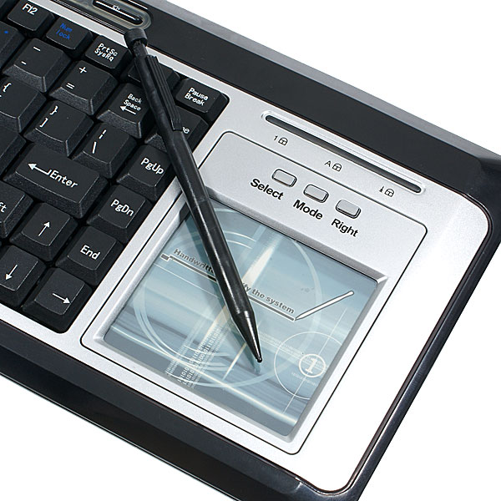
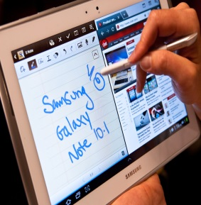
Online Collaborative Learning for Mathematics Education
Exploring the role of handwriting recognition technology
Mandy Lo
University of Southampton
cmml00@ecs.soton.ac.uk

Slide 2
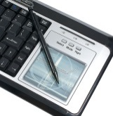
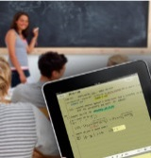
Introduction
Collaborative Learning
The learning model
The benefits
Current development
Constraints

Slide 3
Learning Model
Knowledge Community
Role of Teacher/ Moderator
Idea Generation
Idea Organisation
Intellectual
Convergence
Application
Harasim, L. (2011). Learning Theory and Online Technologies (p. 208)

Slide 4
Benefits
improved reasoning skills
increased awareness of assumptions
enhanced understanding of scope and limitations
improved ability to apply new found knowledge in unfamiliar circumstances

Slide 5
Current Development
Online Collaborative Learning
Facebook
Forums
Virtual Learning Environment
Blackboard
Moodle
etc ....

Slide 6
Constraints
Most OCL studies are text-based subjects
Management, English, History…
Why not….
Science
Technology
Engineering
Mathematics?

Slide 7
Research Question
Is the internet an effective platform for mathematical discussion?
Is electronic formatting of mathematical expression a significant barrier to OCL adoption?
Can handwriting technology solve the problem?

Slide 8
Method
Mixed Method Triangulation
Content analysis of an internet forum
How do people communicate mathematics online?
Online questionnaire
What do people say is the problem
Expert review
What do experts think about handwriting recognition

Slide 9
Forum Statistics
MathHelpForum
52,000+ members/ 650,000+ posts
100 threads from 5 pre-university mathematics forums
Algebra, geometry, pre-calculus, statistics and trigonometry
4819 mathematical statements examined
1385 algebraic statements were posted within a 25 day period
Sande, C., 2011. A Description and Characterization of Student Activity in an Open,
Online, Mathematics Help Forum. Educational Studies in Mathematics 77 (1) : 53–78.

Slide 10
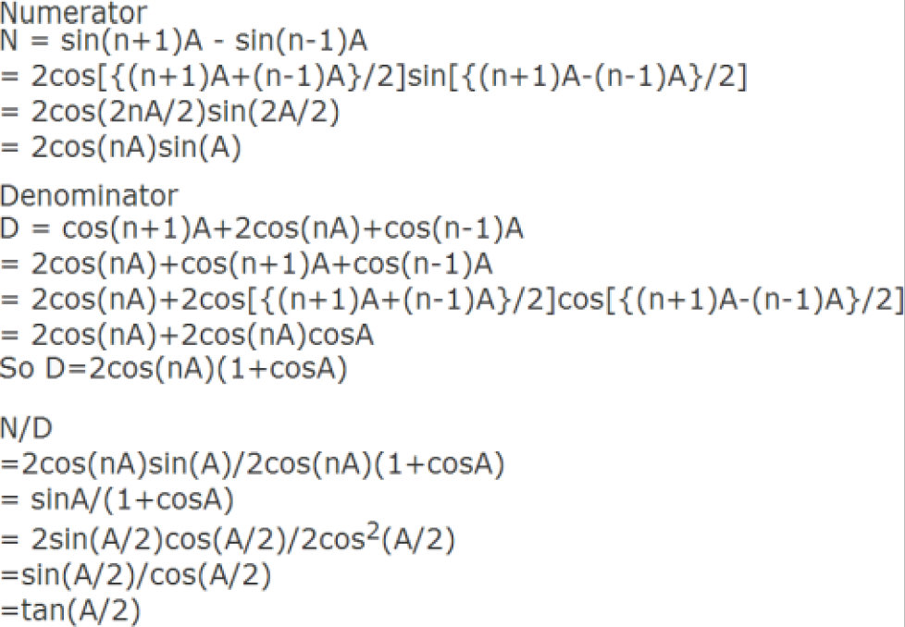
Forum Analysis
Plain Text (44%)

Slide 11
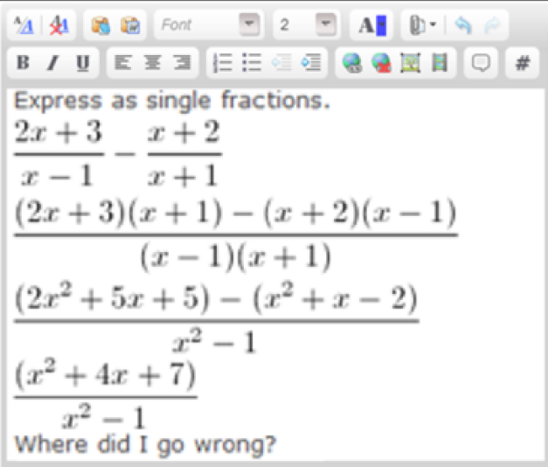
Forum Analysis
Latex (50%)

Slide 12
Forum Analysis
Latex (50%)

Slide 13
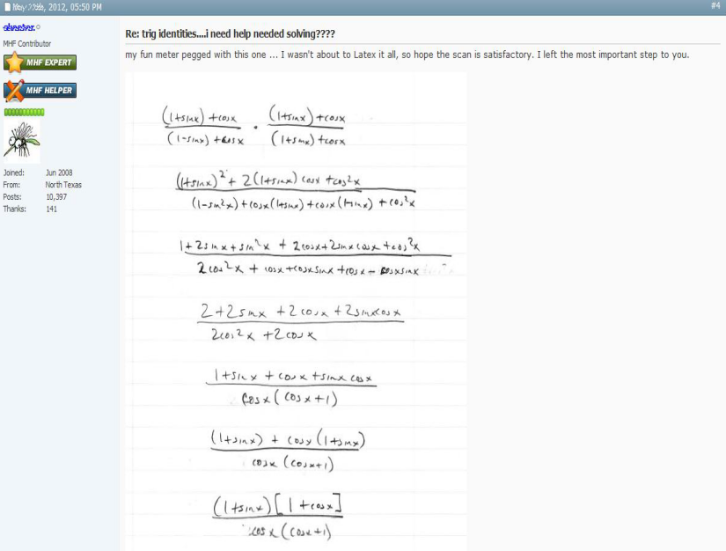
Forum Analysis
Others (6%)

Slide 14
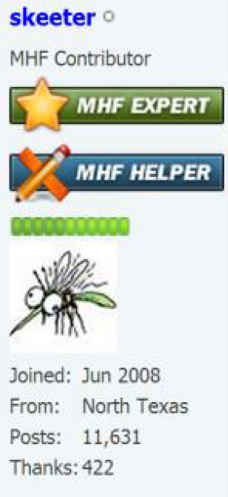
Forum Analysis
Others (6%)
my fun meter pegged with this one... I wasn't about the Latex it all, so hope the scan is satisfactory.
Expert helper
11,631 Posts
422 Thanks

Slide 15
Desire to Learn
I think it's just counter-productive when a student is willing to learn on his/ her own and the only response is "go learn on your own" without pointing them towards a specific textbook and maybe even which books/ resources to avoid (as to prevent the student from learning the material incorrectly, as I find many websites practice the spread of disinformation)

Slide 16
Online Questionnaire
80 participants
44 UK qualified mathematics teachers (avg. 12 years exp)
18 online mathematics tutors
18 postgraduate students

Slide 17
Results
Correlation
UK qualified teachers are more likely to use Microsoft's point and click technology for mathematics input (p<0.001)
Postgraduate students prefer Latex (p=0.028)
72% believe handwriting technology will be helpful
69% indicated that they are likely to use it if it becomes widely available
56% volunteered personal details to be contacted regarding further development

Slide 18
Expert Reviews
4 minute video to demonstrate new concept of handwriting recognition for mathematics education
Experts were chosen from those who participated in the questionnaire and:
Have been teaching mathematics for the last 10 years
Have some experience of handwriting recognition technology
Have not previously been known to the researcher

Slide 19
Expert Reviews
Expert Helper of a Free Math Site
HoD, Comprehensive Secondary School, UK
Experienced Mathematics Teacher:
Community College, USA.
Comprehensive Secondary School, UK

Slide 20
Expert Reviews
Senior Lecturer in Mathematics, UK
“Yes. A robust, reliable, scalable mathematical character recognition package compatible with the industry standard of Latex is long overdue and something that we have been saying should be developed for the past decade.”
Professor in Mathematics Education, a university in Finland.
“It streamlines computer-mediated math communications; Learning LaTeX is tedious and will no longer be necessary.”
Emeritus Professor of Mathematics Education, USA.
“Students could present math expressions in their questions by simply writing it out. Student would not need to learn LaTex or texting conventions. Scanning to jpeg goes partway; Using MathType can be slow but is easily edited. If editable markup is available, MathPen would be a superior choice.”

Slide 21
Proposing MathPen
Instead of ...

Slide 22
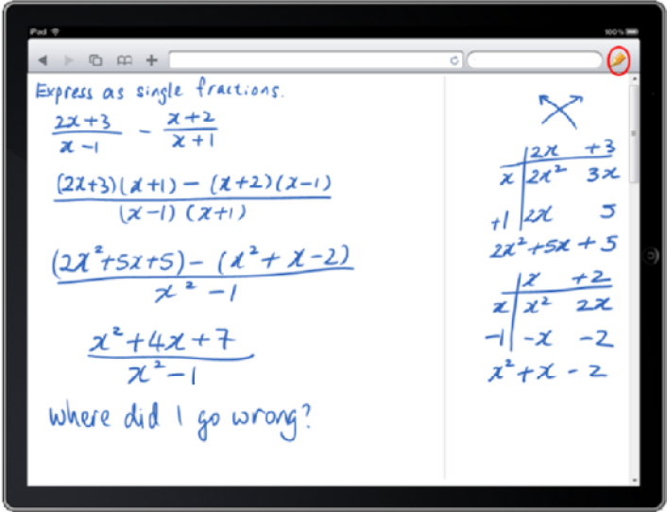
Proposing MathPen
Let's have...

Slide 23
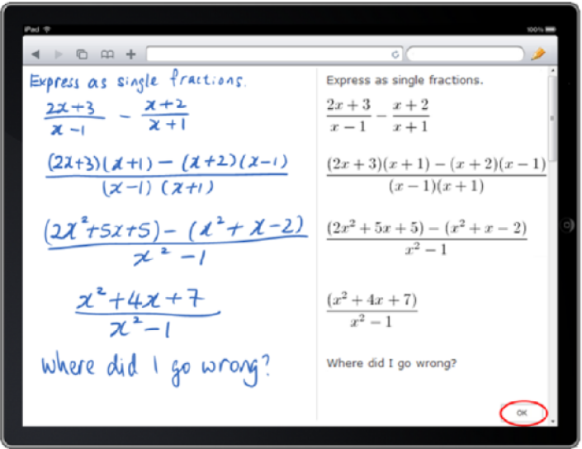
Proposing MathPen
Handwriting Recognition

Slide 24
Proposing MathPen
and Automatic Formatting

Slide 25
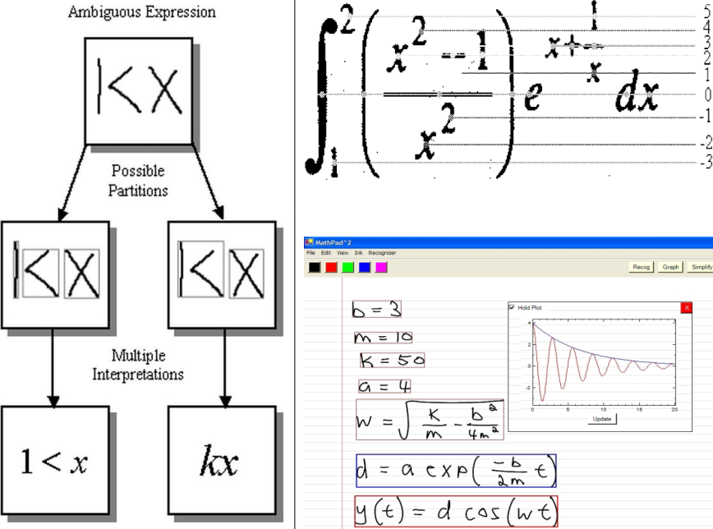
Computer Science
Known algorithms

Slide 26
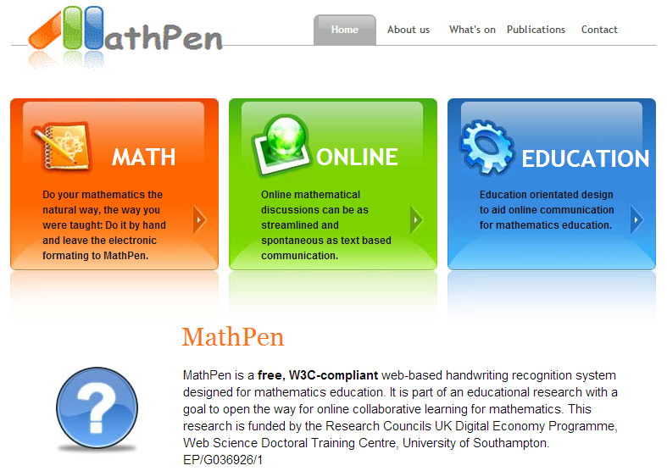
Further Work
www.mathpen.co.uk

