Slide 1
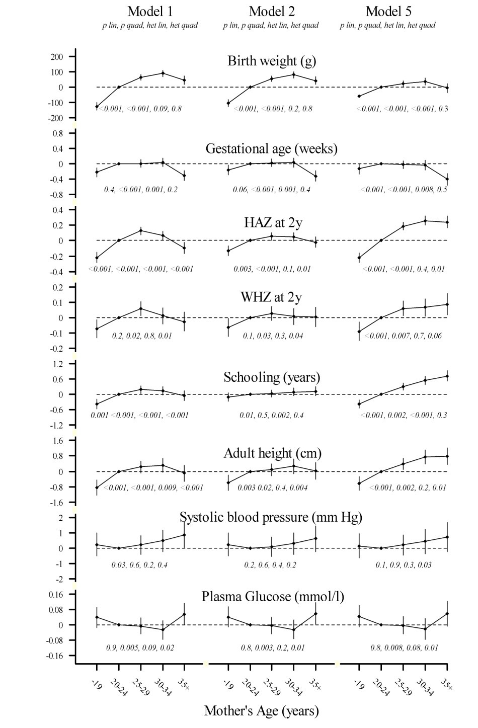
Figure 1: Associations of maternal age with birth weight, gestational age, 2-year height and weight-for-height Z scores, years of schooling, adult height, systolic blood pressure and fasting plasma glucose

