Slide 1
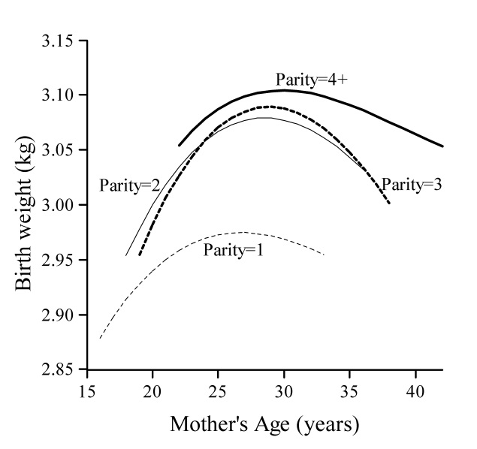
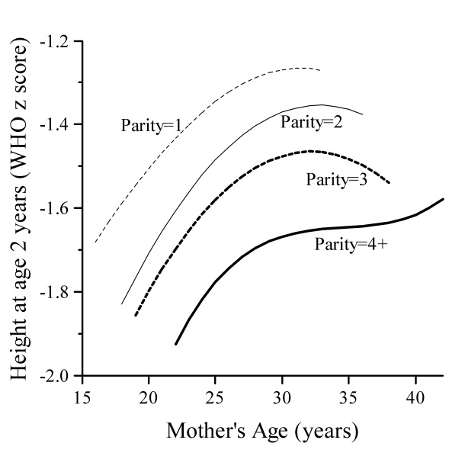
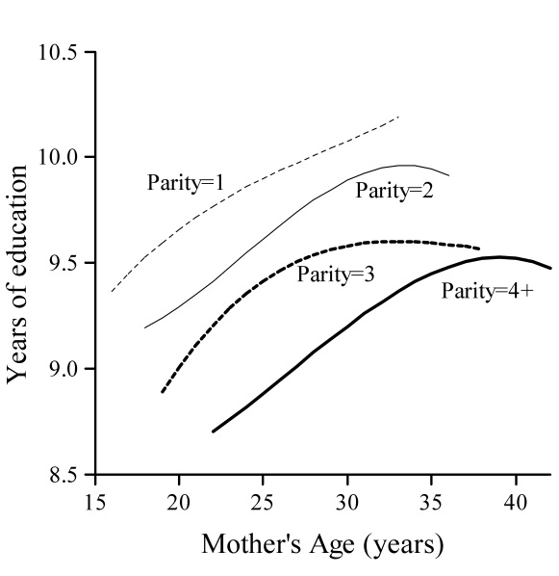
Figure 2: Relationship of maternal age and parity to birth weight, 2-year height Z-score and years of schooling (adjusted for maternal socio-economic status and height)

