Slide 1



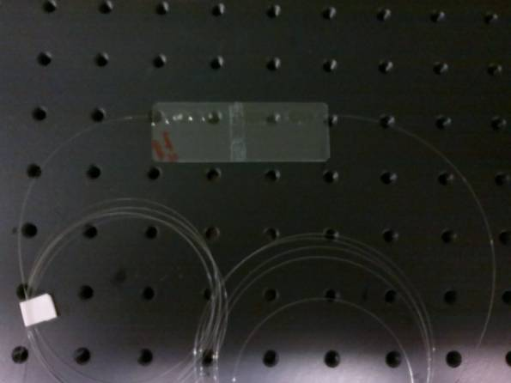
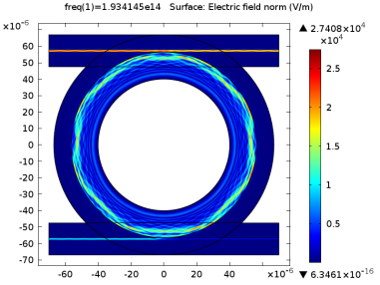
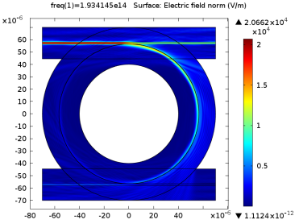
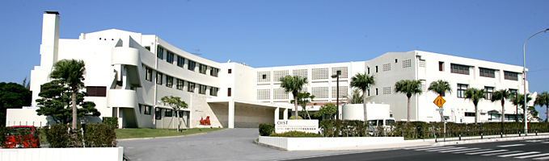

www.prc.dit.ie
@ T H E D U B L I N I N S T I T U T E O F T E C H N O L O G Y
Packaged silica and chalcogenide microspheres and their applications for telecommunications
Pengfei Wang*^{1,2}, Ming Ding³, Ganapathy Senthil Murugan², Timothy Lee², Dan Hewak², Gerald Farrell¹ and Gilberto Brambilla²
¹Photonics Research Centre, Dublin Institute of Technology, Kevin Street, Dublin, Ireland
²Optoelectronics Research Centre, University of Southampton, Southampton SO17 1BJ, United Kingdom
³School of Instrumentation Science and Opto-electronics, Beihang University, Beijing China
Objective
To investigate, both theoretically and experimentally, packaged silica and chalcogenide microsphere and their potential applications in telecommunication.
~15.1 pm/ºC
Silica and soft glass microspheres fabricated to date
Output spectra from the through
and the drop ports
Temperature dependence
Packaged chalcogenide microsphere
Packaged silica microsphere
Tapered fibre
Packaged chalcogenide microsphere
Simulated electric field distribution for a silica microsphere coupled with two tapered fibers in air and polymer
Transmission spectra over the wavelength ranges 1540-1560 nm
Peak shift as a function of exposure time
Conclusion
A compact packaged silica microsphere based add-drop filter with a Q-factor of 0.9 X 10⁵ has been presented .
The transmission spectral responses of the add and drop channels demonstrate the add–drop potential of the filter for very closely spaced DWDM channels.
The photosensitivity of the packaged chalcogenide microsphere device with a Q-factor of 1.8 X 10⁵ to a 405 nm laser radiation has been presented.
These two packaged devices are promising candidates for ideal photonic building-blocks for several telecommunication applications including add-drop filters, highly integrated optical switches, modulators, ultra small optical tunable filters and integrated microlasers.
Fabrication process
Photonics Research Centre
School of Electrical and Electronics Engineering
Dublin Institute of Technology, Ireland
*Email: pengfei.wang@dit.ie & p.wang@soton.ac.uk
ONNA 2015

