Slide 1
How should we measure
& show online learning?
Tim O’Riordan
Web and Internet Science (WAIS)
www.ecs.soton.ac.uk/people/tor1w07
Notes:
I’m a member of WAIS at the University of Southampton and I’m presenting the outputs from a Learning Analytics study carried out over the past 8 months. I carried out content analysis of MOOC comment data using a range of methods – and looked for correlations between them. And I will indicate where I intend to take this in future.

Slide 2
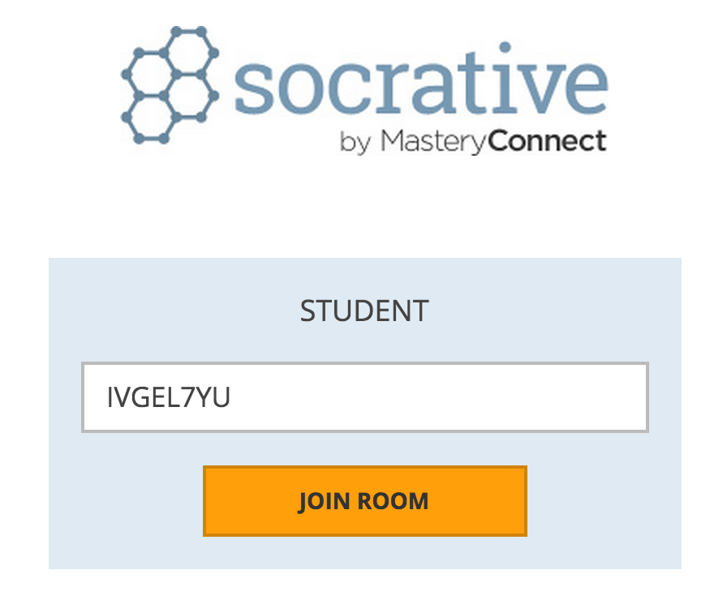

b.socrative.com
IVGEL7YU
How should we measure online learning?
Notes:
In this presentation I’m using Socrative audience response web app to gather your feedback. I’ll be asking some innocuous questions - asking you to rate comments, and gathering any feedback you’d like to give. All data will be gathered anonymously – I won’t know who has said what, and you don’t have to participate if you don’t want to.
You should be able to access socrative on whatever web-enabled device you have, and if you don’t have one I have some iPads which you are welcome to use for this session.

Slide 3
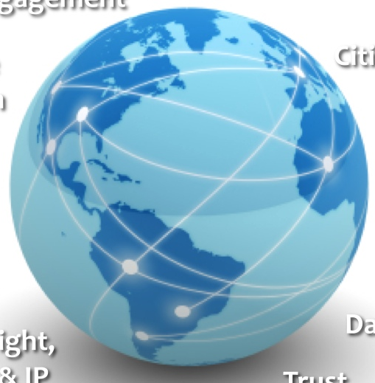
Web & Internet Science
Web of Science
Social Networks/Crowdsourcing
Web of Data
Semantic Web/Open Access
Internet Science
Web of Things/Internet Governance
Cybersecurity
Provenance/Privacy
Technology
Enhanced Learning
Research
Infrastructure
Learning Analytics/MOOCs
Web Observatory/Data Science
Applications
Social Media/Open Government
b.socrative.com IVGEL7YU
How should we measure online learning?
Notes:
While you’re getting socrative working, I’ll tell you a little about me. I’m a web scientist with a background in education, so I’m interested in how we learn on the web and how the web is changing the way we learn. I’m involved in TEL – specifically in attempting to identify online resources that are useful for learning.

Slide 4
b.socrative.com
IVGEL7YU
How should we measure online learning?
Notes:
And that should have given you enough time to get Socrative working. I’ve told you about me – let’s see if we can find out what you all do.
Q. What do you do?
Which of the following is your primary activity? You can only give one answer:
Support teaching and learning
Study teaching and learning
Research teaching and learning
Develop learning technologies
Create and implement strategy
Teach

Slide 5

Motivations
Image: Illustration from the front cover of The Queenslander 16/08/1934.
State Library of Queensland, NKCR
How should we measure online learning?
Notes:
Why am I interested in this? Brief mention of film studies research and edmediashare. We know that striking online resource gold can be a hit or miss operation. Finding and evaluating online learning resources is a significant hurdle to overcome.
Tagging online resources can help – but Web objects are rarely effectively tagged, and ensuring that tags are sufficient, relevant and kept up to date is a problem. Also, some people don’t know what they have - a significant amount of content on the Web that may have value for supporting informal learning, isn’t annotated to emphasise its pedagogical usefulness.
Maybe there’s some automatic way that can help? Maybe there’s something in what people write online without special encouragement that can help identify useful from less useful resources.

Slide 6
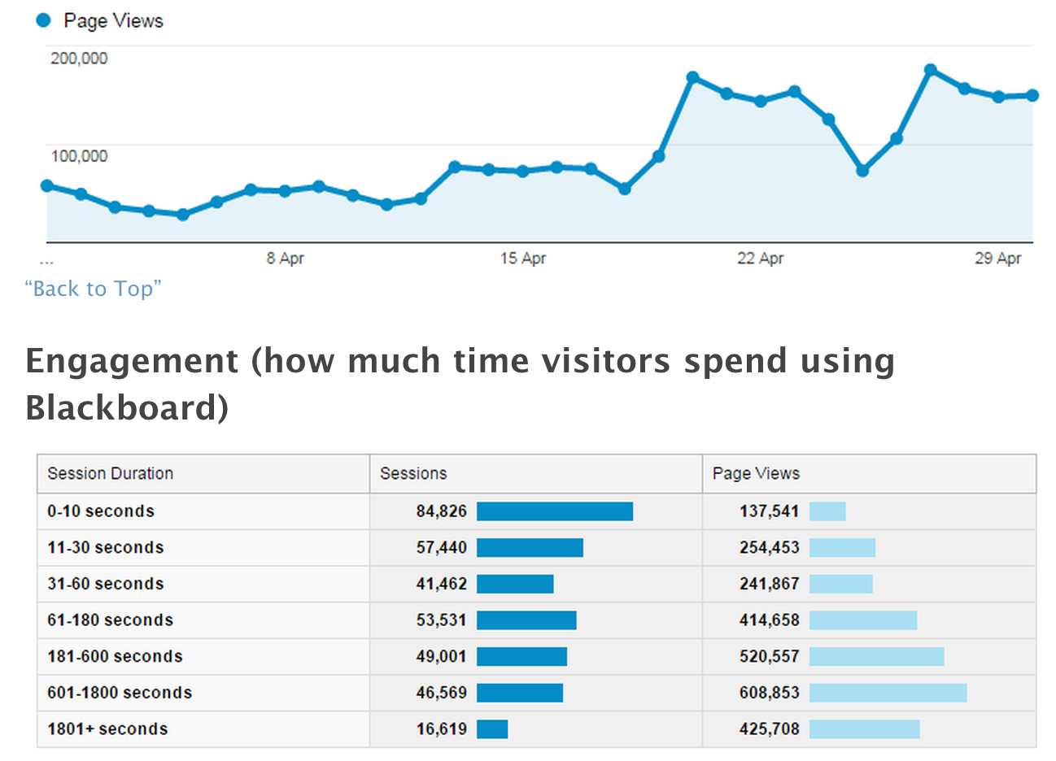
Learning analytics
Image: Blackboard usage, University of Southampton ©2015
How should we measure online learning?
Notes:
A key assumption underpinning Learning Analytics is that analysing and making visible the trace data that people leave behind when they traverse the web can be useful in helping us understand how people learn.
Web-based proxies for behaviour have value as evidence of knowledge, competence and learning – and current research focuses on social network analysis, discourse, and predictive modelling methods. For example, providing evidence of links between positive sentiment , ‘creative capacity’ and betweeness centrality, and the co-construction of knowledge in discussion forums.
But it’s recognised that methods are inaccurate and need refinement.

Slide 7
…typical measurements include time spent, number of logins, number of mouse clicks, number of accessed resources, number of artifacts produced, number of finished assignments, etc. But is this really getting to the heart of the matter?
Eric Duval, 2011
Duval, E. (2011). Attention please! Learning Analytics for Visualization and Recommendation. In Proceedings of LAK11: 1st International Conference on Learning Analytics and Knowledge, 9–17. February 27-March 1, 2011, Banff, Alberta.
How should we measure online learning?
Notes:
Duvall (2011) asserts that “one of the big problems around learning analytics is the lack of clarity about what exactly should be measured” (2011:15) and suggests that typical measurements aren’t adequate for finding out how learning being accomplished.
Maybe there’s something related to how we practice teaching and learning that can help to provide a better measurement? How about pedagogical frameworks – for example?

Slide 8
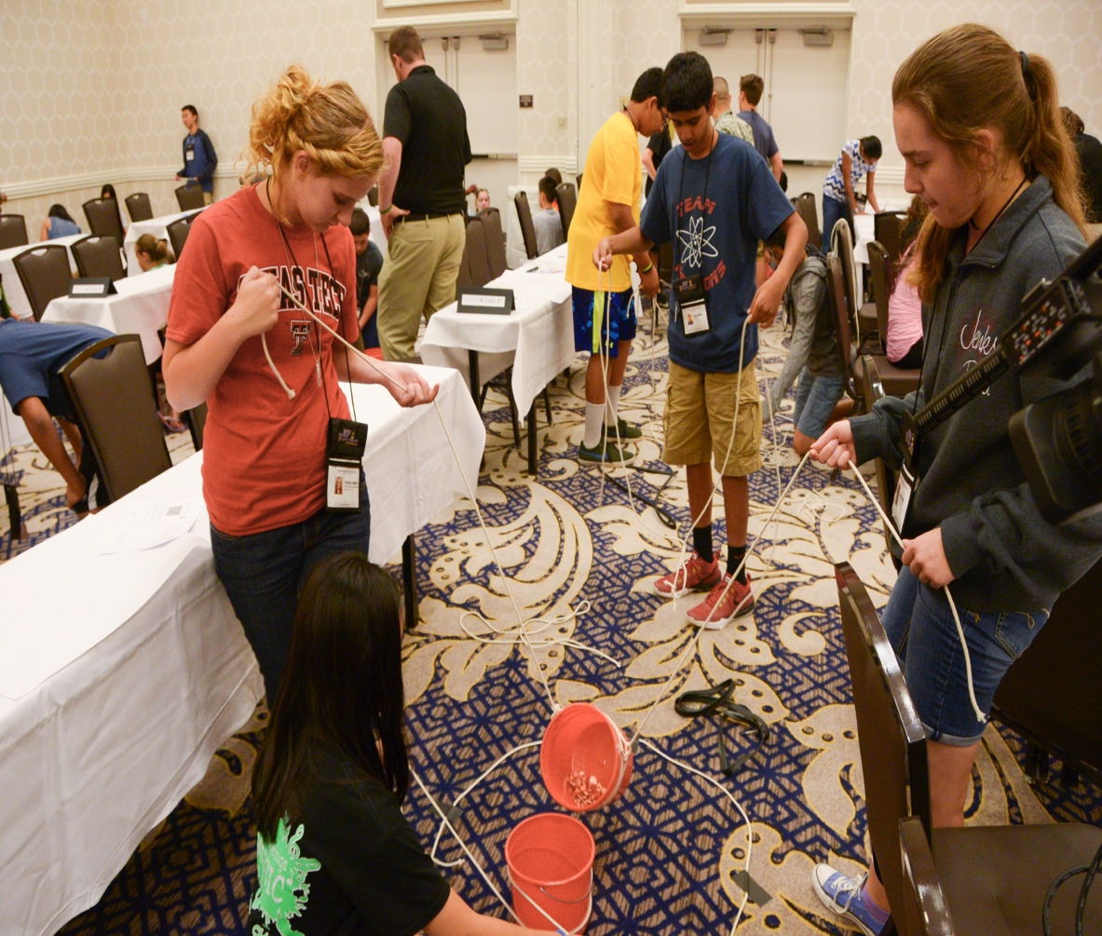
Pedagogical frameworks
Image: Student scientists learn the engineering design process, U.S. Army RDECOM ©2015, CC BY 2.0
How should we measure online learning?
Notes:
These help instructors develop effective interventions.
Most emphasise learning built on prior knowledge, learning by doing, and encouraging metacognition.
The approach I initially adopted was to look at the comments people make about things online to find out if what they said provided evidence of pedagogical activity, and if these could be rated in some way.

Slide 9
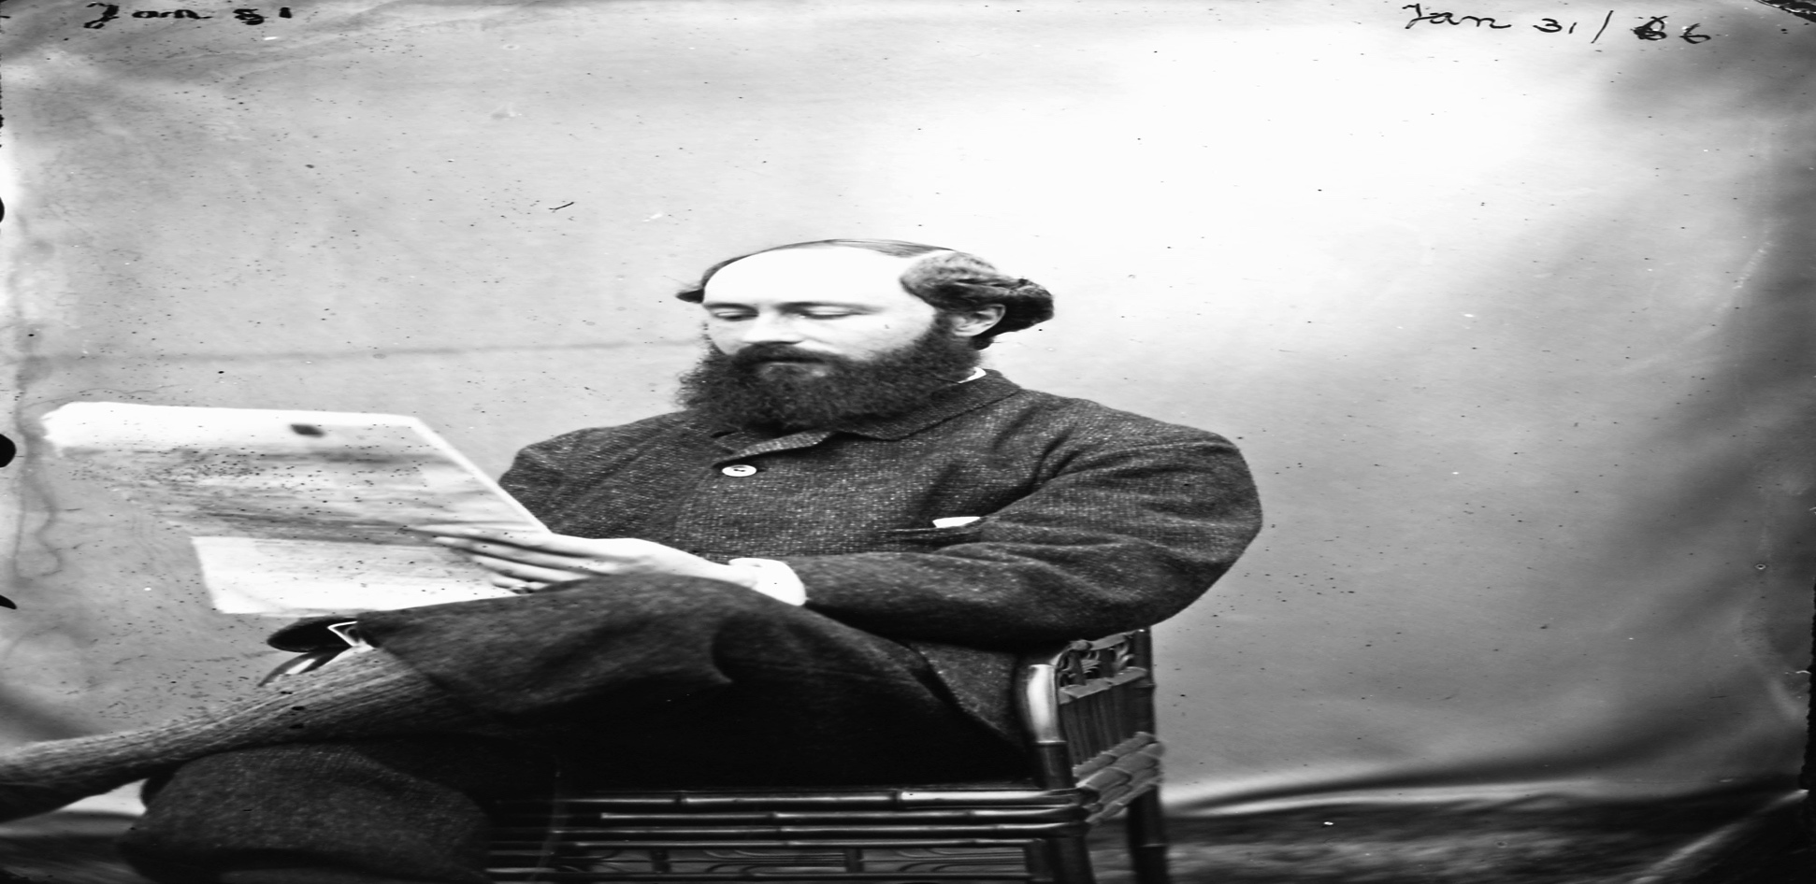
Content analysis
Image: Ambrose Congreve. National Library of Ireland, NKCR
Weltzer-Ward, L. (2011) ‘Content analysis coding schemes for online asynchronous discussion’, Campus-Wide Information Systems, 28, pp. 56–74.
How should we measure online learning?
Notes:
Applying a pedagogical approach to content analysis of computer mediated communication to identify levels of engagement with online objects – it turned out I was alone in doing this.
Weltzer-Ward identified 56 different approaches to content analysis. Out of these 56 approaches three main methods emerge: Community of Inquiry (Garrison, Anderson and Archer, 2010), and analyses adopting Bloom’s taxonomy (Bloom et al., 1956) or the Structure of Observed Learning Outcomes (SOLO - Biggs, Wales and Collis, 1982) or both. In addition to these three instruments, I used a novel content analysis method I had developed from the Digital Artefacts for Learning Engagement Framework (DiAL-e - Atkinson, 2009).

Slide 10
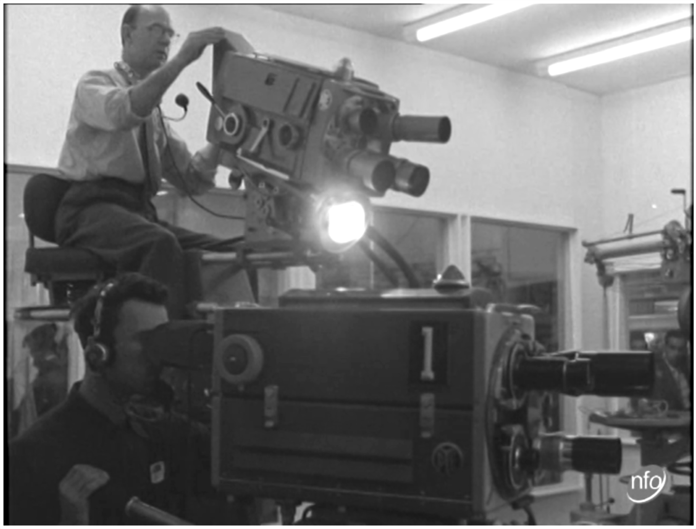
DiAL-e Framework
Narrative, Author,
Empathise, Collaborate,
Conceptualise, Inquiry,
Research, Representation,
Figurative
S. Atkinson, “What is the DiAL-e Framework?,” 2009; http://dial-e.net/what-is-the-dial-e/.
Image: A demonstration television studio. ITN/British Universities Film & Video Council, 2007.
How should we measure online learning?
Notes:
The Digital Artefacts for Learning Engagement (DiAL-e) Framework was developed about 10 years ago to support the use of digitized news films in education – which is where I became familiar with it.
I thought it would be useful for this study because – well - I know it. It also has a distinct non-hierarchical structure. It suggests approaches to using digital objects to support learning, and supports interventions that involve social interaction. All of which could be appropriate for assessing the social and situated nature of online comments.

Slide 11
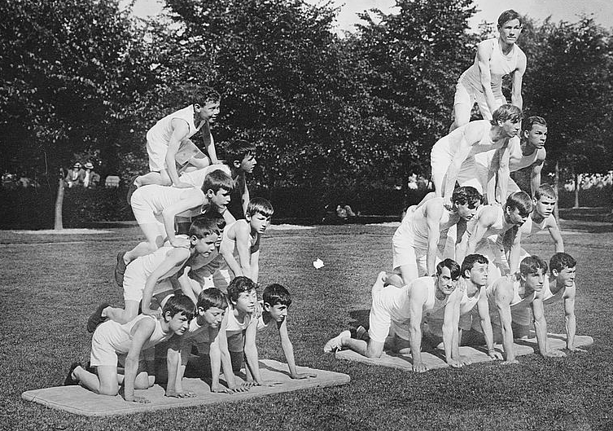
Bloom
Remember
Understand
Apply
Analyse
Evaluate
Create
Krathwohl, D. R. (2002) ‘A Revision of Bloom’s Taxonomy: An Overview’, Theory Into Practice, 41(4), pp. 212–218.
Image: Blind athletes at Overbrook, Pa. Library of Congress, NKCR
How should we measure online learning?
Notes:
‘Bloom’s Taxonomy’ (Bloom et al., 1956), was developed as a classification system to measure the complexity of assessment questions, but has become a popular and well-respected aid to curriculum development and means of classifying degrees of learning. As amended by Krathwohl (2002), Bloom’s Taxonomy consists of a hierarchy that maps learning to six categories of knowledge acquisition (remember, understand, apply, analyse, evaluate ) each indicating the achievement of understanding that is deeper than the preceding category. In content analysis studies Yang et al. (2011) align Bloom’s taxonomy with Henri (1992), a precursor of CoI, in addition, Kember's (1999) association of Bloom’s dimensions with Mezirow's (1991) ‘thoughtful action’ category (e.g. writing), and the utility of mapping word types to Bloom’s levels of cognition (Gibson, Kitto and Willis, 2014) are supportive of the use of the Taxonomy in this study.

Slide 12

SOLO
Prestructural
Unistructural
Multistructural
Relational
Extended abstract
Biggs, J. B., Wales, N. S. and Collis, K. F. (1982) Evaluating the Quality of Learning: Structure of the Observed Learning Outcome Taxonomy. New York, NY: Academic Press
Image: Jewish children with teacher. Samarkand, Library of Congress, NKCR
How should we measure online learning?
Notes:
Similar to Bloom, SOLO (Biggs, Wales and Collis, 1982) is a hierarchical classification system that describes levels of complexity in a learner's knowledge acquisition as evidenced in their writing. SOLO adopts five categories (prestructural, unistructural, multistructural, relational and extended abstract) to distinguish levels of comprehension, from shallow to deep. SOLO-based studies include Gibson, Kitto and Willis (2014) who map the taxonomy to their proposed learning analytics system, and Karaksha et al. (2014) use Bloom and SOLO to evaluate the impact of e-learning tools in a higher education setting. Shea et al. (2011) adopt CoI and SOLO to evaluate online courses, and Ilgüy et al. (2014), Campbell (2015) and Ginat and Menashe (2015) apply SOLO to learner assessment.

Slide 13
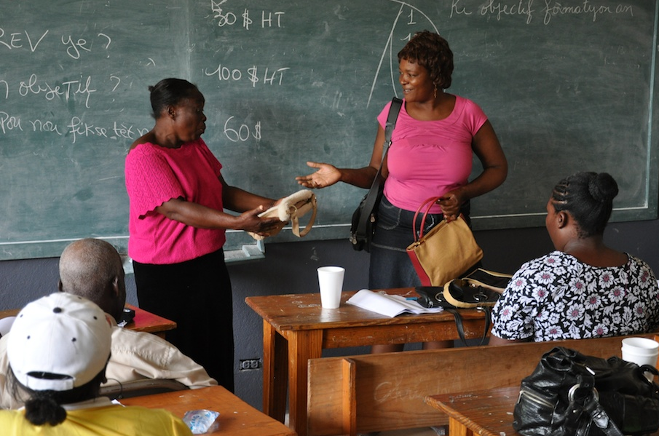
Community of Inquiry
Cognitive presence:
Trigger
Explore
Integrate
Resolve
Garrison, D. R., Anderson, T. and Archer, W. (2001) ‘Critical thinking, cognitive presence, and computer conferencing in distance education’, American Journal of Distance Education, 15(1), pp. 7–23.
Image: Business Management Training. BBC World Service, CC BY-NC 2.0
How should we measure online learning?
Notes:
The fundamental structure of CoI is based on the interaction of cognitive presence, social presence, and teaching presence, through which knowledge acquisition takes place within learning communities (Garrison, Anderson and Archer, 2001). As the current study is concerned with identifying evidence of critical thinking associated with learning objects, the main focus is on the categorisation of the cognitive presence dimension which attends to the processes of higher-order thinking within four types of dialogue: triggering, exploration, integration, and resolution. These are mapped to stages of dialogue – starting with a initiating event and concluding with statements that resolve the issues under discussion.

Slide 14

Data
Image: University of Southampton ,Archaeology of Portus MOOC.
FutureLearn Ltd 2014.. https://www.futurelearn.com/courses/portus/details
How should we measure online learning?
Notes:
6 week Massive Open Online Course
20 steps per week
> 7,000 registered learners
> 1,800 ‘social’ learners
> 20,000 comments containing 1,000,000 words were made available on an anonymised excel spreadsheet

Slide 15
Method
600 comments from 12 steps to 4 rating methods.
Categorised and scored learning activity.
Calculate average rating per step (PV).
Correlate per step and per comment ratings.
Image: University of Southampton ,Archaeology of Portus MOOC.
FutureLearn Ltd, 2014.. https://www.futurelearn.com/courses/portus/details
How should we measure online learning?
Notes:
I went through and hand coded 600 comments from 12 steps in alignment with each DiAL-e category. I then calculated the average score for each step to reach a Pedagogical Value – or PV – for each step.

Slide 16
b.socrative.com
IVGEL7YU
How should we measure online learning?
Notes:
Before I talk about my results - Back to Socrative. What I did was read comment like this one – and in this example I gave a value. What value would you give this comment using Bloom? : evaluate comments using Bloom.

Slide 17
Results
r² = 0.753
p = <0.001
Correlation between Bloom and SOLO
How should we measure online learning?
Notes:
The variables with the strongest statistically significant linear correlation across all four dimensions were the methods based on Bloom and SOLO taxonomies (r² = 0.753, p = <0.001 ).
It is perhaps unsurprising that the instruments derived from taxonomies designed to describe cumulative levels of understanding (Bloom and SOLO) should show the closest correlations.
But both SOLO and Bloom miss the nuances of how conversation develops – something that CoI is better suited to.

Slide 18
Results
r² = 0.688
p = <0.001
Correlation between Bloom and Community of Inquiry
How should we measure online learning?
Notes:
And CoI also had a strong correlation with Bloom r² = 0.688 p<0.001
But CoI misses some of the depth of thinking evidenced by explicit evaluation, and synthesis. Which is why I have chosen Bloom and CoI as the main analytic methods for the next stage of my research.

Slide 19
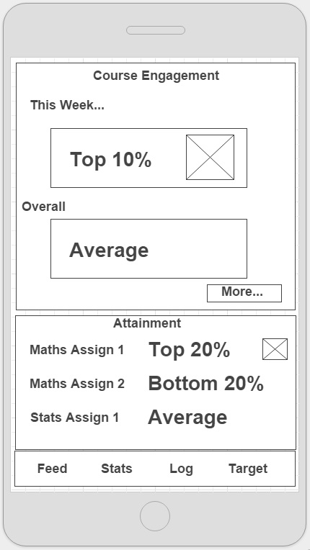
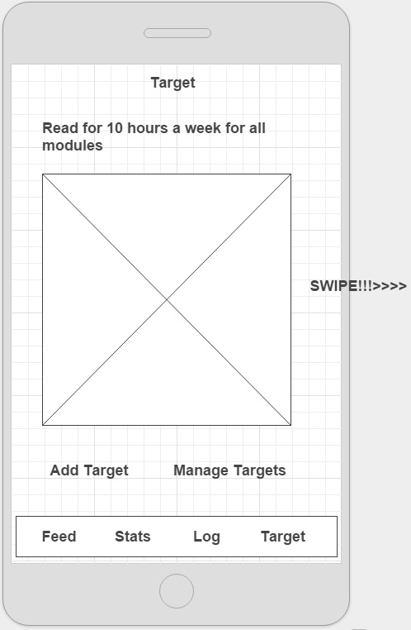
Visualisation
Images: Analytics app wireframe, Jisc Effective Learning Analytics © 2014
How should we measure online learning?
Notes:
How do we go about showing these types of measurement?
Visualisation of data is a big issue. The Effective Learning Analytics project being run by Jisc are currently designing an app for students where they can get feedback on their activities, see if they’re on target or if they are at risk.

Slide 20
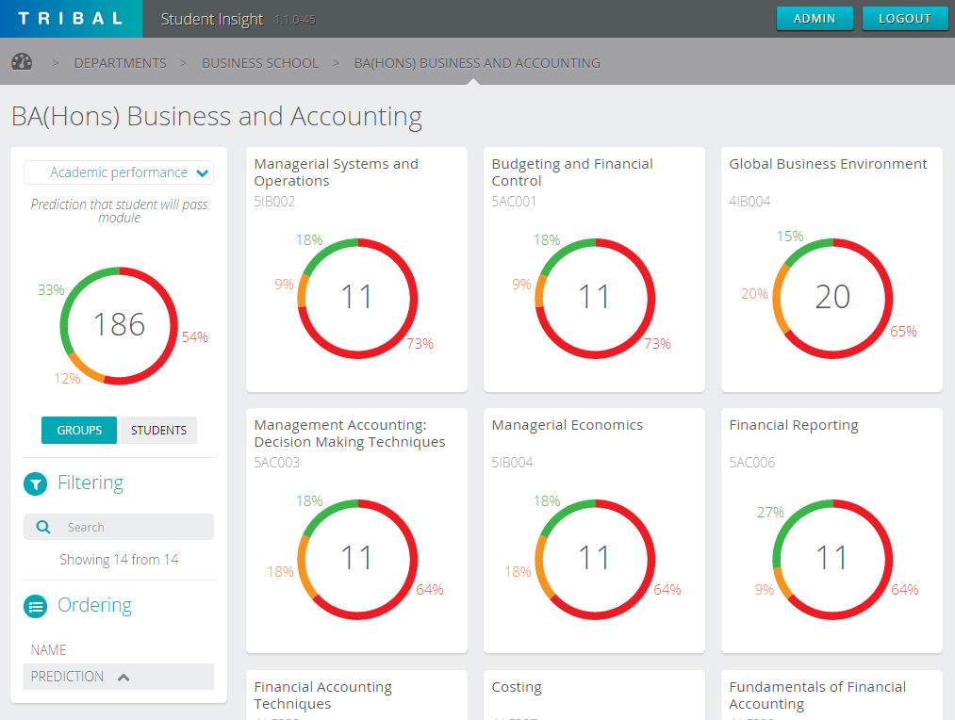
Visualisation
Image: SITS:Vision Student Insight, Tribal Group/University of Wolverhampton, 2014
How should we measure online learning?
Notes:
Although we’re gathering data and it may be of use to learners, educators and administrators - how you show data is just as important as what data you show. In the effort to make data accessible we shouldn’t forget all that stuff about cognitive load, signalling what’s most important, chunking info into digestible bits, weeding out non essential info, and give users control over how they access and visualise the data.
Common issues with visualisations:
Cluttered screens
Inadequate context
Too much detail
As we’ve seen today with changes in how we rated comments – visualising data changes behaviour. We need to be sure that we’re getting the right messages across. Yes, visualisations should be simple and unambiguous. But there’s a tendency emerging for using simplistic colour-coding to encourage good behaviour.

Slide 21

Visualisation
Off-topic
Remember
Understand
Apply
Analyse
Evaluate
Create
Create
Evaluate
Analyse
Apply
Understand
Remember
Off-topic
How should we measure online learning?
Notes:
But not everything can be shown as a traffic light. Where would you map Bloom’s taxonomy on here? What is an appropriate way of showing this info?

Slide 22
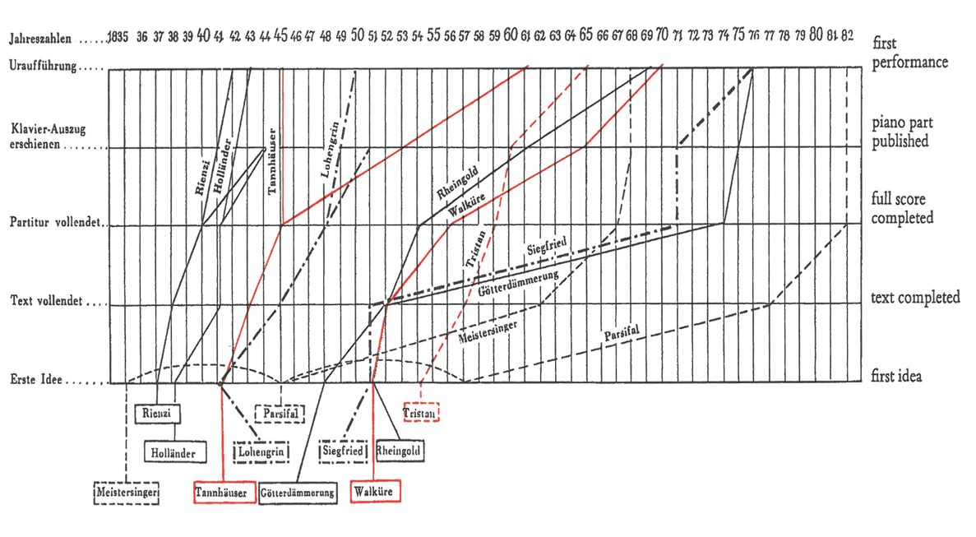
Visualisation
Image: Richard Wagner als Verlagsgefährte, Tabelle III. Ludwig Strecker, 1951
How should we measure online learning?
Notes:
Personally I prefer something more nuanced that shows activity over time – like this classic visualisation of the publishing history of Wagners’ operas. This is where I’m at now – and I’m open to suggests and ideas.

Slide 23
Future work
Diverse subjects.
More coders.
Machine learning.
Visualisation.
How should we measure online learning?
Notes:
Future work involves coding new training samples, using more coders (not just me), running comments through a machine learning process and evaluating results. It’s very easy in this type of analysis to get lost in the process and lose track of the fact this this involves real people who are really trying to learn something – so I also think it’s important to talk to real people about what this means – does any of this relate to people actual experience of engaging in web based environments?
At some point in the not too distant future I will need to look into how to go about making this data readily and meaningfully understandable to users – learners, instructors, as well as institutional administrators.

Slide 24
b.socrative.com
IVGEL7YU
How should we measure online learning?
Notes:
Before I talk about my results - Back to Socrative. What I did was read comment like this one – and in this example I gave a value. What value would you give this comment using Bloom? : evaluate comments using Bloom.

Slide 25
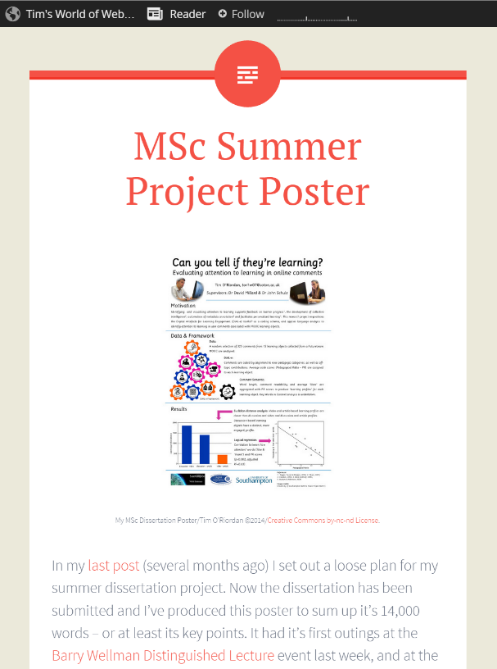

Thank you…
eprints.soton.ac.uk/376609/
tim.oriordan@soton.ac.uk
@studywbv
timswww.wordpress.com
b.socrative.com IVGEL7YU
How should we measure online learning?
Notes:
http://eprints.soton.ac.uk/376609/

