Slide 1
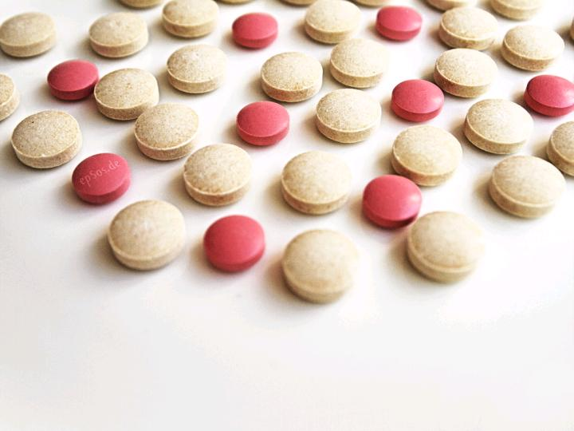
IT for Health
and Science
cc: epSos.de - https://www.flickr.com/photos/36495803@N05

Slide 2
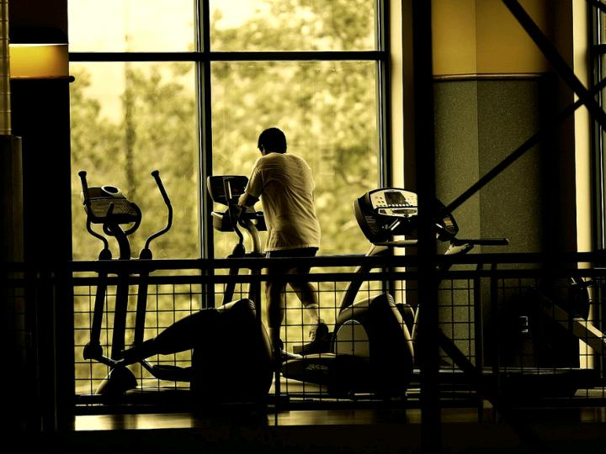
Health
cc: Abdullah AL-Naser - https://www.flickr.com/photos/33685308@N00

Slide 3
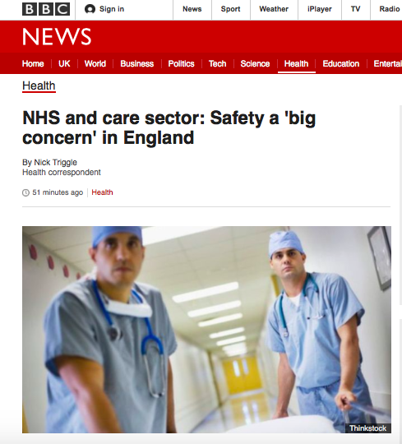

Slide 4
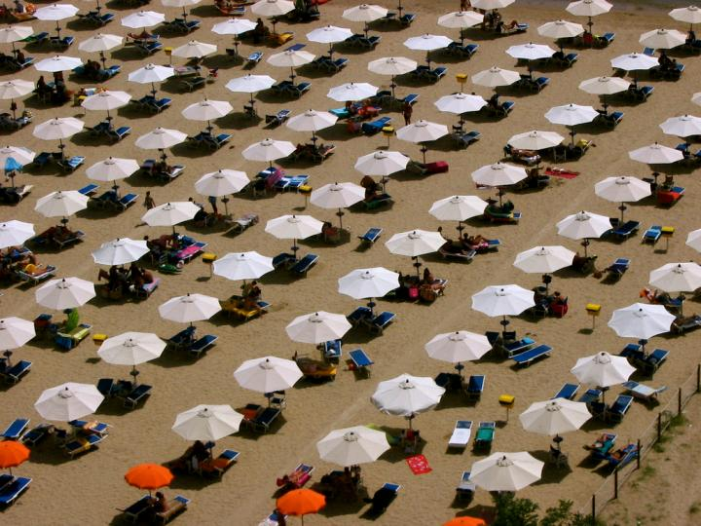
IT
cc: mortimer? - https://www.flickr.com/photos/71651012@N00

Slide 5
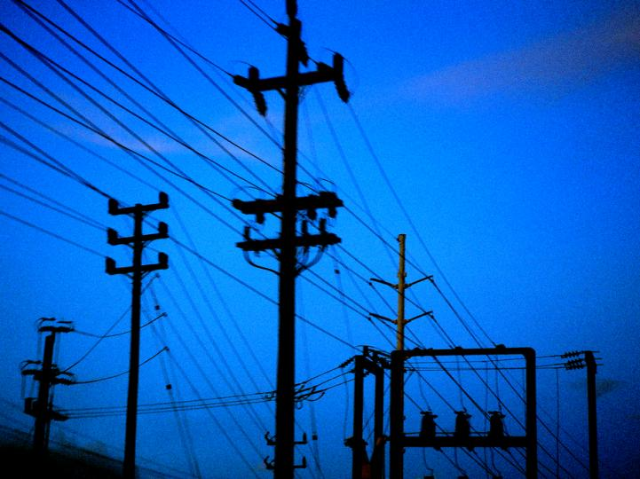
Utility
cc: Keoni Cabral - https://www.flickr.com/photos/52193570@N04

Slide 6
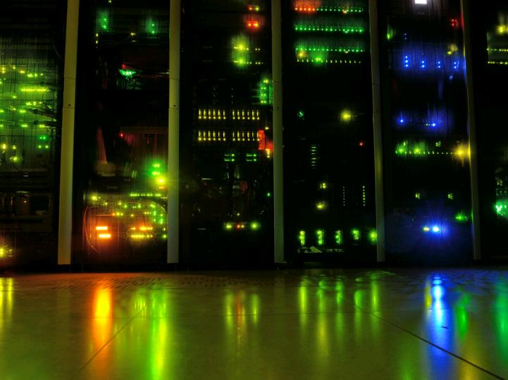
Internet of Things
cc: kewl - https://www.flickr.com/photos/58411470@N00

Slide 7
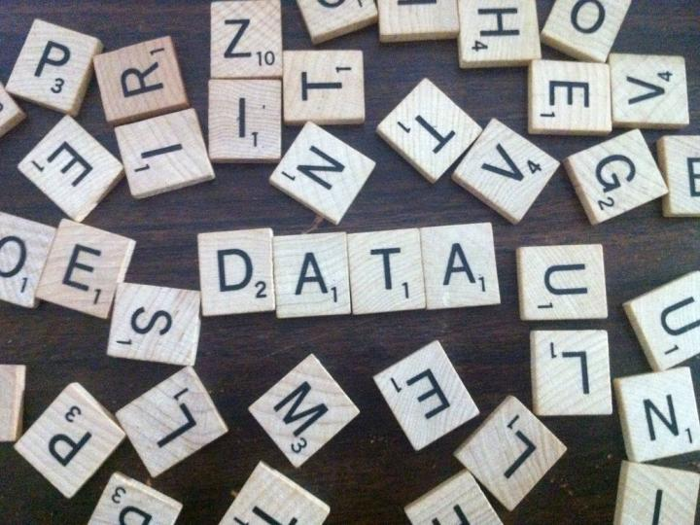
Data
cc: justgrimes - https://www.flickr.com/photos/44718928@N00

Slide 8
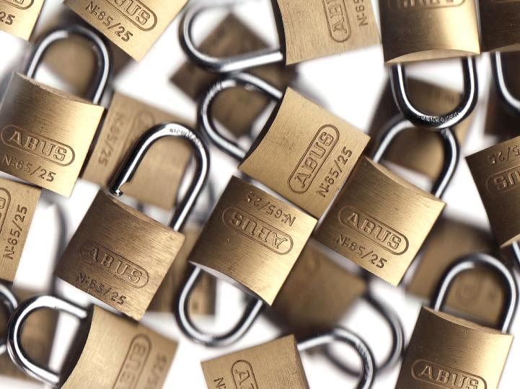
Security
cc: DaveBleasdale - https://www.flickr.com/photos/45936582@N00

Slide 9

Impact
cc: spettacolopuro - https://www.flickr.com/photos/24113168@N03

Slide 10
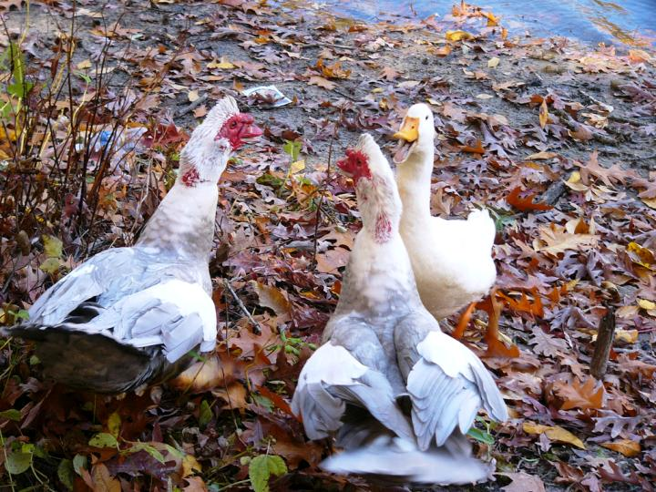
Discussion
cc: Kathleen Tyler Conklin - https://www.flickr.com/photos/79865753@N00

