Slide 1
An agent-based framework for analysing insolvency resolution mechanisms for banks
Bob De Caux, Markus Brede and Frank McGroarty

Slide 2




Introduction
The issue of insolvency and how to handle distressed banks has become an important topic in the wake of the global financial crisis
It has become apparent that the systemic effects of the various resolution mechanisms are not well understood.
How are long-term system dynamics affected by the choice of resolution mechanism?
How can resolution mechanisms be implemented most effectively?

Slide 3
Contagion channels
Contagion can spread through a financial system in several ways:
Direct counterparty exposure on insolvency (liability side)
Liquidity risks and fire-sale effects (asset side)
Information contagion (liquidity hoarding, herding)
To capture these channels, our model must have:
Banks that can adjust their strategy
Dynamic asset and liability contagion channels formed over time.
Long timeframe to capture the effect of resolution mechanisms, both ex-ante (moral hazard?) and ex-post

Slide 4
Existing models
Network models
e.g. Gai (2010), Caccioli (2012)
Capture asset or liability channel
Point of contagion models
Simple resolution mechanism
No moral hazard consideration
Game theoretical models
e.g. Farhi and Tirole (2011)
Capture strategic incentives
Small number of banks/steps
Do not capture path to equilibrium
We aim to develop a simple framework that can combine elements of both streams – micro-level simulation with strategic considerations

Slide 5
Bank representation
Assets Liabilities
Each bank is modelled as a balance sheet
The size of a bank’s equity base b is its reserves plus long term funding (external deposits)
A bank strategy is a tuple {A,L} which determines the desired portfolio allocation between an external asset and cash
If A+L≠1, the bank participates in the interbank loan market
External asset
(Ab)
External deposits
b
Reserves
Cash (Lb)

Slide 6
Bank balance sheets
Assets Liabilities
External asset
(Ab)
IB loan
(A+L-1)b
External deposits
If A+L>1, the bank needs an interbank loan of size (A+L-1)b
b
Reserves
Cash (Lb)

Slide 7
Bank balance sheets
Assets Liabilities
IB depos
(1-A-L)b
External deposits
If A+L<1, the bank makes an interbank deposit of size (A+L-1)b
External asset
(Ab)
b
Note that the value of b is unchanged by the loan decision (apart from a small change to reserves due to loan interest)
Reserves
Cash (Lb)

Slide 8
Why model it like this?
The model allows us to capture the three contagion channels:
Asset side contagion – the price of the asset is subject to random stochasticity as well as supply and demand
Liability side contagion – loan defaults will propagate through lenders’ balance sheets
Information contagion – A and L are subject to evolutionary learning, which can lead to both herding and (liquidity) hoarding behaviour.

Slide 9
Simulating a day’s activity
Deposit and asset price shock
Adjust portfolio
Set and match loan orders
Resolve flows/insolvency
Adjust portfolio
Update strategy
Bank
Bank
Cent. Bank
Depositors move to a new bank
Active Bank
Asset
Asset price changes
Two banks are chosen at random
A random number of depositors leave one bank and move to the other
The price of the asset is also subject to a normally distributed shock

Slide 10
Simulating a day’s activity
Deposit and asset price shock
Adjust portfolio
Set and match loan orders
Resolve flows/insolvency
Adjust portfolio
Update strategy
Bank
Bank
Cent. Bank
Active Bank
Buy/sell
assets
Asset
Cash
Banks adjust their portfolio by buying/selling r units so that their asset portfolio equals Ab
Activity moves asset price - a_{t} = a_{t-1}e^{λr}
Banks must include their impact on the market (b changes with buying/selling)

Slide 11
Simulating a day’s activity
Deposit and asset price shock
Adjust portfolio
Set and match loan orders
Resolve flows/insolvency
Adjust portfolio
Update strategy
Bank
Bank
Cent. Bank
Get new interbank
loans
Get loan from CB
Active Bank
Collateralise
Asset
Banks place loan orders based on liquidity needs
Deposits and loans are matched, loan rate dependent on borrower Capital Adequacy Ratio
If CAR<3%, bank can no longer borrow
CB loans must be collateralised with assets

Slide 12
Simulating a day’s activity
Deposit and asset price shock
Adjust portfolio
Set and match loan orders
Resolve flows/insolvency
Adjust portfolio
Update strategy
Bank
Bank
Cent. Bank
Cash
Cash
Cash
Active Bank
Asset
Try to net settle the accumulated payables and receivable incurred throughout the day
If a bank does not have sufficient liquidity to do so, it is cash flow insolvent
If it has no reserves left, it is equity insolvent

Slide 13
Simulating a day’s activity
Deposit and asset price shock
Adjust portfolio
Set and match loan orders
Resolve flows/insolvency
Adjust portfolio
Update strategy
Bank
Bank
Cent. Bank
Active Bank
Buy/sell
assets
Asset
Cash
Banks adjust their portfolio by buying/selling units so that their liquidity equals Lb
Excess liquidity is not invested in assets

Slide 14
Simulating a day’s activity
Deposit and asset price shock
Adjust portfolio
Set and match loan orders
Resolve flows/insolvency
Adjust portfolio
Update strategy
Bank
Bank
Cent. Bank
Assess fitness and migrate towards strategy
Active Bank
Asset
Fitness is defined as multiplicative return on equity base over a given time horizon
Bank compares fitness to another random bank
If the other bank is fitter, bank migrates its strategy towards the other bank (with inertia)

Slide 15
Bankruptcy resolution
There are three simple methods we can use to resolve a bank insolvency:
Liquidation – CB gets loan collateral, all bank assets are sold, cash is distributed to depositors, loan creditors and equity holders in order
Bail-out – the insolvent bank is provided with additional liquidity to make it solvent again (change to asset side of balance sheet)
Bail-in – loans on the balance sheet of the insolvent bank are converted to equity (change to liability side of balance sheet)
However, there are many interesting questions around implementation:
Timing of intervention, size of intervention, timing of selling assets of insolvent bank, amending insolvent bank strategy to reduce risk…

Slide 16
Long term behaviour
We run the simulation over a long time period to assess the following:
The long term distribution of bank strategies
The susceptibility of the system to cascades of failure
Over time, we would expect the strategy distribution to incorporate information about how bankruptcies are resolved.
However, to make a long term assessment, the number of banks must be constant. Therefore a new bank is introduced every time one is liquidated.

Slide 17
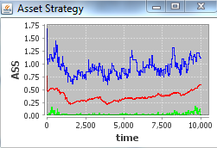
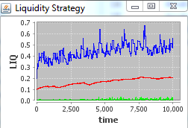
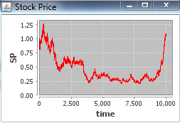
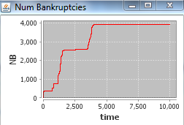
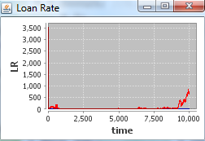
Results – Adapt, regenerate
High level of stochasticity in stock price and deposits.
Banks adapt strategies.
Banks are liquidated and new banks rejoin.
Adapt = 5%, Mutate = 1%.
Lookback = 25 steps.
Initially, risky banks go bankrupt and bank strategies become defensive. However, the level of asset investment recovers to around 50% and loan market is growing. Again, bankruptcies occur in a steady stream.

Slide 18
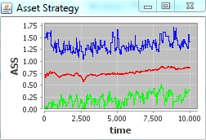
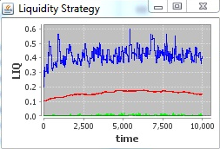
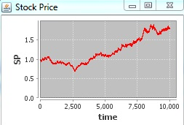
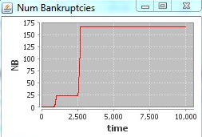
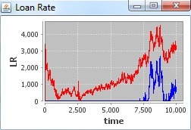
Results – Adapt, regenerate
Low level of stochasticity in stock price and deposits.
Banks adapt strategies.
Banks are liquidated and new banks rejoin.
Adapt = 5%, Mutate = 1%.
Lookback = 25 steps.
With less stochasticity, the level of asset investment grows steadily. Bankruptcies are fewer, but the system is prone to large bankruptcy cascades (t = 2,500). We see CB borrowing in the interbank market.

Slide 19
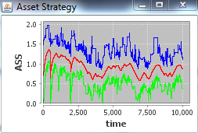
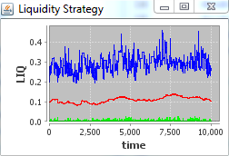
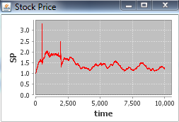
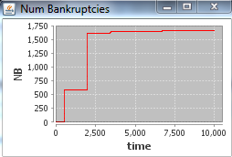
Results – More adaptive
Low level of stochasticity in stock price and deposits.
Banks adapt strategies.
Banks are liquidated and new banks rejoin.
Adapt = 20%, Mutate = 1%.
Lookback = 75 steps.
With a higher level of adaptation, we see the appearance of risk cycles as banks increasingly invest in the asset until the market crashes. The risk cycles are dampened over time, as seen by reduced bankruptcies.

Slide 20
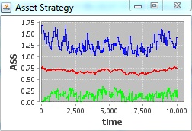
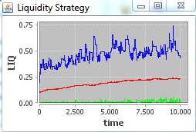
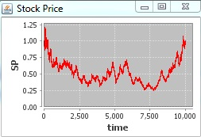
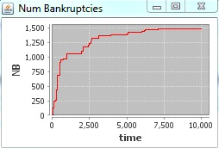
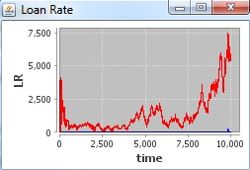
Results – Adapt, bailout
High level of stochasticity in stock price and deposits.
Banks adapt strategies.
Banks are bailed out.
Adapt = 5%, Mutate = 1%.
Lookback = 25 steps.
If we bail banks out instead of liquidating them, the level of asset investment remains higher (75% vs 50%), and the total number of bankruptcies drops . The interbank market also remains active.

Slide 21
Results – Adapt, regenerate
High level of stochasticity in stock price and deposits.
Banks adapt strategies.
Banks are liquidated and new banks rejoin.
Adapt = 5%, Mutate = 1%.
Lookback = 25 steps.
Comparison to bailout.

Slide 22
Summary
One of the first bankruptcy models to cover longer timescales than the point of contagion
Provides a bridge between network and game theoretic approaches
Generates reasonable behaviour, including cyclical risk, and is able to model the evolution of crises
Allows a variety of bankruptcy mechanisms to be tested for effectiveness

Slide 23

Further work
CRISIS is a “bottom-up” agent-based model of the UK economy, including firms and households
Explicitly looks at the network and institutional structure of the financial system
We are working to incorporate the following into CRISIS:
Detailed capital structure for banks
Adaptive bank strategies
Realistic resolution dynamics
This will allow us to investigate:
new insolvency resolution mechanisms, such as CoCos and ERNs
optimal timing and size for an intervention
BUT we need to understand the basic dynamics first

Slide 24
References
[1] Dewatripont, Mathias and Xavier Freixas (2012). Bank Resolution: Lessons from
the Crisis. In The Crisis Aftermath: New Regulatory Paradigms, edited by M.
Dewatripont and X. Freixas, pp105–143.
[2] Haldane, Andrew G and Robert M May (2011). Systemic risk in banking
ecosystems. Nature, 469, pp351–355.
[3] Gai, Prasanna and Sujit Kapadia (2010). Contagion in financial networks.
Proceedings of the Royal Society A, 466, pp2401–2423.
[4] Acemoglu, Daron, Asuman Ozdaglar, and Alireza Tahbaz-Salehi (2013). Systemic
risk and stability in financial networks. National Bureau of Economic Research
Working Paper, 18727.
[5] Caccioli, Fabio, et al. (2012). Stability analysis of financial contagion due to
overlapping portfolios. CORR 2012. URL arXiv:1210.5987.
[6] Brunnermeier, Markus K, et al. (2009). The Fundamental Principles of Financial
Regulation. Geneva London.

