Slide 1
An agent-based framework for analysing insolvency resolution mechanisms for banks
Bob De Caux, Markus Brede and Frank McGroarty
CCS, Tempe 2015

Slide 2




Introduction
The issue of insolvency and how to handle distressed banks has become an important topic in the wake of the global financial crisis
It has become apparent that the systemic effects of the various resolution mechanisms are not well understood.
How are long-term system dynamics affected by bank resolution?
How can resolution mechanisms be implemented most effectively?

Slide 3
How do problems spread?
Contagion can spread through a financial system in several ways:
Exposure to distressed counterparties (liability and asset side)
Information contagion (liquidity hoarding, herding)
To capture these channels, our model must have:
Channels that allow transmission of contagion
Banks that can adjust their strategy through learning
Long timeframe to capture the effect of resolution mechanisms, both ex-ante (moral hazard) and ex-post

Slide 4
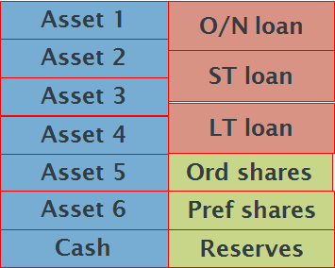
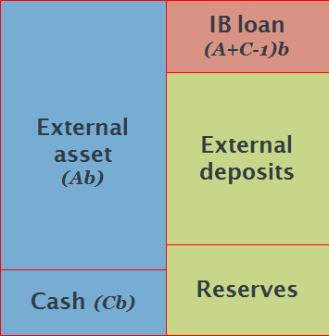
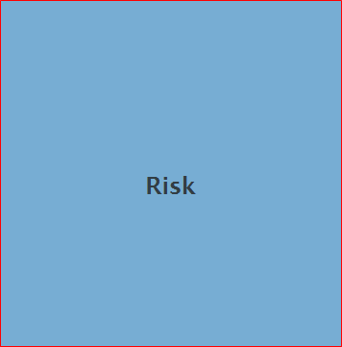
The modelling hierarchy
Our level of model detail will determine our approach and results:
Bank complexity
Bank simplicity
Assets Liabilities
Assets Liabilities
All asset and liability classes are modelled, as well as the bank’s place in the macroeconomy
Bank assets and liabilities are modelled to create channels of contagion
Bank is modelled as one generic source of adaptive risk

Slide 5
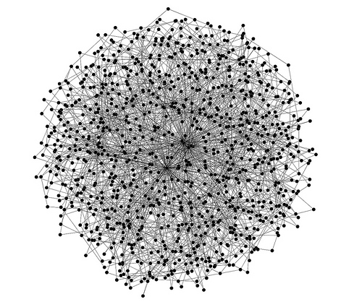

Model setup
Each bank $i$ characterised by a strategy $0≤x_{i}≤1$
Bank profit ${ π}_{i} =f(x_{i})$
Connections represent an undirected network of business relationships or co-investments
A bank $i$ with $k_{i}$ neighbours is of size $k$.
Two dynamic processes operate on the network.

Slide 6

Strategy evolution
Each turn, one bank $i$ compares profit to a bank $j$ of similar size
If bank $j$has a higher profit, then $x_{i}→$ $x_{i}+σ(x_{j}$- $x_{i}$)
Each strategy mutates each turn, drawn from $\left[{−p}_{mut},p_{mut}\right]$
This process causes a very slow evolution of strategies within the population.

Slide 7

Distress contagion
With a small probability $p_{0},$ bank $i$becomes distressed
Bankruptcy then ensues with probability $x_{i}$
This contagion may then spread to neighbouring banks, who may also go bankrupt, dependent on their size
If so, the process then continues
This second contagion process occurs very quickly.

Slide 8
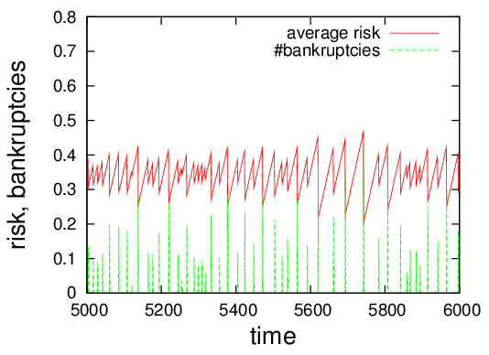
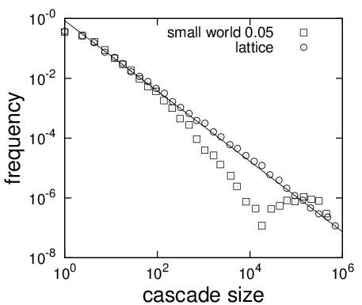
Self-organised criticality
This creates a system of risk accumulation followed by crashes.
MINSKY MOMENT:- “a period of stability encourages risk taking, which leads to a period of instability, which causes more conservative and risk-averse (de-leveraging) behaviour, until stability is restored.”

Slide 9

How can we stop contagion?
Here we focus on the simplest method of government intervention:
When should the regulator step in? All the time? Never? Depending on whether the bank is “Too-Big-To-Fail”?
How can we optimise the “social utility”?

Slide 10
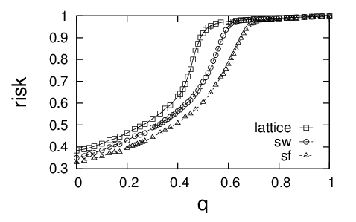
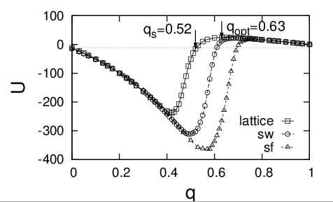
Constructive ambiguity
When a bank become insolvent, it is bailed out with probability q.
Unless it is going to bail out a sufficient number of banks, the regulator should not bail out any at all.

Slide 11
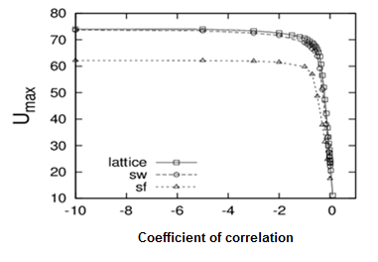
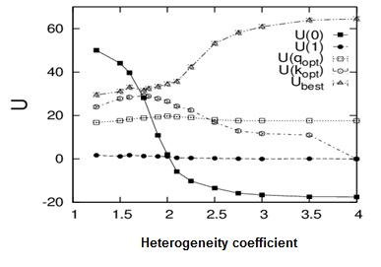
Neighbour-based intervention
Bail out banks according to the riskiness of their neighbours.
Contrary to intuition, bailing out banks positively risk correlated with their neighbours gives poor long term system performance.
An anti-correlated neighbour-dependent strategy performs best of all.

Slide 12
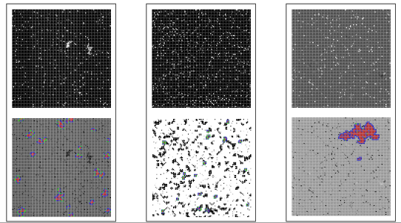
Patterns of risk
Level of risk
Bankruptcy cascades
Mixed strategy
q=0.63
Neighbour based strategy
Mixed strategy q=0.13

Slide 13
Is this a policy panacea?
No, need to be much further to the left on our continuum
However it demonstrates that the policy of the regulator can shape risk within the banking system.
Decisions that seem to make short term sense can lead to long term disaster.
It might be possible to drive the system towards a more robust structure.
Bank complexity
Bank simplicity

