Slide 1



Unlocking Thesis Data
Michael Whitton orcid.org/0000-0001-6838-1100
Sara Gould orcid.org/0000-0003-2763-9755
January 2016
Notes:
Welcome
Introduce each other
Pre-course Survey – talk about the replies

Slide 2
Outline
Why use identifiers for theses?
Results from the Survey & Case Studies
ETHOS and identifiers
Questions and feedback

Slide 3

Why use identifiers?
(1)

Slide 4
Why are theses important?
Most downloaded items in ePrints Soton for 2015:
3. Lawrence, K. F. (2007) The Web of Community Trust - Amateur Fiction Online (4,130 Downloads)
9. Al Darmaki, Ibrahim Abdul Rahman (2008) Globalisation and urban development: a case study of Dubai’s Jumeirah Palm Island mega project (3,252 Downloads)
18. Carr, Leslie A. (1995) Structure in Text and Hypertext. (2,574 Downloads)
646 Theses downloaded over 100 times

Slide 5
Why Are Identifiers Important:
Recommendations from The Metric Tide
http://www.hefce.ac.uk/pubs/rereports/Year/2015/metrictide
10 The UK research system should take full advantage of ORCID as its preferred system of unique identifiers. ORCID iDs should be mandatory for all researchers in the next REF.
13 The use of DOIs should be extended to cover all research outputs. This should include all outputs submitted to a future REF for which DOIs are suitable … they should be extended to cover other outputs where no identifier system exists, such as book chapters and datasets.

Slide 6
Worldwide Activity
Germany (9 institutions)
E.g. Technishe Universität Berlin (4165)
Italy (4 institutions)
E.g. Politecnico di Torino (494)
USA
University of Maryland Libraries (389)
Figshare (392)
Zenodo (203)

Slide 7
Impact and Benefits
Introducing students to the new norm of data sharing and identifiers
Students – Institutions – Funders
Enhancing national scale thesis discovery to make space for data/software
Tracking student careers via ORCiD
Better tracking of theses/data through citations and metrics

Slide 8
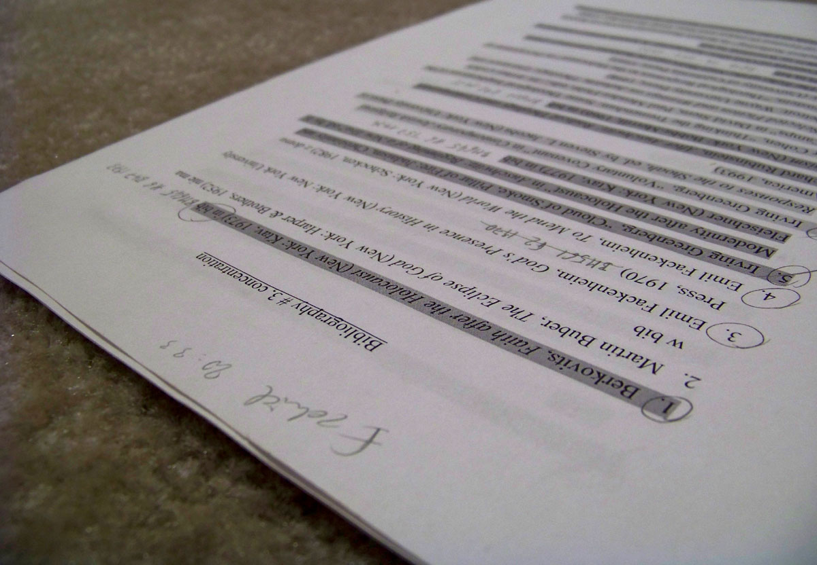
The Survey and Case Studies
(2)
Notes:
do not expect academics to read emails so try every avenue you can - do not expect and academic on a consultation committee to actually consult or report back to the people s/he is supposed to be representing - training of students (and staff) on the
8

Slide 9
Survey
Http://dx.doi.org/10.15123/PUB.4274
http://dx.doi.org/10.15123/DATA.12

Slide 10
What we found from the survey
Lot of interest – 49 responses =35%
33% use DataCite DOIs for Research Data
59% still require both p- and e-copies, often duplicating cataloguing effort
MD created by student, administrator or library/repository
24 volunteered as case studies

Slide 11
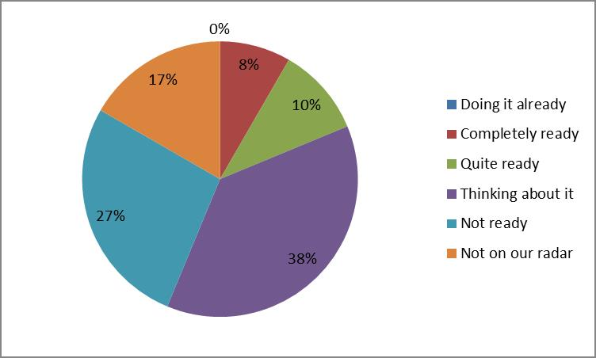
What we found from the survey …
How ready are you to begin assigning DOI identifiers to your theses? N=49

Slide 12
What we found from the survey …
Little or no guidance on supplementary files (aka data), and thus little incentive for students to offer data, so few examples
One DOI or many?
“We will probably use a single record with single DOI”
“Separate record in data repository for each significant data collection, linked to thesis in publications IR”
“ … users will be free to choose granularity of DOI minting.”

Slide 13
Case Studies
University of East London (EPrints)
10.15123/PUB.4301
University of Southampton (EPrints, implementing Pure)
10.15123/PUB.4302
London School of Economics and Political Science (EPrints)
10.15123/PUB.4303
University of the Arts London (EPrints)
10.15123/PUB.4304
University of Bristol (Pure / CKAN)
10.15123/PUB.4305
University of Leicester (DSpace)
10.15123/PUB.4306

Slide 14
What we learned from the case studies
How to assign DOIs
Based on student number (student adds to their Thesis)
Based on repository ID etc.
ORCiDs can be encouraged early
Multiple vs single records
DOIs vs Handles

Slide 15
A widening typology of theses
Single monograph (with appendices)
Monograph and associated data files in their native formats
Thesis by publication
Thesis by practice-as-research
PhDs as components of a Research Group’s programme of work – links between theses and to other outputs
… and who knows what next

Slide 16

ETHOS and Identifiers
(3)

Slide 17
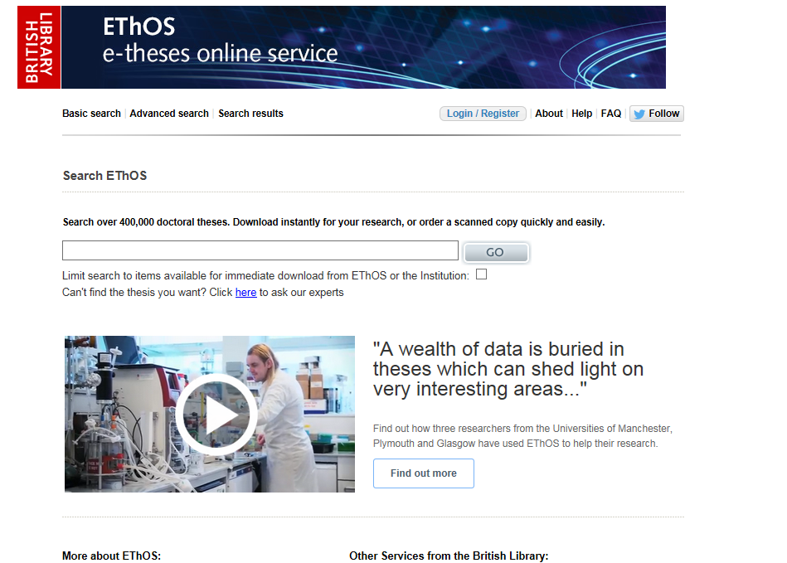
Notes:
This is ethos.

Slide 18
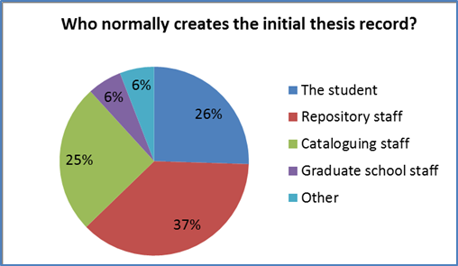
Creating the initial record

Slide 19
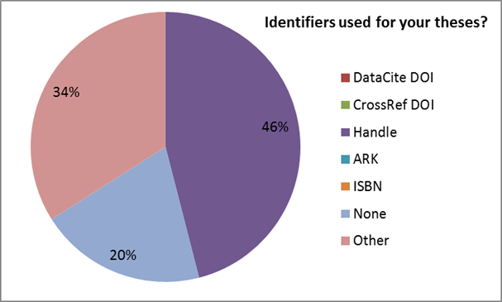
What identifiers do you use for your theses?

Slide 20
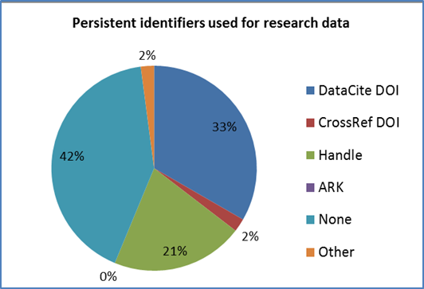
Research data
Notes:
Data is latest ‘big thing’ in the UK. Many institutions already assigning DOIs for their data – so why not theses?
Note CrossRef / DataCite

Slide 21
UTD outcomes - DOIs
Example DOIs
You can use DataCite for theses
Push repository system suppliers to accommodate identifiers in their thesis modules
Does not solve issues of multiple versions of the same thesis – HE institutions need to get in first
Value may still need evidence.

Slide 22
UK Thesis DOIs
University of East London
10.15123/PUB.3929 (10.15123/PUB.3929 )
University of Southampton
10.5258/SOTON/374711 (http://eprints.soton.ac.uk/374711/)
University of Glasgow
10.5525/gla.thesis.6423 (http://theses.gla.ac.uk/6423/)
Imperial College
10.14469/CH/4

Slide 23
Sample DOIs for theses
University of Glasgow - http://theses.gla.ac.uk/6423/
http://ethos.bl.uk/OrderDetails.do?uin=uk.bl.ethos.650368
University of East London - http://roar.uel.ac.uk/3929/
http://ethos.bl.uk/OrderDetails.do?uin=uk.bl.ethos.630167
University of Southampton - http://eprints.soton.ac.uk/374711/
http://ethos.bl.uk/OrderDetails.do?uin=uk.bl.ethos.640751
Notes:
Project did 3 exemplars to show proof of concept. Show Glasgow example.

Slide 24
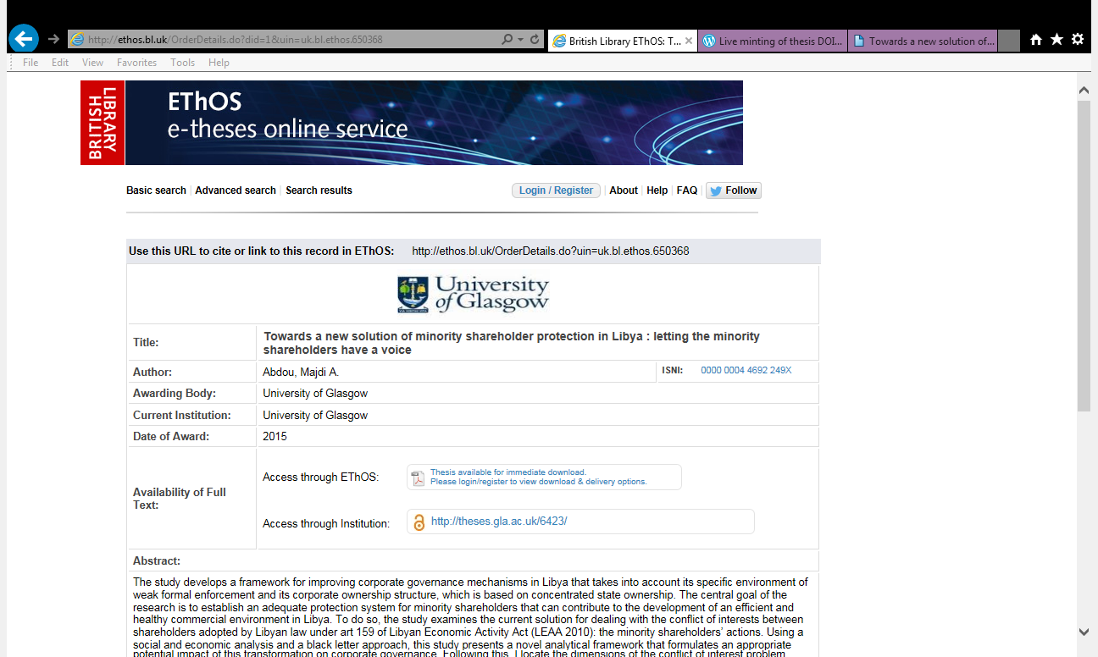
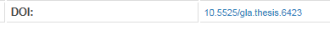
Notes:
Record with a DOI.

Slide 25
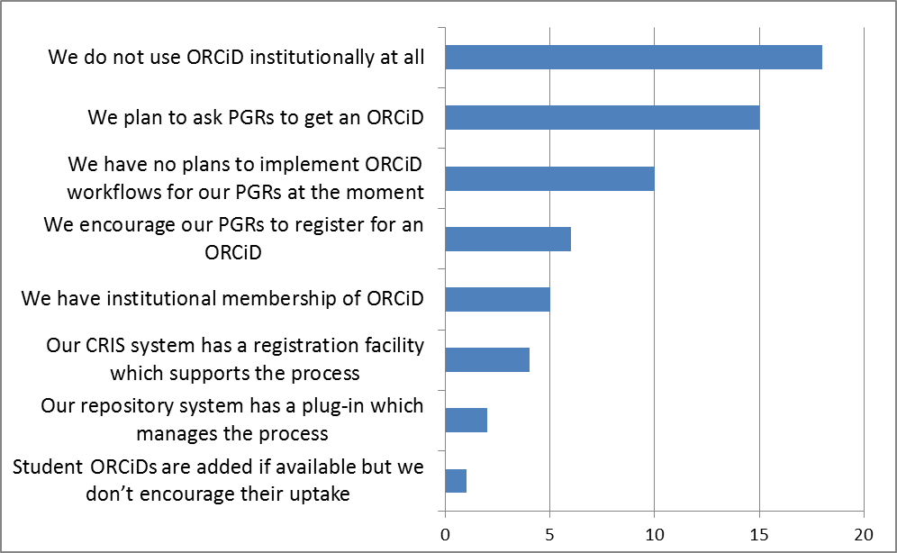
ORCiDs for students – April 2015

Slide 26
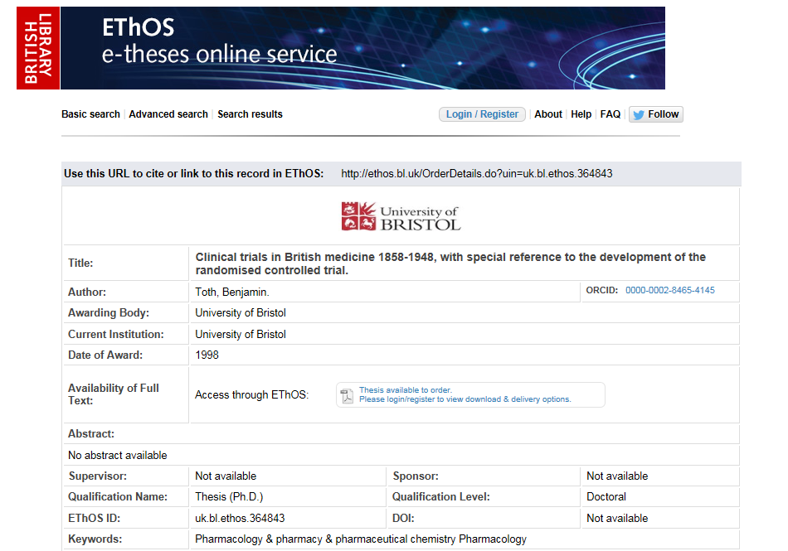
Notes:
Record with an Orcid. (Bristol = PURE)

Slide 27
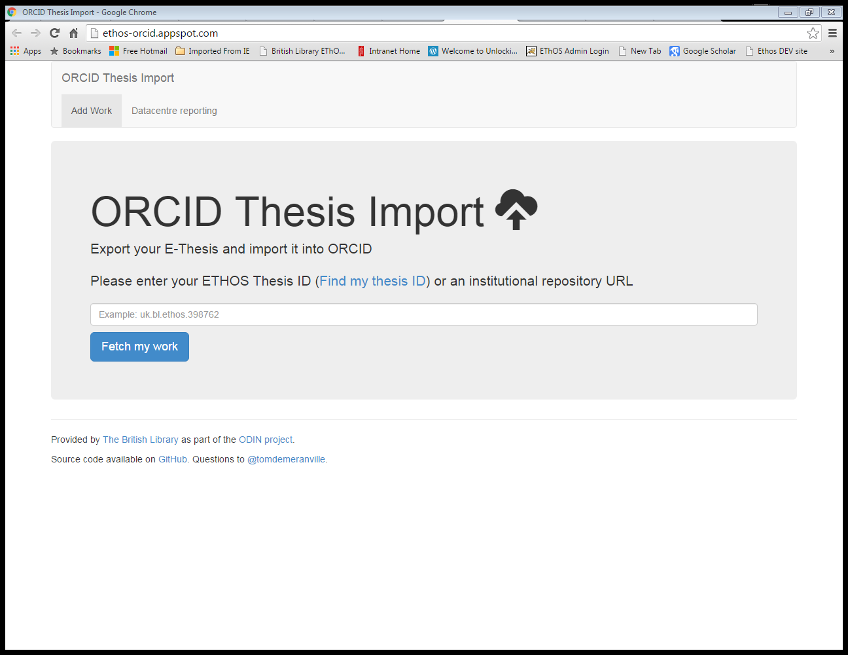
ORCiD Thesis importer

Slide 28
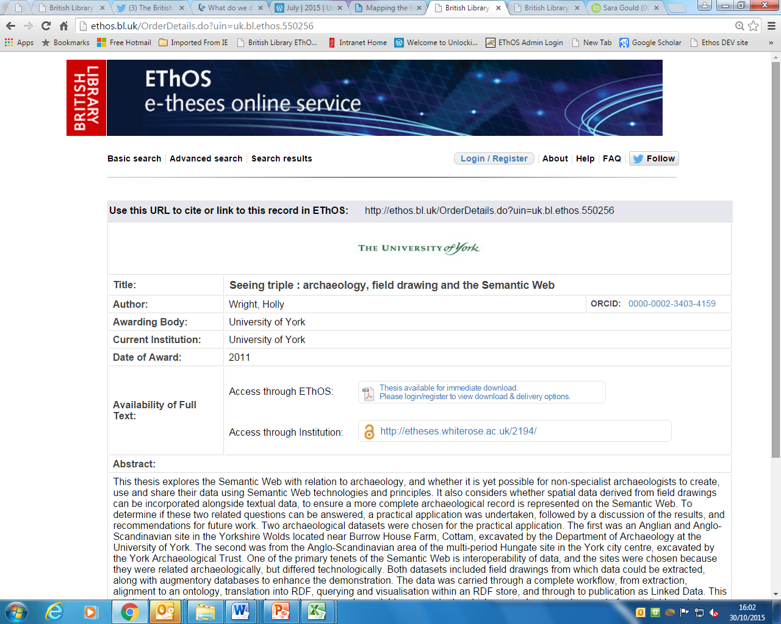
Next step?
Is this your thesis?
Add it to your ORCiD profile
Notes:
Button.

Slide 29
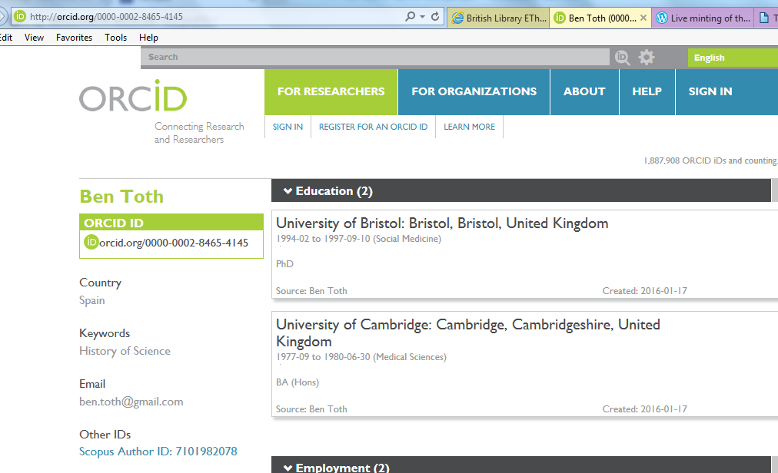
Notes:
The author’s ORCiD profile

Slide 30
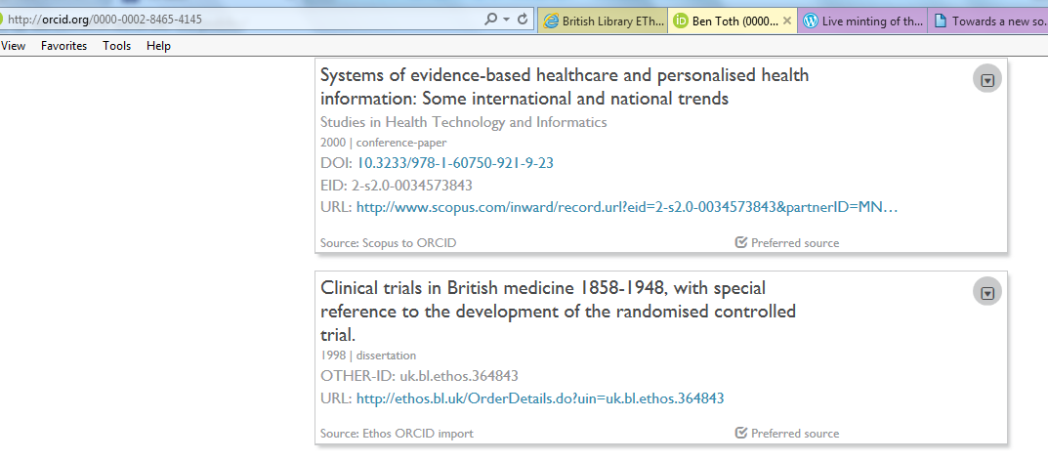
Link to EThOS from ORCiD
Notes:
ORCiD entry showing his PhD entry and link to EThOS.

Slide 31
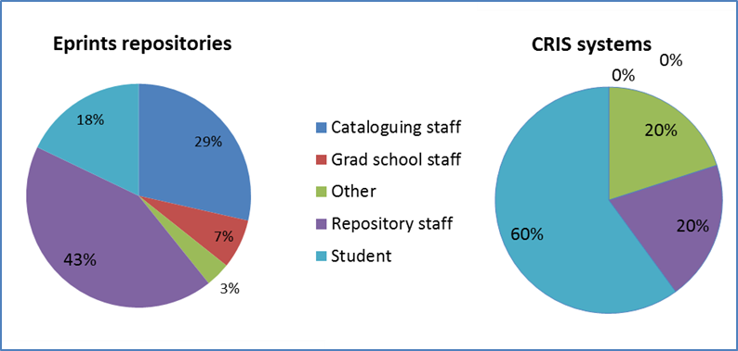
Who normally creates the initial thesis record?

Slide 32

Pure
Support for ORCID
Register DOIs for Data
Suggested Improvements
Register DOIs for Theses
Send DOIs and ORCiD to ETHOS

Slide 33
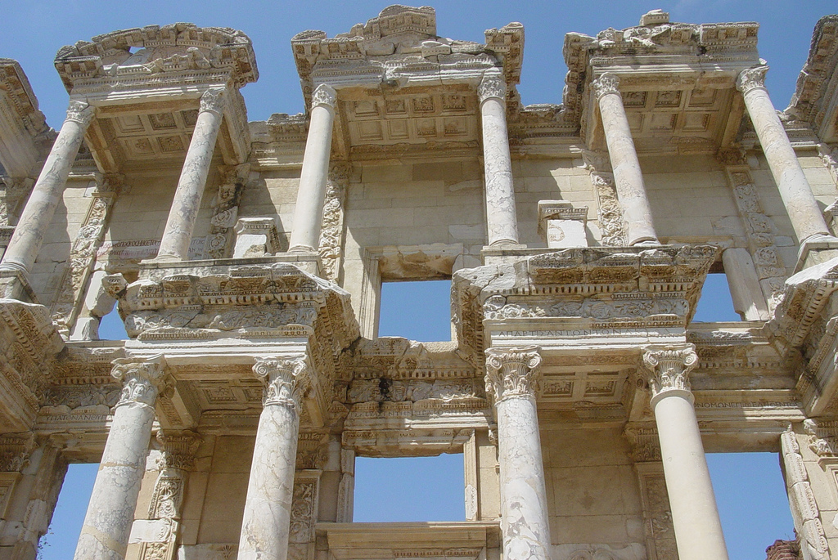
Questions?
(4)
Notes:
33

Slide 34
Thank you
Stephen Grace, UTD Project Manager (LSBU, was UEL)
Michael Whitton (University of Southampton)
Sara Gould (British Library)
Rachael Kotarski (British Library)
All outputs at http://dx.doi.org/10.15123/PROJECT.15
Blog at: https://unlockingthesisdata.wordpress.com
With thanks to Jisc for funding UTD

Slide 35




Credits
(1) hjl (2013). Silence, Texting, and the Pursuit of Knowledge. https://www.flickr.com/photos/hjl/8671009300
(2) Krawcowicz, Barbara (2009). Exam. www.flickr.com/photos/krawcowicz/3444474221/
(3) Grey, G. P. (2005). British Library Gate Shadow. https://commons.wikimedia.org/wiki/File:British_Library_Gate_Shadow.jpg#/media/File:British_Library_Gate_Shadow.jpg
(4) Leonard, Nick. (2006) Library. www.flickr.com/photos/jungle_boy/223447312/

