Slide 1
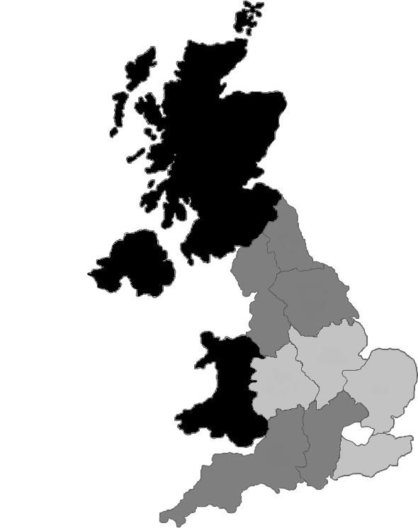
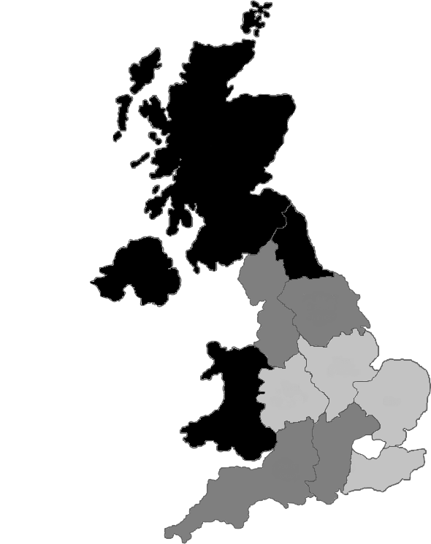
BOYS
GIRLS
Relative Rate
Referent
Low <1.50
Medium 1.50-1.64
High ≥ 1.65

