Slide 1
i-UPAC
Jeremy Frey
Chemistry, University of Southampton, UK
j.g.frey@soton.ac.uk
@profehem

Slide 2

PURE
cc: larces - https://www.flickr.com/photos/23629727@N02

Slide 3

APPLIED
cc: Gerard Stolk (vers le Carême) - https://www.flickr.com/photos/20762304@N00

Slide 4
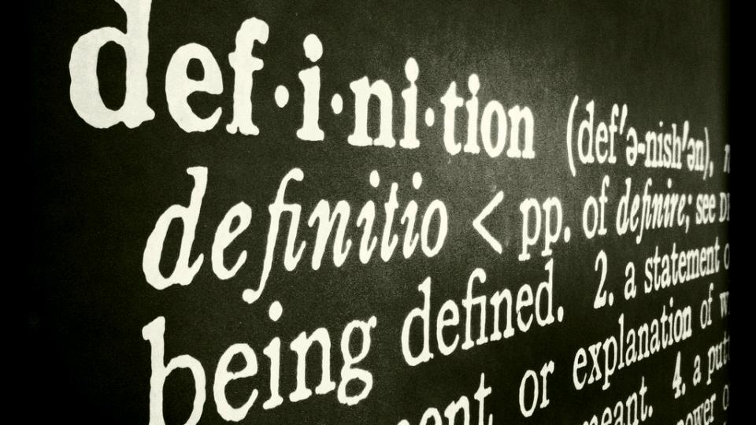
DEFINITIONS
cc: fabianmohr - https://www.flickr.com/photos/78101915@N00

Slide 5

RELATIONSHIPS
cc: tuchodi - https://www.flickr.com/photos/35034360491@N01

Slide 6
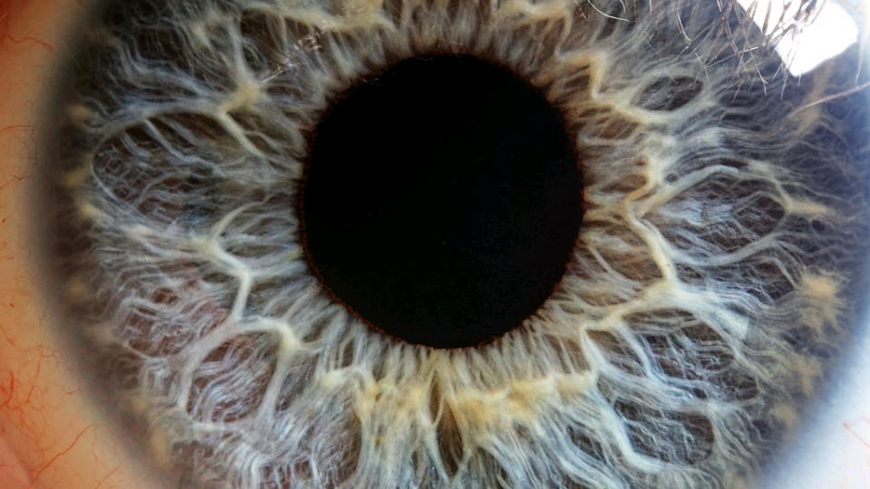
HUMAN
cc: Macroscopic Solutions - https://www.flickr.com/photos/107963674@N07

Slide 7

MACHINE
cc: Pierre J. - https://www.flickr.com/photos/7969902@N07

Slide 8

INTELEGENT
cc: --Filippo-- - https://www.flickr.com/photos/71882589@N00

Slide 9
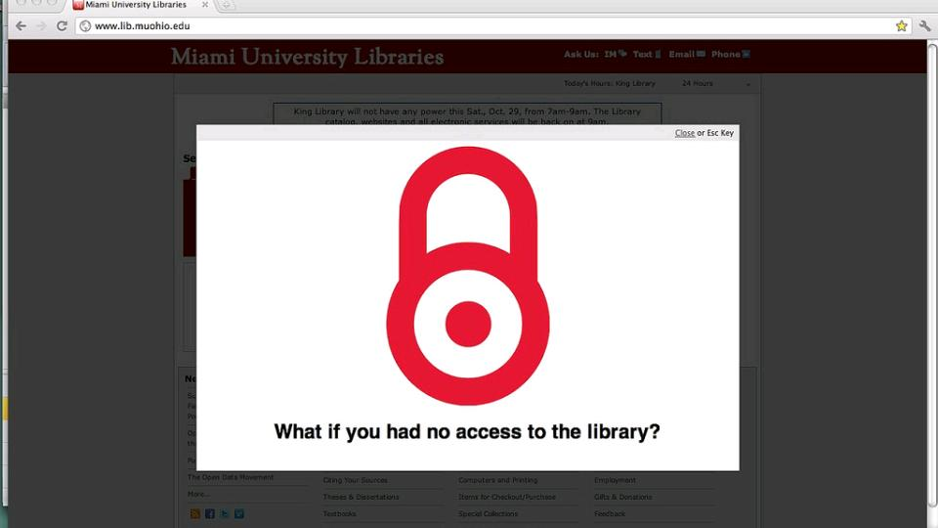
ACCESS
cc: JenWaller - https://www.flickr.com/photos/8392849@N07

Slide 10
Chemical Information
Chemical information includes the data, quantities, concepts, relationships, standards, terminology and definitions key to understanding chemistry (in context).
The digital future for structural representation is provided for - InChI – but what of other chemical information?
Bioinformatics has been widely supported by governmental funds; cheminformatics far less so
Royal Society report on Science as an Open Enterprise – “intelligent access” is key in a digital world
The Challenge - Enabling computers to understand chemical terminology and relationships unambiguously

Slide 11

DIGITAL
cc: quimby - https://www.flickr.com/photos/92388598@N00

Slide 12

DATA DRIVEN
cc: FutUndBeidl - https://www.flickr.com/photos/61423903@N06

Slide 13
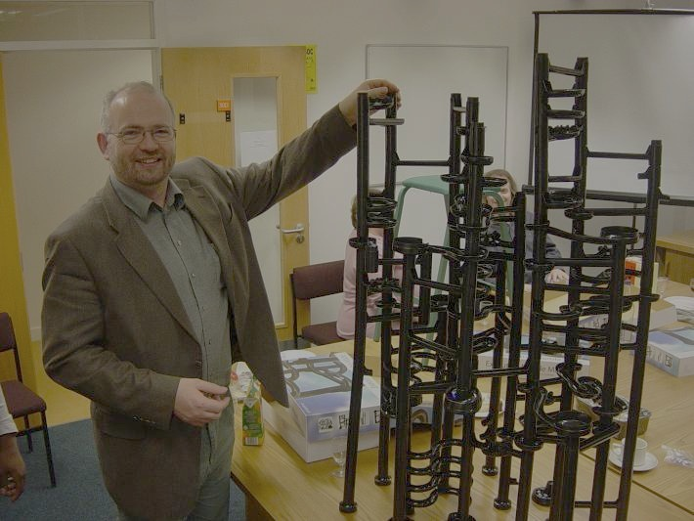
How do we communicate process?
If you can't describe what you are doing as a process, you don't know what you're doing.
W. Edwards Deming
Surprisingly difficult to explain what a process involves
Much of the detail is assumed to be understood and not explicitly discussed
This is where the miss-understandings usually arise.

Slide 14

Ontology
cc: Rich Anderson - https://www.flickr.com/photos/99105016@N00

Slide 15
Others will do this first
Not a good idea!
Notes:
It’s a Data Driven world
The world is moving on from the human readable science
Link up much more ICSU – WDS
Manufacturing, research, teaching and learning all now computer assisted e.g. databases, data–mining, electronic laboratory notebooks
IUPAC should set the digital standards for chemistry (even if it can't actually support the systems directly)
If we don't do this soon then the other science areas that use chemistry will do this for us and not necessarily correctly

Slide 16

FORWARD
cc: `James Wheeler - https://www.flickr.com/photos/24128704@N08

Slide 17

Priority
cc: Robert S. Donovan - https://www.flickr.com/photos/10687935@N04
Notes:
Opportunity for IUPAC to take the lead in creating a consistent global framework for Human AND Machine-readable (and “understandable”) chemical information – the identifier www.iupac.org is the key asset

Slide 18

COMMUNITY
cc: quinn.anya - https://www.flickr.com/photos/53326337@N00
Notes:
For IUPAC to re-engage with its roots in industry given the importance of open “intelligent access” for innovation

Slide 19
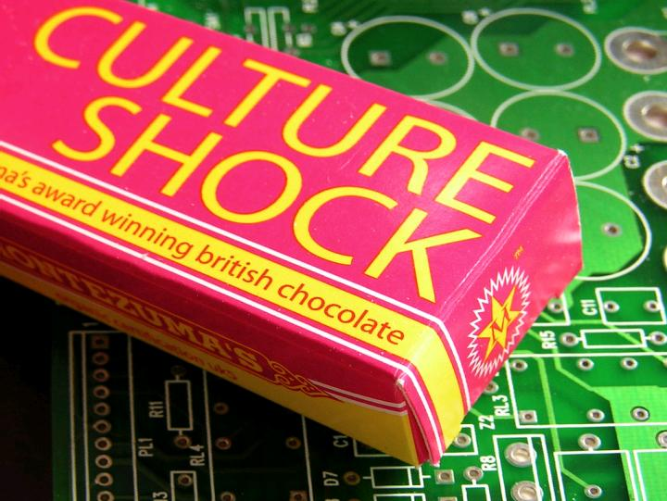
Culture
cc: jovike - https://www.flickr.com/photos/49503078599@N01

Slide 20

strategy
cc: horrigans - https://www.flickr.com/photos/8495857@N04
Notes:
Standards are IUPAC a core competence
To raise IUPAC profile and www.IUPAC.org brand in a very significant way
Collaboration with ICSU, WDS, RDA, other chemical societies, and UN bodies such as FAO and environmental agencies

Slide 21
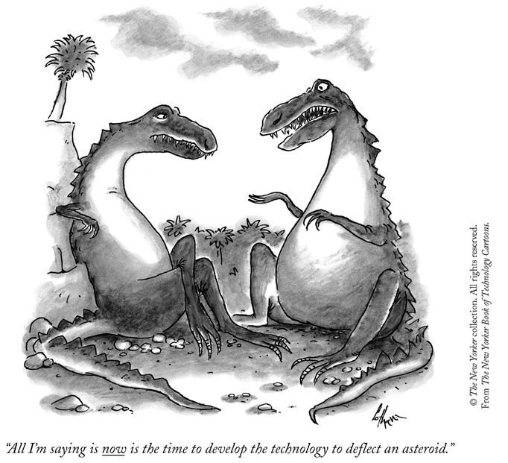
We must speed up the knowledge discovery process
All I am saying is that now is the time to develop the technology to deflect an asteroid

