Slide 1
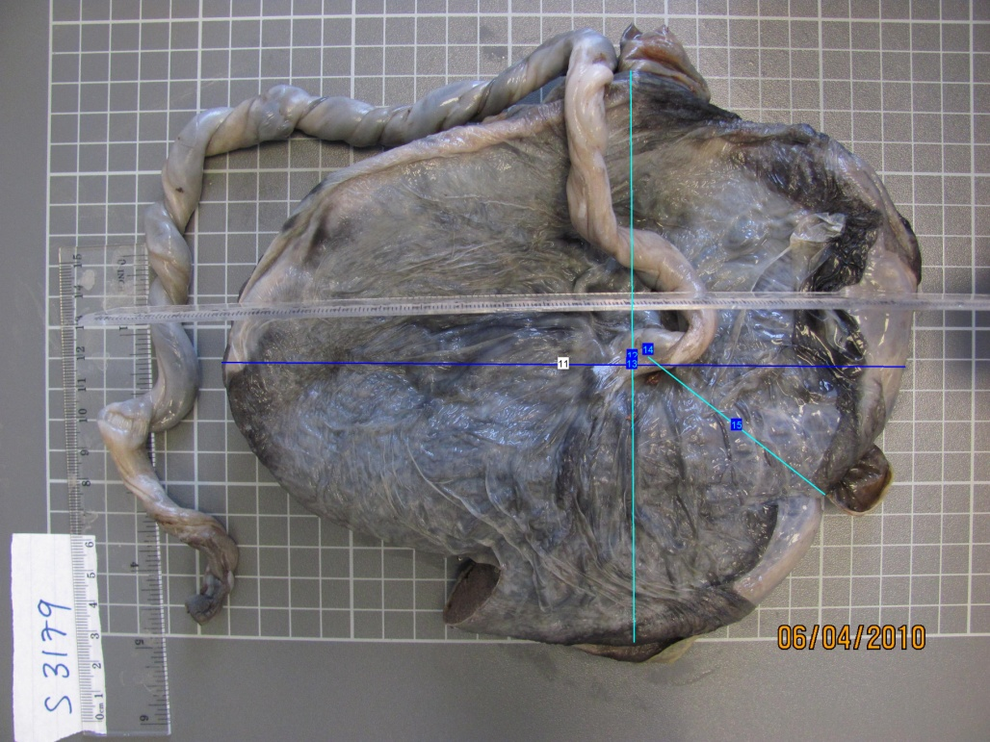
Notes:
Figure 1: Image of the fetal side of a placenta and umbilical cord. Lines illustrate measurements of length (dark) and width (light)

Slide 2
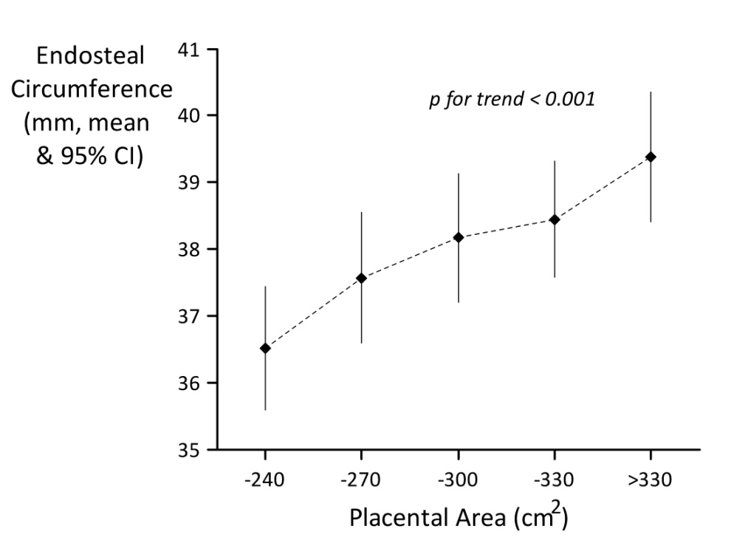
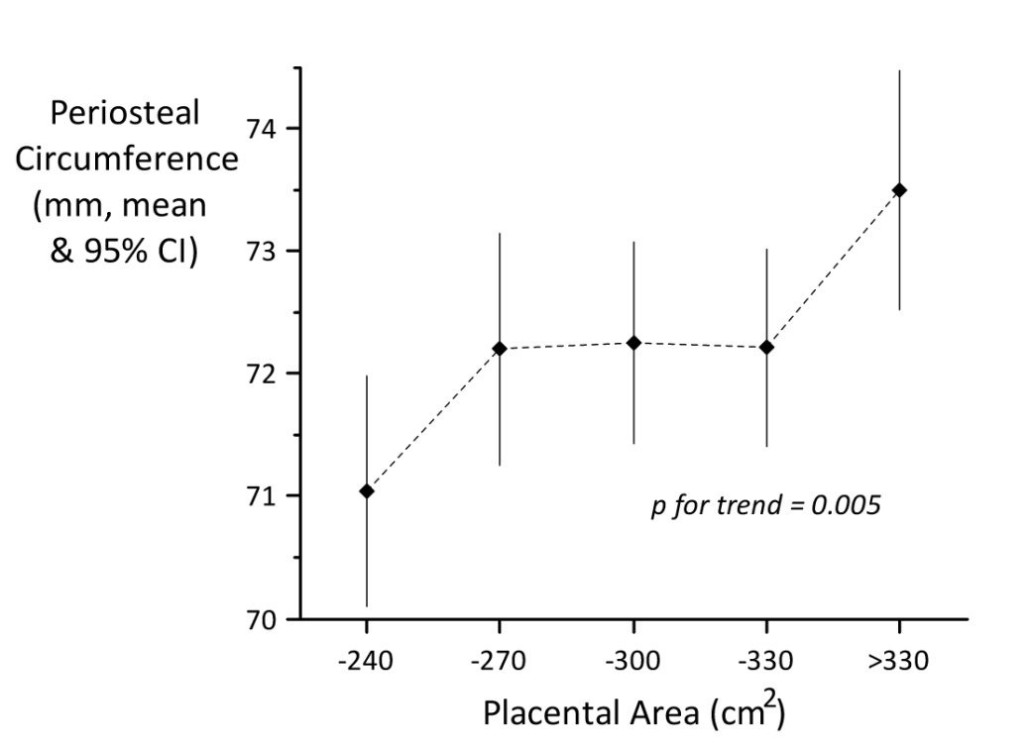
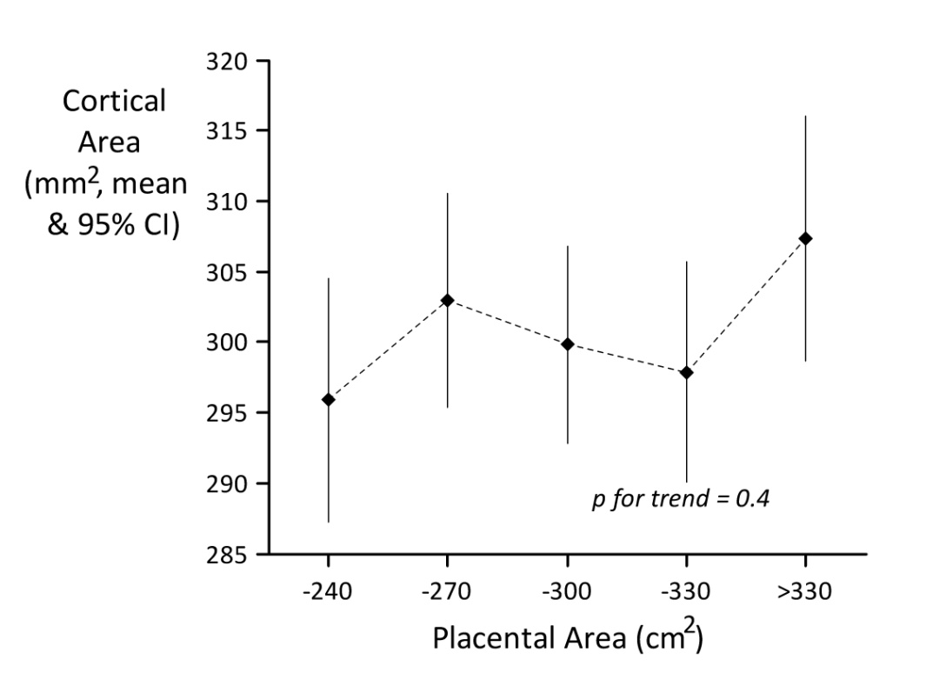
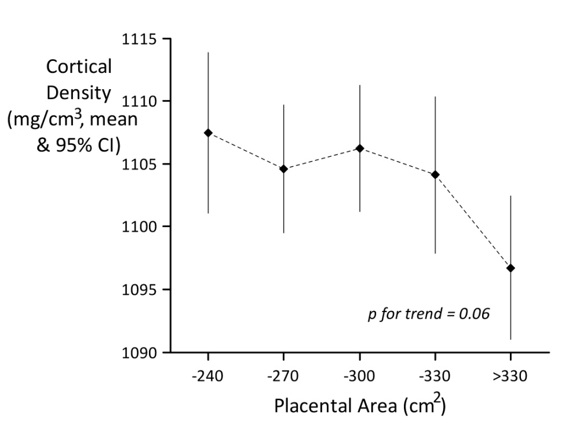
Notes:
Figure 2: Associations between placental characteristics and childhood pQCT measurements at 15.5 yrs. Data are adjusted for child’s age at gestation, age at pQCT, sex and pubertal stage at 13.5 years; maternal age at delivery, maternal height, maternal weight, parity.

