Slide 1

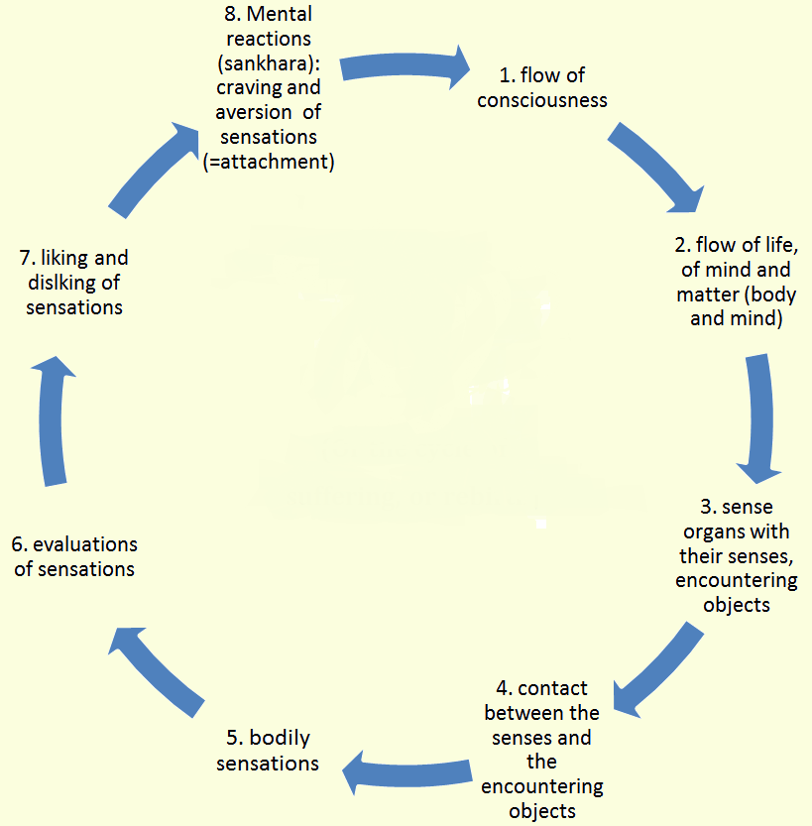

A qualitative study into the micro-processes and mechanisms of mindfulness Willeke Rietdijk, University of Southampton, UK Email: W.Rietdijk@soton.ac.uk
Introduction
Many empirical studies have shown beneficial effects of mindfulness-based interventions, but little research has been conducted into the actual inner processes taking place in, and phenomenological experiences of mindfulness. This research involves a micro-level phenomenological study of moment-to-moment mindfulness experience, using the Elicitation Interview method, which is based on Husserlian phenomenology. Phenomenology and mindfulness are both concerned with how things appear as they are in awareness and therefore phenomenology is an appropriate and interesting method for the study of mindfulness.
Rationale
This type of research is important for our understanding of mental and emotional processes, of learning and psychological change, as well as for the field of consciousness studies. It will also help increase our understanding of how to practice mindfulness, and how the benefits of mindfulness can be optimised within the settings in which it is applied. First-person studies of mindfulness are crucial for our neuroscientific understanding of mindfulness.
Mindfulness mechanisms from the literature
1. Proposed model based on mechanisms and models from the recent literature:
(¹Baer, 2010; ²Lievesley, 2008; ³Shapiro et al., 2006; ⁴Grabovac et al., 2011; ⁵Goenka, 2010;⁶Deikman, 1982,Malpass, 2011)
2. Interacting Cognitive Sub-systems (ICS) (Barnard & Teasdale, 1991; Teasdale and Chaskalson, 2011a,b)
Propositional (semantic) vs implicational meaning (implicit + holistic – “senses” of knowing, impressions, affect)
In the working memory for holistic implicit meaning we can change what, why and how we experience
→ Disrupting mental/emotional configurations (this links with Dependent Origination in Buddhism)
3. Psychodynamic model of mindfulness (Epstein, 2007)
Very different types of explanations of mindfulness; and concepts/aspects
None of the studies have looked at the moment-to-moment unfolding of micro-experiences of mindfulness.
Methodology
A micro-study of the mindfulness experience, using the Elicitation Interview (EI) (Vermersch, Depraz & Varela, 2003; Petitmengin, 2006; Vermersch, 2009) to bring participants back into an embodied reliving of a recent meditation experience.
Reliving pre-reflective experience in a situated and embodied way
The epochè (Husserl) as initial suspension, repeated at every step
Retrieving passively stored, pre-reflective experience
3-5 medium-experienced meditators x 3-5 interviews → ~20 interviews
Focus not on descriptions of experience, but on active, in the moment reliving of pre-reflective experience
Selecting short sequences (seconds) of the mindfulness meditation
Possibly using a bell to interrupt meditation and interview straightaway
Philosophical issues:
Is it possible to retrieve pre-reflective experience or are relived past experiences constructed? (likely a combination?)
What kind of pre-reflective information would be stored during mindfulness?
Subtle tensions between meditative and elicitation processes?
Attitude³
Intention³
Non-attachment² Acceptance^{1,2} Equanimity⁵
Self-compassion^{1?}
Mindfulness¹
Decentering^{1,7}
Exposure^{2,7}/defusion
Reperceiving³
Attentional control^{2,7?}
Cognitive change²
Attention regulation / Samatha in Buddhism⁴
Psychological flexibility^{1?}
Emotion regulation^{1,7?}
Self-compassion^{1?}
Wisdom-insight
Affective =Insight/Vipassana meditation
Re-perceiving as meta-mechanism?^{3,7}; transformation in sense of self^{7;} A move towards ‘the observing self’ ?⁶
Definitions of mind
New ideas in consciousness studies postulate that consciousness is not confined in the brain, but in what we do - body and mind are inseparable (Noë, 2009).
The Buddhist concept of mind: 1) heart-mind (citta); 2) that which contains the content of the mind (thoughts, experiences, emotions, body).
Thus, mind and objects of mind are considered to be one and the same thing:
Our sense of ‘I’, of being the centre of our awareness, is also considered content of the mind
There is no centre; all content of the mind is fleeting, temporary.
“The thoughts are the thinker”; “the experiences are the experiencer”
Data analysis and pilot study findings
Interpretative Phenomenological Analysis (IPA) or more flexible Thematic Analysis?
Possibility of very different and idiosyncratic experiences coming up across participants
What will be the focus? Do not want to exclude anything beforehand.
Focus on how mindful attention is lost and regained? If mind has wandered off, is this pre-reflective information which can be retrieved via the EI interview?
Not a biographical or narrative approach, BUT:
To what extent can (should) narrative be avoided?
How to “bracket” ordinary judgments from the experience?
Focus on the technique of meditation or the experiences during meditation?
Focus on how equanimity is performed towards any sensation or experience?
First findings
Incredibly rich descriptions of just a few seconds of meditation
A lot of narrative included (= meaning of the experiences to the participant) → very personal, emotional experiences, sensations, and meanings
Participants astounded by the detail of the information coming up that they would otherwise not have remembered
Need to focus down even further in order to bracket ordinary interpretations?
Phenomenology
Phenomenology is the systematic study of first-person experience (of that which appears) (Edmund Husserl (1859-1938))
Bringing things back to their essences by phenomenological reduction (bracketing, the épochè)
Suspending the natural attitude (the way we normally look at things, which includes interpretations and judgements)
In a somewhat different conceptualisation, it is concerned with the meaning the experience has for the person experiencing it (Gallagher & Zahavi, 2012) .
Neurophenomenology
Varela’s (1991) starting point for neurophenomenology was an emphasis on the embodied nature of the human mind (Merleau-Ponty). His aim was to combine first-person methods with neuroscience to solve “the hard problem” of consciousness (Varela, 1996).
He proposed to use mindfulness to study experience in the moment rather than after the fact (1991):
Experiencing what the mind is doing as it does it, study human experience in its immediate, lived aspects.
Embodied, open-ended reflection: reflection is on experience, but reflection is also an experience in itself
This can also be applied to the study of mindful experience.
Buddhist Psychology and Phenomenology
Our mind responds to sensations which result from contact between the six senses and their sense objects. This results in ignorance, craving, aversion.
Dhammas → phenomenological
‘bytes’ of experience (Olendzki, 2011)
The three jewels of real wisdom:
suffering, impermanence, no-self
Dependent Origination →
A Buddhist phenomenological
attitude towards experience:
Bare awareness or bare attention
Equanimity; non-attachment
(“Intimate detachment”)
“By observing all sensations equanimously, gross, consolidated sensations and emotions dissolve into subtle vibrations, arising and falling with great rapidity, and the solidity of the mental-physical structure disappears” (Goenka, 2010)
For more information: W.Rietdijk@soton.ac.uk
I wish to thank my supervisors, Dr Sarah Parsons and Dr Jenny Byrne, and the University of Southampton for supporting this research.

