Slide 1
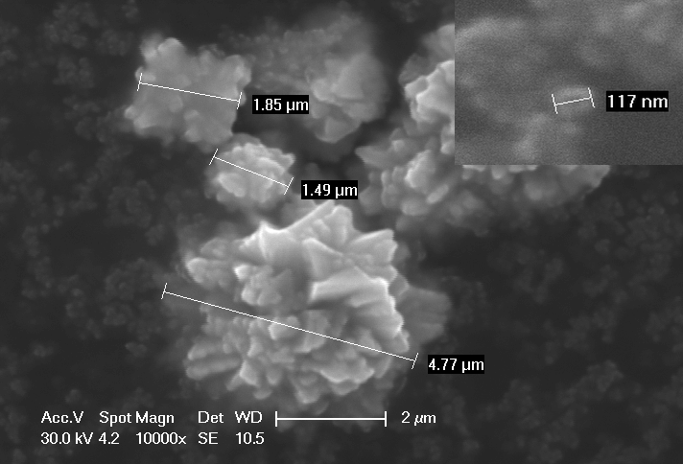
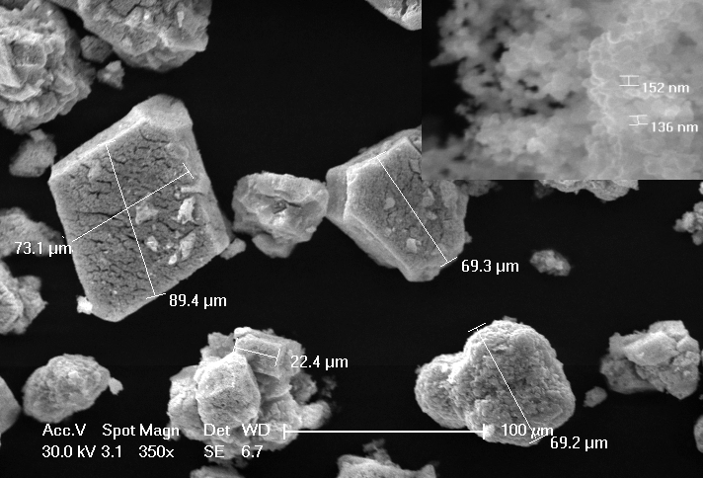
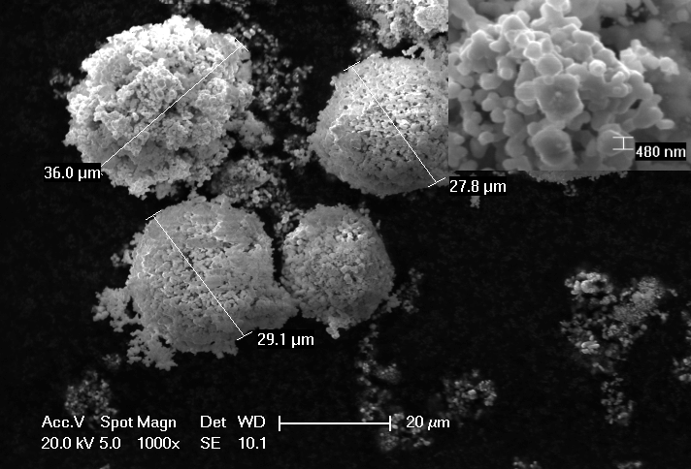
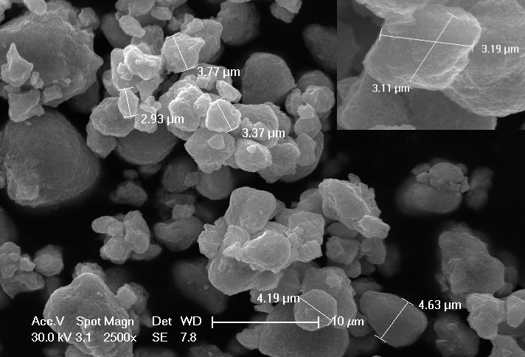
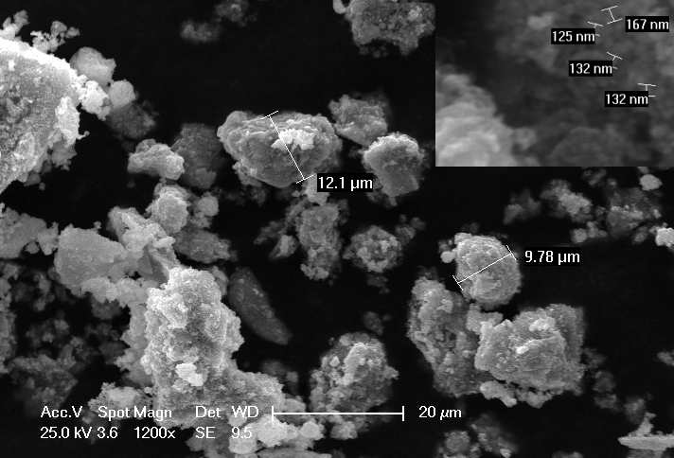
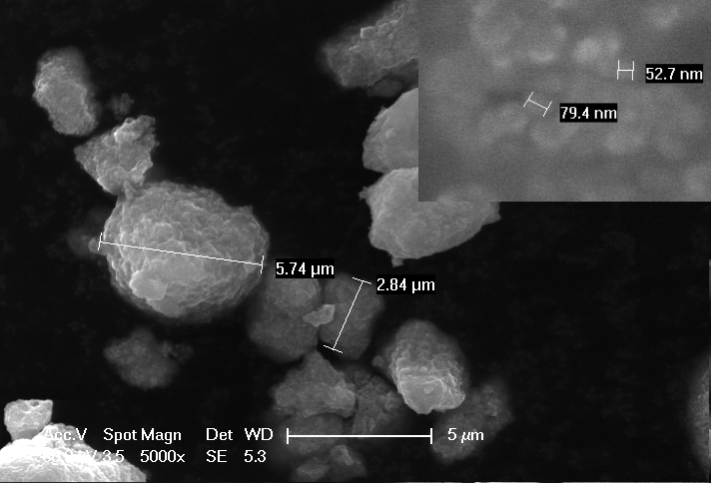
Crystallite Size Determination:
A Comparison of Methods and Approaches
Mark Light & Sarah Clark, University of Southampton UK
Abstract
A number of treated Ni metal powders were used to investigate various methods of crystallite size determination by X-Ray diffraction, these were complemented by electron microscopy imaging. Whilst there is strong agreement between some methods, a wide range of values is often obtained and it can be difficult to align these with direct SEM observations - especially for complex samples.
Methods
Halder-Wagner (HW): Multiple peak method extracting the crystallite size from the Williamson-Hall type plot. A peak width standard (LaB₆) was used to correct for the instrumental broadening.
Whole Pattern Profile Fitting (WPPF): The Rietveld approach of extracting the crystallite size as a refined parameter from refinement of a structural model against the whole pattern. A peak width standard (LaB₆) was used to correct for the instrumental broadening.
Fundamental Parameters (FP): An approach that does not require an instrumental broadening standard but models the instrumental effects using a convolution of the emission spectrum of the X-Ray source and profiles derived form the various optical devices placed in the beam path.
Electron Microscopy: A complementary technique that directly images the crystallites on an individual basis as opposed to the average views of X-Ray methods.
1
4
2
5
3
6
*Insets are at increased magnification and show interpreted crystallites
FWHM* |  | Halder-Wagner (H-W) |  | Fundamental Parameters (FP) |  | Rietveld (WPPF) |  | SEM
LaB₆ | 0.066 | SL | D2 | SL | D2 | SL | D2
1 | 0.093 | 244(8) | 68(3) | 256(9) | 154(2) | 246(5) | X | 100
2 | 0.099 | 219(28) | 49(2) | 165(6) | 117(1) | 267(4) | 278(10) | 500
3 | 0.264 | 25(3) | 19(3) | 39(5) | 34(2) | 39(2) | 41(06) | 130
4 | 0.244 | 27(3) | 23(4) | 42(6) | 42(23) | 46(3) | 42(4) | 150
5 | 0.212 | 39(4) | 23(3) | 55(1) | 44(5) | 57(3) | 35(05) | 70
6 | 0.231 | 29(4) | 23(4) | 48(8) | 42(3) | 54(4) | 45(2) | 70
Results
All the X-Ray methods reported here are based on multiple peaks or whole pattern profile fitting. Application of the basic Scherrer equation¹ on individual peaks can yield crystallites sizes that vary as much as 60% from the ‘all peak’ average.
SEM images are not easy to parameterise but show a) very inhomogeneous samples & b) a big difference between particle size and crystallite size.
The biggest differences between X-Ray methods is for samples 1 & 2 which show least peak broadening.
In general FP and WPPF methods give comparable values whilst the H-W method gives smaller crystallite sizes.
Compared to values interpreted from SEM images X-Ray methods are shown to give consistently smaller crystallite sizes (ca. 40%).
* FWHM (±0.001) values are for the LaB₆(200) & Ni(111) peaks measured on the SmartLab that occur at similar 2θ values.
Experimental
Rigaku SmartLab: Bragg-Brentano geometry using a 9kW Cu rotating anode. θ/2θ scans with 0.02° steps in the range 40-158° were recorded at a rate of 2° per minute.
Bruker D2 Phaser: Bragg-Brentano geometry using a 300W Cu sealed tube. θ/2θ scans with 0.02° steps in the range 40-144° were recorded at a rate of 0.7 seconds per step.
Electron Microscopy: Images were taken on a FEI XL30ESEM scanning electron microscope.
Data Analysis: All data manipulations were performed using PDXL 2 (Rigaku Corporation , 2007-2013). Zero strain and spherical crystallites were assumed.
Conclusions
For smaller crystallite sizes peak broadening is dominated by sample broadening and correcting for instrumental effects is less critical.
For larger crystallite sizes peak broadening is dominated by instrumental effects and MUST be diligently corrected for.
Estimation of crystallite sizes above ca. 200nm are extremely method dependent.
Profile fitting methods must be based on a fully converged, well modelled refinement.
Assumptions about the homogeneity of the sample and crystallite size versus grain size can be dangerous!
References
1. P. Scherrer, “Bestimmung der Grösse und der inneren Struktur von Kolloidteilchen mittels Röntgenstrahlen,” Nachr. Ges. Wiss. Göttingen 26 (1918) pp 98-100.
Acknowledgements
Alistair Clark for help with electron microscopy.
Notes:
FP: Can also provide information on the crystallite size distribution by analysing the degree of Gaussian and Lorentzian components of the experimental peak shape.

