Slide 1
SmartLab: Some initial results and experiences.
Dr Mark Light
University of Southampton

Slide 2
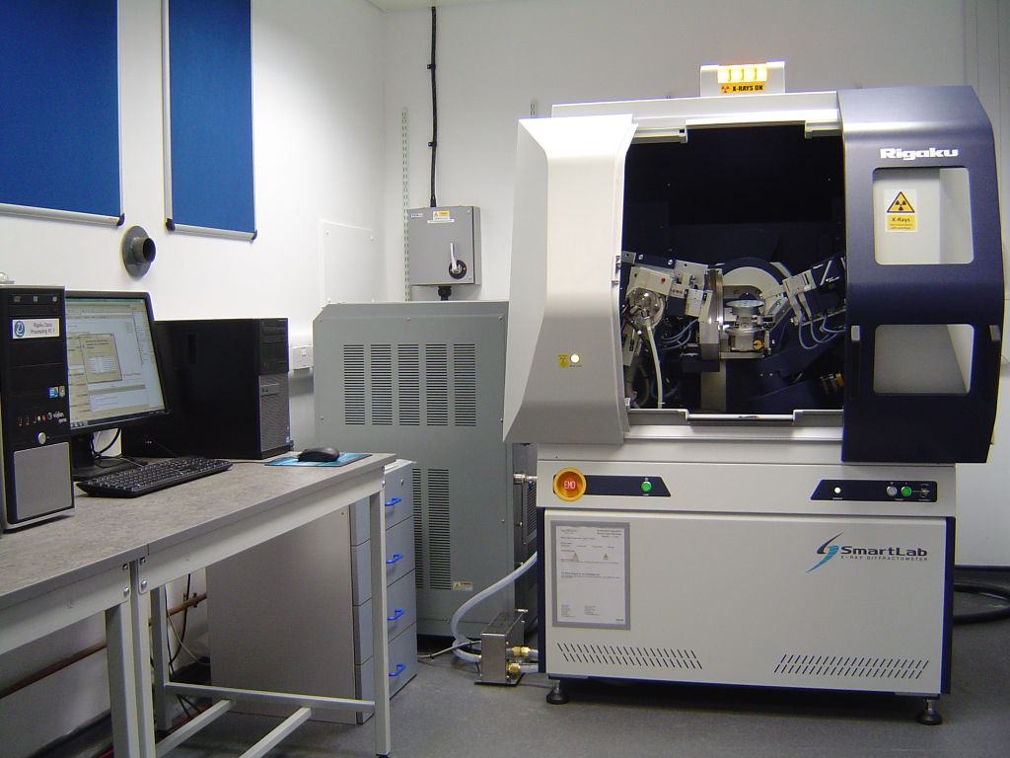
Outline:
SmartLab configuration
Micro diffraction
Texture – pole figures
In-plane diffraction
Epitaxy - RSM
Installed May 2013

Slide 3
SmartLab configuration
9kW Cu rotating anode (Kα1, Kα2, Kβ, [WLa1, WLa2])
5 axis goniometer (in-plane arm) θs, θd, χ, ϕ, 2θ_{χ}
Ge(220) 2-bounce monochromator & analyser
CBOf, 50μm collimator, micro-diffraction stage
RxRy, xy & capillary spinner stages
D/teX ULTRA 250 1D detector

Slide 4
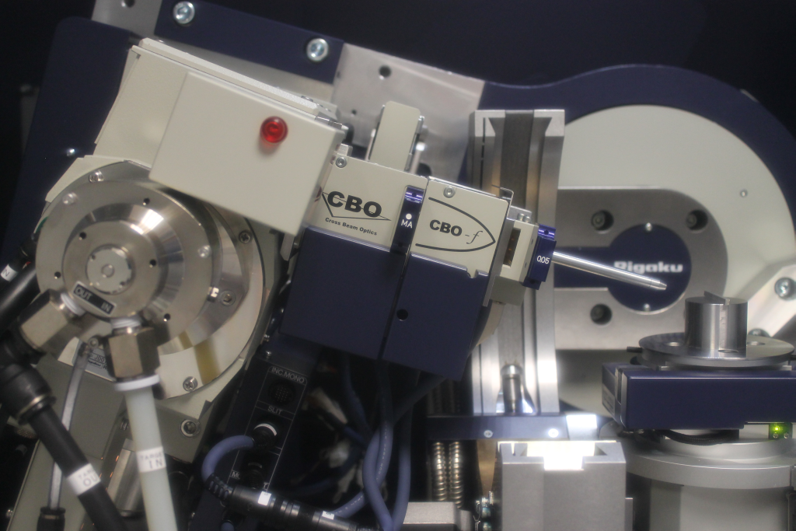
Microdiffraction
Notes:
No collimator = ca. 400 microns

Slide 5
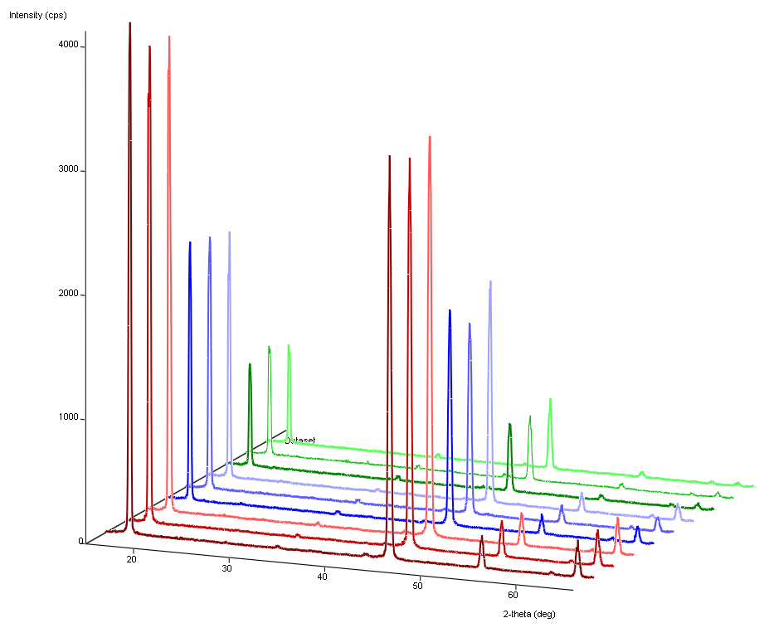

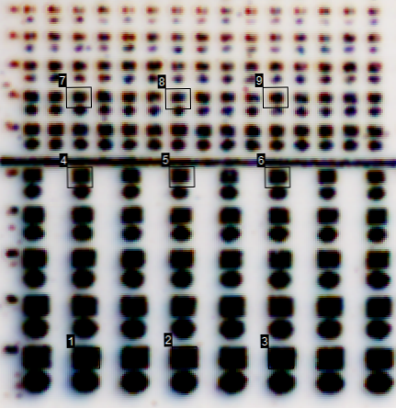
Patterned silica
Patterned silica
PVD TiN
Bi₂Te₃
Si
(006)
(0015)
(0018)
(0021)
Notes:
PVD TiN conducting layer on Si , patterned silica – various size holes – range of 30 microns
Preferred orientation, on a TiN surface you get random orientation – and on SiO2 you get some orientation – so the patterning drives the preferred orientation/
Adam Mater. Res. Bull. 2007, 42, 1986 (R-3mh, a = 4.38, c = 30.50 Å)

Slide 6
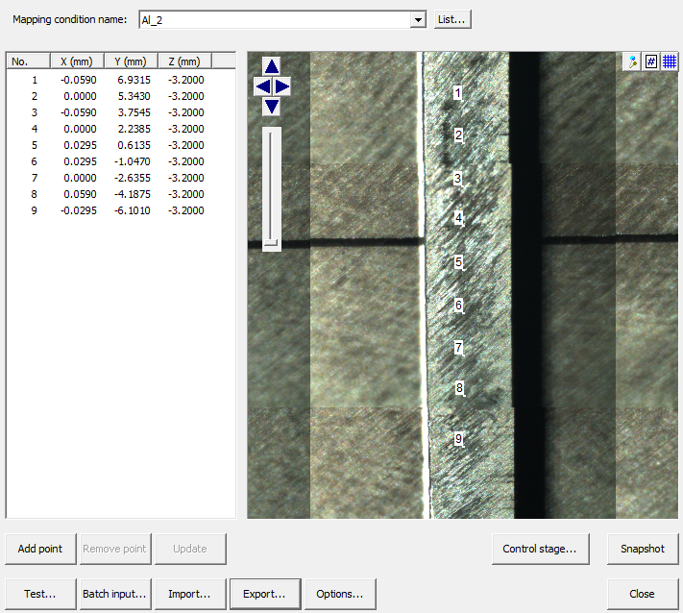
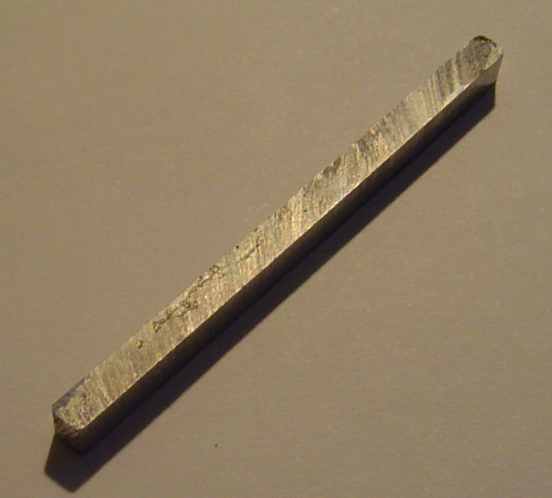
Residual stress in aluminium

Slide 7
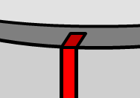
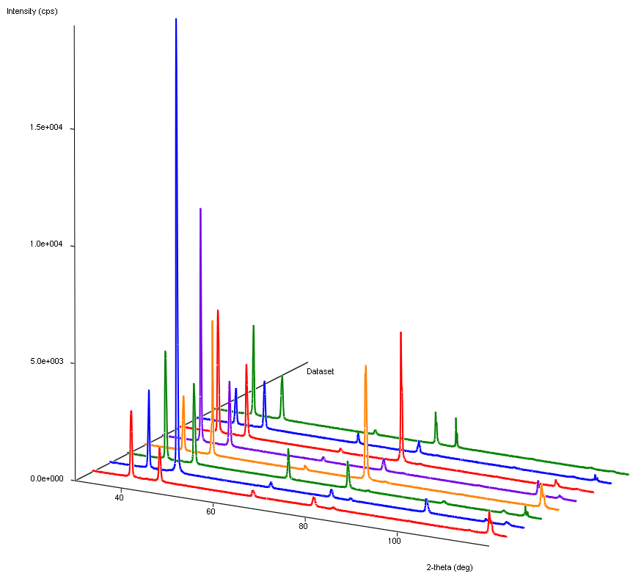
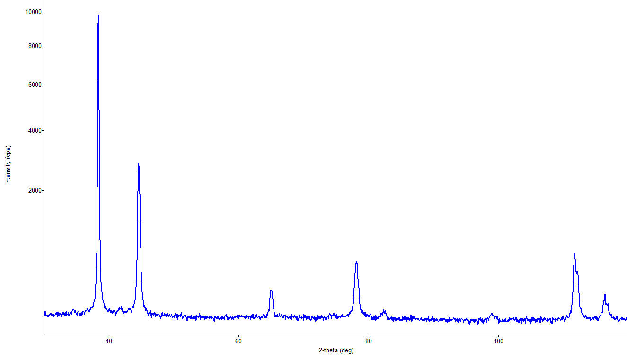
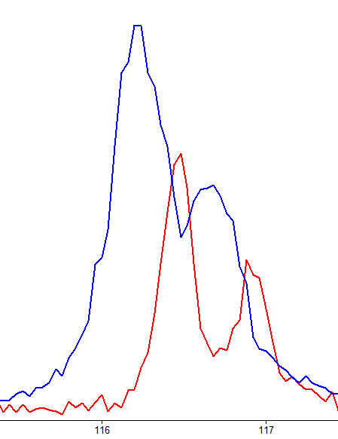
θ/2θ symmetric scans
(111)
C
T
(200)
(311)
(331)
(220)
(222)
(400)
(420)
a = 4.057(2) Å
a = 4.052(2)Å

Slide 8
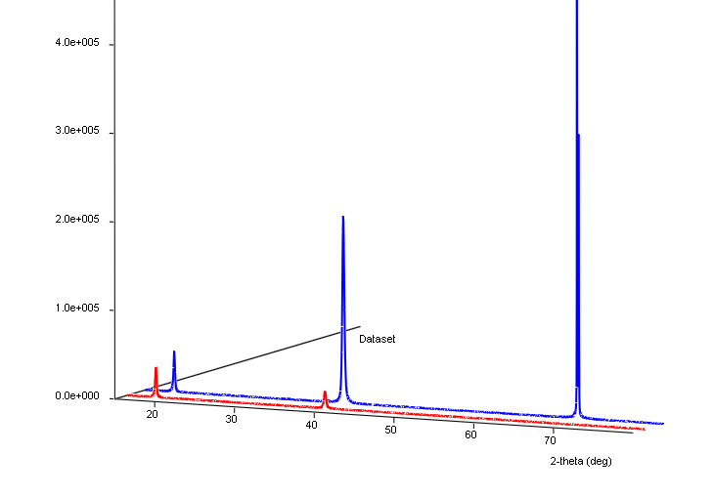
Texture
X
Pt
Si
Si (400)
Symmetric
Asymmetric
Pt (111)
Phase X (111)
Notes:
Blue = symmetric, red = asymmetric

Slide 9
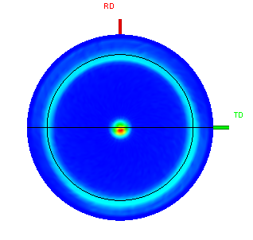
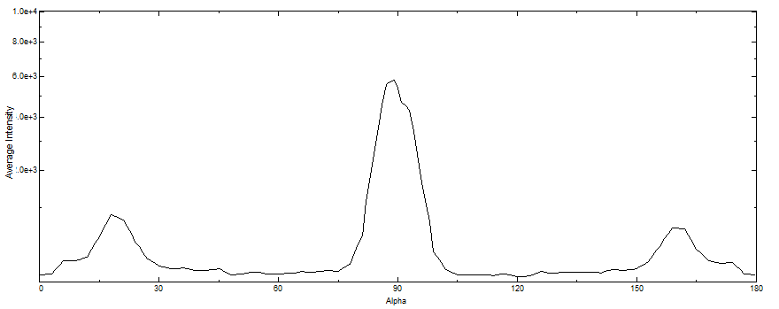






111 reflection, (111) fibre orientation
α = 19.5
Notes:
111 reflection of cubic phase, showing classic 111 fibre texture.
Alpha = 19.5
Highest intensity at centre from the (111) planes aligned parallel to sample surface.
Ring at alpha = 19.5 from random orientations (twists) of the (-111), (11-1), (1-11) planes that make an angle to (111) of 19.5. The intensity present is spread out uniformally around the ring.
LiMn2O4 on Pt layer on Si subrate (100)

Slide 10
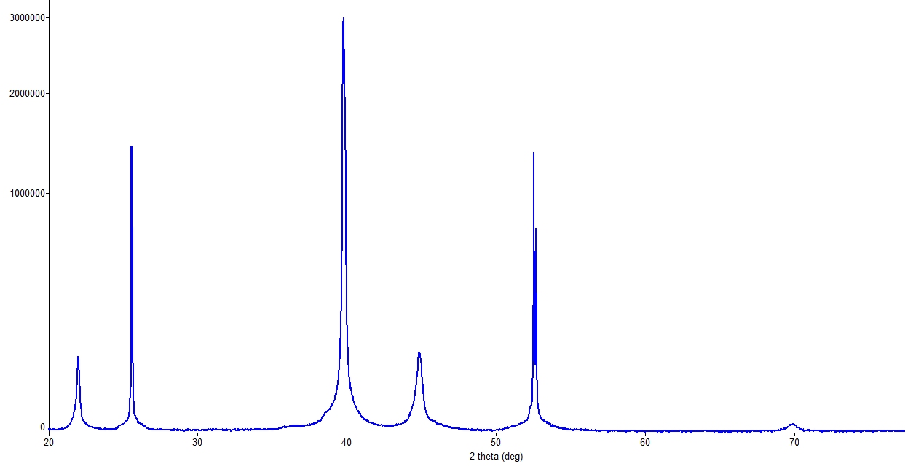
X
Pt
Al₂O₃
Pt
3.977 3.977 3.988 90 90 90
Al₂O₃
Al₂O₃
X (100)
X (111)
X (200), (002)
Notes:
200 and 002 are a very close overlapped doublet due to the tetragonal cell The fact that a and c are very similar could explain a very slight asymmetry in the 100 surface normal pole

Slide 11
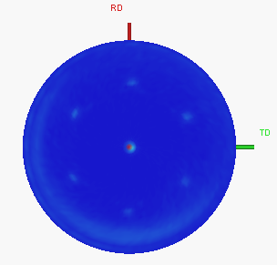
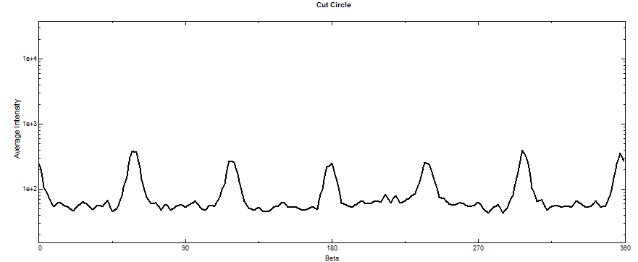
100 reflection, (111) & (100) orientation?
α = 33.5
Notes:
The pole normal shows that the 100 are parallel to the surface, but the poles at 33.5 indicate there must also be some (111) orientation of the crystallites.

Slide 12
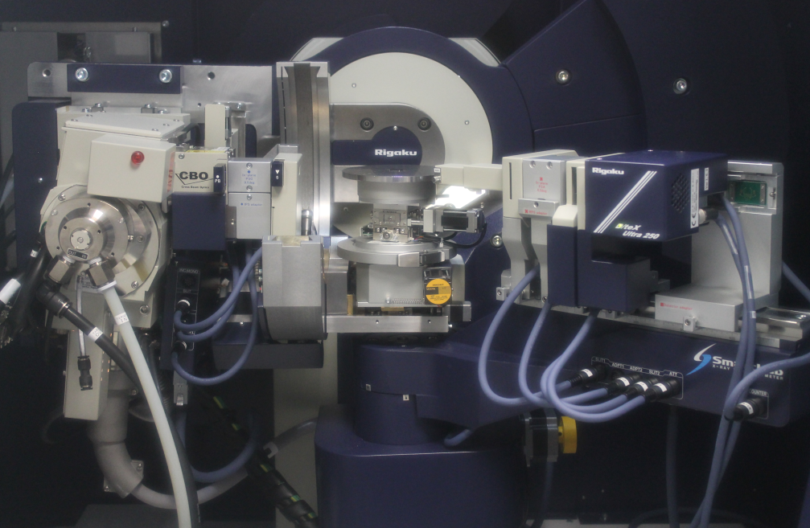
In-Plane

Slide 13
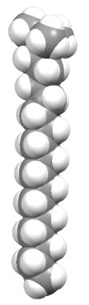
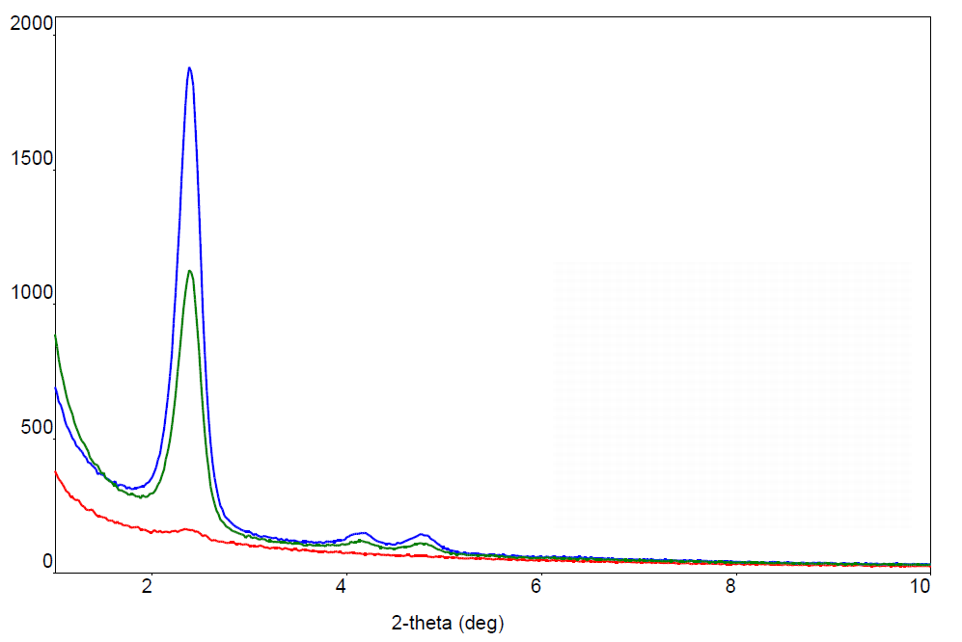
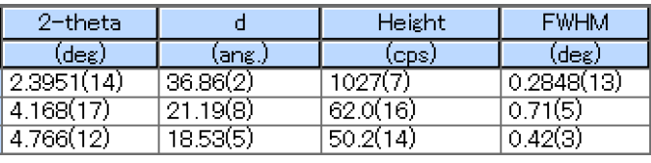
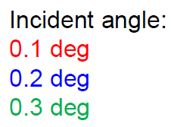


meso-porous
silica
100nm
In,TiO
Mesoporous silica
glass slide
d₁=36.86(2)
d₁(10)
d₂(11)
d₃(20)
d₂=21.19(8)
d₃=18.53(5)
$$d_{2}={d_{1}}/{\sqrt{3}}$$
$$d_{3}={d_{1}}/2$$
2θ_{χ} in-plane scan, 3 hour scan
Notes:
Grown from CTAB surfactant – via electrochemically assisted method. This aligns the surfactant normal to the surface and aids nucleation at the surface via production of OH groups.
(C₁₆H₃₃)N(CH₃)₃Br, cetyltrimethylammonium bromide
Pore size = 4.26nm

Slide 14
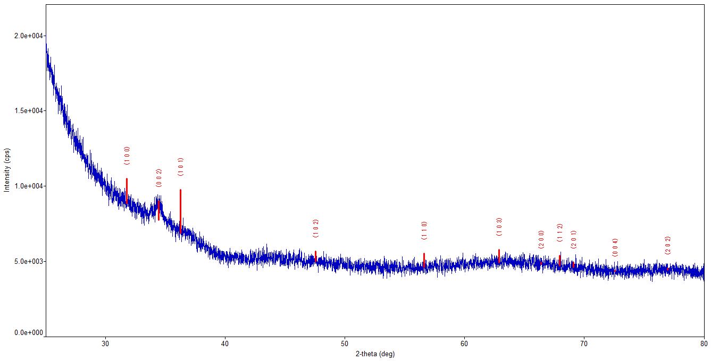
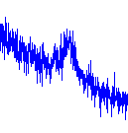
Zinc oxide
1. θ/2θ symmetric scan
ZnO
20nm
ALD @ 200°C
Diethyl zinc, oxygen precursor sources
quartz
Notes:
5 minute scan, only ZnO 0002 peak visible
Atomic Layer Deposition

Slide 15
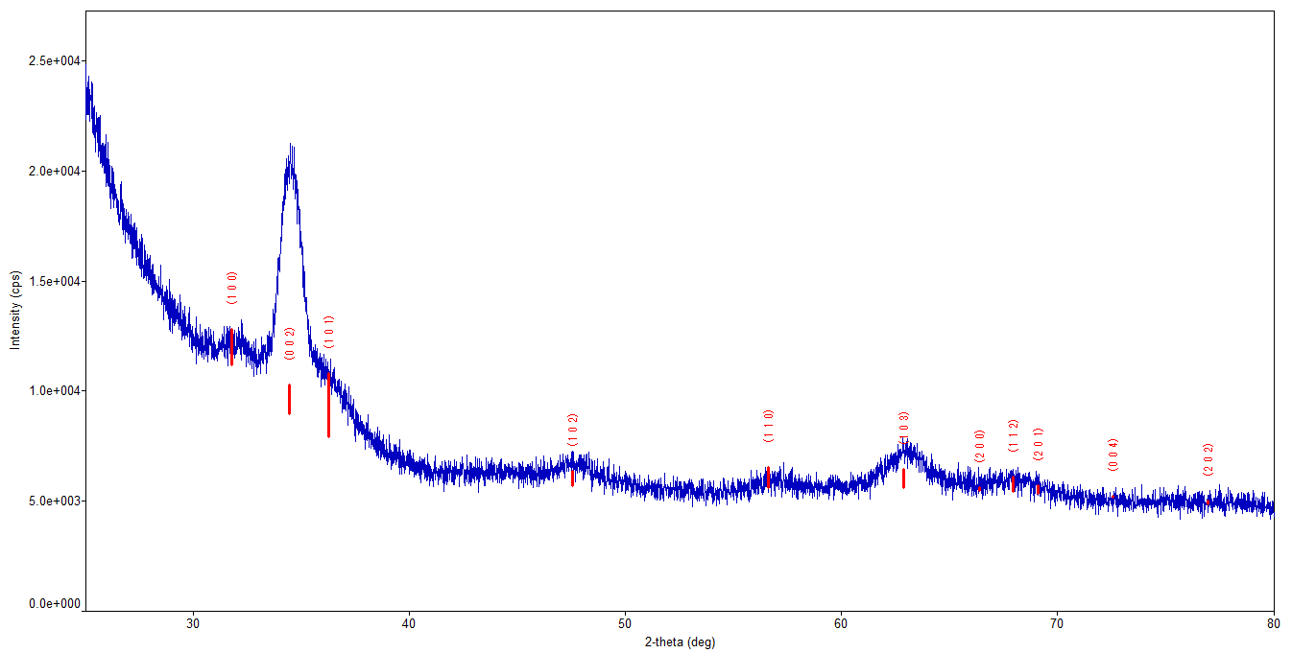
2. Grazing Incidence 2θ asymmetric scan
(002)
16.75°
34.5°
0.5°
Notes:
GI picks up many more peaks.
The 002 reflection is much stronger than predicted indicating the sample has strong c axis preferred orientation.
However, as this is a GI 2theta scan, the diffraction vector is inclined (34/2)-0.5 to the sample surface normal – so precise preferred orientation information is not obtained.

Slide 16
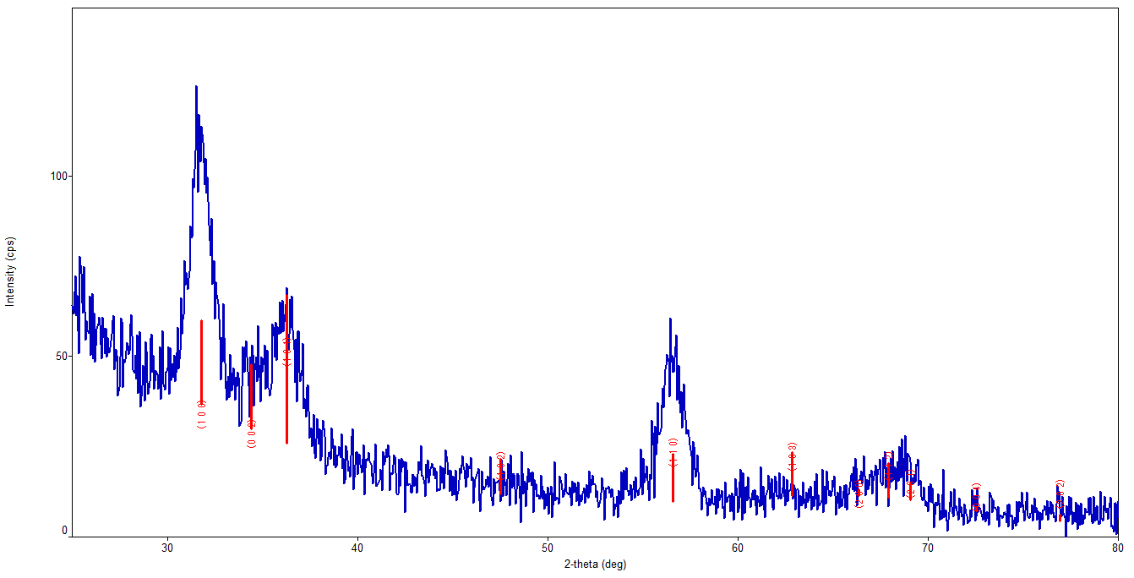
3. In-plane scan
(100)
(110)
Notes:
The 100 and 110 reflections are stronger than theoretically expected supporting the c-axis preferred orientation

Slide 17
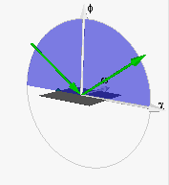
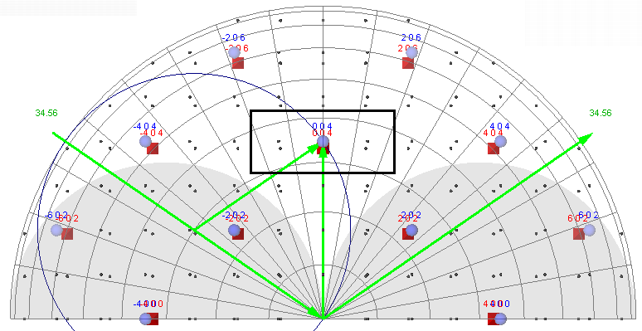
Epitaxy
004 reflection, symmetric geometry
Ge
Si
ω step, 2θ/ω scan
1D detector θ direction
3°
Omega step

Slide 18
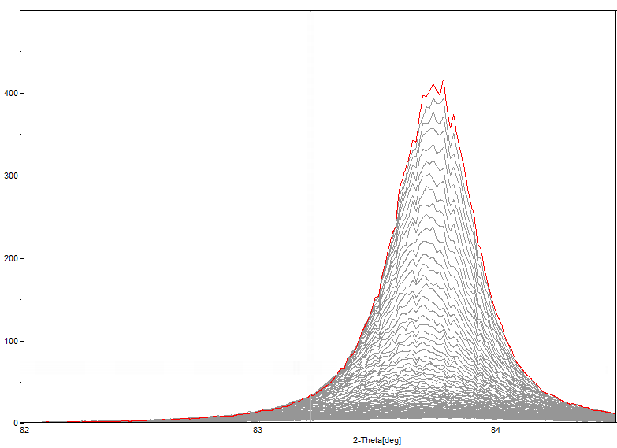
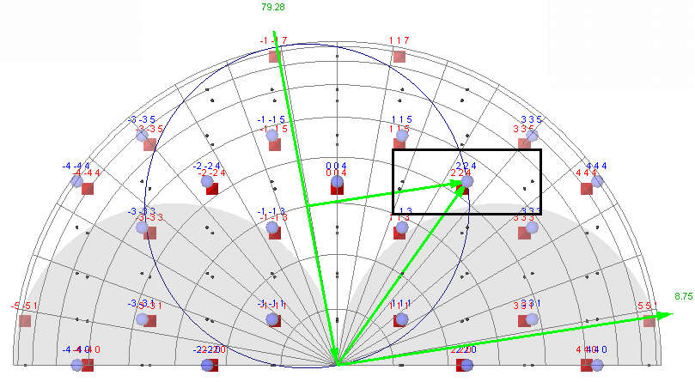
224 reflection, asymmetric geometry

Slide 19
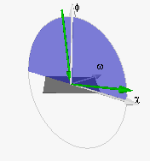
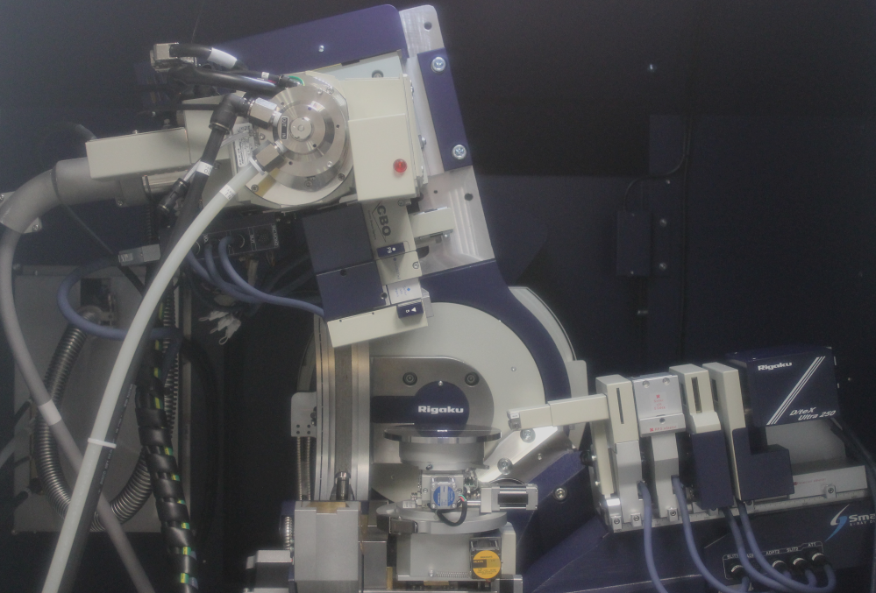
Asymmetric geometry

Slide 20
Target reflections
No: 00-005-0565
Name: Silicon, syn [NR]
Space Group: Fd3m(227)
Cell: 5.4300 5.4300 5.4300
90.000 90.000 90.000
Crystal System: Cubic
2theta d I (hkl)
28.42 3.138 100.0 (1,1,1)
47.31 1.920 60.0 (2,2,0)
56.10 1.638 35.0 (3,1,1)
69.17 1.357 8.0 (4,0,0)
76.37 1.246 13.0 (3,3,1)
88.06 1.108 17.0 (4,2,2)
94.97 1.045 9.0 (5,1,1)
106.73 0.960 5.0 (4,4,0)
114.13 0.918 11.0 (5,3,1)
127.57 0.859 9.0 (6,2,0)
136.93 0.828 5.0 (5,3,3)
No: 00-003-0478
Name: Germanium
Space Group: Fd3m(227)
Cell: 5.6200 5.6200 5.6200
90.000 90.000 90.000
Crystal System: Cubic
2theta d I (hkl)
27.34 3.260 100.0 (1,1,1)
45.55 1.990 66.0 (2,2,0)
53.89 1.700 53.0 (3,1,1)
66.23 1.410 8.0 (4,0,0)
73.33 1.290 16.0 (3,3,1)
84.11 1.150 27.0 (4,2,2)
89.93 1.090 13.0 (5,1,1)
101.32 0.996 7.0 (4,4,0)

Slide 21
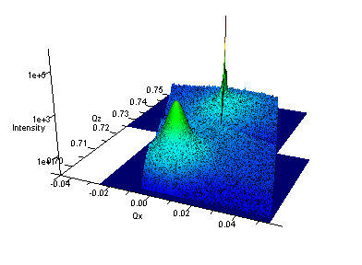
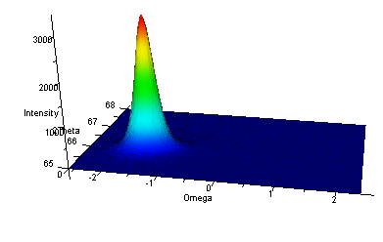
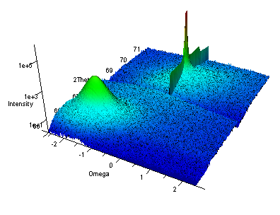
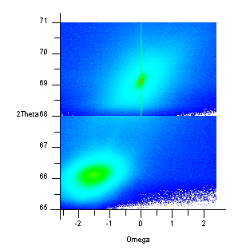
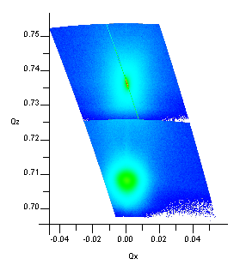
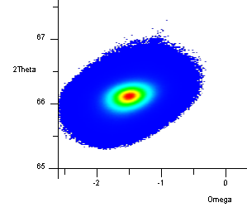
(400)

Slide 22
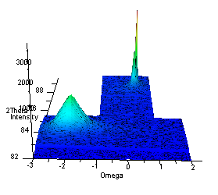
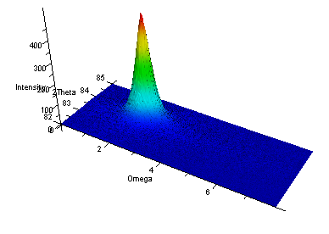
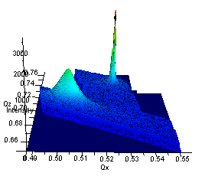
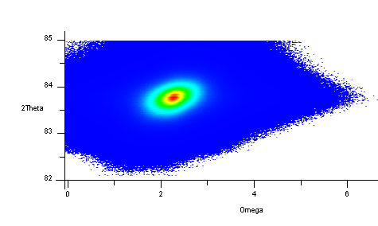
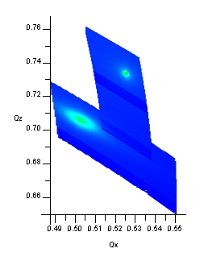
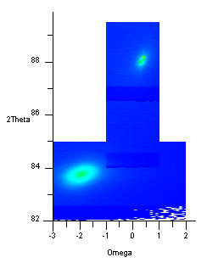
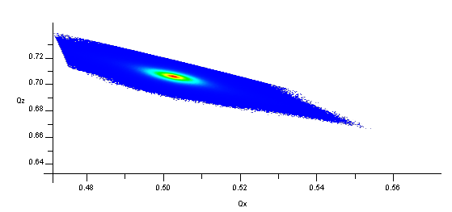
(224)

Slide 23
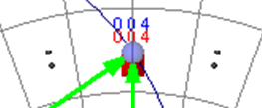
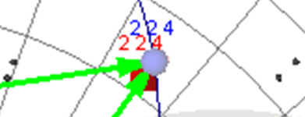
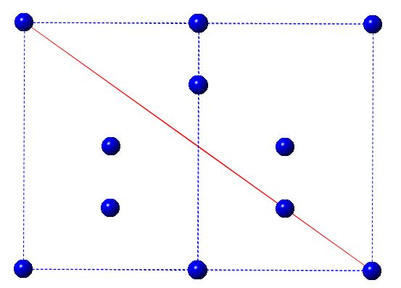

Relaxed
Strained
Misoriented
00l
cubic[112]
00l
cubic[112]
00l
film[001]
tet[112]
hh0
hh0
hh0
(224)
(004)
After: Takayuki Konya, The Rigaku Journal, 25(2), 2009.
 |  | Lit | Exp |  | Lit | Exp
 | a | (400) |  |  | (224)
Si | 5.430 | 1.357 | 1.357 | 0 | 1.108 | 1.107 | 0.001
Ge | 5.620 | 1.410 | 1.405 | 0.005 | 1.150 | 1.154 | -0.004

Slide 24
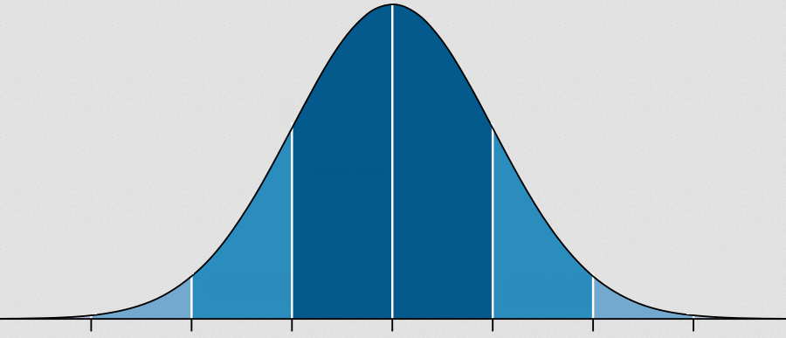
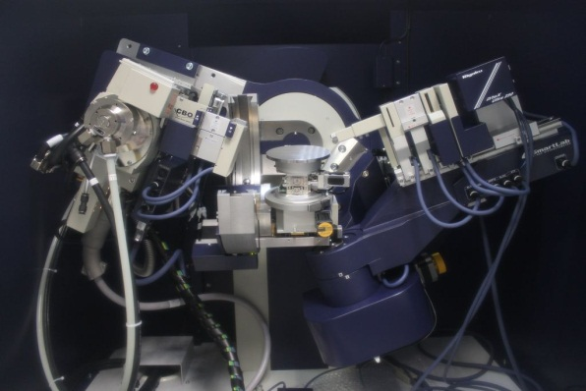
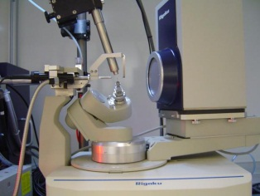

Conclusions
Find out as much about the sample as possible
Need to ask the right diffraction question
Don’t rush setting up the measurement
Single crystal structure solution
Powder phase identification
Everything else!

Slide 25
Acknowledgements
Anna Scott – Southampton, Engineering (Al stress)
Callum Littlejohns – Southampton, ORC (Ge on Si)
Callum Robertson – Southampton, Chemistry (mesoporous silica)
Sophie Benjamin – Southampton, Chemistry (Bi₂Te₃)
Harold Chong – Southampton, ECS (ZnO)
Duncan Smith
Keisuke Saito – Rigaku
Andrew Hector – Southampton, Chemistry
Southern Water

