Slide 1
Material Processing of Polystyrene Boron Nitride Nanocomposites
Raed Ayoob
Supervisor(s): Thomas Andritsch and Alun Vaughan
16 September 2015
Early Career Researchers Colloquium, Institute of Physics
Notes:
Please use the dd month yyyy format for the date for example 11 January 2008. The main title can be one or two lines long.

Slide 2
Presentation Outline
Introduction
Research Motivation
Polymer Nanocomposites
Experimental Results and Discussion
Material Preparation
Differential Scanning Calorimetry (DSC)
Thermogravimetric Analysis (TGA)
AC Breakdown Strength Measurements
Scanning Electron Microscopy (SEM)
Conclusion
Notes:
If using a school logo, make sure that if you have a long page title, it does not encroach on the logo. Allow about 2cm around the logo. Run the page title onto two lines if necessary.

Slide 3
Introduction
Notes:
Use divider pages to break up your presentation into logical sections and to provide a visual break for the viewer. The title can be one or two lines long.

Slide 4
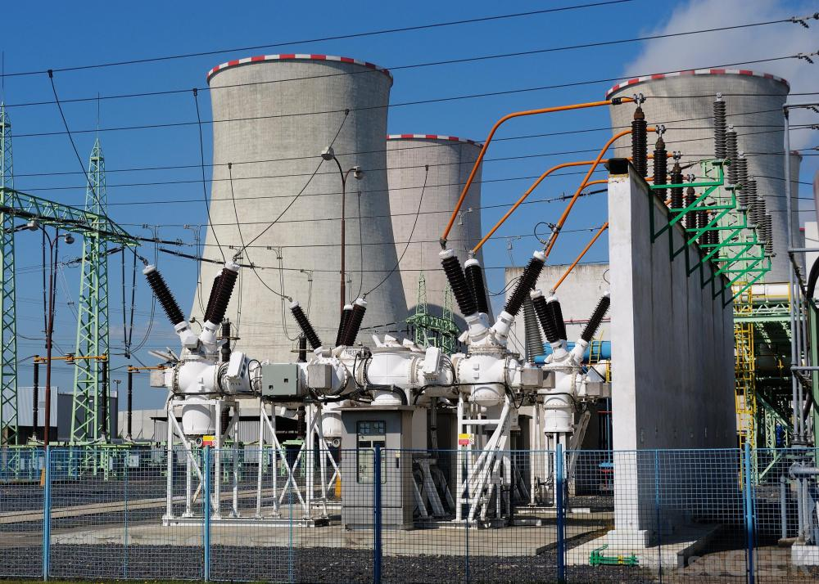
Research Motivation
Rising power requirements
Material costs
Energy efficiency requirements
Need for improved dielectric properties
Mechanical
Electrical
Thermal
Polymer nanocomposites offer promising results
Notes:
If using a school logo, make sure that if you have a long page title, it does not encroach on the logo. Allow about 2cm around the logo. Run the page title onto two lines if necessary.

Slide 5
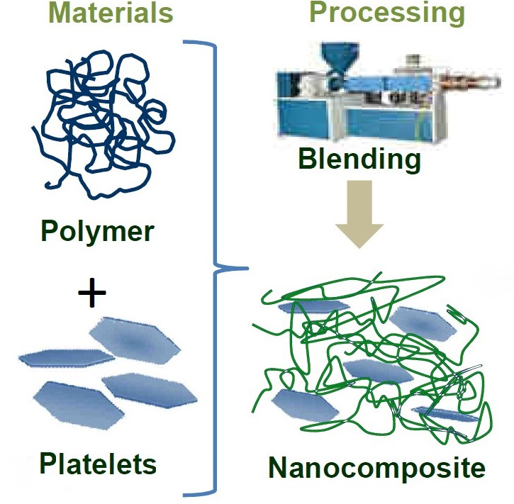
Polymer Nanocomposites
A polymer with nano sized filler is a polymer nanocomposite or nanodielectric.
Fillers can have different sizes and geometry.
Polymer/nanofiller interface responsible for property changes.
Notes:
If using a school logo, make sure that if you have a long page title, it does not encroach on the logo. Allow about 2cm around the logo. Run the page title onto two lines if necessary.

Slide 6
Polymer Nanocomposites
Should we use polymer nanocomposites?
Do they improve dielectric properties?
Dielectric breakdown strength
Dielectric losses (tan delta)
Space charge
Consistent results regarding mechanical properties.
Inconsistent results regarding electrical properties.
Why?
Notes:
If using a school logo, make sure that if you have a long page title, it does not encroach on the logo. Allow about 2cm around the logo. Run the page title onto two lines if necessary.

Slide 7
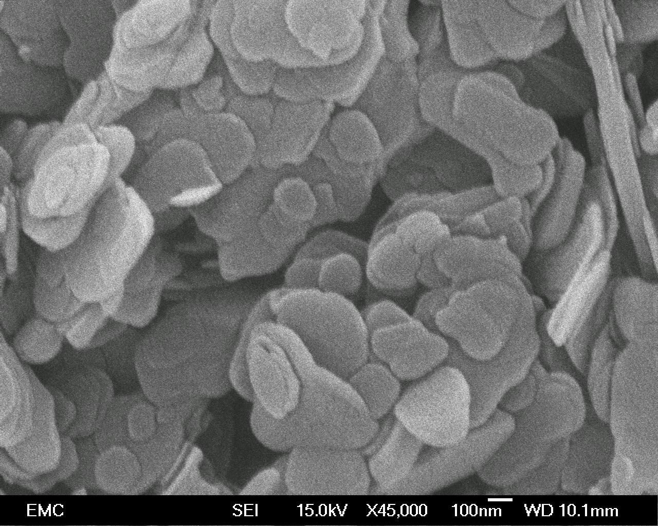
Polymer Nanocomposites
Many problems with material processing.
Nanoparticle agglomeration
Water content of the material
This study mainly focuses on how different solvents affect the nanoparticle agglomeration.
Notes:
If using a school logo, make sure that if you have a long page title, it does not encroach on the logo. Allow about 2cm around the logo. Run the page title onto two lines if necessary.

Slide 8
Experiments
Notes:
Use divider pages to break up your presentation into logical sections and to provide a visual break for the viewer. The title can be one or two lines long.

Slide 9
Materials
Host polymer – atactic polystyrene (a-PS)
Amorphous structure
Ideal for this study
Nanofiller – hexagonal boron nitride (h-BN)
High breakdown strength
High thermal conductivity
Similar study was done in the past with polyethylene as the host polymer.

Slide 10
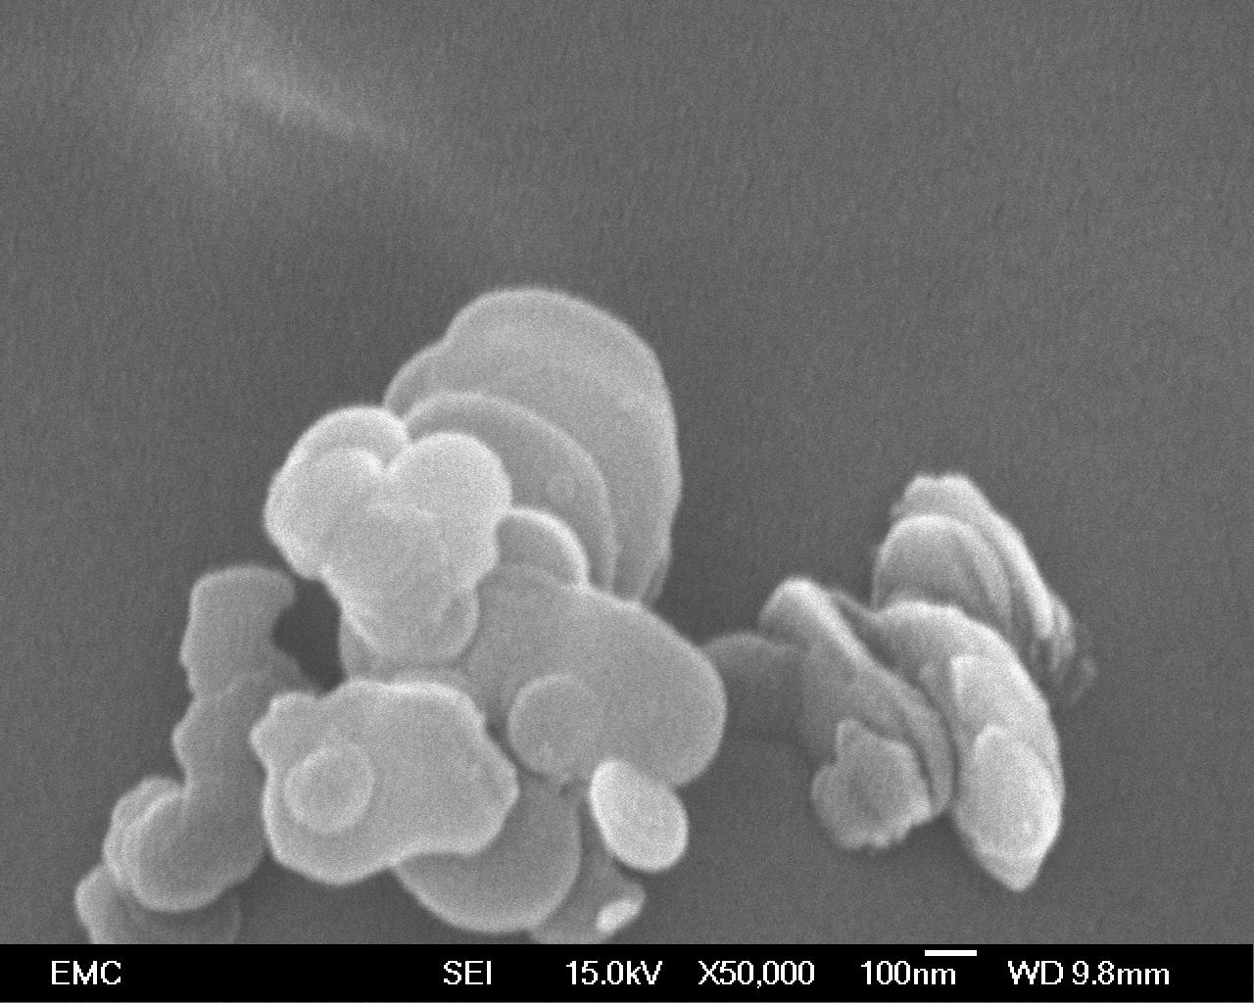
Materials
We are interested in the dispersing the h-BN.
Layered structure
Stacked platelets
Exfoliation?
We are trying to separate these platelets to achieve a better dispersion.

Slide 11
Material
Three Solvents were used in this study to see their effect on the degree of “exfoliation”:
Dichloromethane (DCM)
Toluene (TOL)
Chlorobenzene (CB)
Isopropyl alcohol (IPA) was used to precipitate the polymer/nanofiller mixture.

Slide 12
Material Preparation
Two methods:
1) Below glass transition of polystyrene
When DCM was used (boiling point ~40 °C)
2) Above glass transition of polystyrene
When TOL was used (boiling point ~111 °C)
When CB was used (boiling point ~131 °C)
Glass transition temperature of polystyrene is ~100 °C.

Slide 13
Material Preparation
The h-BN was sonicated in the solvent for 30 minutes.
The a-PS was stirred in the solvent at room temperature (DCM) or heated to the boiling point of solvent (TOL and CB).
After the a-PS had dissolved, the sonicated h-BN solution was added to it quickly and then poured in a separate beaker containing IPA for precipitation.
Nanocomposite materials were dried and melt pressed.

Slide 14
Differential Scanning Calorimetry
DSC was used to measure glass transition temperature (T_{g}).
A sample mass of ~20 mg was used.

Slide 15
Differential Scanning Calorimetry
The materials in the table are denoted in the following format:
Polymer/nanofiller/filler content/solvent
e.g. PS/hBN/5/DCM refers to a a-PS/h-BN nanocomposite with 5 wt% of nanofiller processed in DCM
Material | T_{g} (°C)
PS/hBN/0/DCM | 101.7
PS/hBN/5/DCM | 101.2
PS/hBN/0/TOL | 92.7
PS/hBN/5/TOL | 91.6
PS/hBN/0/CB | 92.3
PS/hBN/5/CB | 91.5

Slide 16
Differential Scanning Calorimetry
The increase in T_{g} could be due to the strong interaction between the polymer and the nanofiller which reduces the mobility of the polymer chains at the interface.
However, this is not the case since the unfilled polymer in solution has a very similar to the nanocomposite processed in the same solvent.
This lack of change in T_{g} could be due to poor interaction between the polymer and the nanofiller.

Slide 17
Thermogravimetric Analysis
TGA was used to determine filler content
Material | Filler Content (wt%)
PS/hBN/5/DCM | 5.67
PS/hBN/5/TOL | 3.55
PS/hBN/5/CB | 5.36

Slide 18
AC Breakdown Strength
Samples for breakdown strength were 70 µm thick.
Samples were placed between two ball bearing electrodes with a radius (~6.3 mm) much greater than the thickness of the sample.
A 50 Hz alternating voltage was applied increasing at a rate of 50 V s⁻¹ until breakdown occurred.
20 breakdown measurements per material were performed and a two-parameter Weibull distribution was used to analyze the data.

Slide 19
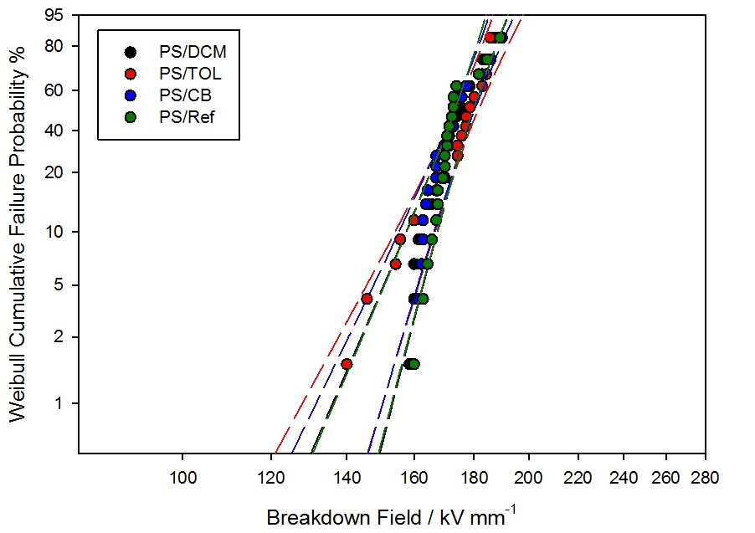
AC Breakdown Strength
Fig. 1 shows the breakdown strength of the unfilled polystyrene (unprocessed and solution processed).
Invariant data suggests (not proves) that there is no residual solvent.
Fig. 1. Weibull Plot of AC breakdown measurements of unprocessed polystyrene and solution processed polystyrene prepared using different solvents.

Slide 20
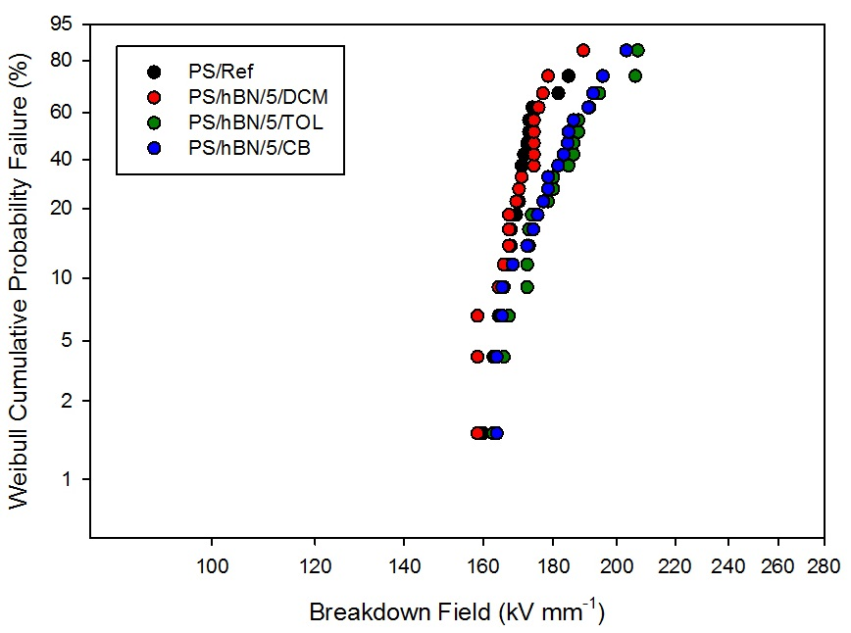
AC Breakdown Strength
Fig. 2 shows the breakdown strength of the nanocomposites relative to the reference polystyrene
Nanocomposite processed in DCM very similar to unfilled polystyrene
Nanocomposites processed in TOL and CB exhibit slightly higher breakdown strength.
Fig. 2. Weibull Plot of AC breakdown measurements of unprocessed polystyrene and PS/hBN composites prepared using different solvents.

Slide 21
AC Breakdown Strength
Table showing the Weibull parameters for all the materials.
Material | Scale parameter α / kVmm⁻¹ | Shape parameter β
PS/Ref | 195 ± 3 | 24 ± 6
PS/hBN/0/DCM | 195 ± 3 | 24 ± 7
PS/hBN/5/DCM | 194 ± 3 | 25 ± 7
PS/hBN/0/TOL | 196 ± 4 | 20 ± 6
PS/hBN/5/TOL | 207 ± 5 | 16 ± 5
PS/hBN/0/CB | 194 ± 4 | 21 ± 6
PS/hBN/5/CB | 204 ± 4 | 19 ± 5

Slide 22
Scanning Electron Microscopy
Scanning electron microscopy (SEM) was used to observe the nanoparticle dispersion in an effort to explain the breakdown results.
Samples for SEM were prepared using a permanganic etching technique to expose the surface and examine the nanoparticle dispersion.

Slide 23
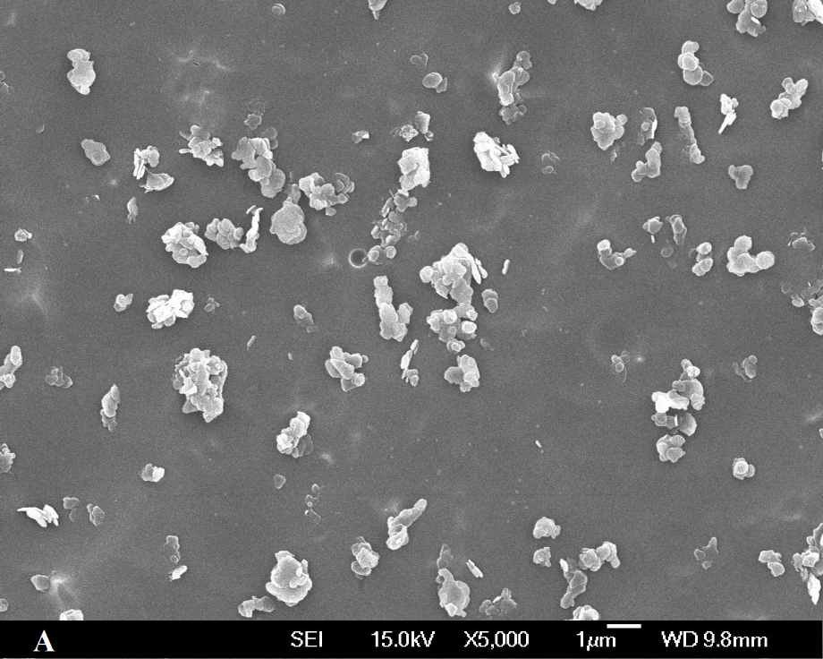
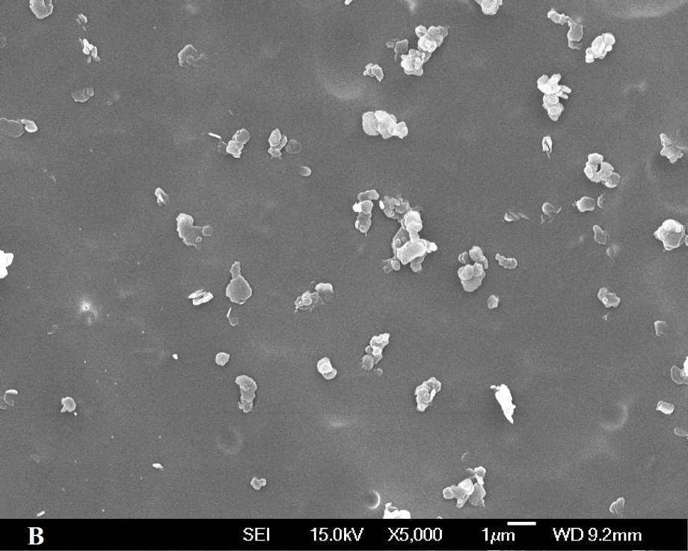
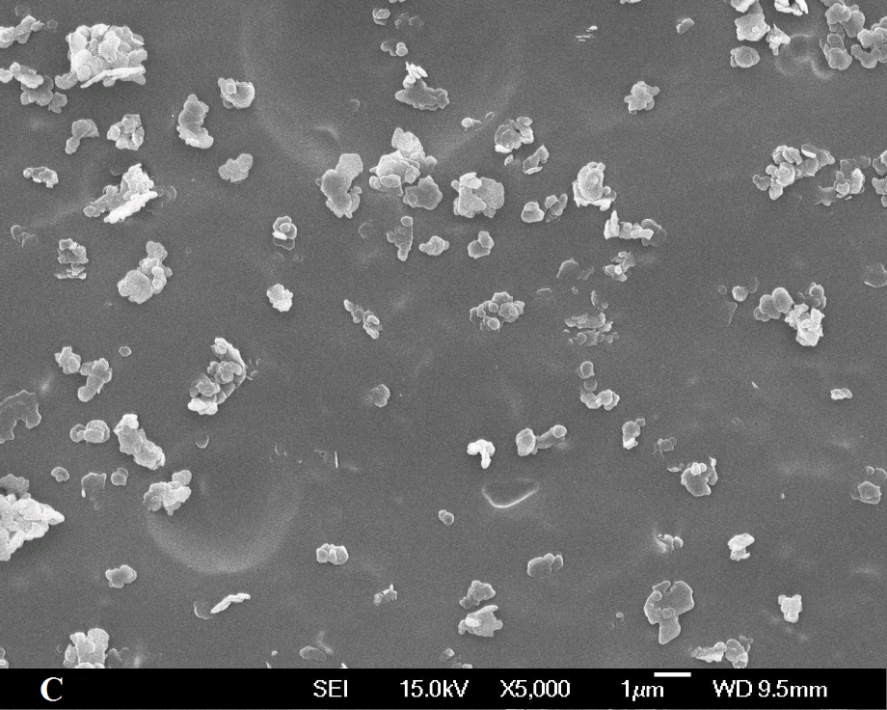
Scanning Electron Microscopy
High magnification SEM micrographs of the nanocomposites
DCM
TOL
CB

Slide 24
Discussion
Breakdown results are supported by SEM results.
Dispersion in TOL sample is the best which also had the highest breakdown strength.
The presence of agglomerates in the DCM sample does not affect the breakdown strength.
The reason for the slight improvement in the TOL and CB samples could be due to the large temperature difference between heating of polymer and precipitation.

Slide 25
Conclusion
Notes:
Use divider pages to break up your presentation into logical sections and to provide a visual break for the viewer. The title can be one or two lines long.

Slide 26
Conclusion
Thermal analysis show the T_{g} of the TOL and CB systems are similar and lower than the DCM system.
No significant change in T_{g} between nanocomposites and equivalently processed unfilled polystyrene due to weak interactions.
Electrical breakdown measurements show that the TOL and CB systems have a slightly higher breakdown strength than the unfilled polystyrene and the DCM system, which are very similar.
SEM examination shows that the h-BN is present largely as agglomerates in the DCM system, mostly as tactoids in the TOL system, and a combination of both in the CB system.

Slide 27
Conclusion
From these results, we can conclude that toluene is the best solvent to use.
However, the effects we observed might not be due to just the solvent.
Since the results for the TOL and CB system are similar, we might conclude that the rate at which the gel forms during precipitation during the material processing stage might be the key to improving the dispersion in this system.

Slide 28
Notes:
You can use a full-bleed image to create impact on a page. Caption the image as shown.

