Slide 1
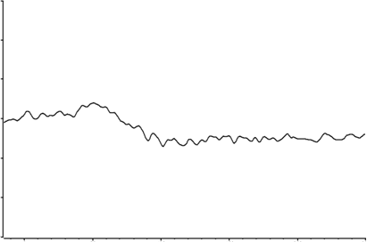
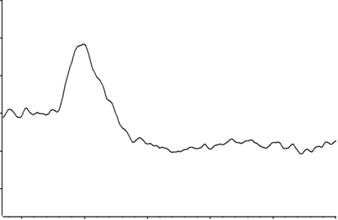
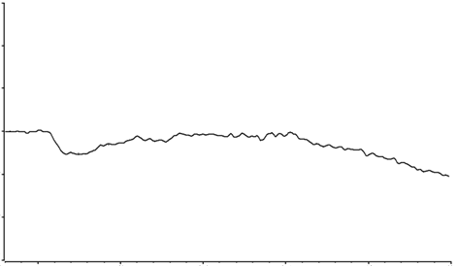
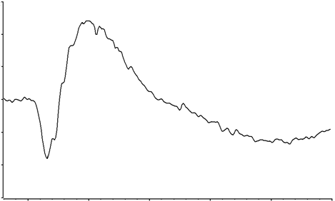
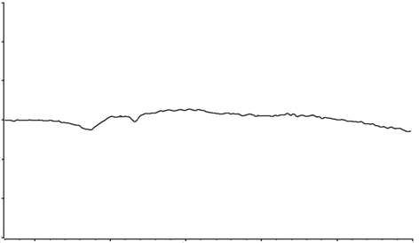
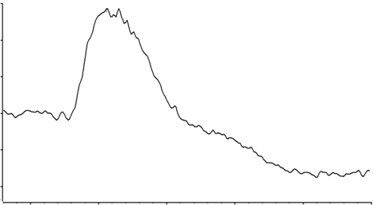
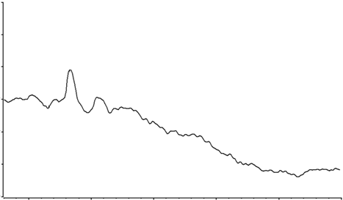
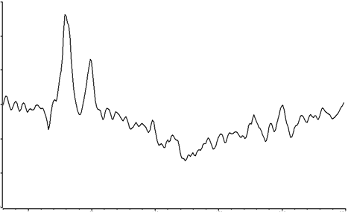
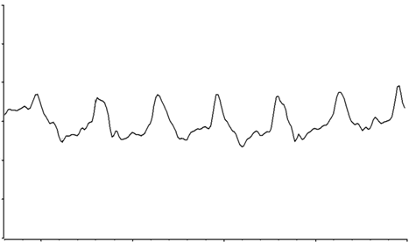
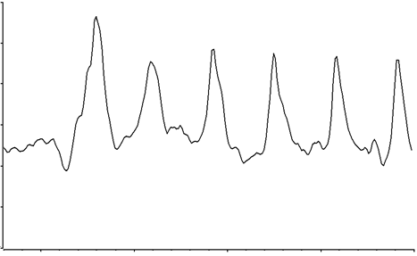
Patient
Control
PERG
10 µV
10 µV
5 µV
5 µV
0 µV
0 µV
-5 µV
-5 µV
-10 µV
-10 µV
0 mS
100 mS
200 mS
0 mS
100 mS
200 mS
Maximal mixed cone/rod ERG
200 µV
200 µV
100 µV
100 µV
0 µV
0 µV
-100 µV
-100 µV
-200 µV
-200 µV
0 mS
100 mS
200 mS
0 mS
100 mS
200 mS
Scotopic rod ERG
200 µV
200 µV
100 µV
100 µV
0 µV
0 µV
-100 µV
-100 µV
-200 µV
-200 µV
0 mS
100 mS
200 mS
0 mS
100 mS
200 mS
Photopic cone ERG
100 µV
100 µV
50 µV
50 µV
0 µV
0 µV
-50 µV
-50 µV
-100 µV
-100 µV
0 mS
100 mS
200 mS
0 mS
100 mS
200 mS
30 Hz flicker
100 µV
100 µV
50 µV
50 µV
0 µV
0 µV
-50 µV
-50 µV
-100 µV
-100 µV
0 mS
100 mS
200 mS
0 mS
100 mS
200 mS

