Slide 1
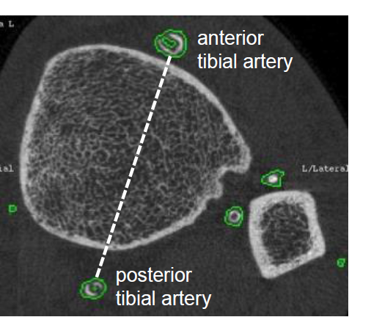
Figure 1: presence of lower leg arterial calcification
The anterior and posterior tibial artery (ATA and PTA respectively)
are the most frequently affected sites. Interosseous branches are
also visible on this figure.

