Slide 1
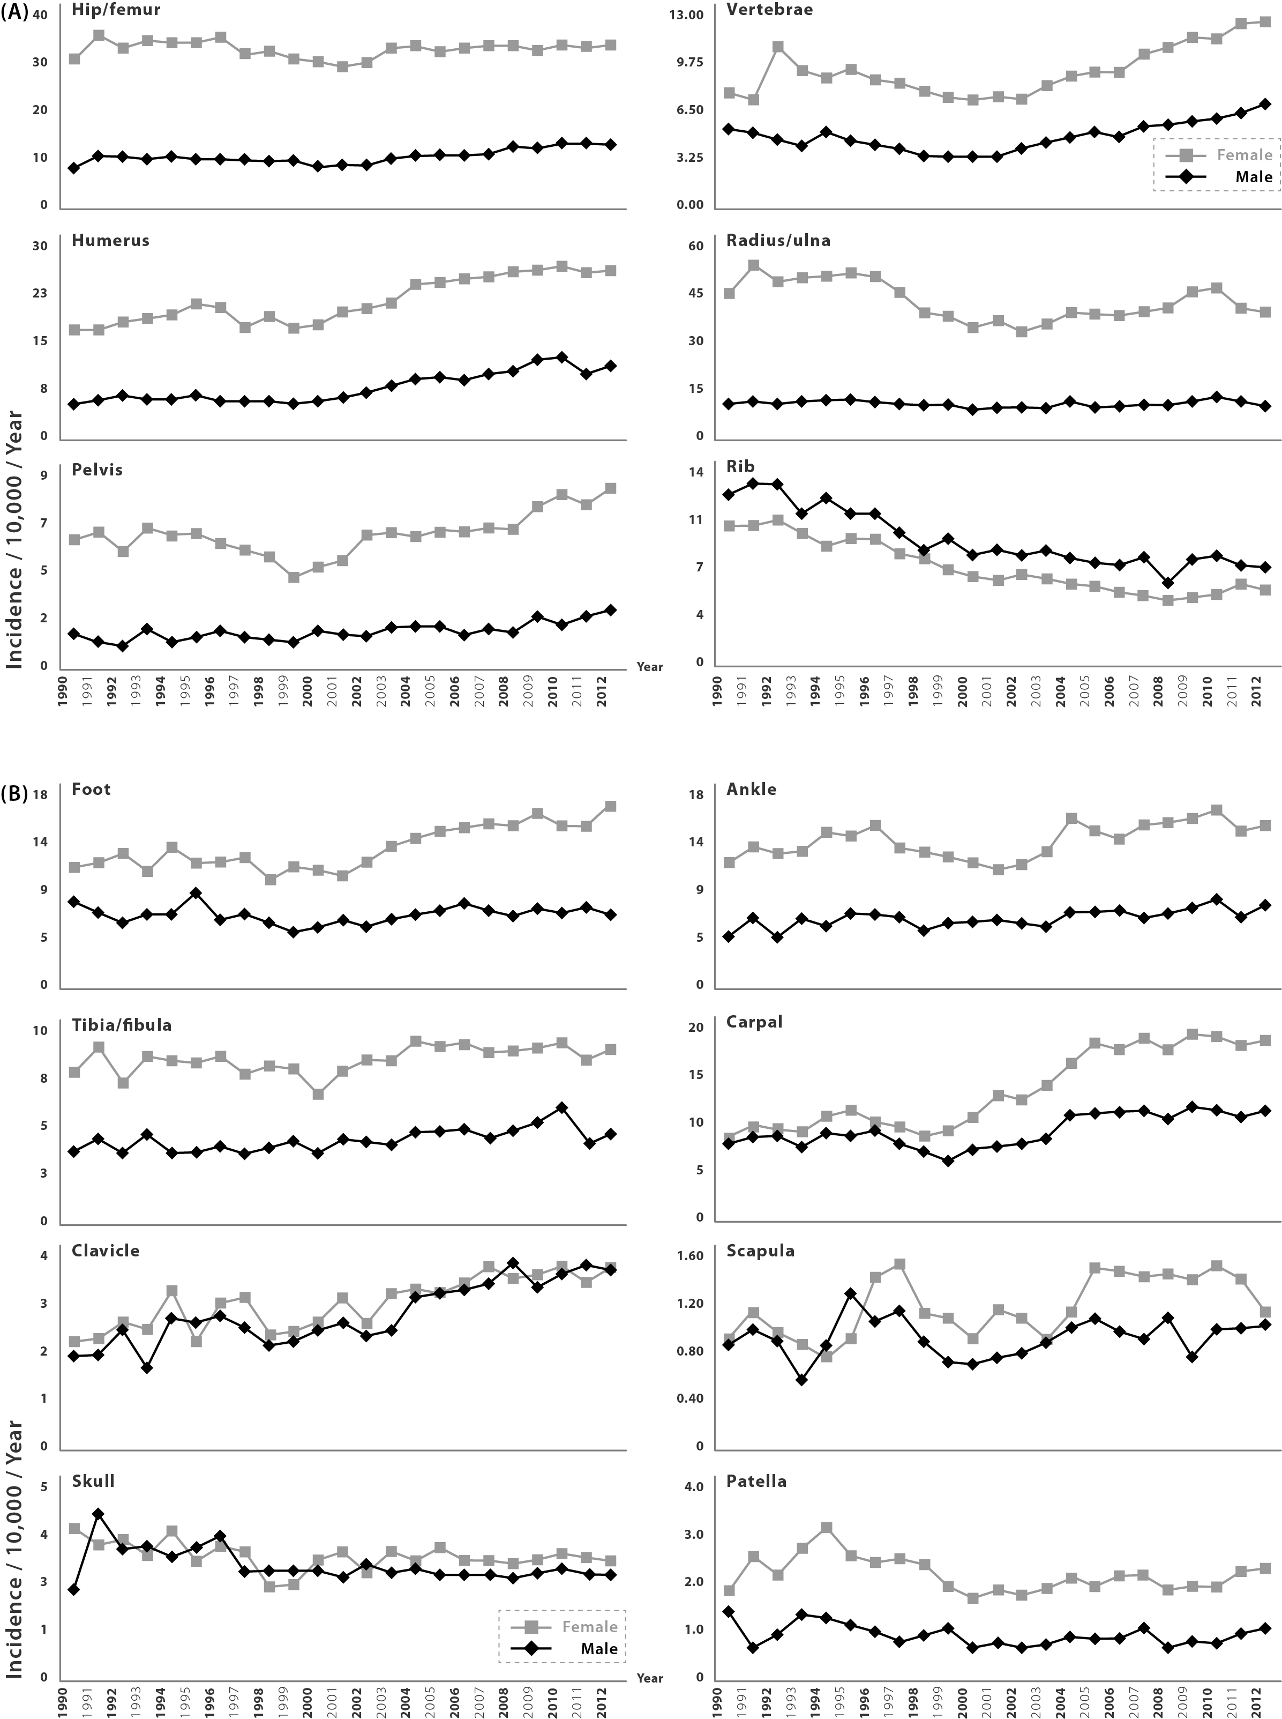
Incidence/ 10,000 py
Incidence/ 10,000 py
Notes:
Figure 1 Yearly incidence rates in the years 1990 to 2012 of (A) osteoporotic fractures and (B) other fracture sites.

Slide 2
Distal forearm
Women
Notes:
Figure 2: Incidence (per 10,000 py) of distal forearm, vertebral and hip fractures in women 1990-2012 in the UK, stratified by 5-year age band.

Slide 3
Men
Notes:
Figure 3: Incidence (per 10,000 py) of distal forearm, vertebral and hip fractures in men 1990-2012 in the UK, stratified by 5-year age band.

