Slide 1

Digital micromirror device-based adaptive optics approach for enhanced micro-machining fidelity
D. J. Heath¹, B. Mills¹, J. A. Grant-Jacob¹, M. Feinaeugle³, V. Goriainov², R. Oreffo², R. W. Eason¹
¹Optoelectronics Research Centre, University of Southampton, UK
²Institute of Developmental Sciences, University of Southampton, UK
³Department of Mechanical Engineering, University of Twente, The Netherlands

Slide 2
Outline
Past work and challenges in DMD projection-based laser manufacturing
DMD mask shifting
Taking advantage of limited bandwidth
Custom substrates, including cell growth assays
Conclusions
Notes:
Will go through some of our past work, along with challenges we’ve faced. Will show how a combination of mask repositioning on the DMD and exploiting limited bandwidth can overcome some of these problems. Will show some of the work we’re doing towards cell growth assays.
Developing laser manufacturing techniques, with UK industrial partners, for high-precision, high-speed, flexible etc fabrication – applications in sensing, bio-medicine, metamaterials, etc etc etc
DMDs offer many advantages for laser machining, which have yet to be established in industry
Not just beam shaping, but other more advanced techniques, which the group at Southampton are pioneering, and I will talk about some of these today.

Slide 3
DMD-based laser manufacturing
Using 800nm wavelength, 150 femtosecond laser pulses
Spatial intensity profile of each laser pulse is modified by the DMD, and then imaged on to the sample

Slide 4
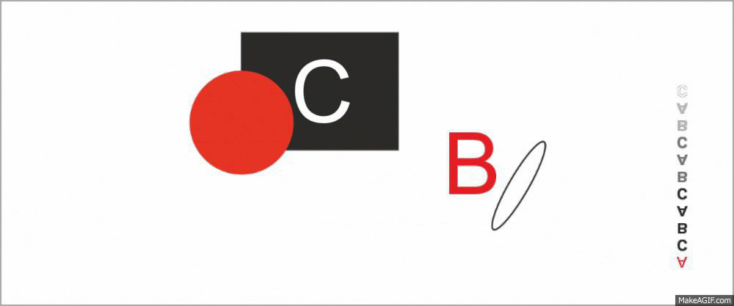

DMD-based laser manufacturing
Using 800nm wavelength, 150 femtosecond laser pulses
Spatial intensity profile of each laser pulse is modified by the DMD, and then imaged on to the sample
array of mirrors,
showing the pattern
(the DMD)
sample is
translated
input
laser pulses →
focussing
objective
spatially-shaped
laser pulses →
sample movement direction →
Notes:
[Will go through first few slides quite quickly to set the scene]. We use femtosecond pulsed laser to illuminate a DMD, which we use as a dynamic intensity mask. We focus the shaped pulses down to a sample, which is translated between exposures, with DMD updating, pulse triggering and sample translation under automated control.

Slide 5
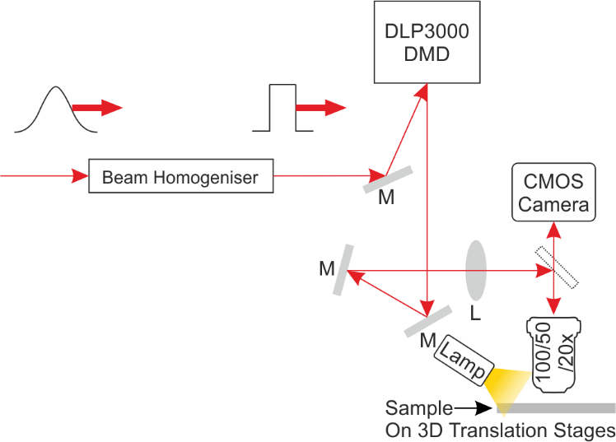
Experimental schematic
Homogenise input pulse
Energy density on DMD is ~1mJ/cm²
Energy density on sample is ~0.01‑10J/cm²
Well below damage threshold of DMD due to magnification
Notes:
Here’s a quick view of our experimental setup. First step of the setup is a beam homogeniser, so that we get even illumination across the DMD. Typically the energy density at the DMD is <~1mJ/cm2. We then redirect through focussing objectives onto a sample, which is mounted on 3D translation stages, while viewing through a dichroic via a CMOS camera.

Slide 6
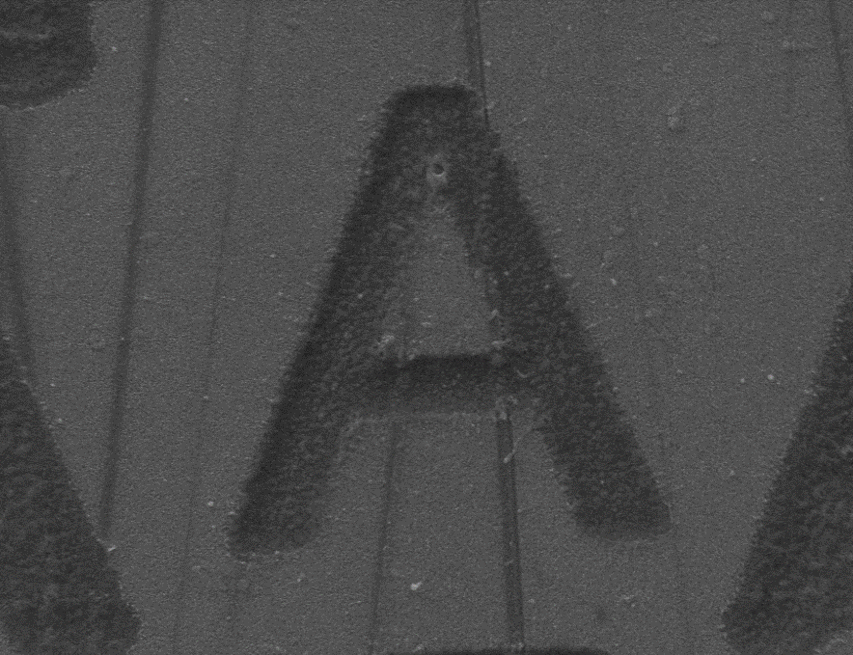
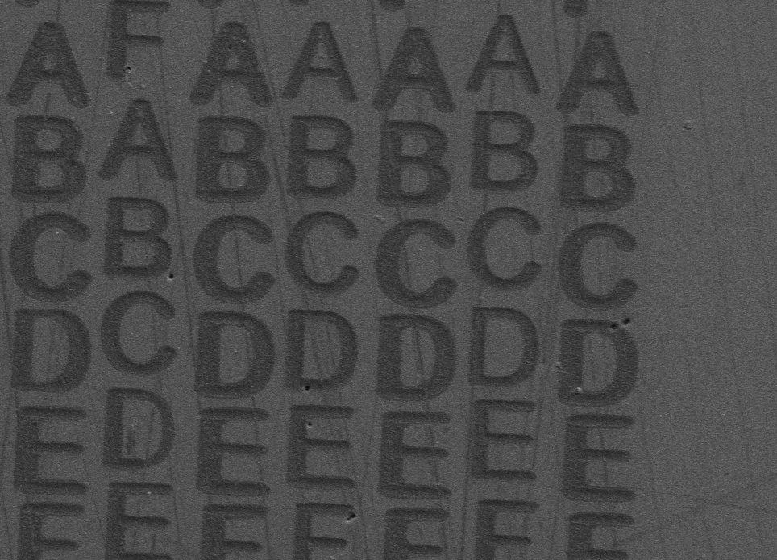
DMD-based laser manufacturing
Almost any material
Routinely produce ~1cm² samples
~2µm resolution each exposure
10µm
50µm
Notes:
The high intensities possible on the system mean that we can machine almost any material, including diamond. Each exposure yields few micron resolution features, where each of these letters was generated in a single exposure, and we can build up large 2D arrays (1cm2 typical).

Slide 7
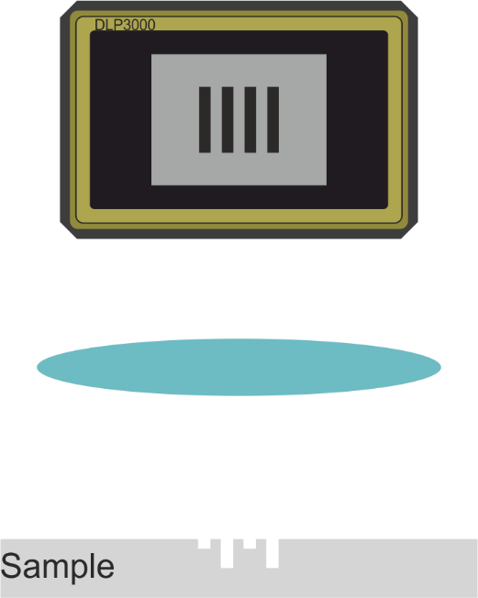
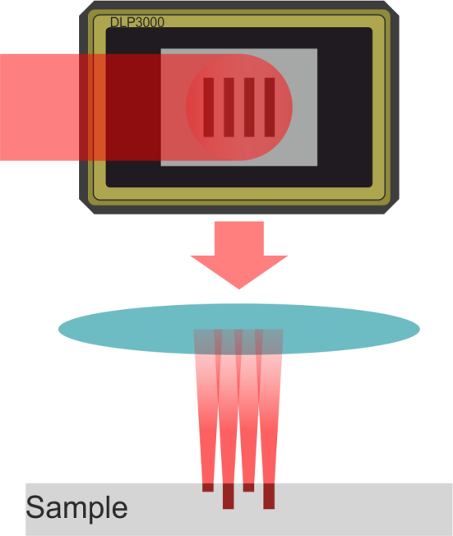
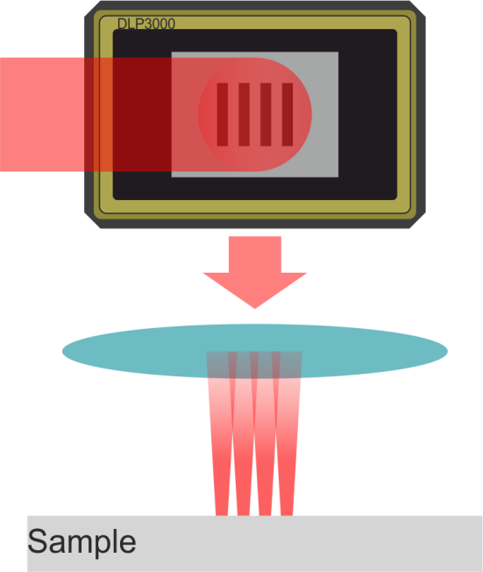
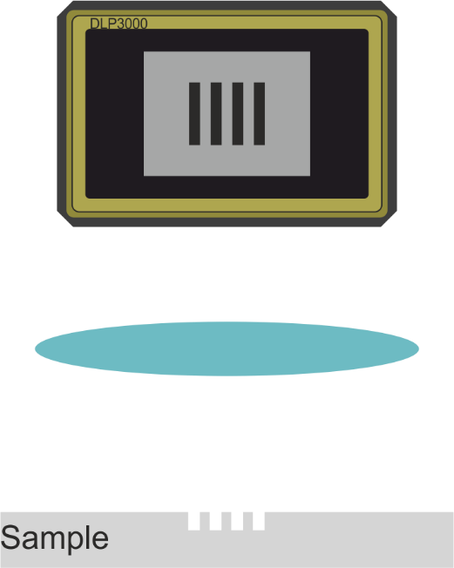

Laser-manufacturing challenges -Hardware
Positional accuracy
Binary intensity
✔
✘
50µm
Notes:
However, there were a few limitations to our method. [Show positional accuracy picture] You may have noticed that the letters in adjacent lines here didn’t quite line up, and that’s a consequence of limited move-and-return accuracy in our translation stages. One could potentially buy more accurate stages, but these ones were already cost several thousand pounds; to get sub-micron accuracy over several millimetre movements without some iterative shunting, you’re looking at tens of thousands. You can also see that each feature seems to be machined to the same depth – this is a drawback of binary image-projection type ablation. [show left hand side series of binary intensity images] In an ordinary projector, you can achieve grayscale images by dithering some mirrors on and off, and it averages to the human eye as a varying intensity, but when your exposure time is 150fs, much shorter than mirror switch freq, you can’t do that. If you expose your DMD mask with uniform intensity, what you’ll get at the sample is uniform depth features. What you can’t do is expose a regular mask with uniform intensity [show right hand side] and expect different depths of feature.

Slide 8
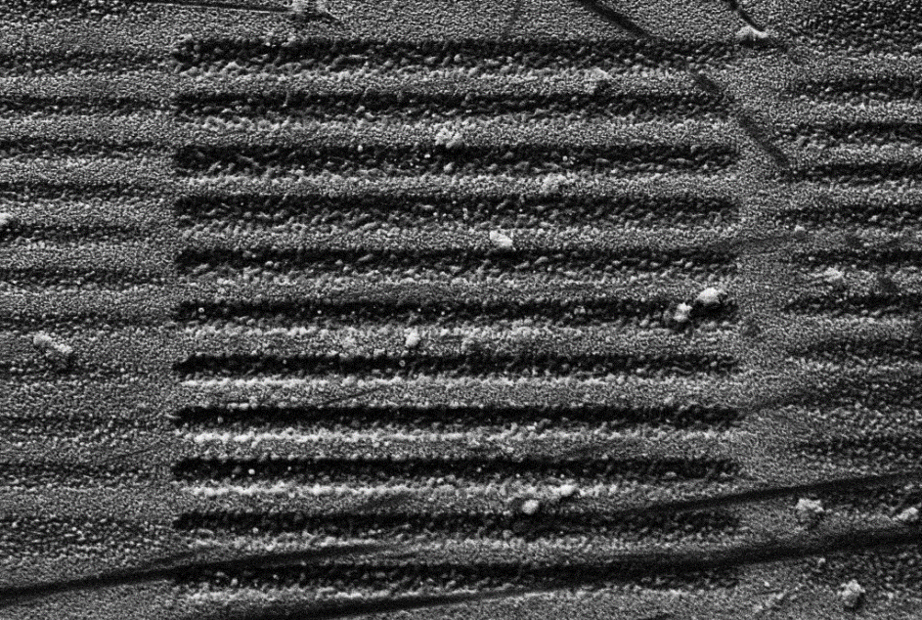
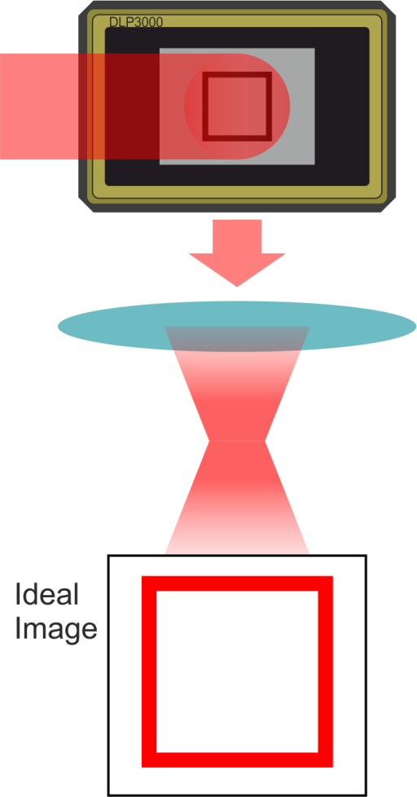
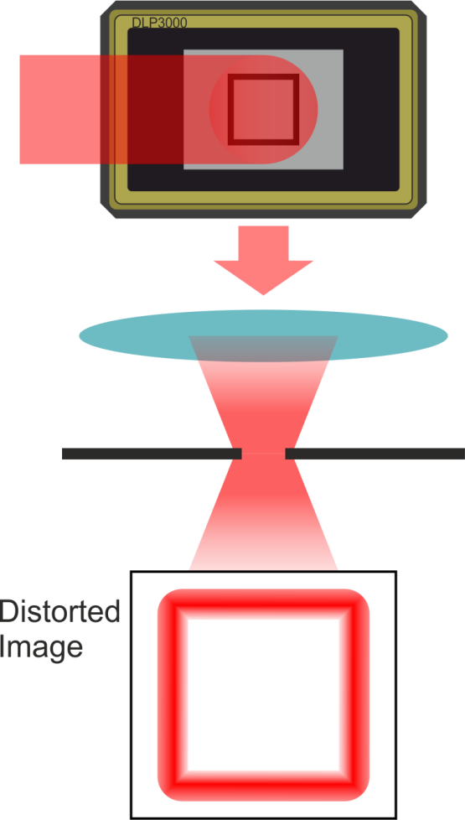
Laser manufacturing challenges
-Optical
Resolution
Diffractive/clipping losses
10µm
Notes:
Then there are some problems faced more broadly across optics. Depending on the wavelength you use and the optical elements, there’s going to be some limit to the resolution you resolve, and you’re not going to beat that [show resolution image]. Additionally, even if your mask doesn’t look like it has high resolution, it actually requires high frequency spatial components to produce a crisp square. On the left here [show left ideal image] is what you get if you capture all spatial frequencies, and the beam line doesn’t get clipped anywhere. On the right here [show right image] is what you might expect with more realistic lenses, which can’t capture all spatial frequencies, and might get clipped at the entrance to an objective, for example – rounded corners to our sharp shape, and a blurring of the intensity around the edges.

Slide 9
Laser manufacturing challenges
-Solutions
Higher positional
accuracy
Crisp image
reproduction
Install better
Translation stages
Install higher
NA optics
Adaptive DMD
Mask
Switch to shorter
wavelength
Liquid crystal
SLM
Higher resolution
patterning
Greyscale intensity

Slide 10
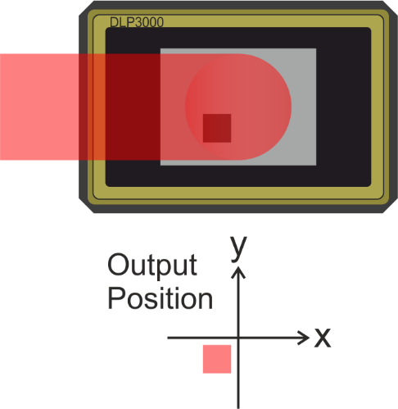
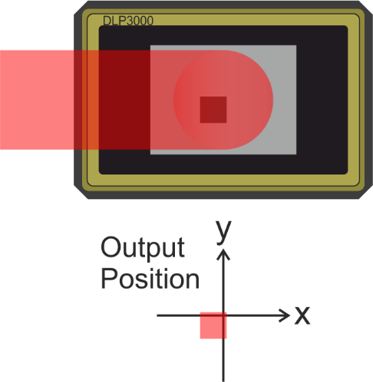
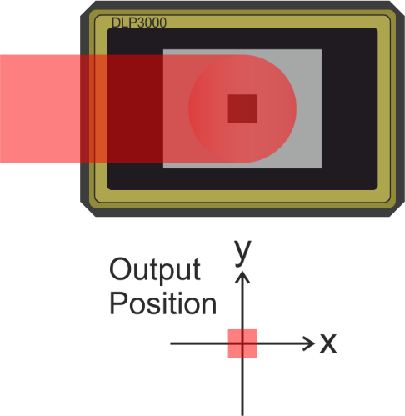
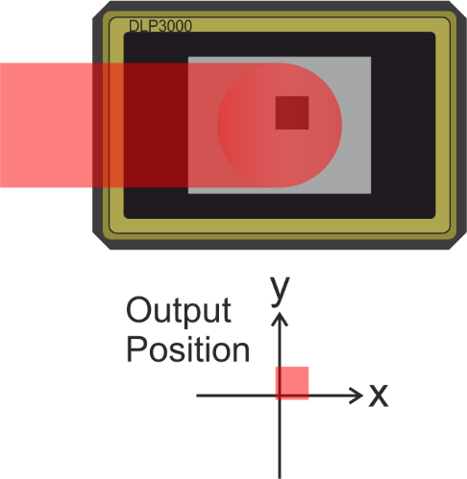
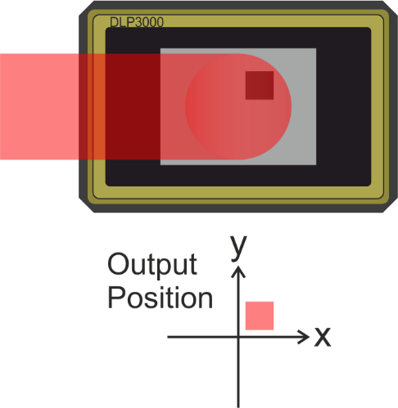
Positional correction
We can move the mask on the DMD
Top-hat incident illumination
Translational symmetry of mask
Translation at sample depends on optics
1 DMD pixel (10µm)→ 100nm (at sample)
Notes:
So what can a DMD do to help with these issues? I’ll start with positional accuracy – [show ‘we can move the mask on the DMD] as long as your mask doesn’t take up the entire DMD surface, you’re actually free to move it around [show gif]. As long as you have uniform intensity on the DMD, like we do, you then have translational symmetry of the projected pattern – same shape, same relative intensity distribution, shifted purely by updating the DMD mirrors. The size of this translation at your sample depends on your optics, but for our system with a 100x objective lens, a shift of 1 pixel meant a translation of around 100nm.

Slide 11
Positional correction
DMD, 100nm repositioning
Camera, 500nm resolution view
Translation stages, few micron error repositioning
100nm accurate
500nm accurate
Few micron accurate
Weak link!
Notes:
So we have a DMD that can do 100nm repositioning [click], a camera that resolves down to about 500nm [click], and translation stages that have move-and-return errors of a few microns – spot the weak link.

Slide 12
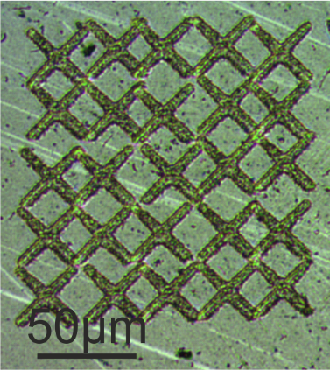
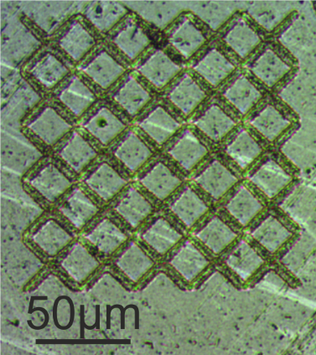
Positional correction
Pair DMD mask realignment with image recognition
Test: Regular 2D array of 5 by 5 X’s
No correction
With correction
Notes:
The solution then is to pair image recognition with shifting the mask on the DMD. As a test, we took an array of 5 by 5 X’s, and wanted to ablate them into a grid. Here’s the result on our stages with no correction [show left image], notice that a lot of the legs don’t meet up, there’s a relative offset between each X of a few microns. Here’s with correction [show right], the ends of each X seem to meet down to optical precision, just as intended. The image-recognition relies on simple phase correlation algorithms, which take a couple of FFTs – even working with non-optimised code, this took around a tenth of a second for each detection.

Slide 13
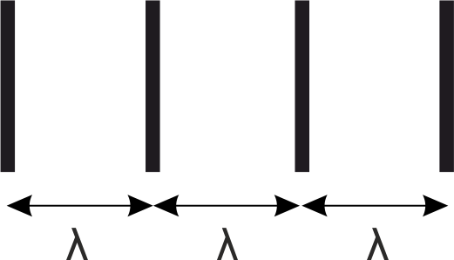
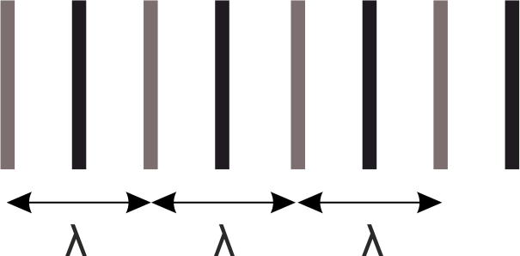
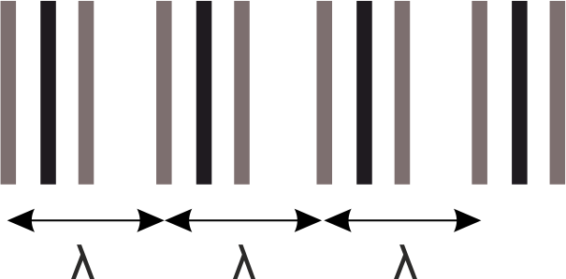
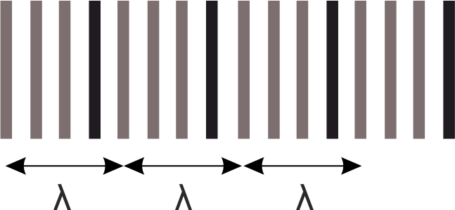
Multiple exposures
Feature size: not limited by wavelength
Spacing between features (resolution): limited by wavelength
We can ‘beat’ the diffraction limit, using multiple laser pulses
Notes:
So what can a DMD do about the diffraction limit? Well, we borrowed an idea from EUV integrated circuit lithography called multiple exposures. It’s important here to draw the distinction between resolution and feature size – you can print almost arbitrarily fine features in a single exposure, as long as their periodicity is above the diffraction limit, which is on the order of the wavelength of light you’re using. If you can print very fine features then, there’s nothing stopping you shifting that same pattern and printing it again between the features from before – each printing obeys the limit of diffraction, but you end up with a final structure below the diffraction limit. [Show gif somewhere here].

Slide 14
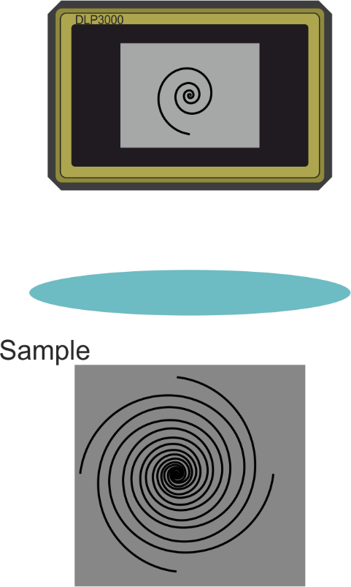
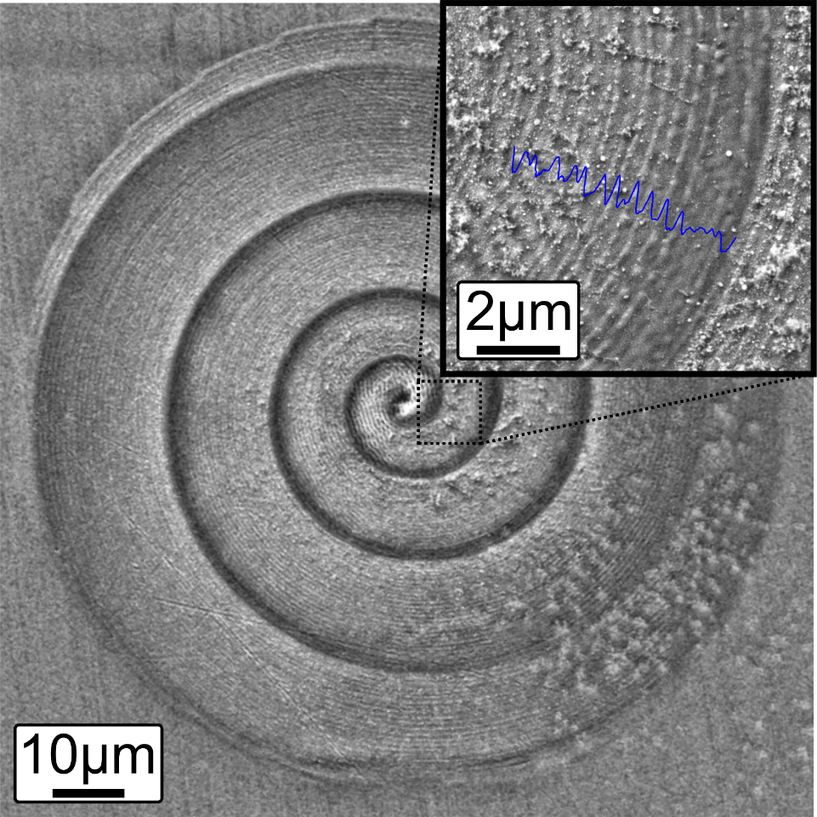
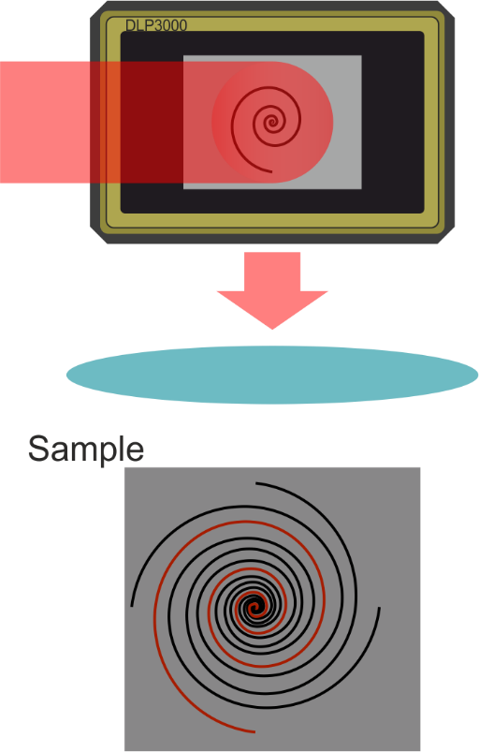
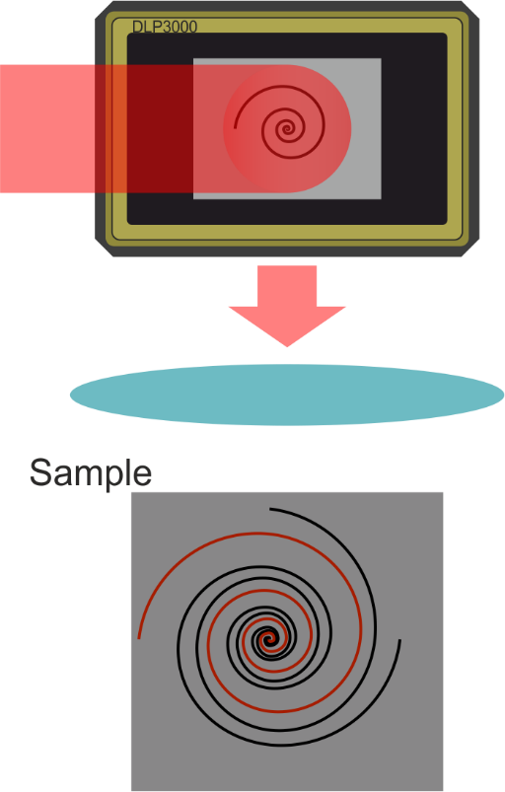
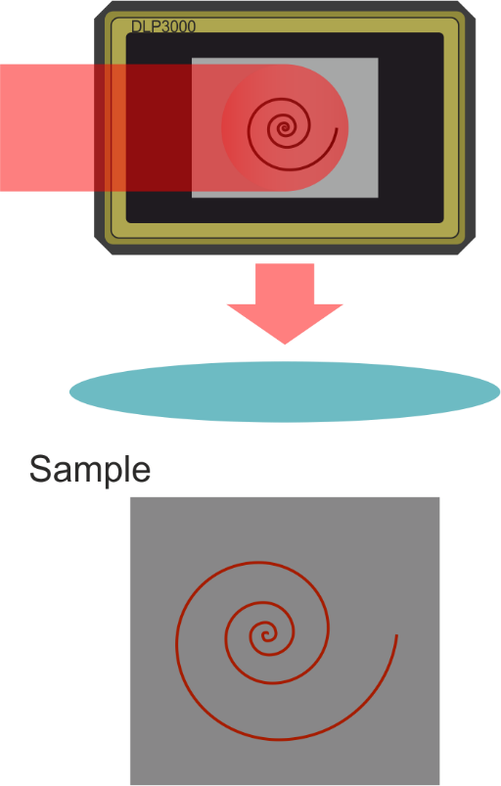
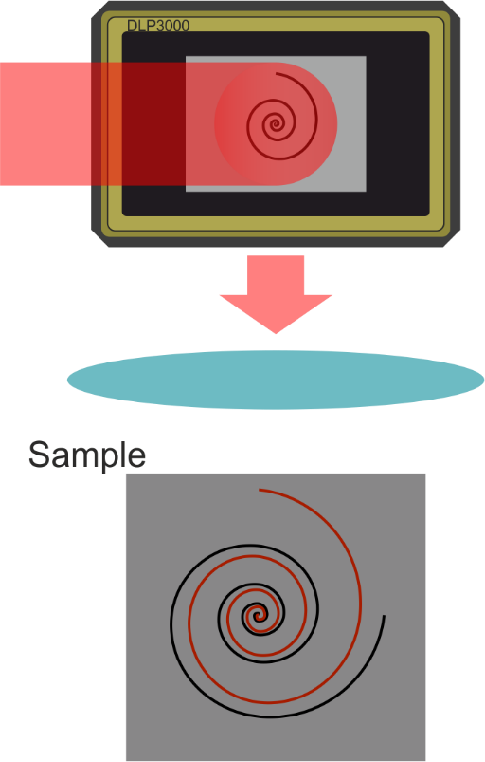
Multiple exposures
Sequentially rotated Archimedean spirals
370nm period on 1µm limited system – 2.5x below limit
Applications in metamaterials and microfluidics
Limit becomes a function of optical and material effects
Notes:
To test the limits of the idea on DMDs, we used rotating Archimedean spirals on the DMD surface, and ablated them into nickel [show series of cartoon images]. The spirals have an increasing resolution towards the centre, so we were able to check a wide range of resolutions at once. What we found was [show SEM and 2.5x below text] that we were able to reduce to 2.5x below the diffraction limit with this technique.

Slide 15
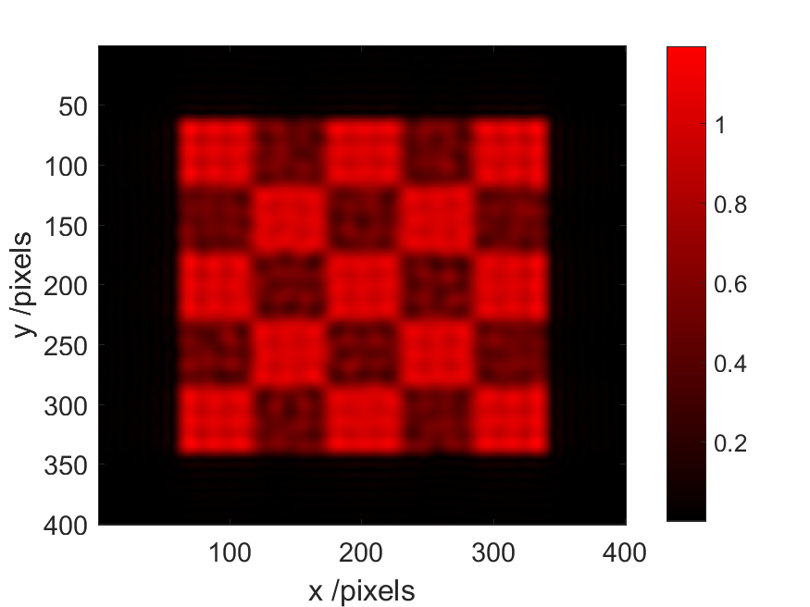
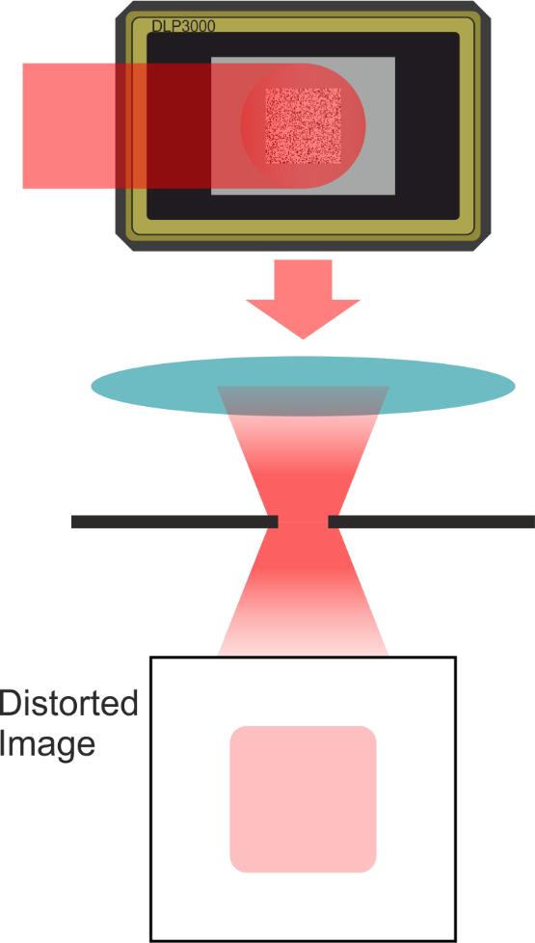

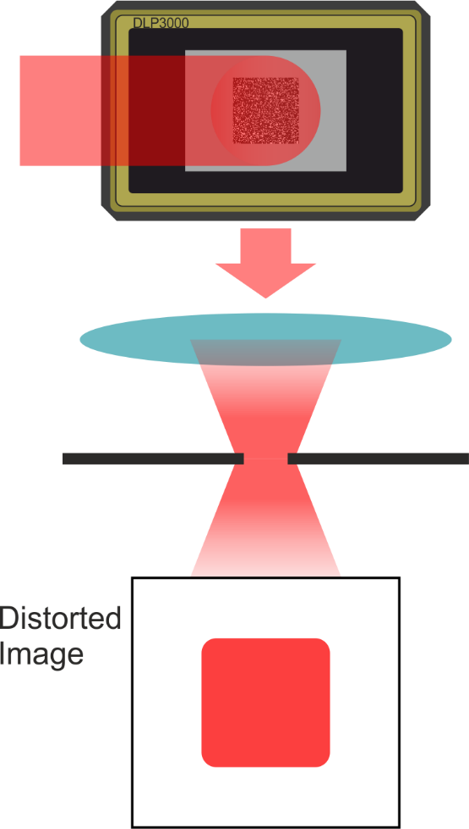
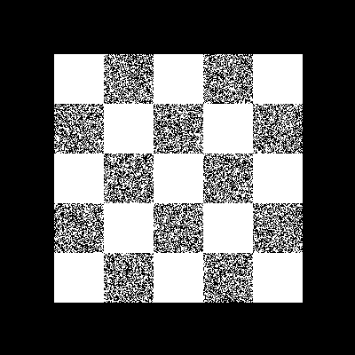
Greyscale intensity control
Point spread function → each point at sample is an average of many DMD pixels
25% on
50% on
75% on
Displayed on DMD
Notes:
So we can position each exposure nicely, and go below the diffraction limit, but with DMDs we’re still limited to a single depth of feature in each shot. However, recalling the optical filtering problem from earlier, and that a single DMD pixel is too small to resolve on our system, you can achieve a sort of greyscale control simply by randomly switching some of the mirrors off. With a single DMD scaling down to 100nm, and the diffraction limit being around a micron, optical filtering means that the output of every block of 100 pixels will be averaged at the sample. So if we turn only 25% of pixels on within a square, we get a faint square [show first image], turn 50% on and you get a more intense square [show second] and so on [show third]. You can then build up multi-level masks with this approach [show checkerboard mask], which project to multi-level patterns [show simulated output].

Slide 16
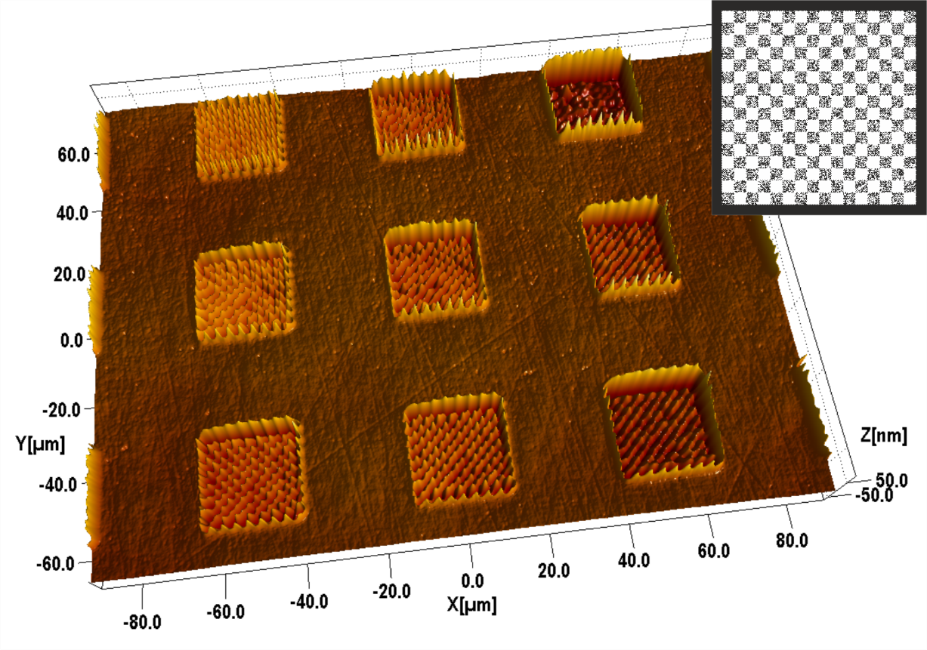
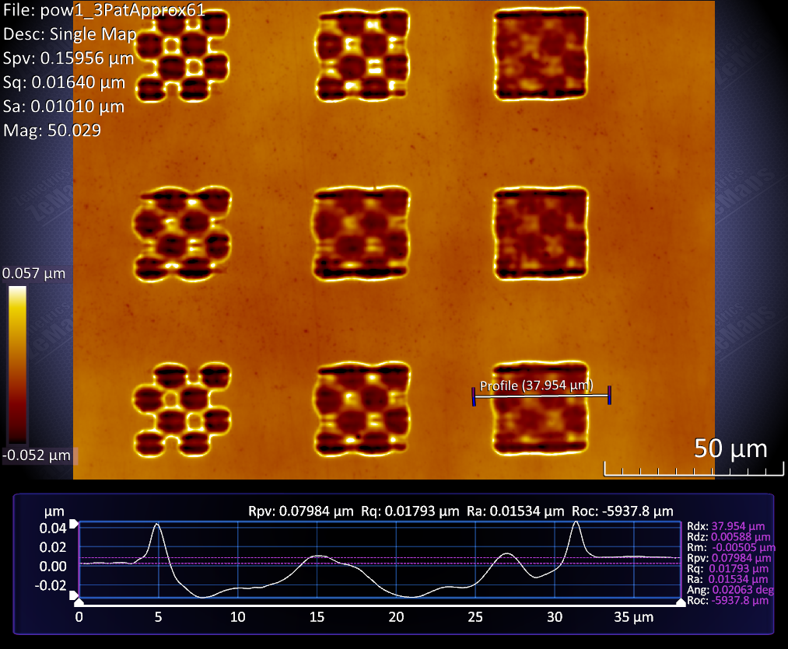
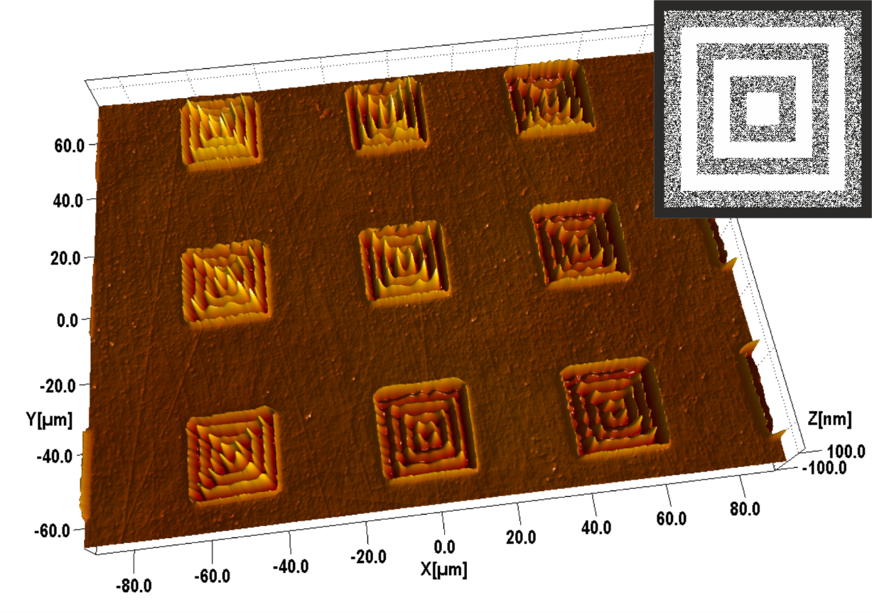
Greyscale intensity control
Single mask on DMD, single pulse
Notes:
[show first image] we’ve demonstrated that this technique really does produce controllable ablation depth, each column of features here was produced with checkerboards of different on/off ratios. And the periodicity of the step changes can approach what we’ve done for single-level masks [show second], down to a few micron resolution. Of course, you don’t have to stick to checkerboards, a variety of patterns can be projected this way.

Slide 17


Optical Proximity Corrections
Limited bandwidth of spatial frequencies → distortions such as ‘rounded corners’ will still occur
‘Dog bone’ additions a common solution
Helps, but what about complex shapes?
Simulate your beam line and material → automate optical proximity correction
Notes:
Now the last issue, what about those rounded corners and blurred edges? [Show first text and image] Is there any change you can make to an intensity mask to correct for that? A common solution is known as adding ‘dog bones’ [show black dog bone squares], adding a bit more to corners, or widening lines at points where you know you’re going to be losing intensity. Not to mention, most masks of this type have continuous amplitude and phase corrections, which aren’t available with DMDs. This method works [click], to an extent, but can get very complicated for more complex shapes, and requires specialised software. [click]But if you can simulate elements of your beamline, you can predict which parts of your mask aren’t going to image well. Pairing this with knowledge of your material, you can predict where you’d like more intensity coming from your mask.

Slide 18


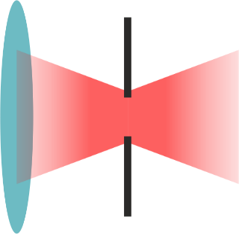
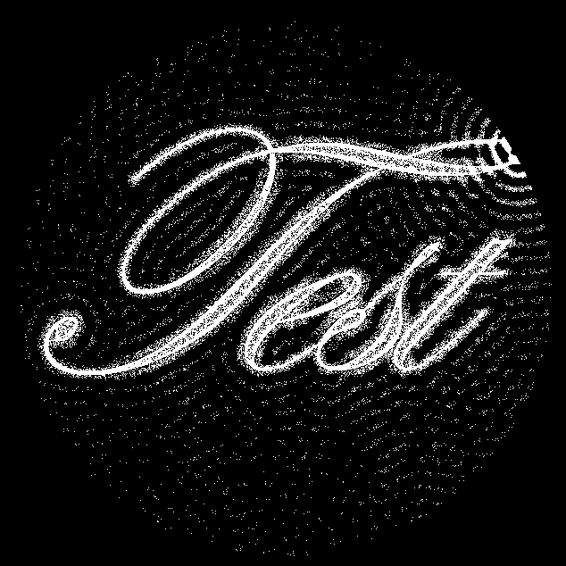
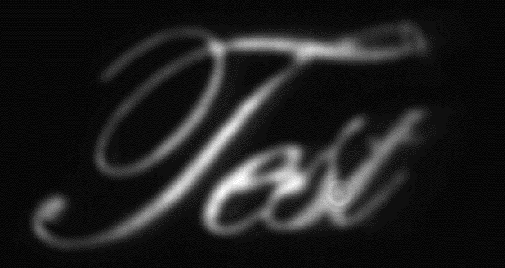
Optical Proximity Corrections
Camera view
DMD mask
Notes:
We took a complex shape – a stylised piece of text saying ‘test’ [show first image], displayed it on a DMD and imaged it through a nearly-closed aperture [show lens-aperture image], and collected the result on a live camera view [show third]. This meant there was a lot of optical filtering, and great distortion to the image. Without prior knowledge of the resulting camera view of an uncorrected mask, we generated a new mask with a predicted limit to the bandwidth for our aperture, and imaged it through the aperture at the same intensity [show last image]. As you can see, fine elements that were lost in the uncorrected image have been recovered. [put a bit of extra description about distant pixels helping while result is displayed]

Slide 19
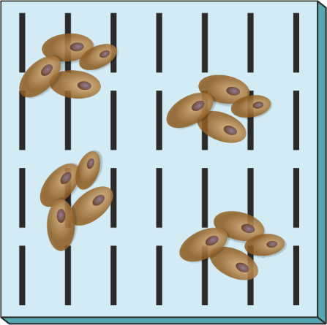
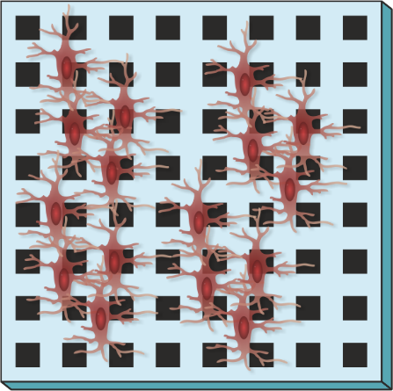
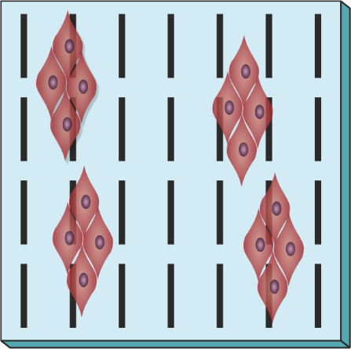
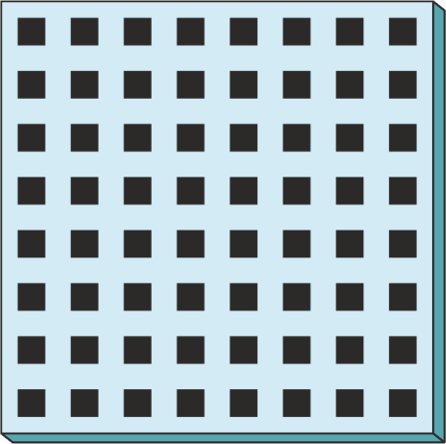
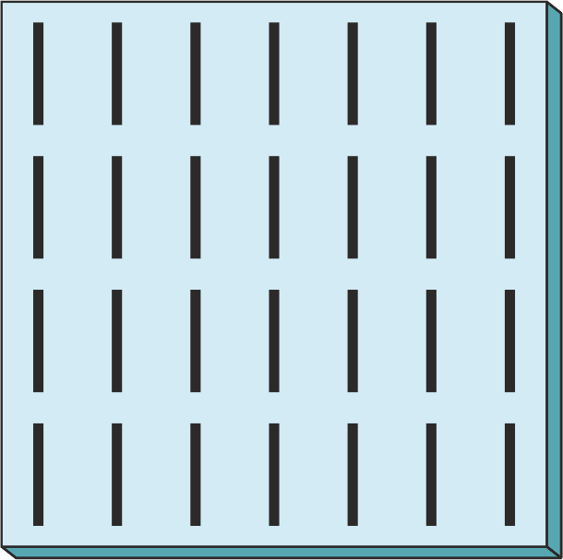
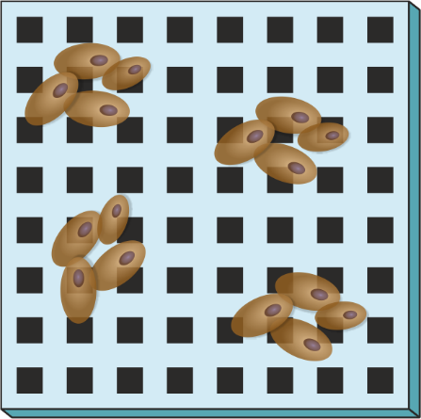
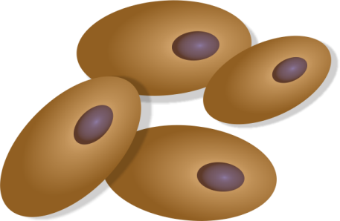
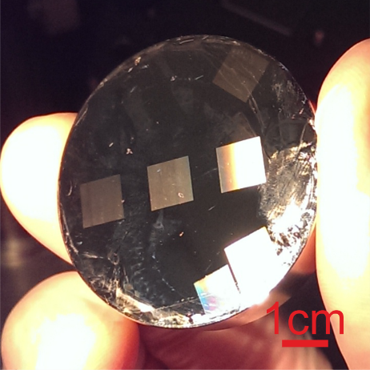
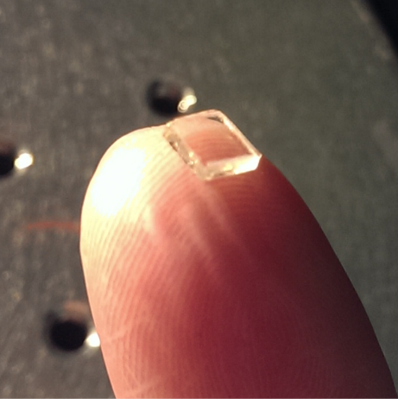
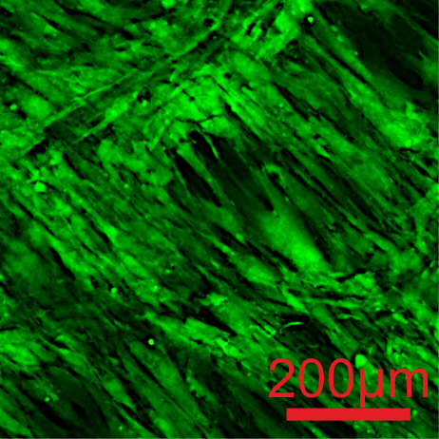



Cell growth assays
Different surface topographies desirable for different cell types
Want <100 copies of each highly custom assay?
Laser-machine custom master
Drop-cast PDMS
Peel away casted assay
Notes:
Finally, I’d like to talk a little about what we’ve been doing with these new DMD-enabled machining approaches. As it happens, the resolution and size scales we have achieved make for ideal fast-prototyping of cell growth assays. Depending on the cell type you’re interested in, and the behaviour you’re looking for, different surface topographies might be preferable [show first text]. If you a population of cells [show first image], and a substrate patterned with lines, you might find that muscle cells thrive[show animation], while if you put them on an assay patterned with squares you might find that’s what bone cells prefer [show second animation]. Typically, for these types of assays, you’ll want maybe only a few copies to test your cell growth on, but the underlying pattern itself has to be designed and generated from scratch [show second text]. The scale of these assays is around 1cm2, and so slow for standard lithographic techniques to produce. What we do is DMD-laser machine a highly bespoke ‘master’ substrate [show image], drop-cast it with bio-friendly polymer, such as PDMS [second], and peel away a functional growth assay – with the master free to be used for more copies [third]. Some real results then: 1cm2 regions machined in nickel, a PDMS cast taken, and bone cells cultured on PDMS [with clicks]

Slide 20
Conclusions
DMD mask translation → positional correction and sub-diffraction limit features
Averaged pixel contributions → short pulse greyscale intensity
Single-pixel control → DMD optical proximity corrections
DMD adaptive mask techniques → solving common laser machining problems
This work was supported under EPSRC (grant number EP/L022230/1)

