Slide 1
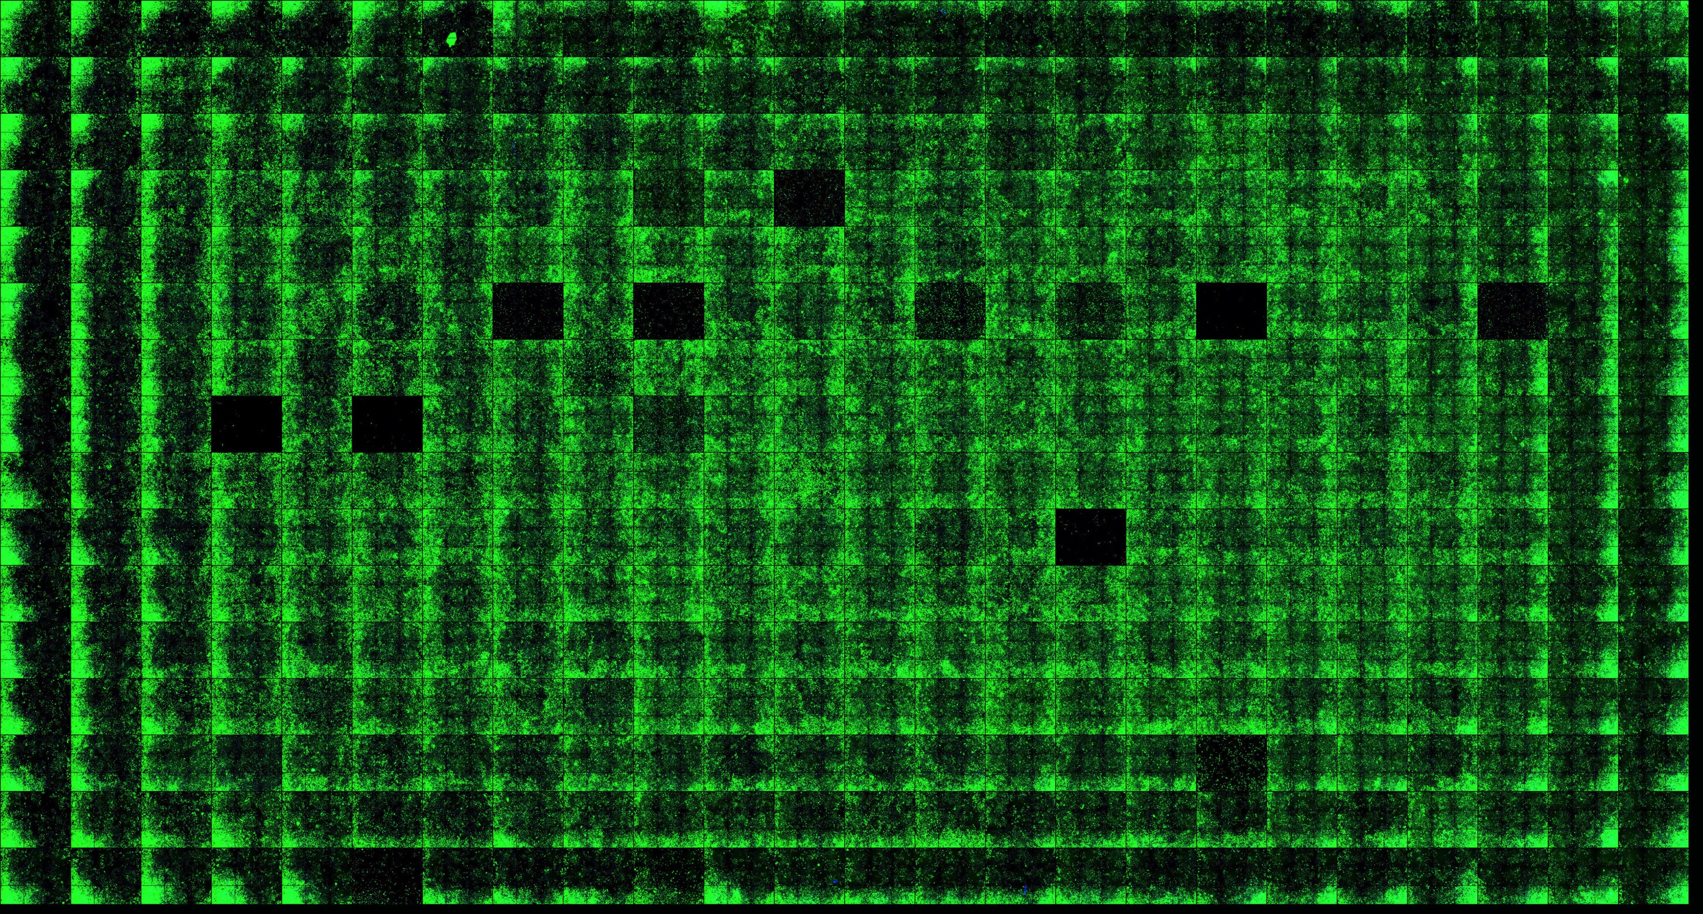
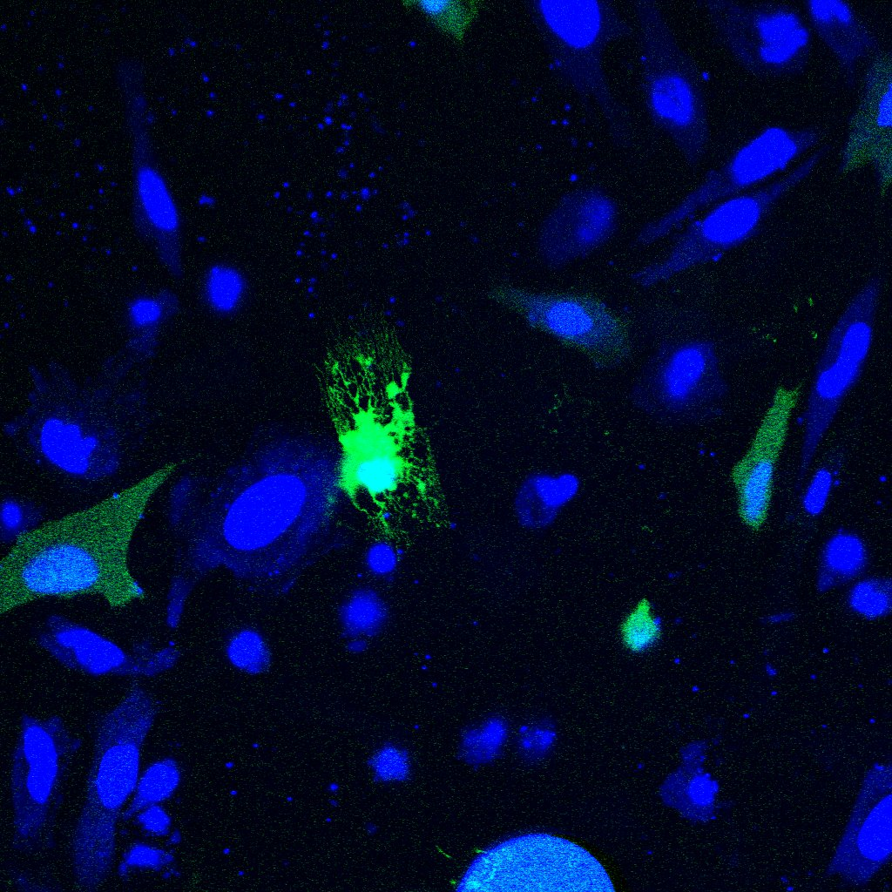
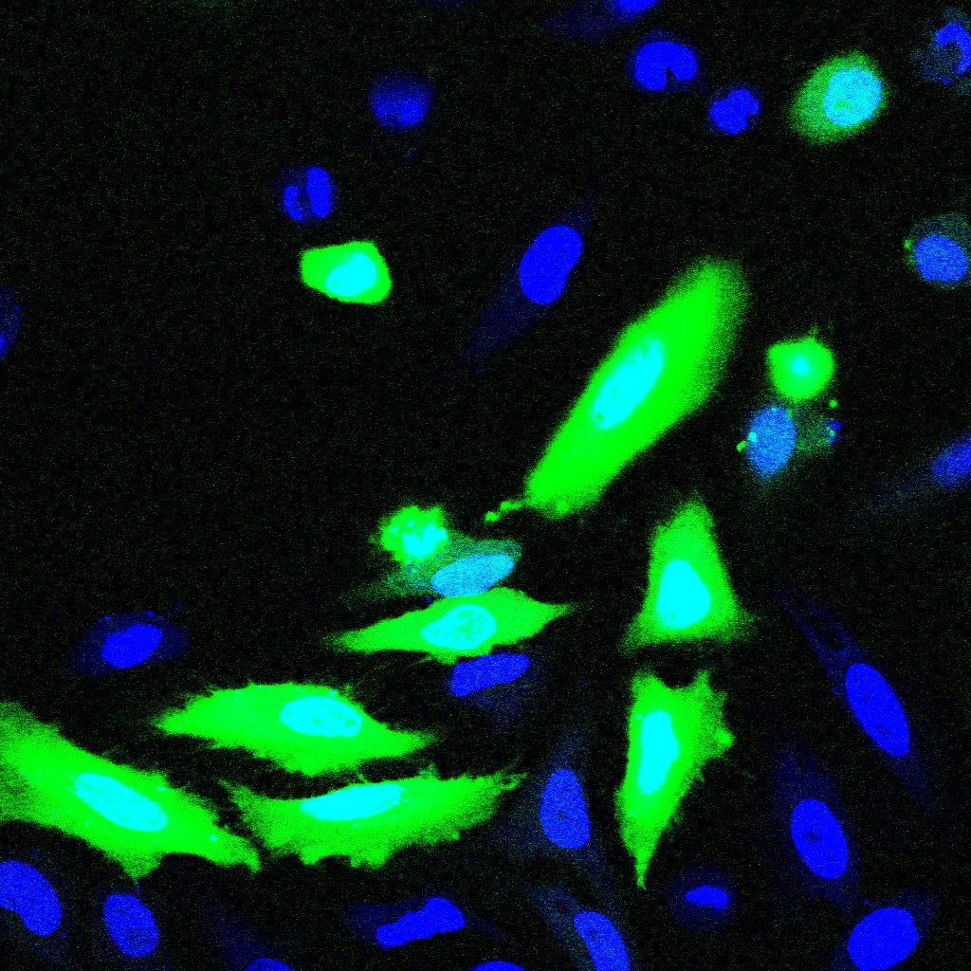
promoter
GFP
pA
HTS facility
Increased skipping
of targeted exon
Exon to be
analyzed
Stable transformation in cell lines
fluorescence
Exon inclusion
Exon skipping
Increased inclusion
of targeted exon
compounds
Synthetic, semi-synthetic, or natural compounds libraries
Figure 2

