Slide 1
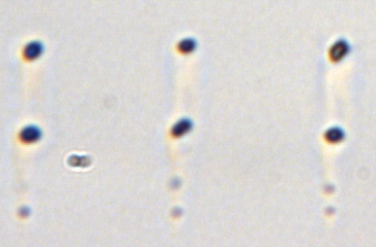
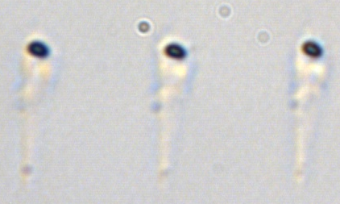
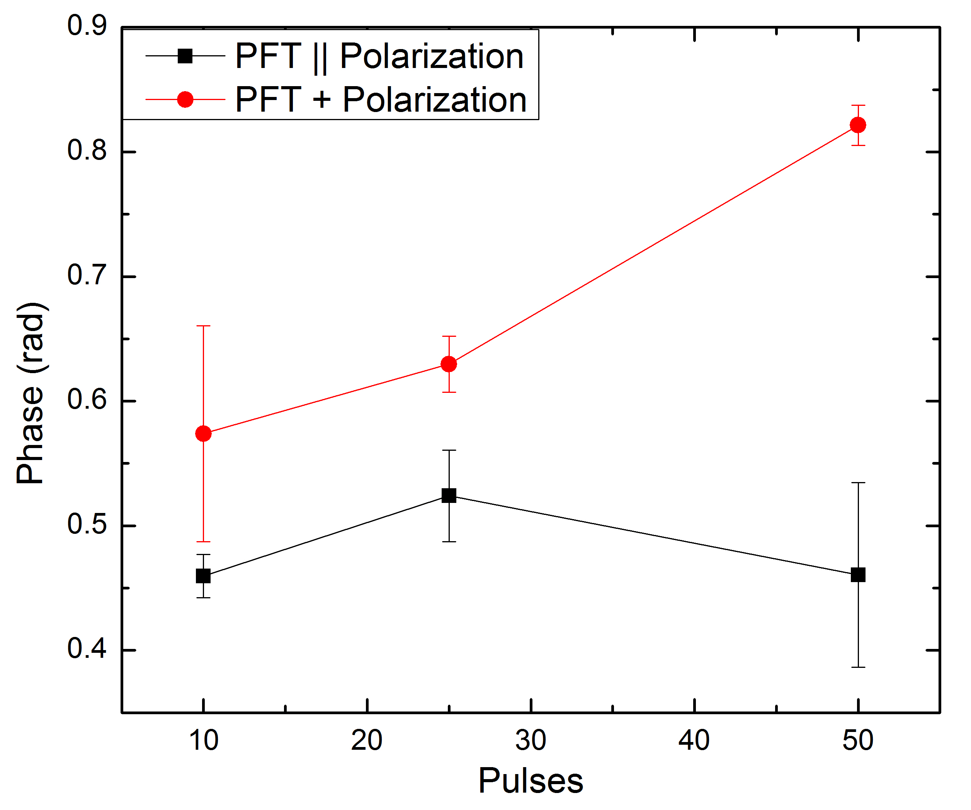
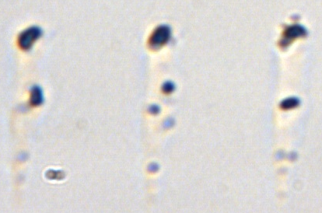
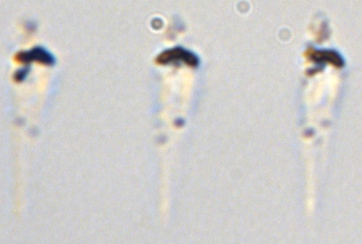
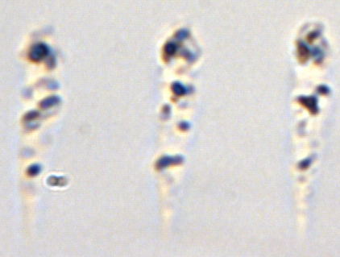
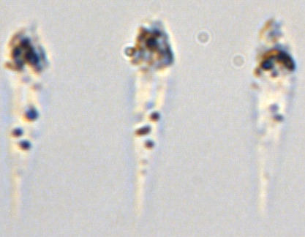
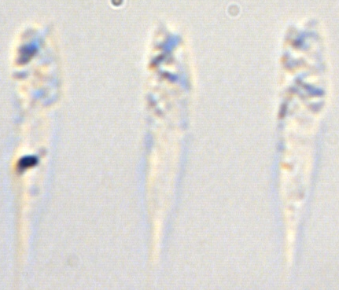
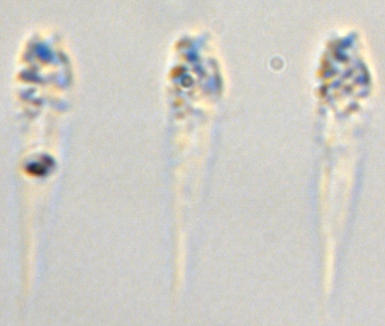
0°
90°
10 pulses
25 pulses
50 pulses
500 pulses
Notes:
Figure 1: Stationary Modification in Fused Silica with the Polarization parallel (0⁰) and perpendicular to PFT (90⁰). After a large duration, thermal effects become more predominant but the overall shape cause by the blade effect is evident. Plot of phase across the structure versus pulses shows dominance in the perpendicular case.

Slide 2
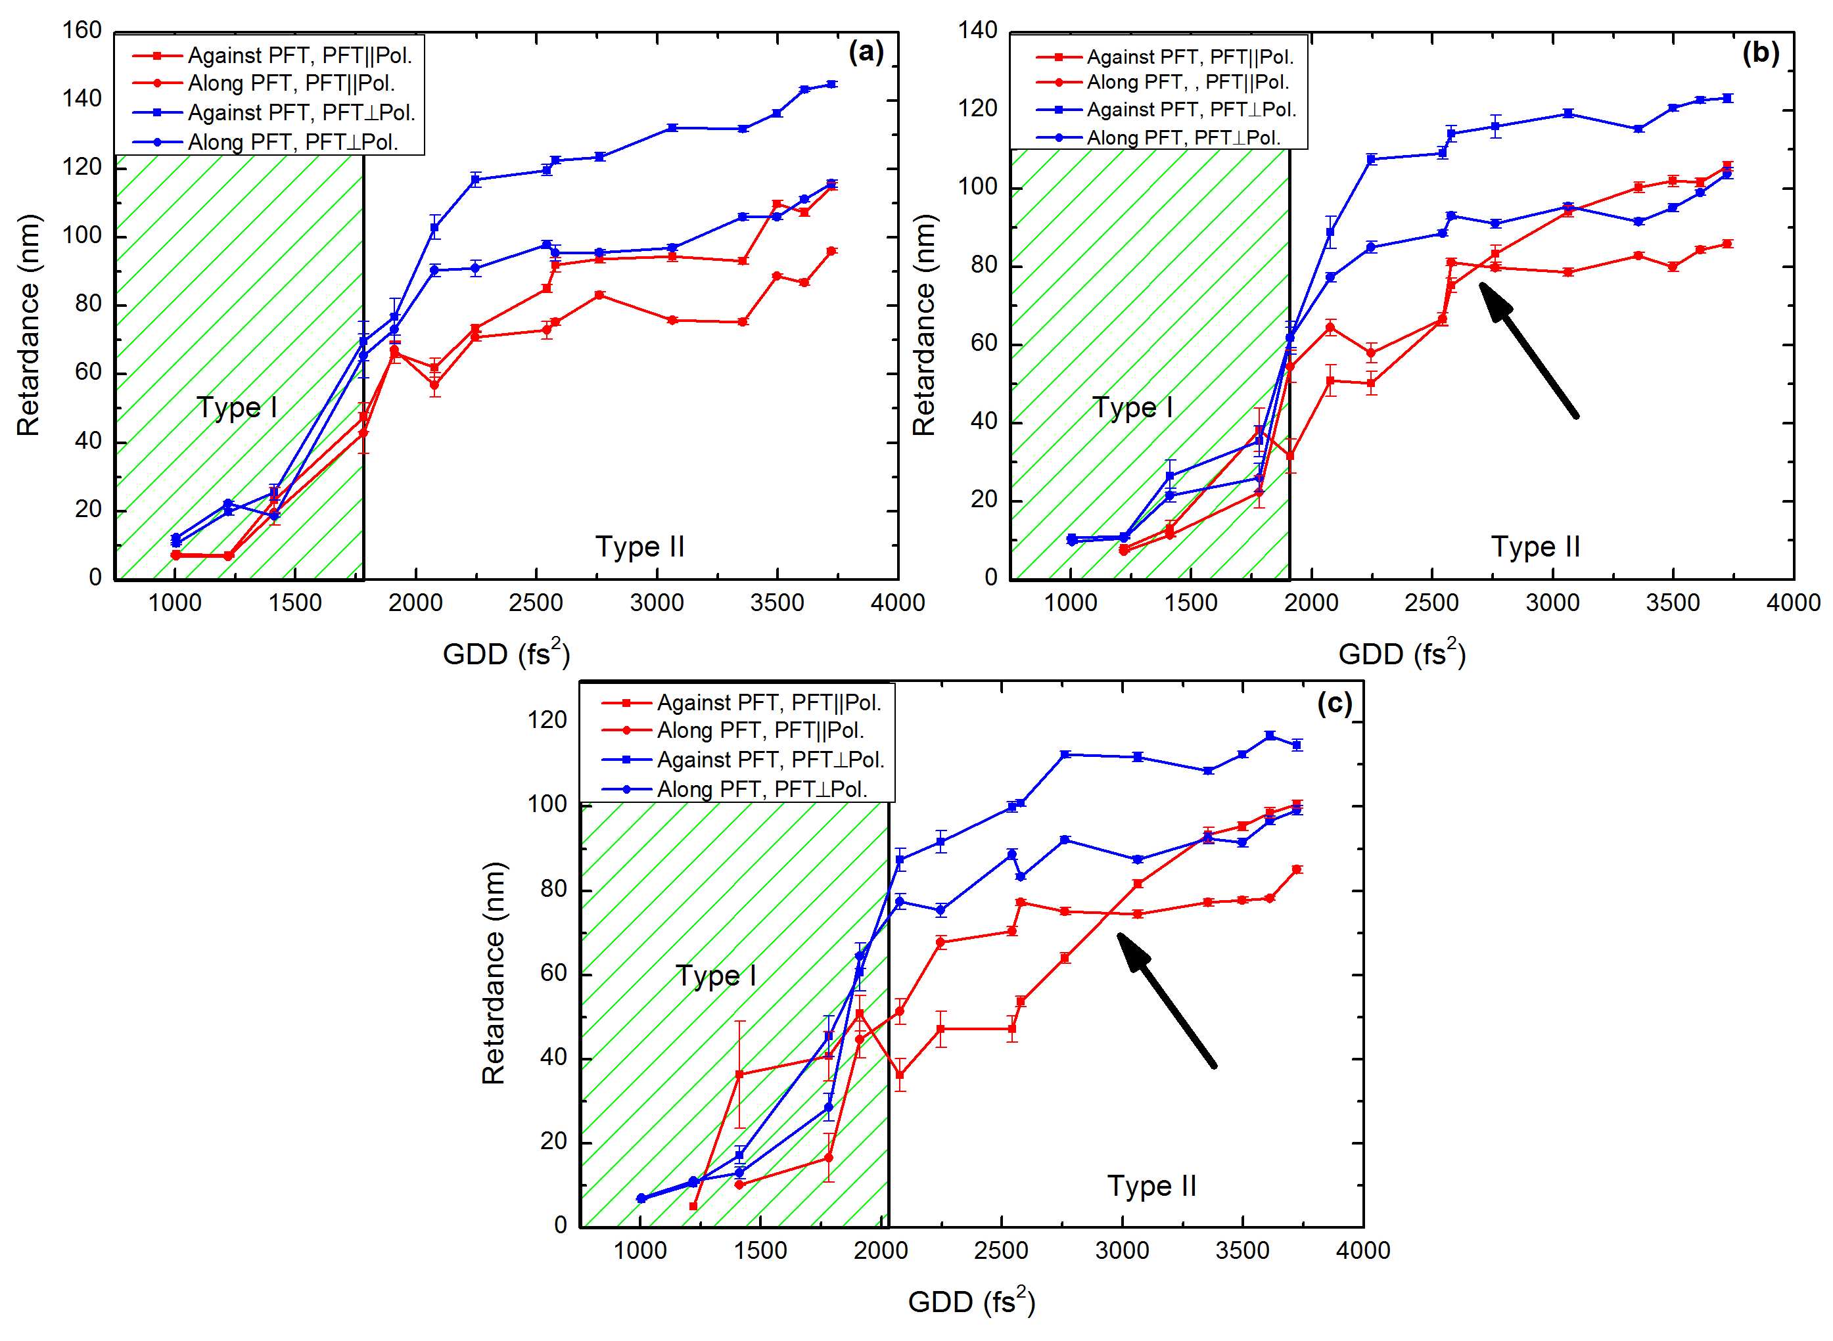
Notes:
Fig 2. Writing lines in the direction of the tilt. Red lines represent PFT || Pol. Blue lines represent PFT + Pol. Square is against the tilt. Circles are along the tilt. Blade effect = stronger modification. Also enhancement of quill effect. Notice arrows pointing to the flip of modification dominance in quill effect.

Slide 3
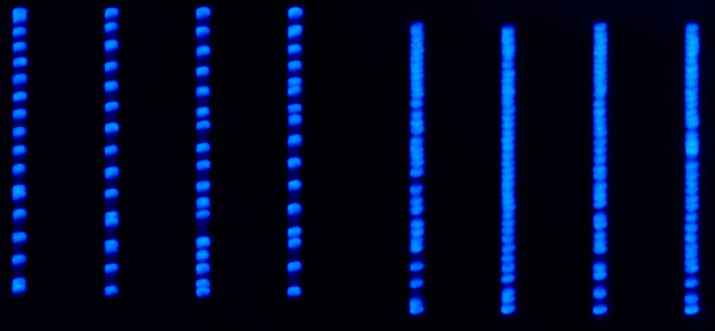
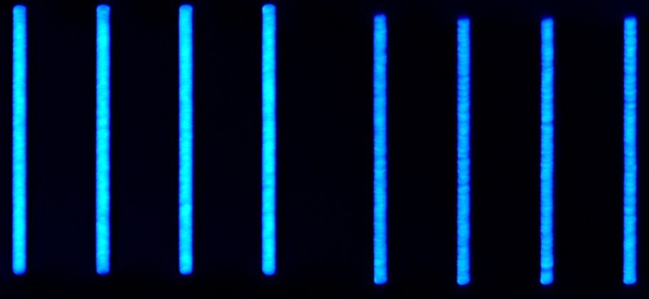
Notes:
Fig 3. Quill effect threshold lower along direction of tilt but once the threshold has been met and Type II modification is smooth, more modification is done in the direction against the tilt. (90 um/s structures, top GDD= 2300, lower GDD = 3000)

Slide 4
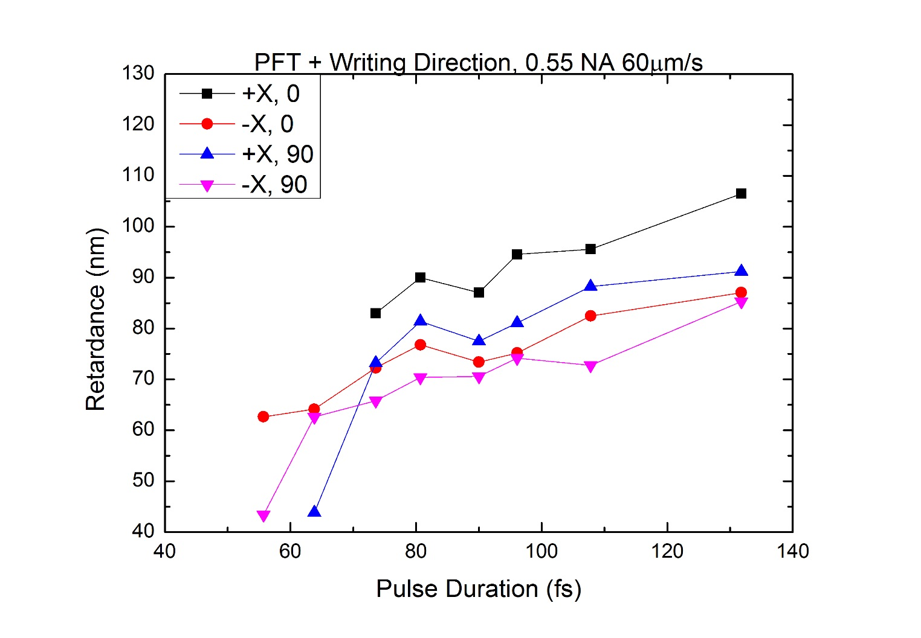
Notes:
Dominance of perpendicular case is seen when writing perpendicular to the PFT as well. (Not sure if I’ll add these plots to publication). Not as dominant when writing along PFT.

