Slide 1
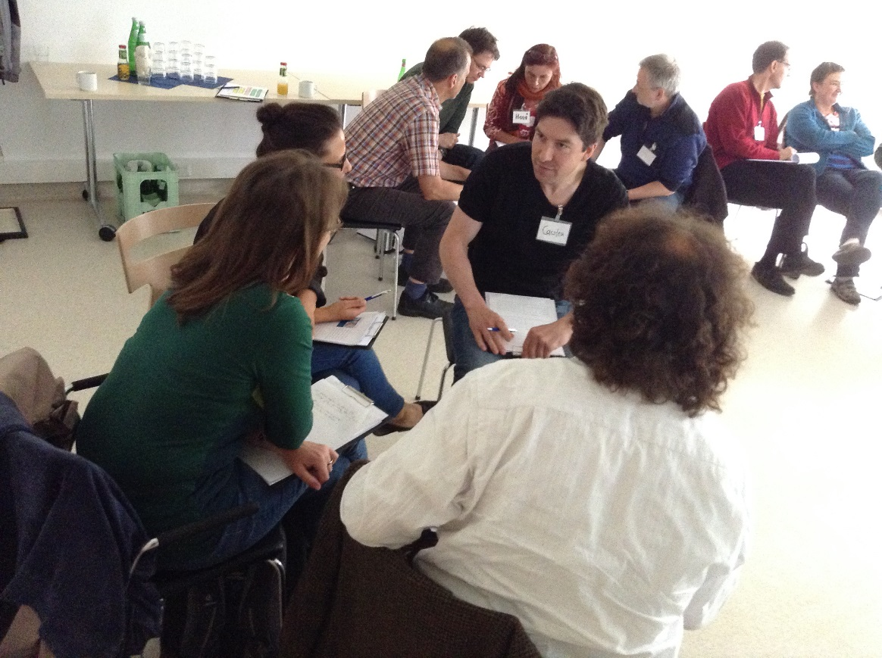
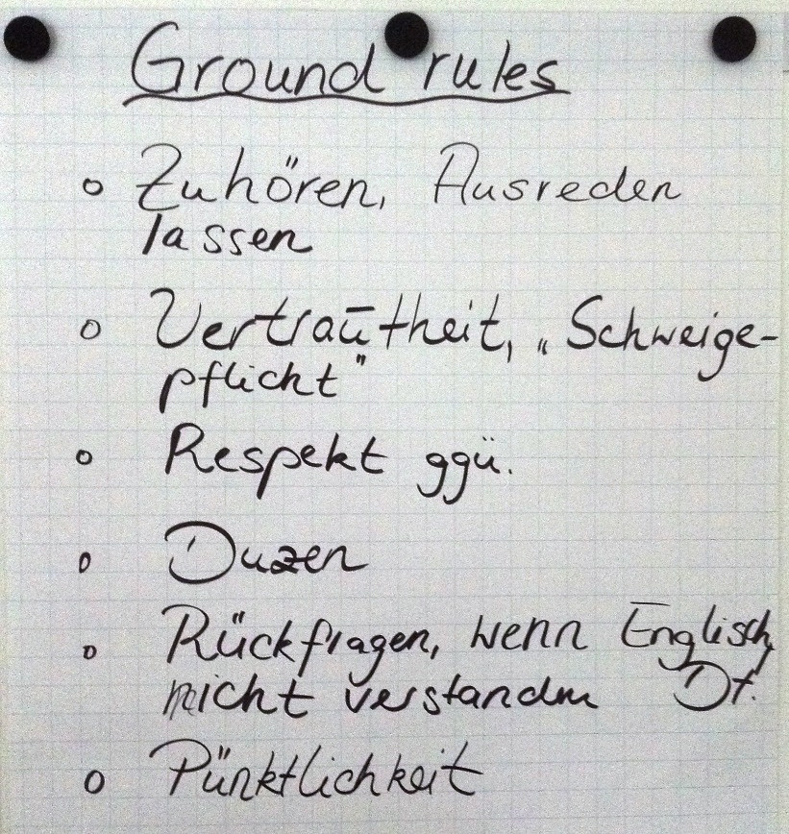
"Fresh Approaches to Clinical Teaching" (FACT) – developing and delivering an innovative staff development course at Kassel School of Medicine
RIME 2017 in Düsseldorf
Dr. Julia Schendzielorz, Dr. Clare Polack, Dr. Sandy Miles, Dr. Anja Timm

Slide 2
Background
The BM(EU) programme
Kassel School of Medicine
Quality assurance and regulation
Staff development
Notes:
I can talk quickly about all these things off the top of my head

Slide 3
Faculty Development
Faculty Development
Introduction weeks
FACT
TTD
Assessment training
Implementation support
Individual mentoring
Existing process
MEDUSA
Observing

Slide 4
FACT (Fresh Approaches to Clinical Teaching)
1 ½ days
Diverse experience
Bi-lingual
Delivered by core team
Building relationships
Bespoke
Both theoretical and experiential
Notes:
Multiprofessional and multi level
Relationships – between and with us. Impt not staff developers – people who have done it looking for relationships in future

Slide 5
Qualitative analysis – focus groups and observations
Participants valued…
the interactive format and variation of teaching techniques
the concepts on feedback and reflection
the opportunities for role play
meeting new people – building up a network
Participants discussed controversially…
language arrangements
preferred form of address
Notes:
- Approach: Participants of the first course were asked to provide feedback to AT at the end of both dates. In addition, they were asked to complete the questionnaire on day 2.
Overall: very positive… Participants…
Negatives – were not about content – more planning and environment

Slide 6
Quantitative analysis - questionnaires
Paper-and-pencil
Overall enjoyment, organisation and facilities, learning outcomes
Free text boxes
Course | Participants | Response rate
1 | 15 | 93,33 %
2 | 17 | 94,12 %
3 | 12 | 75,00 %
4 | 10 | 90,00 %
5 | 9 | 100,00 %
Overall | 63 | 90,49 %

Slide 7
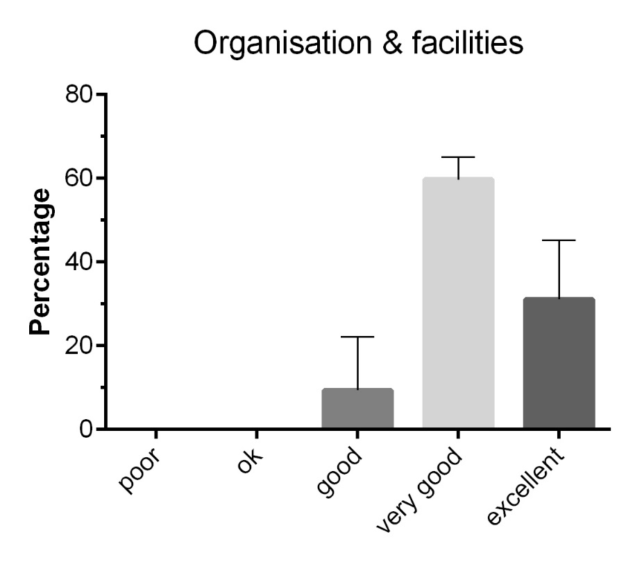
General
A
B

Slide 8
FACT Learning outcomes
Knowledge
Describe an overview of the BM(EU) curriculum.
Recognise the principles involved in the assessment in the BM(EU) curriculum.
Show an understanding of learning theory and how to apply it to practical teaching methods.
Skills
Recognize the key factors that create the optimal learning environment.
Show the skill of making specific observation and giving focused feedback appropriately.
Recognize the importance of facilitating reflection in the learner.
Attitudes
Show an awareness of different strategies to optimize students’ learning opportunities without compromising the care given to patients.
Consider the importance of being honest about ones’ own uncertainties.
Demonstrate a flexible and supportive approach to the learning process.
Notes:
Only use of needed

Slide 9
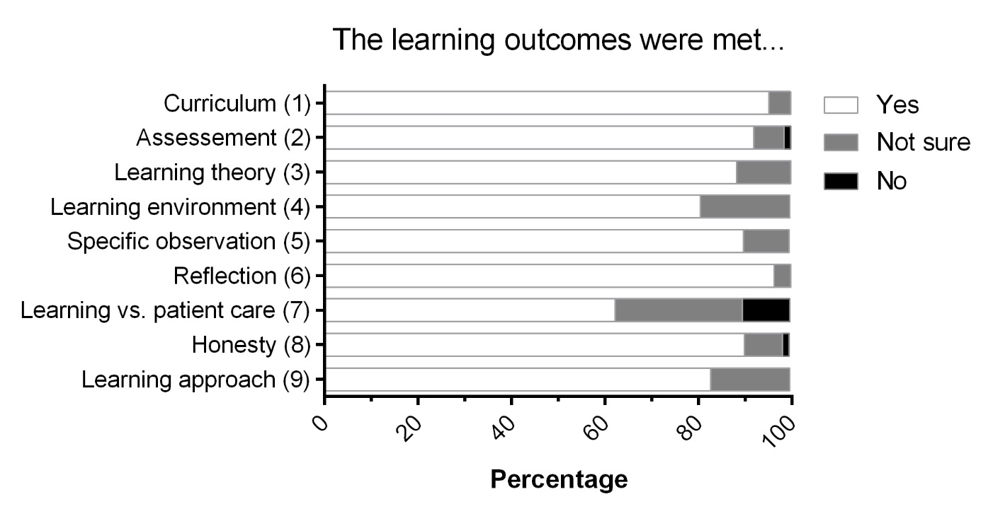
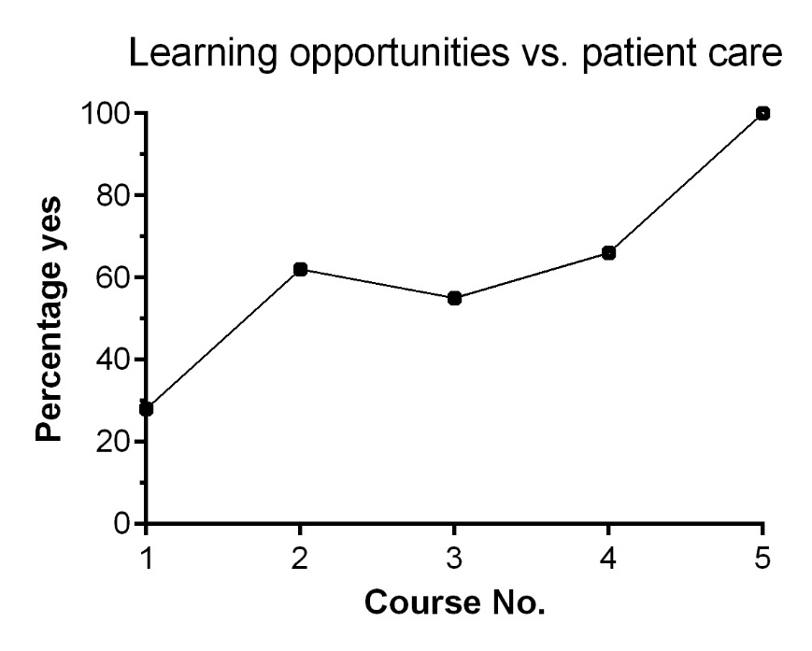
Learning outcomes
A
B

Slide 10
Quotes from free text
The possibility to develop a new strategy to make the student-doctor relationship better so that the student profits from us as supervisors in a better way.
After this course I look forward to having the students.
I feel much safer concerning what I have to do with the students and have learned a lot about cooperating in the team.
Must have event for all practitioners and their bosses of involved clinics.
Very consistent and modern concept, not only useful for dealing with students but also in general.
Even though I usually do not like role plays I enjoyed these.
Combination of listening and doing it created a great atmosphere.
It was a great atmosphere of sharing thoughts and reflections.

Slide 11
Summary
What works well | Challenges
Intensely bespoke and ongoing refinement | Barriers to participation (time, money, workload, permission...)
Timing | Barriers to implementation (time, money, workload, permission...)
Experience/authenticity of facilitators | Realisation that not an end point in learning
Safe space | Facilitators’ time
Creating a community of peers
Intense, memorable and shared
Mutual investment in the educational concept
Informs management of issues by core team

Slide 12
Looking ahead
Identifying further development opportunities
Catering for specific needs
Support
Strengthening, maintaining and building relationships

