Slide 1

A Mission Concept for Geostationary Passive Microwave Interferometric Radiometry using Formation Flight
International Workshop on Measuring High-Wind Speeds over the Ocean
Ahmed Kiyoshi Sugihara El Maghraby 17 November 2016
Astronautics Research Group, asem1g14@soton.ac.uk
Dr Angelo Grubaišić, Dr Camilla Colombo and Dr Adrian Tatnall

Slide 2
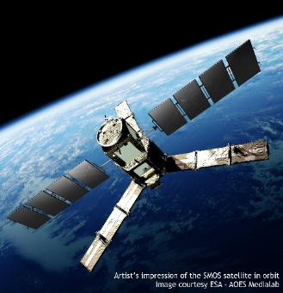
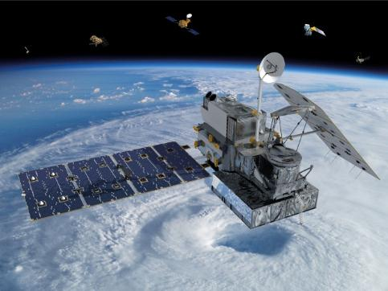
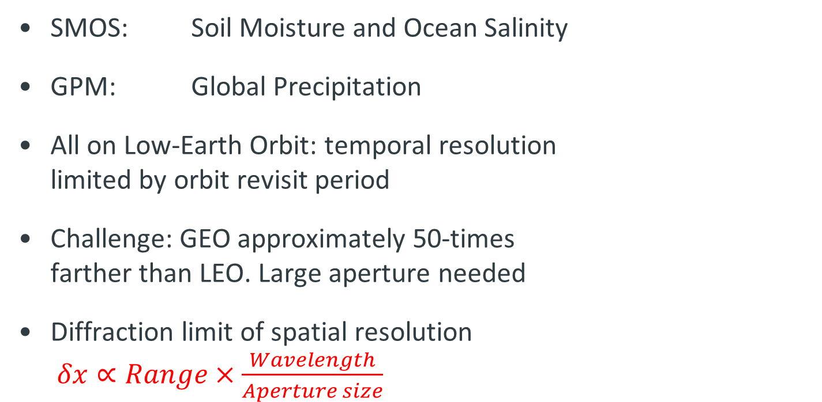
Current Limitations on Radiometry Missions
SMOS: Soil Moisture and Ocean Salinity
GPM: Global Precipitation
All on Low-Earth Orbit: temporal resolution
limited by orbit revisit period
Challenge: GEO approximately 50-times
farther than LEO. Large aperture needed
Diffraction limit of spatial resolution
$δx∝Range×\frac{Wavelength}{Aperture size}$

Slide 3
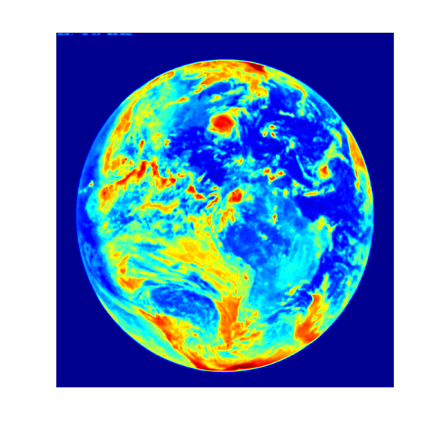
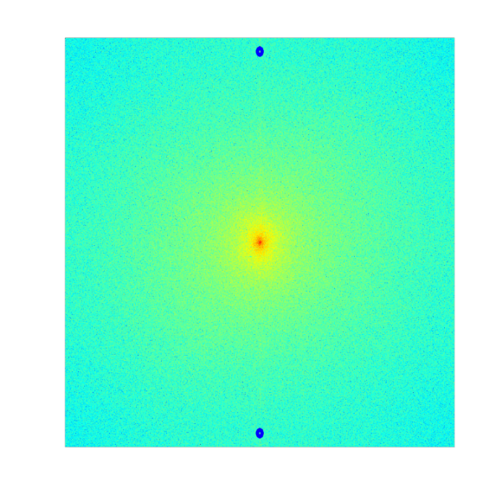
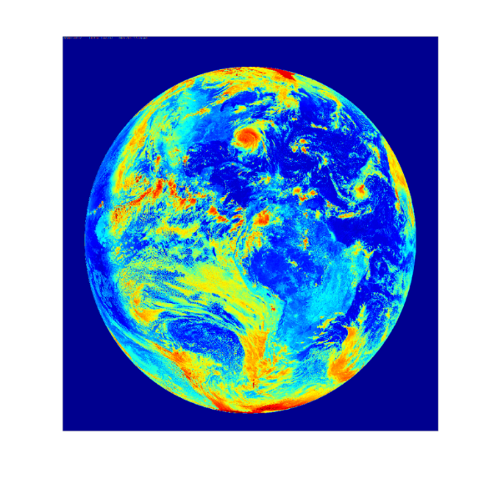

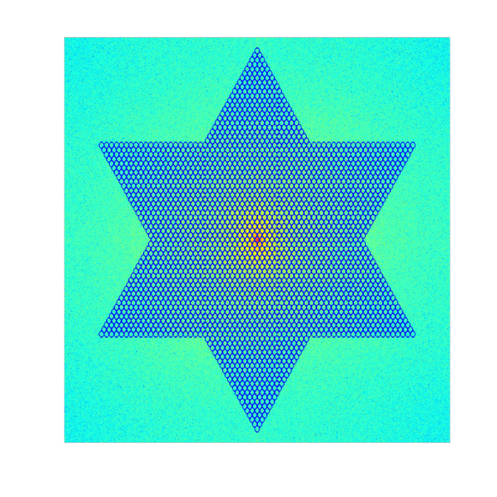
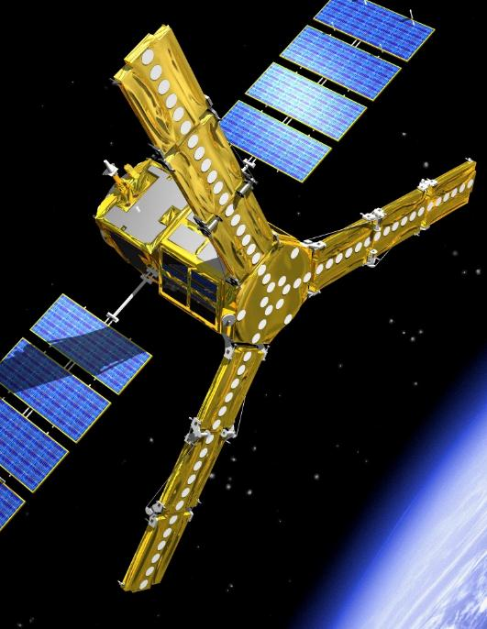
Interferometry and the Visibility Function
Fourier Transform
Inverse Fourier Transform
Image
Visibility

Slide 4
Designing Visibility Sampling Pattern
Effects of Single-Element Companions

Slide 5
Designing Visibility Sampling Pattern
Effects of Duplicate Arrays

Slide 6
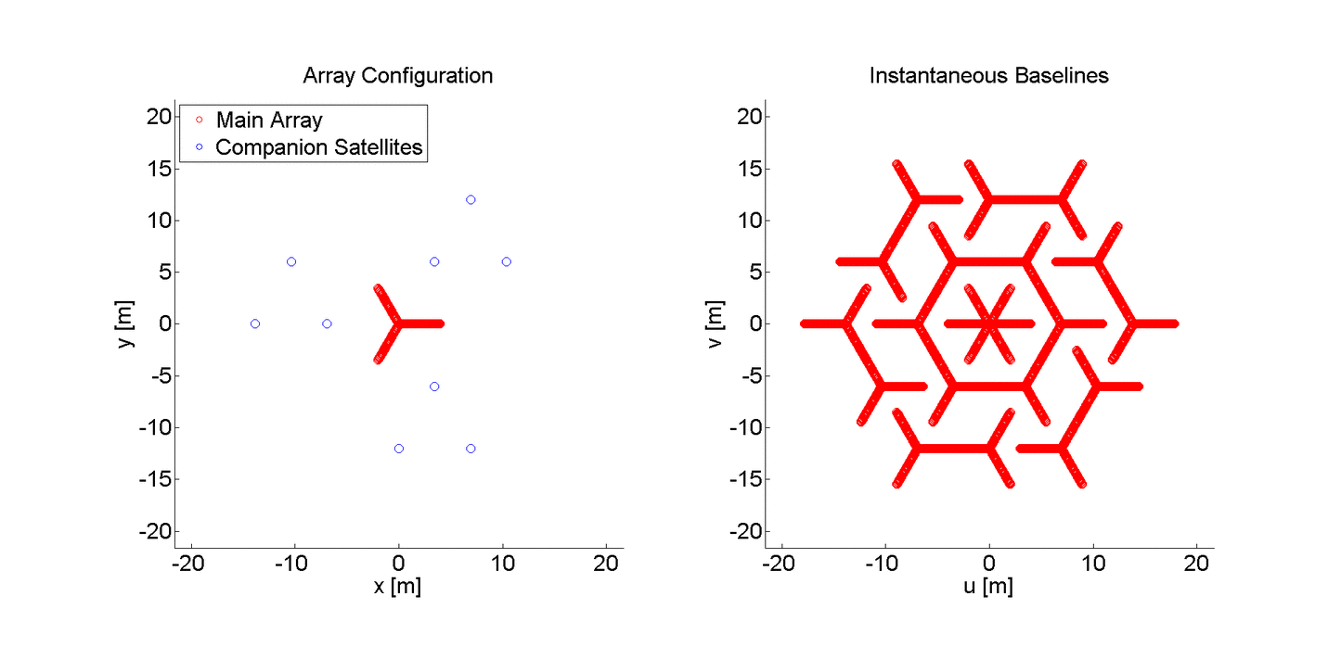
The Single-Element Companion Concept

Slide 7
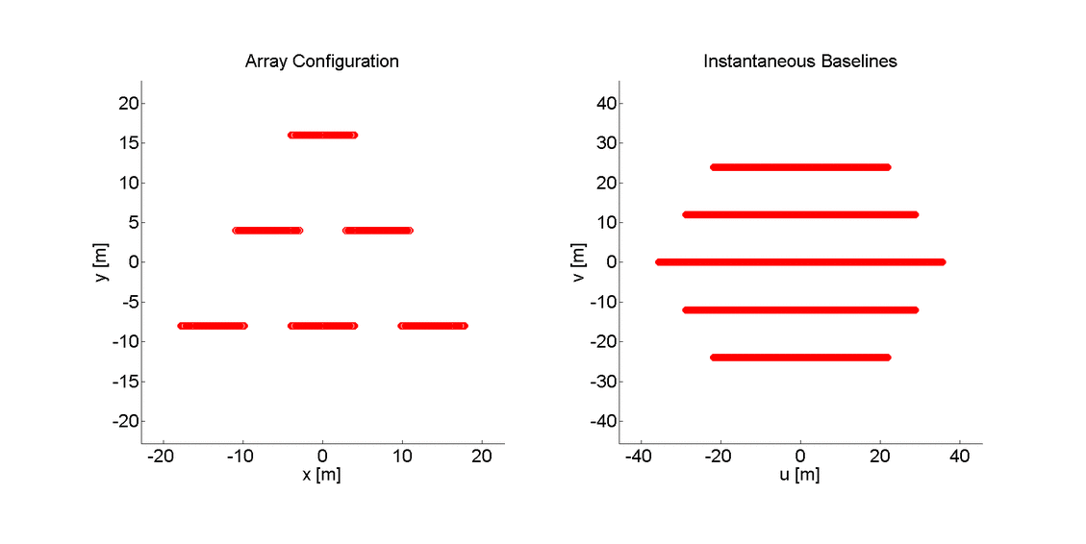
The Array Duplicate Concept

Slide 8
Mission Concept Comparison @ 10 GHz
 | Single-Element Companion |  |  |  | Array Duplicates
Scaling | Companions | Aperture Diameter | Spatial Resolution | Constellation Mass | Satellites | Aperture Diameter | Spatial Resolution | Constellation Mass
 | 3 | 8.0 m | 143.1 km | 868 kg | 3 | 16.0 m | 71.6 km | 1974 kg
 | 9 | 14.4 m | 79.5 km | 1288 kg | 6 | 28.8 m | 39.8 km | 3948 kg
 | 18 | 20.0 m | 57.2 km | 1918 kg | 9 | 40.0 m | 28.6 km | 5922 kg
 | 30 | 32.0 m | 35.8 km | 2758 kg | 12 | 64.0 m | 17.9 km | 7896 kg
Correlators | Centralised |  |  |  | Distributed
TT&C | Centralised

Slide 9
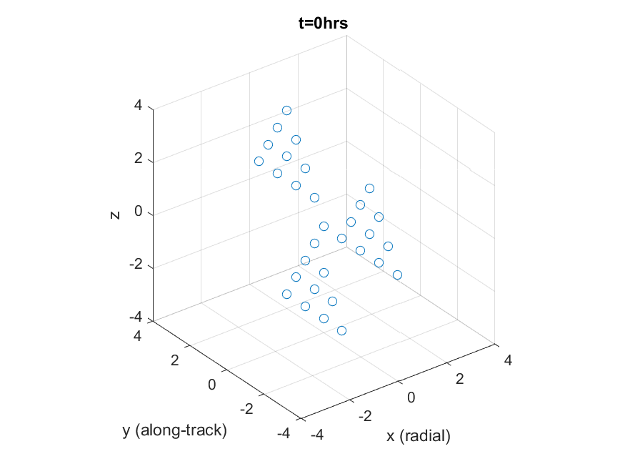
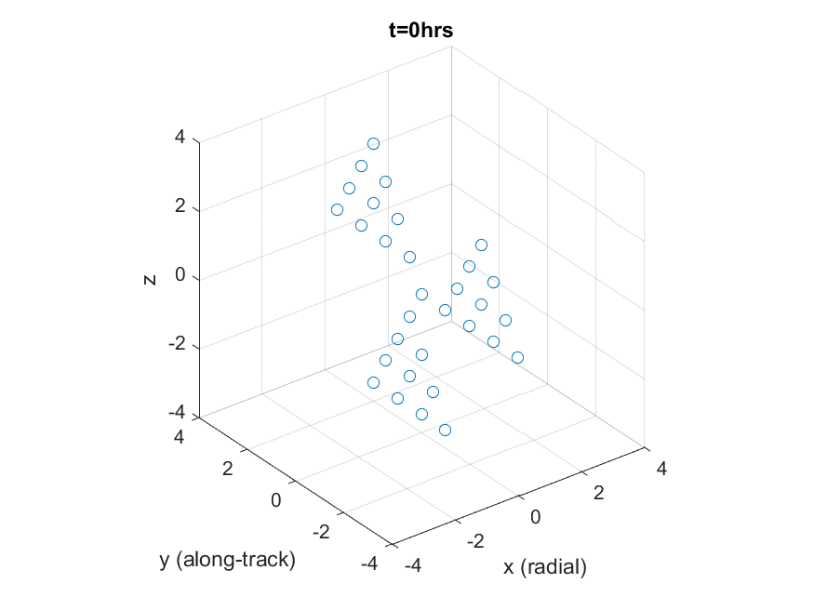
Formation-Flying: Fixed Formation

Slide 10
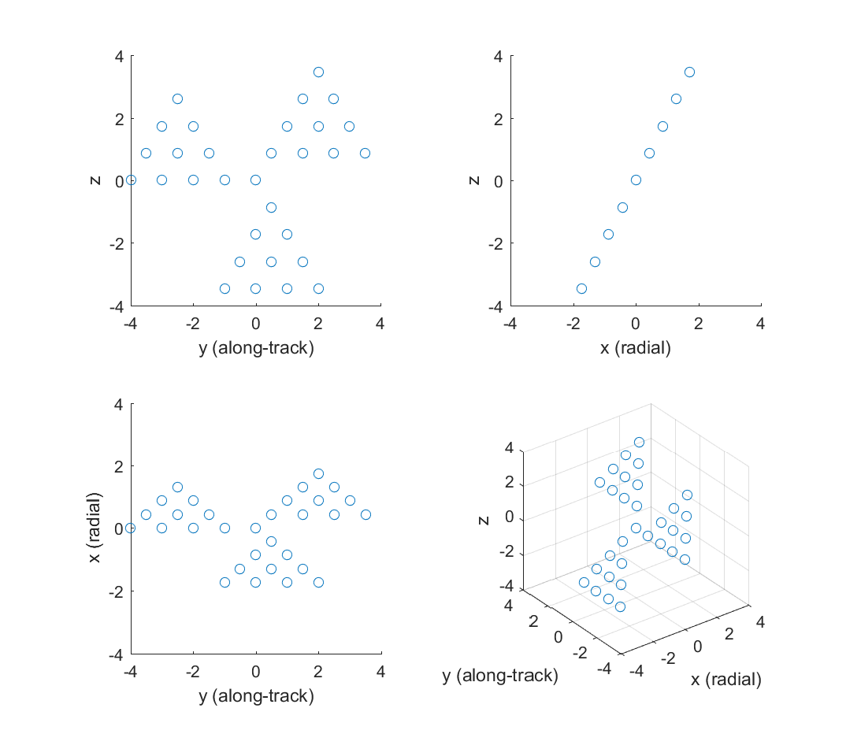

Formation-Flying: Relative Orbit

Slide 11
Formation-keeping requirements (Annual)
 | Single-Element Companions |  | Array Duplicates
 | Relative Orbit | Fixed | Relative Orbit | Fixed
Aspherical Gravity (up to C55) | 4.10E-4 m/s | 1.32E-4 m/s | 4.10E-4 m/s | 1.32E-4 m/s
SRP | 5.53E-1 m/s | 5.53E-1 m/s | 2.69E-4 m/s | 8.11E-7 m/s
3BP (Sun) | 3.34E-4 m/s | 5.27E-5 m/s | 3.34E-4 m/s | 5.27E-5 m/s
3BP (Moon) | 3.62E-4 m/s | 1.66E-4 m/s | 3.62E-4 m/s | 1.66E-4 m/s
Levitation | 0 | 1.67 m/s | 0 | 1.67 m/s
Total | 5.54E-1 m/s | 2.23 m/s | 1.38E-3 m/s | 1.67 m/s

Slide 12
Effect of Formation Flight Deviation
Interferometer output dependent on antenna element positions
Any error in measuring relative position will lead to errors
Single-Element Companion Concept
Array Duplicate Concept

Slide 13
Effect of Formation Flight Deviation

Slide 14
Conclusion
Identified novel architectures for Geostationary microwave interferometry
Concept can be used for geostationary radiometry, unprecedented spatial resolution from medium-Earth orbits, or extend reach to very low frequencies
Two viable mission concepts identified, key requirement performance figures characterised
Orbital characteristics of the formations characterised
Micron-level inter-satellite ranging likely required

Slide 15
Thank you
Ahmed Kiyoshi Sugihara El Maghraby 17 November 2016
Astronautics Research Group, asem1g14@soton.ac.uk
Dr Angelo Grubaišić, Dr Camilla Colombo and Dr Adrian Tatnall

Slide 16
Publications and Thank you
A.K. Sugihara El Maghraby, A.R. Tatnall, A.N. Grubisic, “A Constellation Concept for Microwave Interferometric Radiometry from Geostationary Orbit,” in RSPSoc, NCEO and CEOI-ST Joint Annual Conference 2015, Southampton, United Kingdom, 2015
A.K. Sugihara El Maghraby, C. Colombo, A.N. Grubisic, A.R. Tatnall, “A Novel Approach to Microwave Interferometric Radiometry in the Geostationary Orbit using Formation Flight,” in Internatlional Astronautical Congress 2016, Guadalajara, Mexico, 2016
International workshop on measuring high-wind speeds over the ocean, November 2016
International Geoscience and Remote Sensing Symposium (IGARSS 2017), July 2017 (Planned)
Suitable Geometry for GEO radiometry in IEEE Transactions on Geoscience and Remote Sensing (Planned)
Formation flight dynamics of such concept at the geostationary orbit in Advances in Space Technology (Planned)

