Slide 1
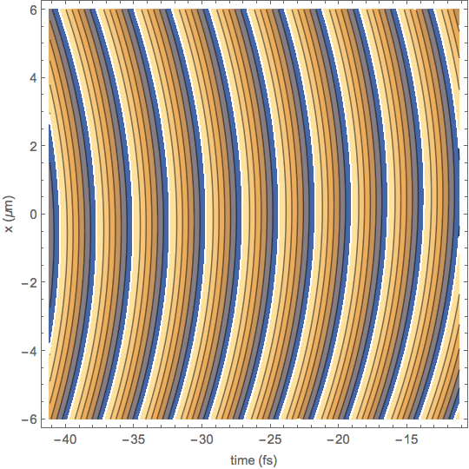
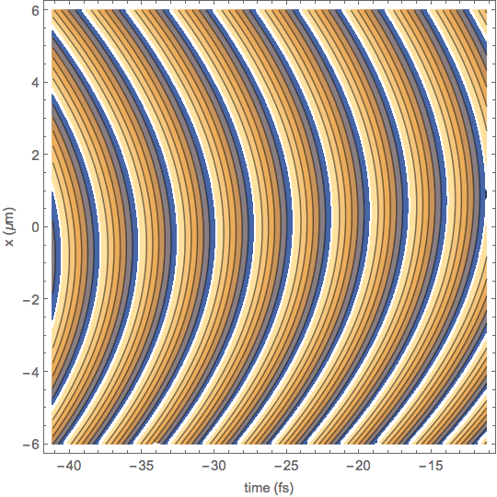
Beam aspect ratio: 4
Pulse duration 15fs
Z-position: zR/2 inside of focus.
Contour plot of wave phase (wavefronts) for 700 fs2 added spectral chirp. For large chirp, each frequency component arrives at a different time, so this curvature matches the Gaussian beam CW calculation.
Contour plot of wave phase (wavefronts) for zero added spectral chirp. Here, frequency components are superposed, and the angular variation of the beam with frequency enhances the wavefront curvature somewhat.

