Slide 1

Online Grocery Shopping:
Identifying Change in Consumption Practices
Jo Munson
Thanassis Tiropanis
Michelle Lowe

Slide 2

E-commerce is big business, not least in the UK
+16%
UK online retail expenditure
Introduction

Slide 3
UK online grocery market is relatively small…
Introduction

Slide 4
…but projected to grow rapidly
Introduction

Slide 5

Insight into online grocery consumer behaviour invaluable for retailers
Customer retention
Personalisation
Complementary service provision
Increasing LTV in low margin industry
Multi-channel planning
Introduction
Notes:
The case for understanding online grocery consumption practices are numerous…

Slide 6

…and good for governments, academia and consumers too
Town planning and policy design for governments
Better quality services for consumers
Socio-technical understanding of consumer behaviour in academia
Introduction

Slide 7
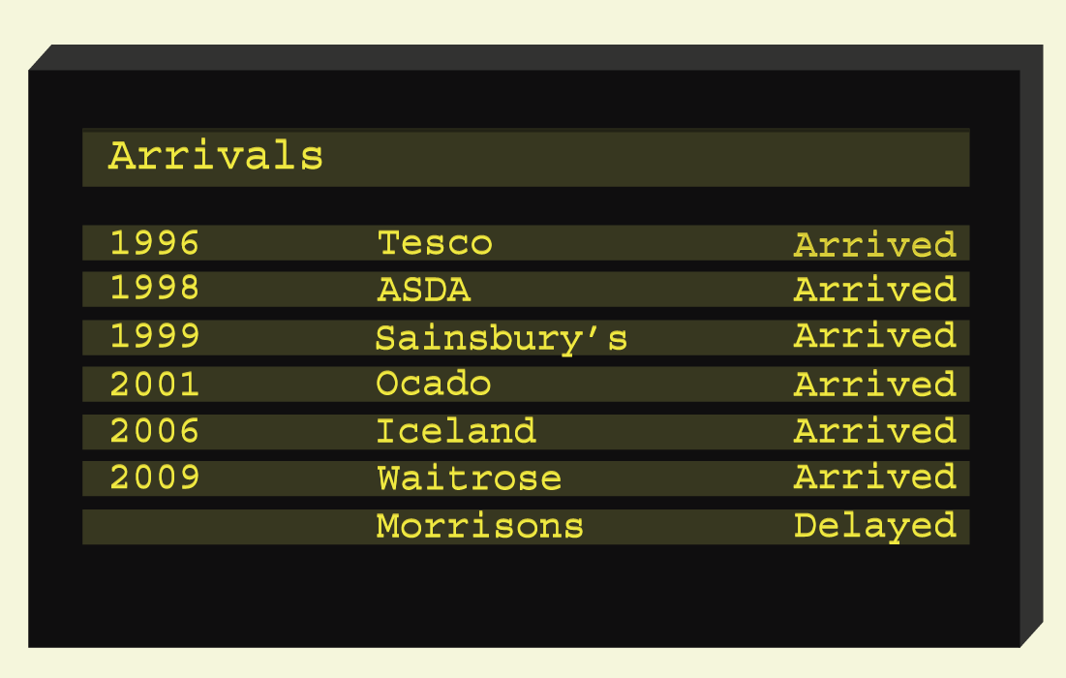
The problem…
Lack of good quality data
Most research conducted is:
Synthetic lab-based
Survey / ‘intention’ based
Introduction
Notes:
Despite this, there is little work accounting for new and contingent bahaviours, not least because of historically poor access to retailers’ data

Slide 8

The opportunity… and another problem
Access to WM Morrisons Plc (Morrisons) Google Analytics account
But…
No comparable offline dataset available through Morrisons
Most comprehensive publicly available data covering online and offline grocery shopping in UK: ONS LCF survey
Introduction

Slide 9
Aims of this study
Are there differences in consumption behaviours in online and offline grocery shopping in the UK?
Is the Morrisons sample representative of online grocery shopping at the national level?
Are online grocery shoppers price sensitive?
Are online grocery baskets stable?
Aims of this study

Slide 10
Methodology & results
Are there differences in consumption behaviours in online and offline grocery shopping in the UK?
Is the Morrisons sample representative of online grocery shopping at the national level?

Slide 11
Dataset descriptions
Morrisons sample
986,973 transacted food and drink items from 41,201 users/households
National level ‘population’
Living Costs and Food (LCF) survey of 4,760 households, mapped back to general population
Methodology

Slide 12
Variables used to compare Morrisons sample with national statistics
Variable
Food category | Bread & cereals, Fruit & veg., Meat, Fish, Dairy & eggs, Confectionary, Non-alcoholic Drinks, Other
Food freshness | Fresh, Not Fresh
Region | NE, NW, E/W Midlands, SE, SW, East of England, Yorkshire, London, Wales, Scotland
Methodology

Slide 13
Comparing online and offline baskets
Null hypothesis 1
At the national level, the distribution of revenue between food categories for online and offline transactions is the same
Result of χ² test
Strong evidence to reject null hypothesis
Confectionary & Meat overweight in offline sample
Other & non-alcoholic drinks overweight in online sample
Methodology

Slide 14
Comparing Morrisons sample with ‘population’
Null hypothesis 2
The distribution of revenue between food categories for the online LCF 2016 and online Morrisons sample transactions is the same
Result of χ² test
Some evidence to reject null hypothesis
Bread and cereals overweight in Morrisons sample
Methodology

Slide 15
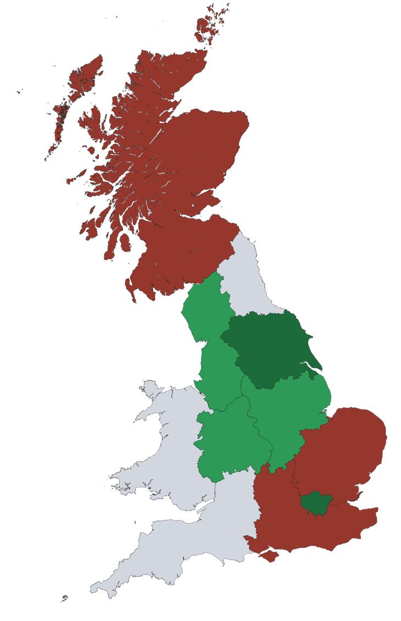
How does the Morrisons sample compare to the UK population distribution?
Sample distribution relative to population
< -4.75%
-4.76 – +1.5%
+1.51 – +7.75%
> +7.75%
Methodology

Slide 16
Comparing re-weighted Morrisons sample with ‘population’
Null hypothesis 3
The distribution of revenue between food categories for the online LCF 2016 and re-weighted online Morrisons sample transactions is the same
Result of χ² test
Insufficient evidence to reject null hypothesis
Re-weighted sample not significantly different from ‘population’
Methodology

Slide 17
Comparing proportion of fresh and non-fresh products in online and offline baskets
Null hypothesis 4
The distribution of revenue between fresh and non-fresh for the offline LCF 2016 and re-weighted online Morrisons sample transactions is the same
Result of χ² test
Sufficient evidence to reject null hypothesis
Proportion of fresh products is larger in Morrisons sample
Methodology

Slide 18
Methodology & results
Are online grocery shoppers price sensitive?
Are online grocery baskets stable?

Slide 19
Last page visited before adding products to basket
Price sensitive | Stable
Offers | Shopping list
Flash sales | Favourites
Sort by price ascending | Suggested order
 | Previous order
Methodology

Slide 20
Average basket value
Results
Notes:
This may indicate that Morrisons shoppers spend more than the national average, or that they shop less frequently.
UK national level may be an underestimate since the based on proportion who have bought groceries online in pat 12 months, not those who do so on a regular basis

Slide 21
Morrisons specific behaviour: Price sensitivity
Results
Notes:
23% of ads using price sensitive behaviours such as engagement with offers and sorting products by price
No comparative offline study, but majority of products added without obvious attention to price and may indicate overstimation by retailer of bargain seeking and price compairion behaviours. Furthermore, most price savvy adds came from engagement with offers prominent on site – retailer’s product placement
Concordant with findings of Urbany et al ‘offline only era’ retailers tended ot overstimate proporiton who regular switch to save money

Slide 22
Morrisons specific behaviour: Basket Stability
Results
Notes:
Page on-site from which products were added to basket
39% came from stable bahaviours such as using previous orders, saved favourites
The high proportion of unstable product adds to basket could indicate that the retailer is overesetimateing the difficulry in up-selling and infiltrating online baskets

Slide 23
Conclusions, implications & future work

Slide 24

Conclusions
Differences in basket consumption between online and offline grocery shopping in the UK
Re-weighting Morrisons offers potential to represent national-level behaviour
Conclusions

Slide 25

Conclusions
Some evidence that online consumers spend more on fresh products than offline, contrary to popular belief
Some evidence consumers are not as price-sensitive as retailers / current research suggests
Conclusions

Slide 26

Future work
Examine behaviour by location, device, time
How the capacity to edit baskets affects basket composition
Qualitative investigation
Towards a ‘Theory of online grocery shopping behaviour’
Future work

Slide 27
Online Grocery Shopping:
Identifying Change in Consumption Practices
Jo Munson – j.munson@soton.ac.uk
Thanassis Tiropanis
Michelle Lowe
https://link.springer.com/chapter/10.1007/978-3-319-70284-1_16

